Slide 1
WEEKLY UPDATE
Argonne National Laboratory
Sep 1st, 2026
1

Slide 2
Questions
1. What are the current gaps for RAS Problems 1–3?
2. Is Problem 3 completed under the current physical validator?
3. What does OFQ actually contribute relative to standard LR/DP?
4. Can the current solver move from RAS benchmarks to Version A corridor instances?
RAS benchmark
P1 gap: 14.86%
P2 gap: 57.75%
P3 gap: 29.83%
All three current UBs: 0 physical conflicts
Corridor
Version A data/objective/validator integration: completed
Feasible recovery on native corridors: not yet completed
Current bottleneck: bootstrap fails before pair/LNS recovery
Original Fluid Queue
Mechanism established
Incremental benefit still requires formal ablation
2

Slide 3
RAS P1–P3 Benchmark Scorecard
Problem | Trains | LB | Validated UB | Gap | Runtime | Conflicts | Status
RAS 1 | 12 | 1817.10 | 2134.21 | 14.86% | 68.3 s | 0 | Feasible
RAS 2 | 18 | 2653.81 | 6281.93 | 57.75% | 456.0 s | 0 | Feasible
RAS 3 | 20 | 3366.82 | 4797.85 | 29.83% | 1456.56s | 0 | Feasible
P1 currently has the smallest gap; P2 is substantially harder.
The current recovery pipeline produces physically validated schedules for all three RAS instances.
3

Slide 4
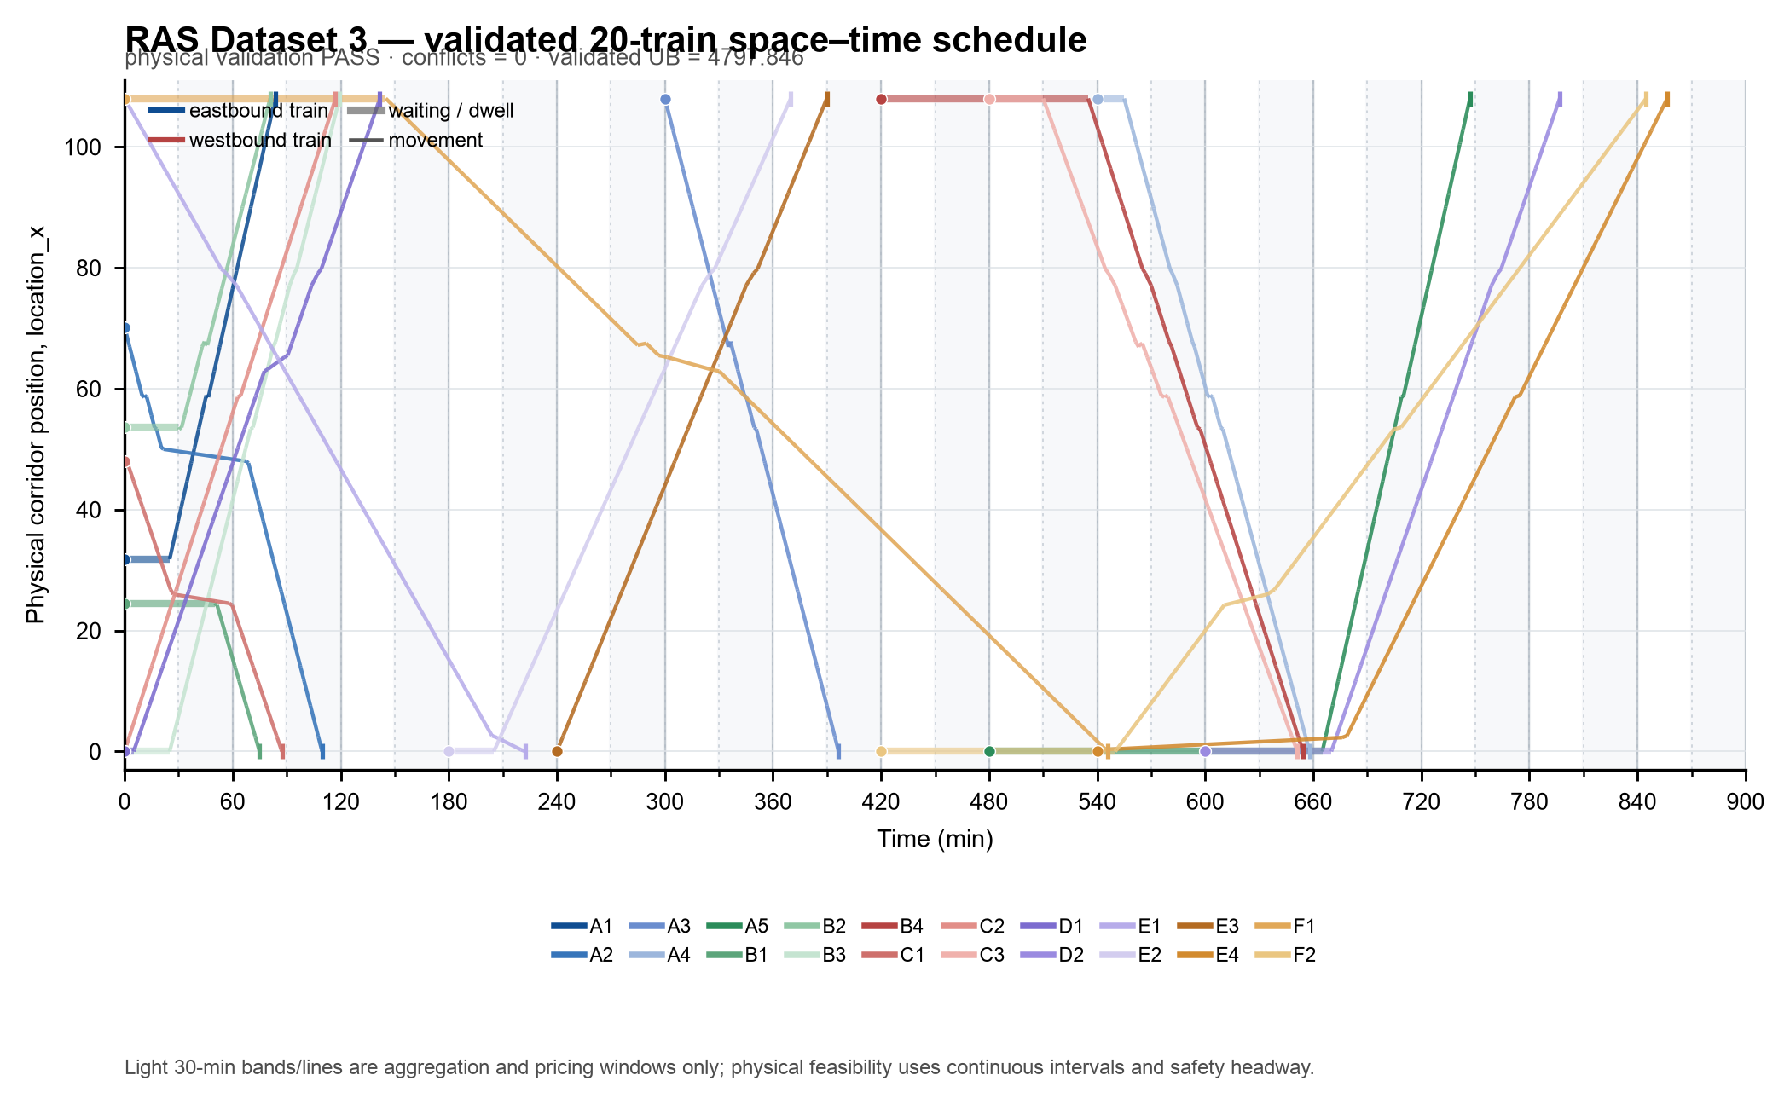
RAS Dataset 3: What Is Completed and What Is Not
Completed
1. Physical feasibility
Current full validator: PASS
Scheduled trains: 20/20
Physical conflicts: 0
2. Current best result
LB = 3366.818
UB = 4797.846
Gap = 29.83%
3. Bug fixed
Illegal same-direction main-track overtaking corrected
Not Completed
Lower bound is still relatively weak
Corridor-scale performance has not yet been established
Frequency sensitivity remains to be tested systematically
4

Slide 5
Relative Algorithm Performance
Method | Role | Observed Result | Runtime / Search Evidence | Current Conclusion
g+h pruning | DP acceleration | 3,559 labels pruned; objective unchanged | runtime comparison to add | Safe acceleration
OFQ + LR + DP | LB baseline | LB = 3345.109 | baseline | Core decomposition
Joint-order MIP | LB strengthening | 3345.109 → 3366.818 (+0.649%) | modest additional solve | Small gain
B&B / CBS-style branching | LB strengthening | 0 useful uplift | min-child gain = 0 | Ineffective on P3
Cross-resource coupling | LB strengthening | no usable native bound | CPLEX pilots failed | Suspend
Pair-deep / recovery | UB | 4830.411 → 4797.846 final accepted move | validated improvement | Most reliable primal improvement
5

Slide 6
Why the Lower Bound Plateaued
Evidence
Joint-order coupling improves LB by only 0.649%
B&B/CBS-style branching produced zero min-child uplift
88% of node–train records retained multiple exact minimizers
Pair/triple cross-resource pilots produced no usable additional bound
Hypotheses
Strong degeneracy in single-train DP solutions
Local ordering decisions do not sufficiently change the relaxed face
Physical-conflict branching is weakly aligned with LR decision variables
Remaining gap may require stronger cross-train coupling rather than additional local branching
These conclusions currently apply only to the Problem 3 configuration.
6

Slide 7
What OFQ Contributes — and Required Ablation
Experiment | What We Measure
PATH-K DP without congestion pricing | objective / conflicts / runtime
Standard LR + PATH-K | LB / iterations / runtime
OFQ update + LR + PATH-K | LB / convergence / price stability
OFQ/LR + current recovery | validated UB / recovery time
What OFQ is intended to provide
Queue-informed congestion prices
Train-level DP decomposability
A scalable mechanism for steering trajectories away from congested resources
7

Slide 8
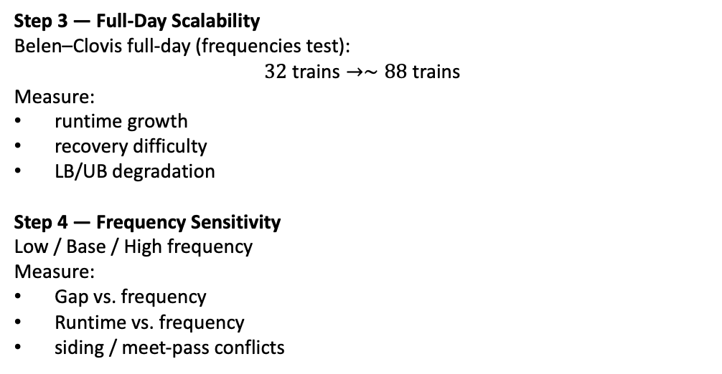
Corridor Experiment Pathway
Phase 1 — Benchmark Transfer
Belen–Clovis, NM
BNSF Southern Transcon
236.6 miles
26 nodes / 25 controlling blocks
32 trains
Current method
OFQ + LR + PATH K DP→Current Feasible Recovery→Full Physical Validator
Current Status
✓ Data/model integration
✓ Stage A completed
! Recovery bottleneck
! No formal LB/UB/gap yet
Step 1 — Resolve 32-train feasibility
Diagnose the minimal conflict core around WB01Z
Step 2 — Complete corridor benchmark
Obtain:
Formal/certified LB
0-conflict validated UB
Optimality gap
Runtime
Step 3 — Full-Day Scalability
Belen–Clovis full-day (frequencies test):
$$32\text{ trains}→∼88\text{ trains}$$
Measure:
runtime growth
recovery difficulty
LB/UB degradation
Step 4 — Frequency Sensitivity
Low / Base / High frequency
Measure:
Gap vs. frequency
Runtime vs. frequency
siding / meet-pass conflicts
8

Slide 9
Schedule, Deliverables, and ANL Decisions Needed
Stage | Status | Deliverable
RAS P1–P3 benchmark | Completed | LB, validated UB, gap, conflicts
Version A data/objective/validator integration | Completed | Adapter + validator + objective audit
Belen–Clovis 32-train benchmark | In progress | LB, UB, gap, runtime
Belen–Clovis full-day (~88 trains) | Next | Scalability results
Low/Base/High frequency study | Next | Gap/runtime/conflict curves
OFQ ablation | Next | DP vs LR vs OFQ comparison
ANL review gate | Final | 8-slide deck + CSV + logs
1. Frequency Definition
What should define Low / Base / High frequency for the formal sensitivity test?
2. Scheduling → Planning Feedback
What scheduling outputs should be returned to the upstream planning model?
9

