Slide 1
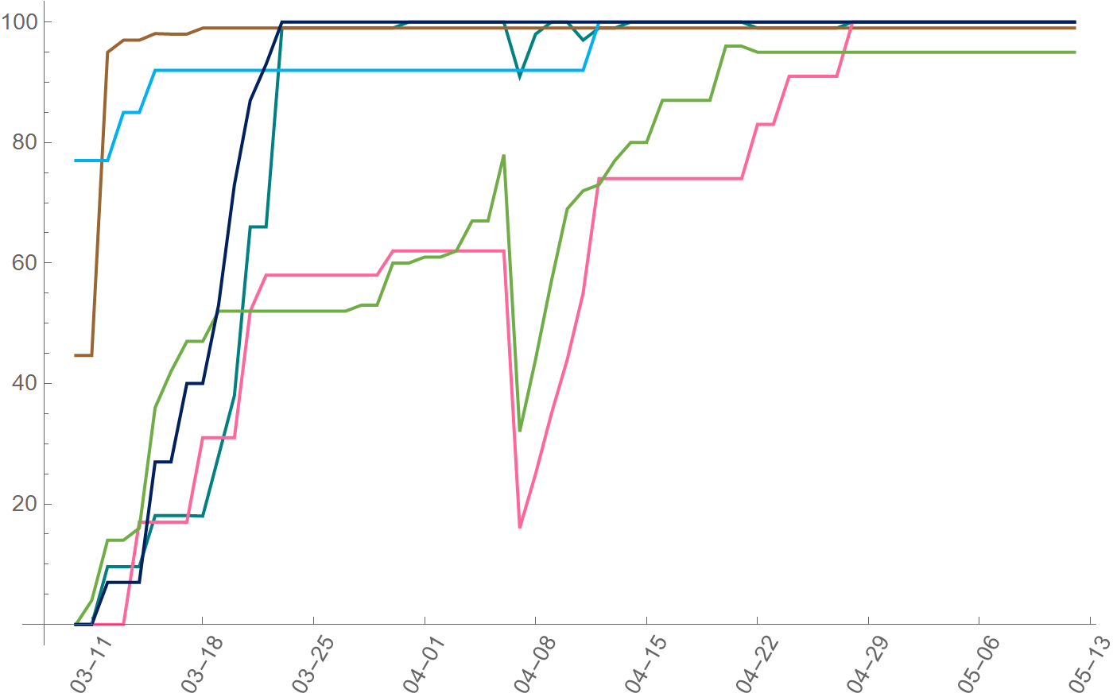
The Great East Japan Earthquake
Strong aftershocks occurred
between April 7th and 11th
Recovery rate [%]
Expressway
National road
Bullet train
Local train
Airport
Seaport
Date

