Slide 1
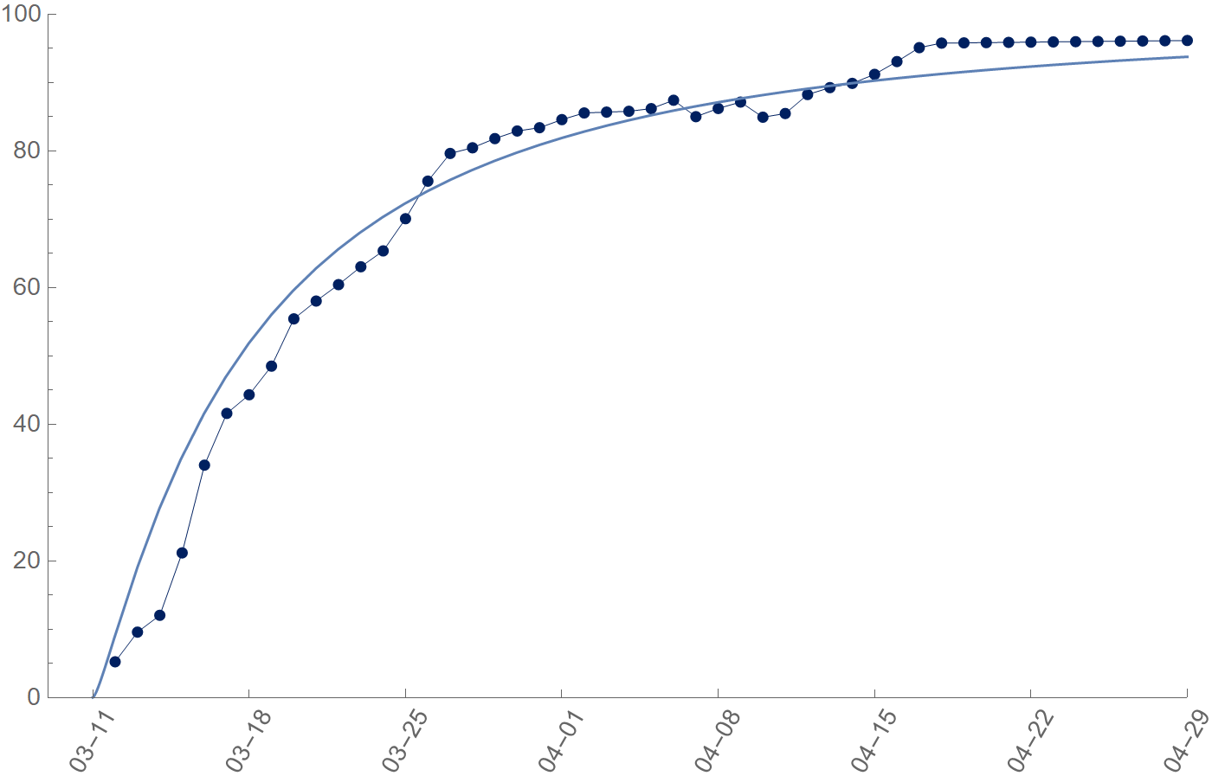

The Great East Japan Earthquake
Strong aftershocks occurred
between April 7th and 11th
Recovery rate [%]
Observed data
LEA
Date

Slide 2

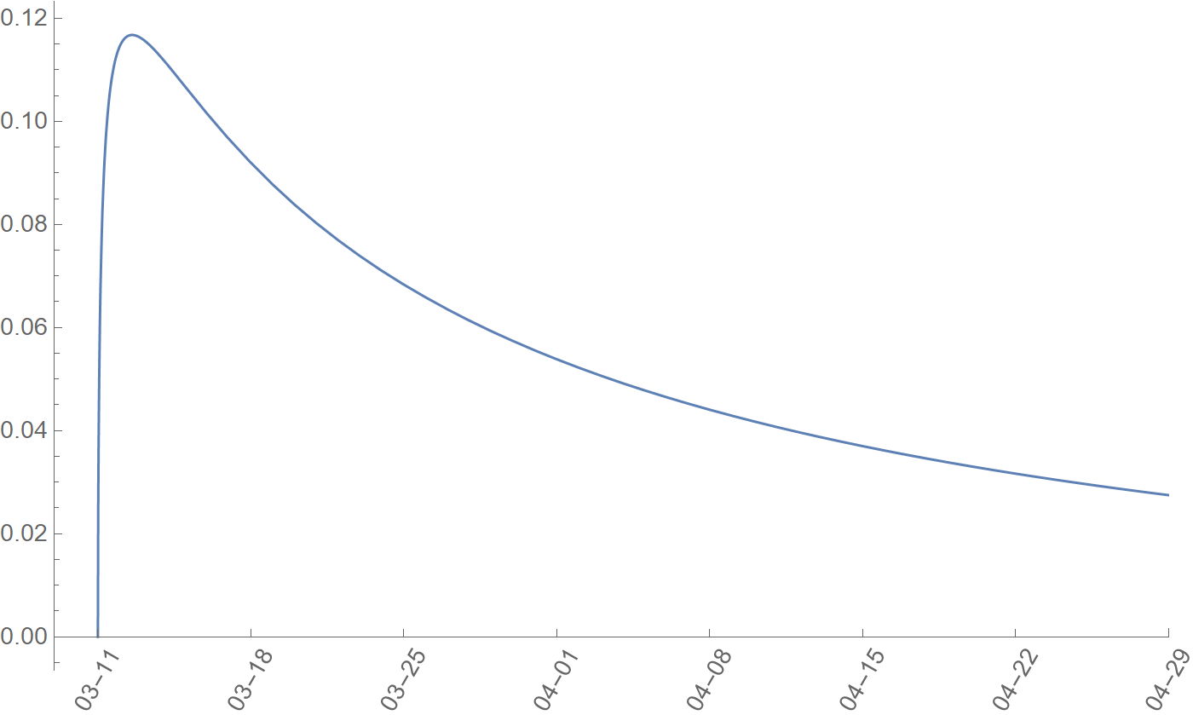
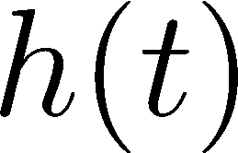
The Great East Japan Earthquake
Date

