Slide 1
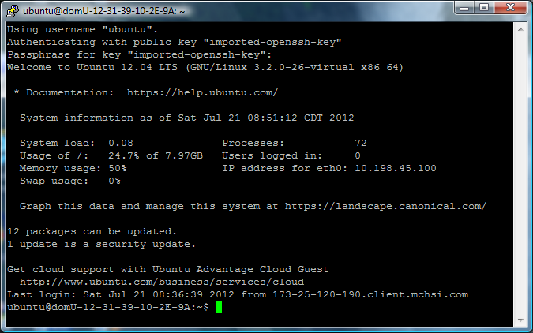
Concerto Project CS 452, Summer 2012
Base server
Amazon EC2 cloud instance running Ubuntu Server 12.04
Intel(R) Xeon(R) CPU E5430 @ 2.66GHz
~618 MB RAM (590 MiB)
Additional software
LAMP (Linux Apache mySQL PHP)
Concerto
LibreOffice
GhostScript
ImageMajik
phpMyAdmin (optional)

Slide 2

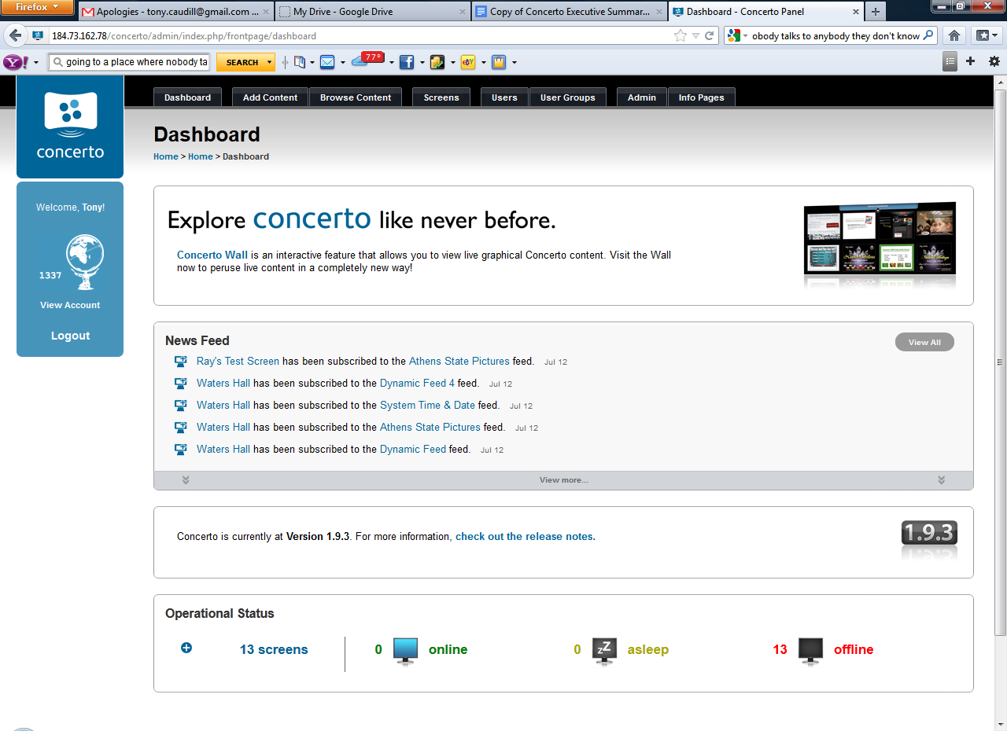
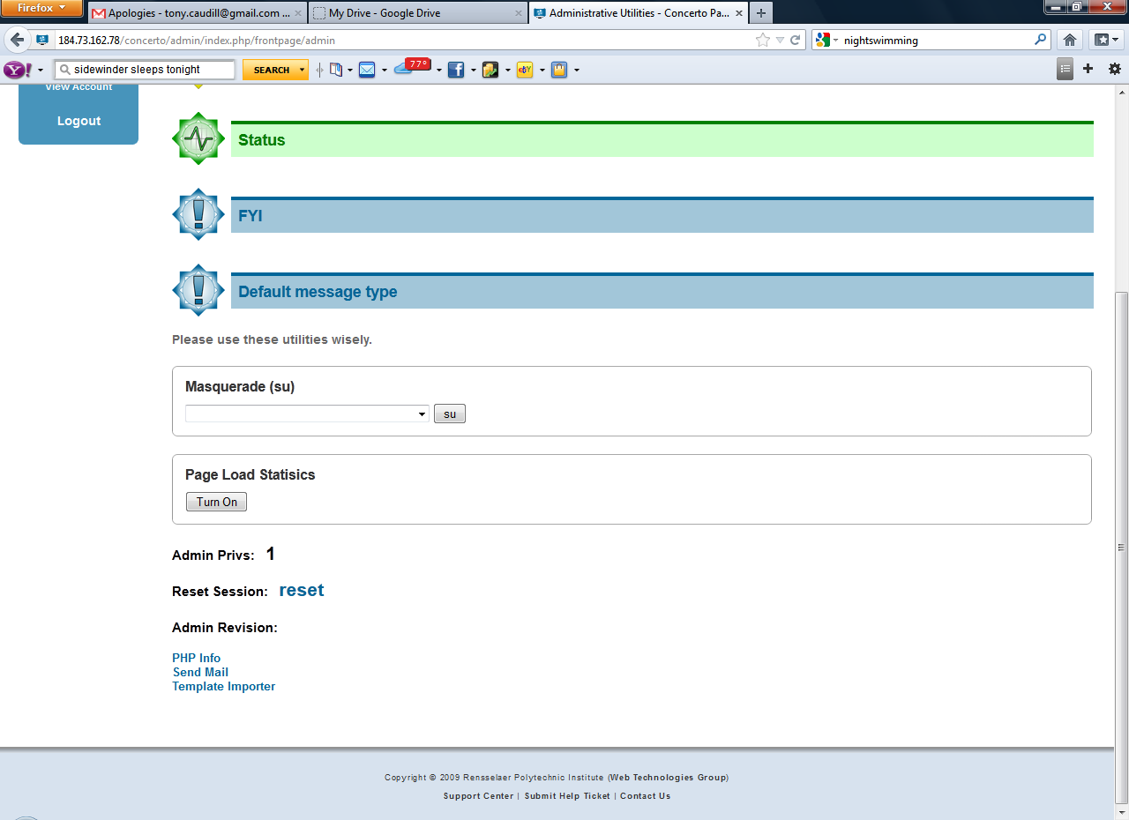
Concerto Project - Admin

Slide 3
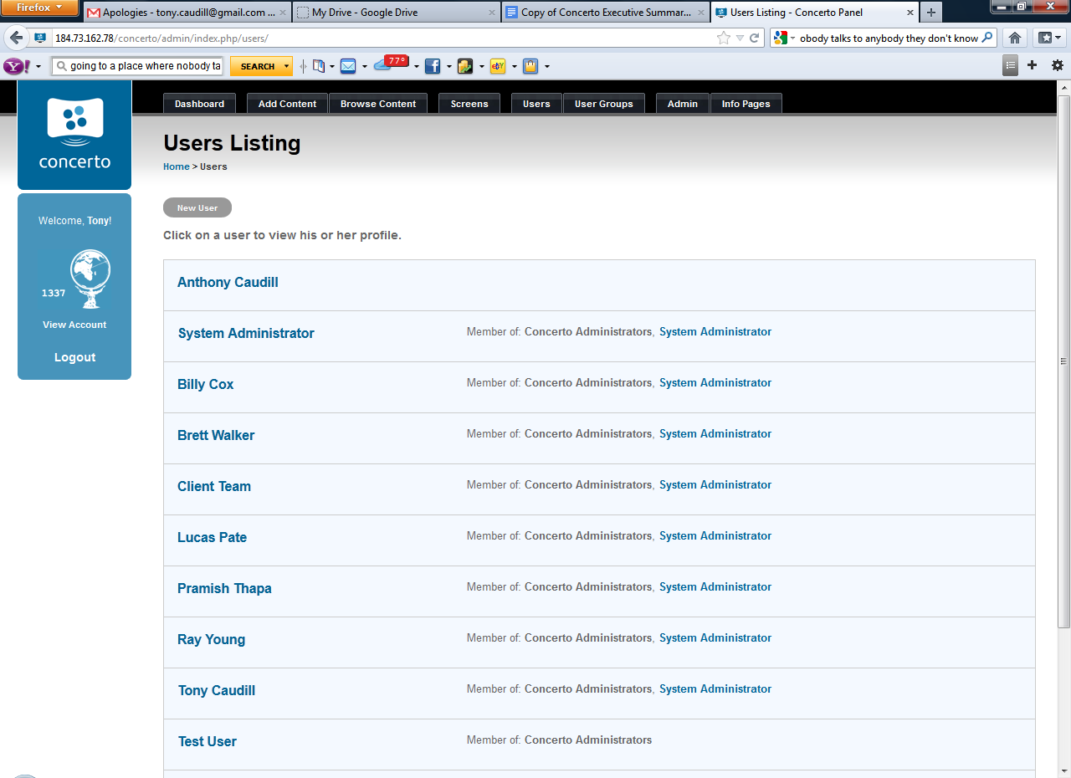
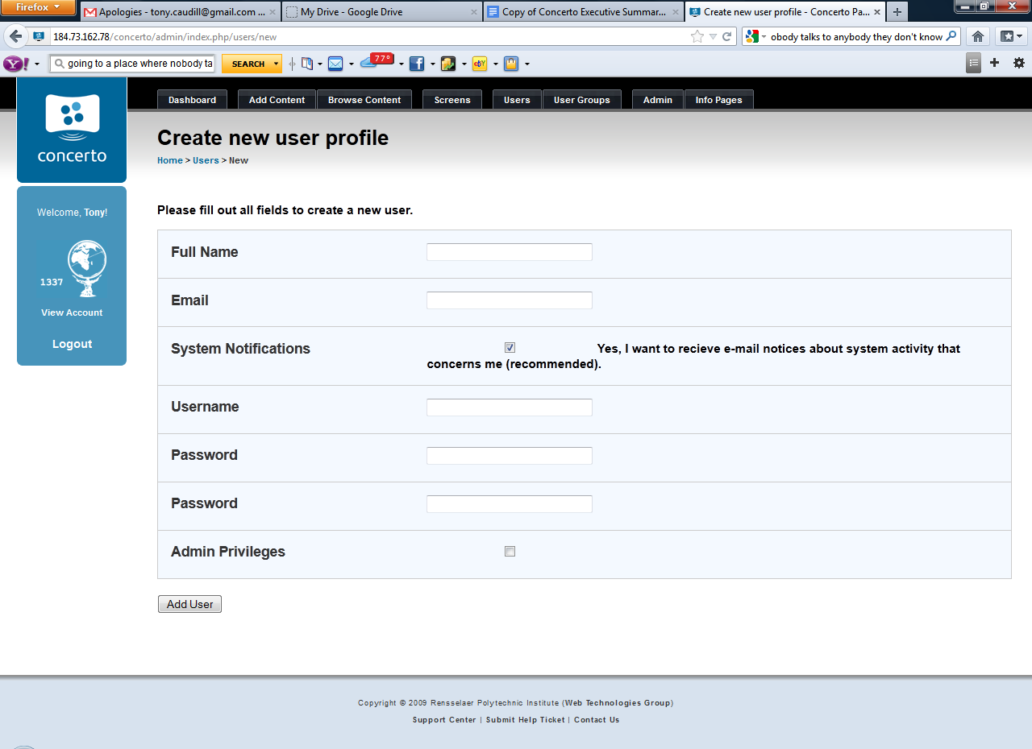
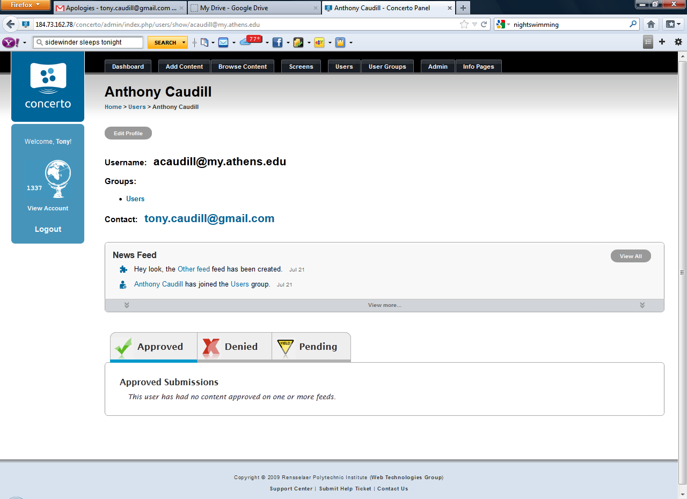
Concerto Project – Managing Users

Slide 4
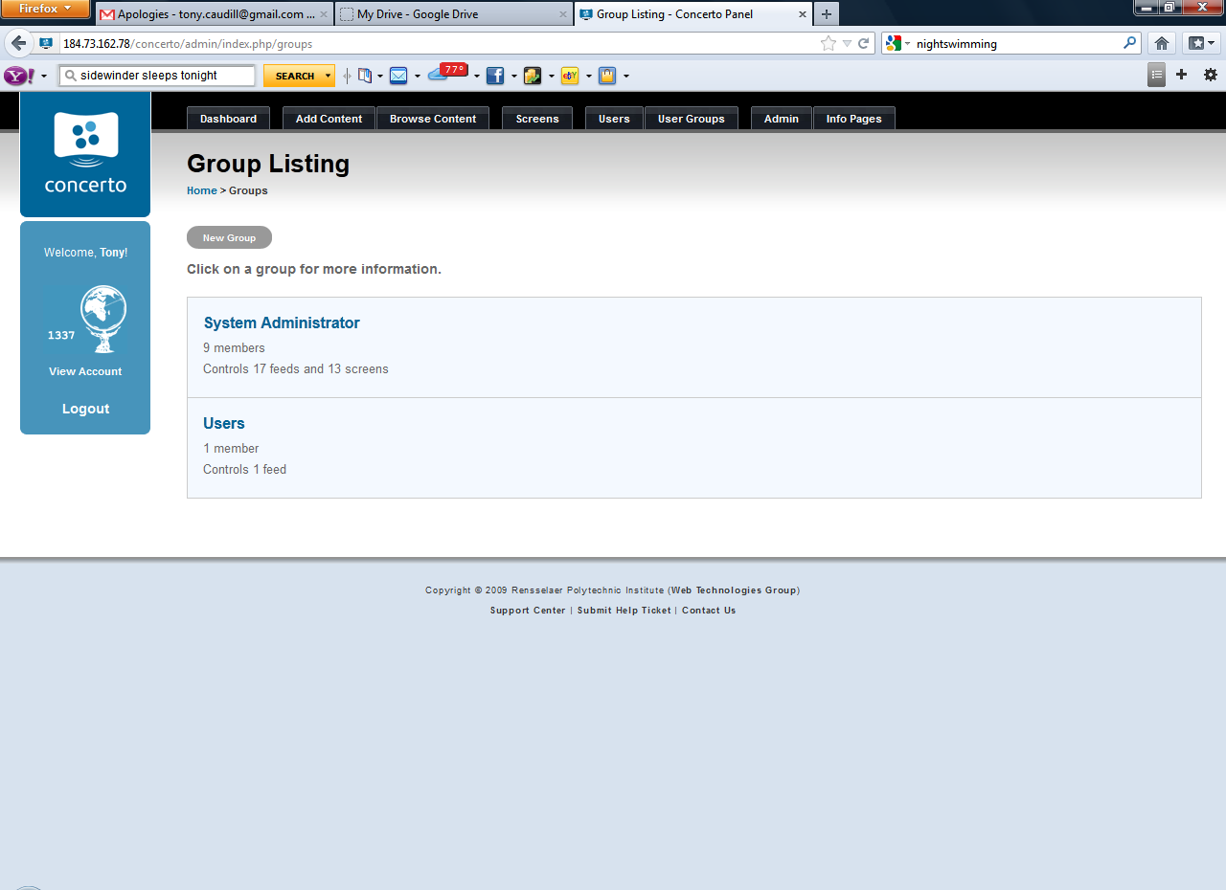
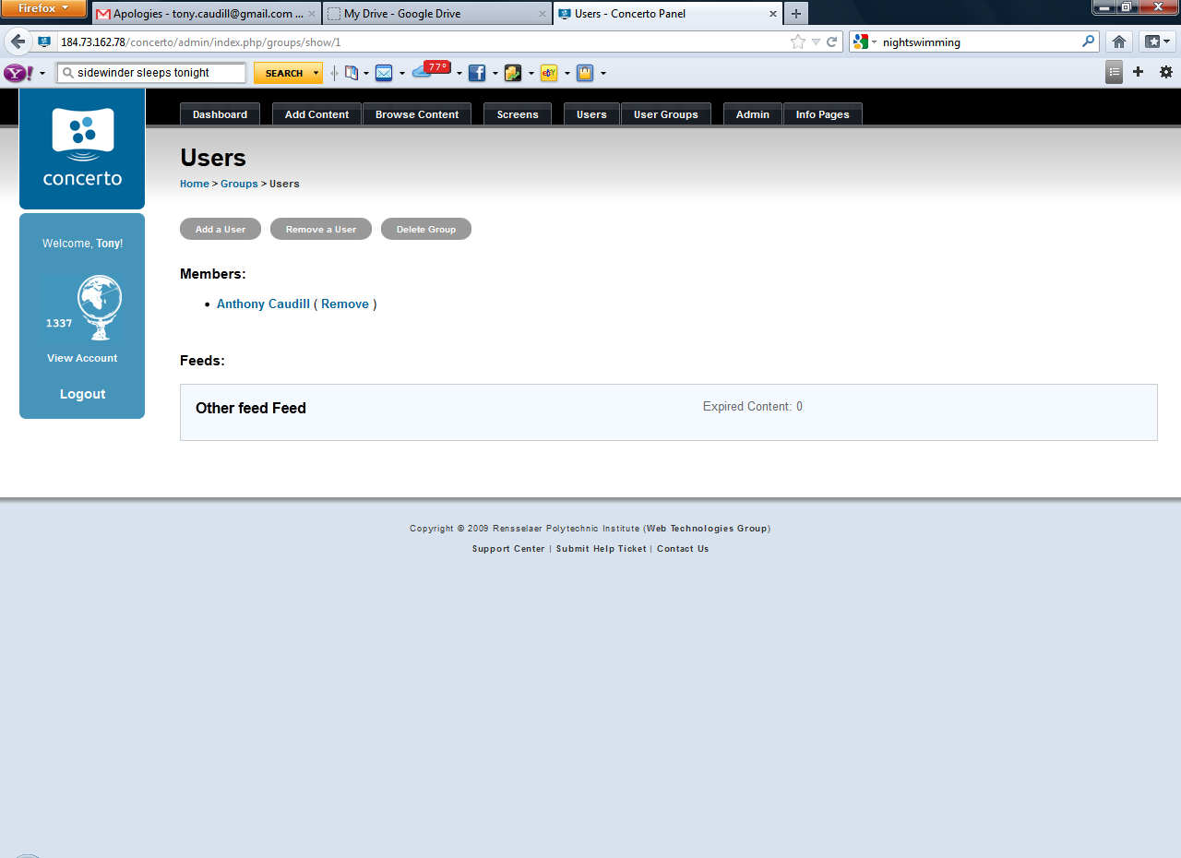
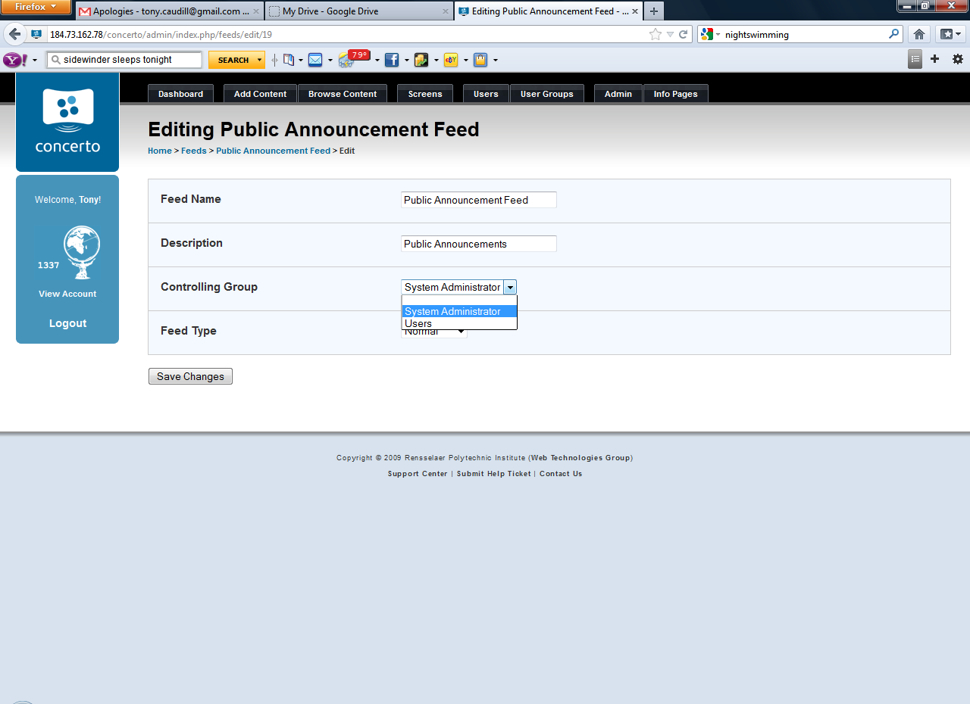
Concerto Project – Managing Groups

