Slide 1
cs2340:Agile Development
Spring 2018
Agile Development

Slide 2
Software Development Life Cycle (SDLC)
Conceptual Model
  Waterfall, Evolutionary Prototyping, Spiral, Staged Delivery, etc.
Management of Risk
Sequence of Activities
Agile Development

Slide 3

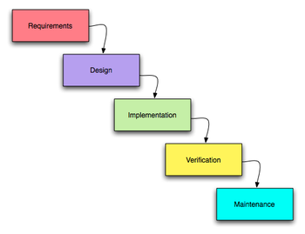
In the beginning was….
The Waterfall
Agile Development

Slide 4

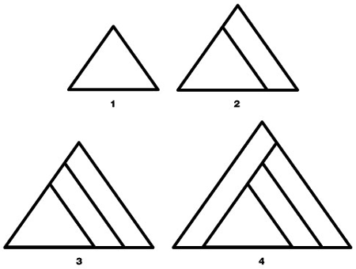
Two Ways to Build a Pyramid
(John Mayo-Smith)
Agile Development

Slide 5
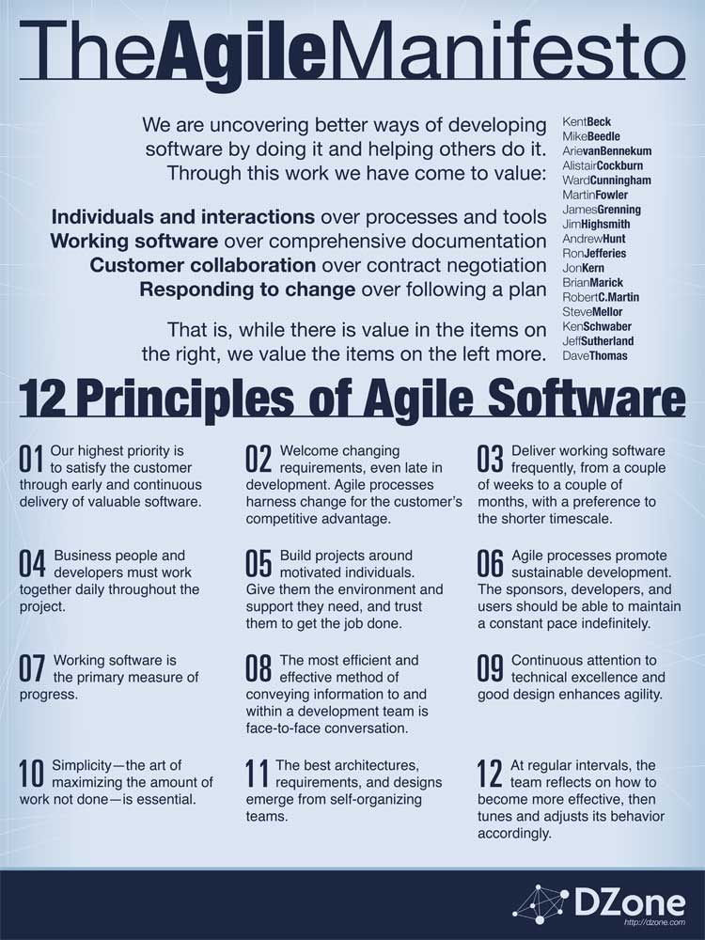
Thus was
Born:
Agile Development

Slide 6
Iterative Delivery
Project divided in pieces called iterations
At end of iteration something is delivered
No schedule slip (timeboxing as opposed to scopeboxing)
Each iteration nominally 4 weeks (but can be as short as 1 week in XP, or 6 weeks in RUP)
Each iteration does varying amounts of analysis, design, implementation and testing
Agile Development

Slide 7
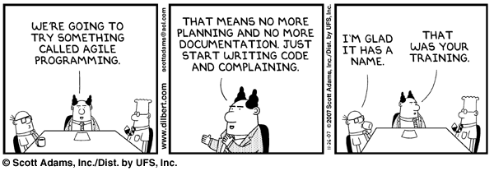
DANGER DANGER WILL ROBINSON
Agile Development

Slide 8
Some Agile Processes
SCRUM (project management)
Extreme Programming (XP) (processes)
EVO(requirements focused)
RUP Dx (complete system)
Agile Development

Slide 9
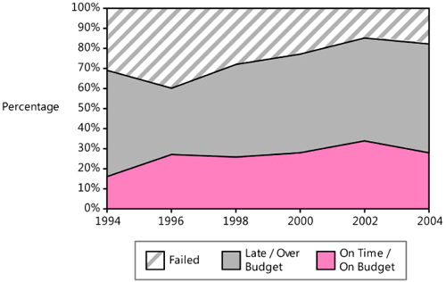
Industry Estimation
Agile Development

Slide 10
Recall the 4 factors
Size
Human Factors
Uncertainty
Defects
from Steve McConnell, understanding software projects

Slide 11
SCRUM
Focuses mainly on management of software product development
Timeboxed iterations called sprints
Project planned through use of 2 spreadsheets (Product and Sprint)
Daily Meeting (Pigs and Chickens)
Each sprint ends with “ready” deliverable
Agile Development

Slide 12
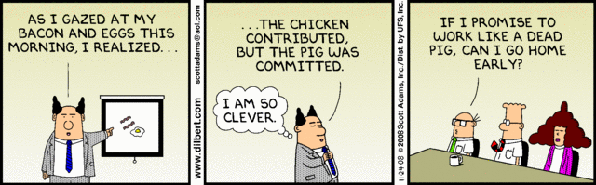
Agile Development

Slide 13
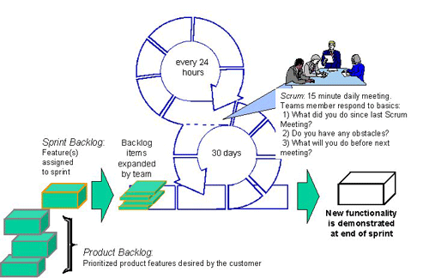
SCRUM
Agile Development

Slide 14
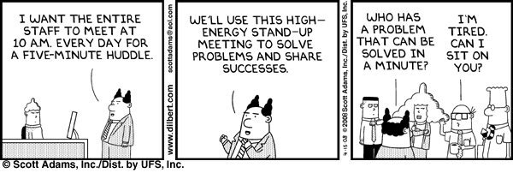
The Standup Meeting
Agile Development

Slide 15
Zenhub Demo
Issues = Features/Stories/Products
Milestones = Sprints/Iterations
Labels = filtering and organization
Estimation = Fibonacci Sequence
Demo Project: https://github.com/guitarbob99/ProjectManagement

