Slide 1
Line Fitting,
Residuals, and Correlation

Slide 2
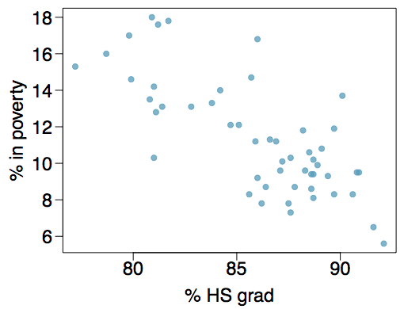
Poverty vs. HS graduate rate
The scatterplot below shows the relationship between HS graduate rate in all 50 US states and DC and the percent of residents who live below the poverty line (income below $23,050 for a family of 4 in 2012).
Response variable?

Slide 3
Poverty vs. HS graduate rate
The scatterplot below shows the relationship between HS graduate rate in all 50 US states and DC and the percent of residents who live below the poverty line (income below $23,050 for a family of 4 in 2012).
Response variable?
% in poverty

Slide 4
Poverty vs. HS graduate rate
The scatterplot below shows the relationship between HS graduate rate in all 50 US states and DC and the percent of residents who live below the poverty line (income below $23,050 for a family of 4 in 2012).
Response variable?
% in poverty
Explanatory variable?

Slide 5
Poverty vs. HS graduate rate
The scatterplot below shows the relationship between HS graduate rate in all 50 US states and DC and the percent of residents who live below the poverty line (income below $23,050 for a family of 4 in 2012).
Response variable?
% in poverty
Explanatory variable?
% HS grad

Slide 6
Poverty vs. HS graduate rate
The scatterplot below shows the relationship between HS graduate rate in all 50 US states and DC and the percent of residents who live below the poverty line (income below $23,050 for a family of 4 in 2012).
Response variable?
% in poverty
Explanatory variable?
% HS grad
Relationship?

Slide 7
Poverty vs. HS graduate rate
The scatterplot below shows the relationship between HS graduate rate in all 50 US states and DC and the percent of residents who live below the poverty line (income below $23,050 for a family of 4 in 2012).
Response variable?
% in poverty
Explanatory variable?
% HS grad
Relationship?
linear, negative, moderately strong

Slide 8
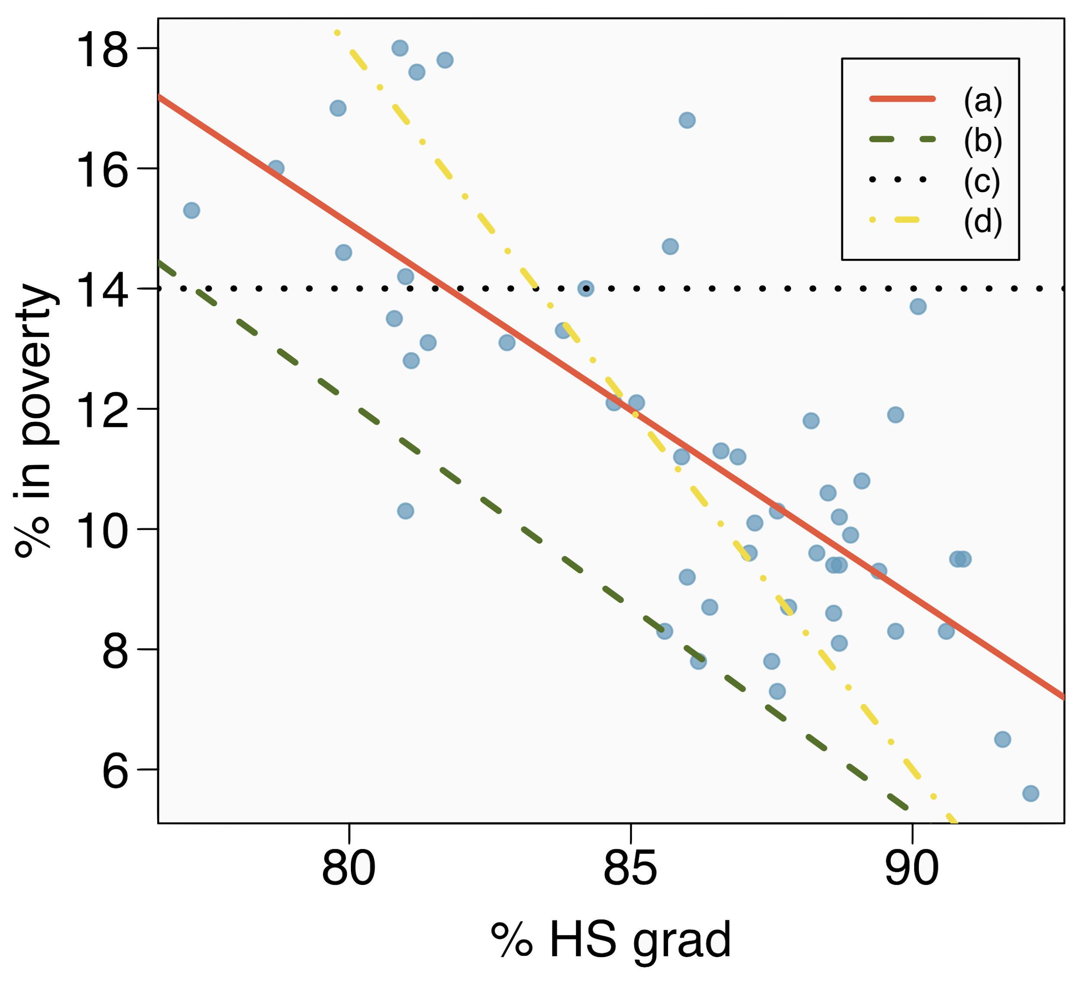
Eyeballing the line
Which of the following appears to be the line that best fits the linear relationship between % in poverty and % HS grad? Choose one.

Slide 9
Eyeballing the line
Which of the following appears to be the line that best fits the linear relationship between % in poverty and % HS grad? Choose one.
(a)

Slide 10
Eyeballing the line
The high school graduate rate for some new state (not plotted) is 85.1%. What poverty level do you predict for this state?

Slide 11

Poverty vs. HS graduate rate
The linear model for predicting poverty from high school graduation rate in the US is
The "hat" is used to signify that this is an estimate.

Slide 12
Poverty vs. HS graduate rate
The linear model for predicting poverty from high school graduation rate in the US is
The "hat" is used to signify that this is an estimate.
The high school graduate rate for some new state (not plotted) is 85.1%. What poverty level do you predict for this state?
64.78 − 0.62 x 85.1 = 12.018

Slide 13
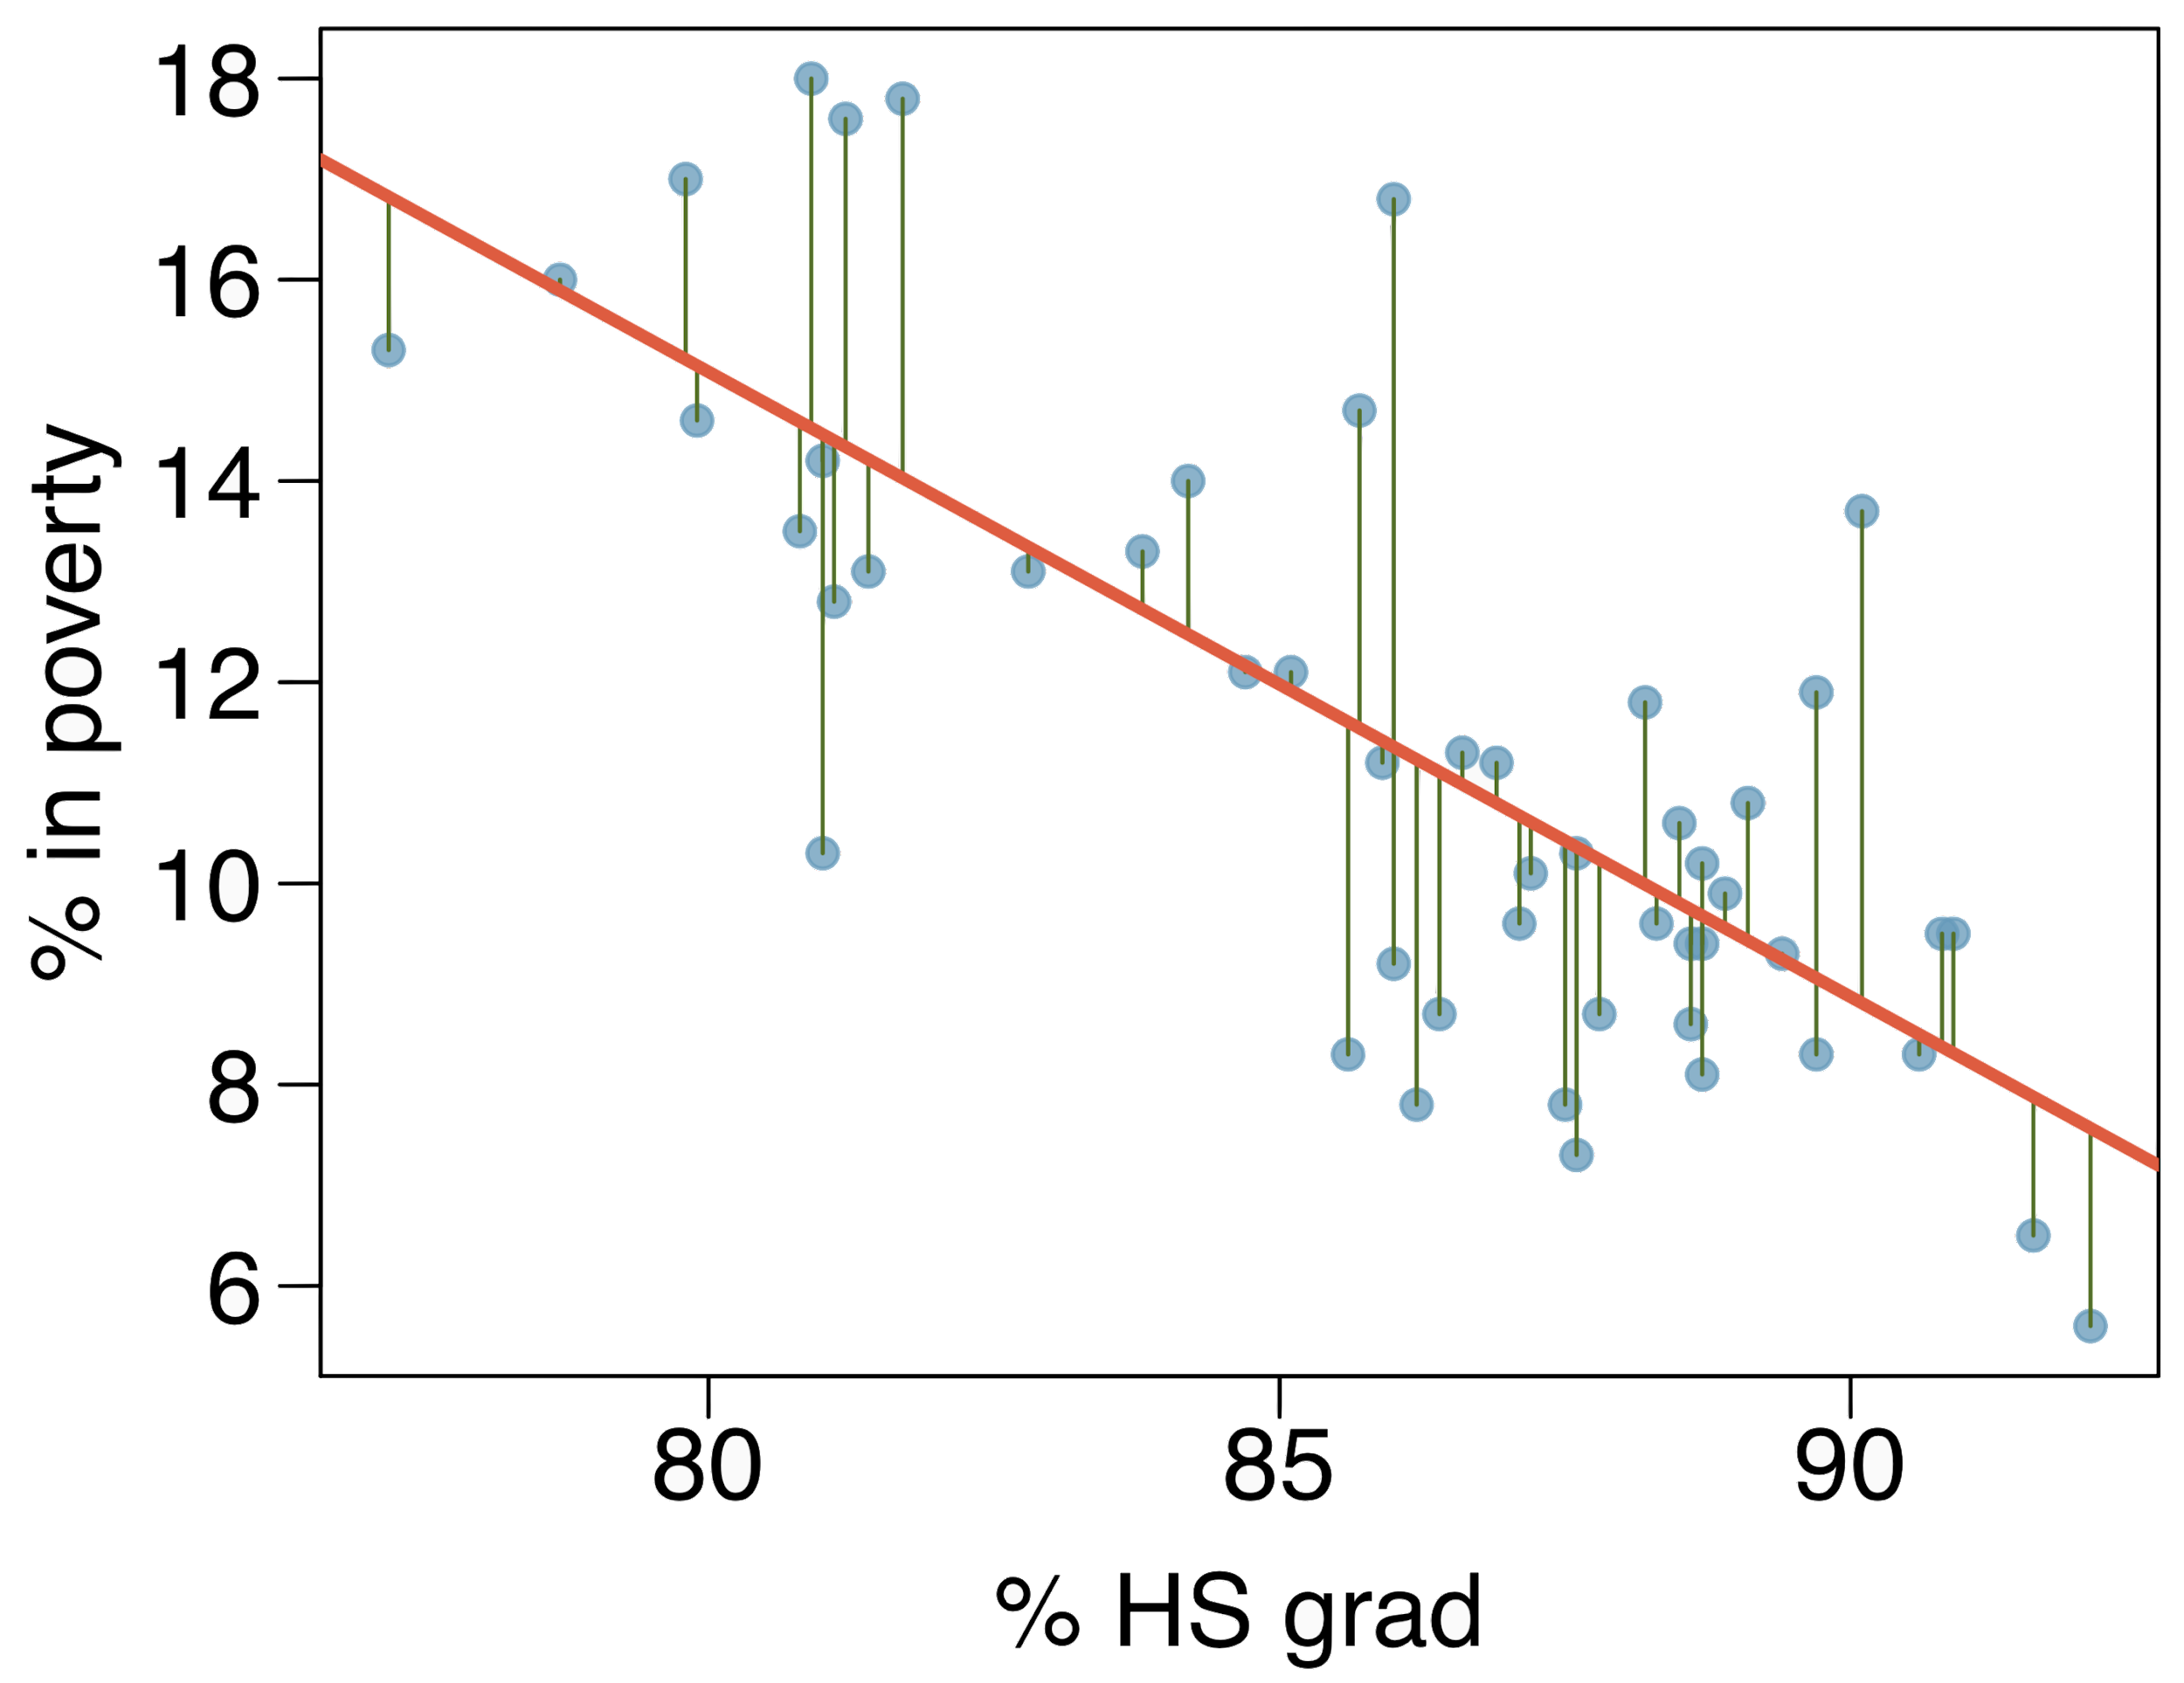
Residuals
Residuals are the leftovers from the model fit:
Data = Fit + Residual

Slide 14
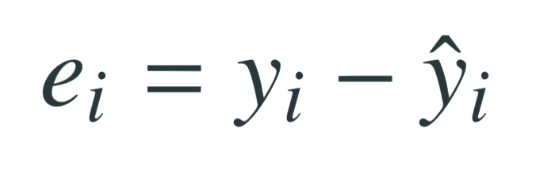
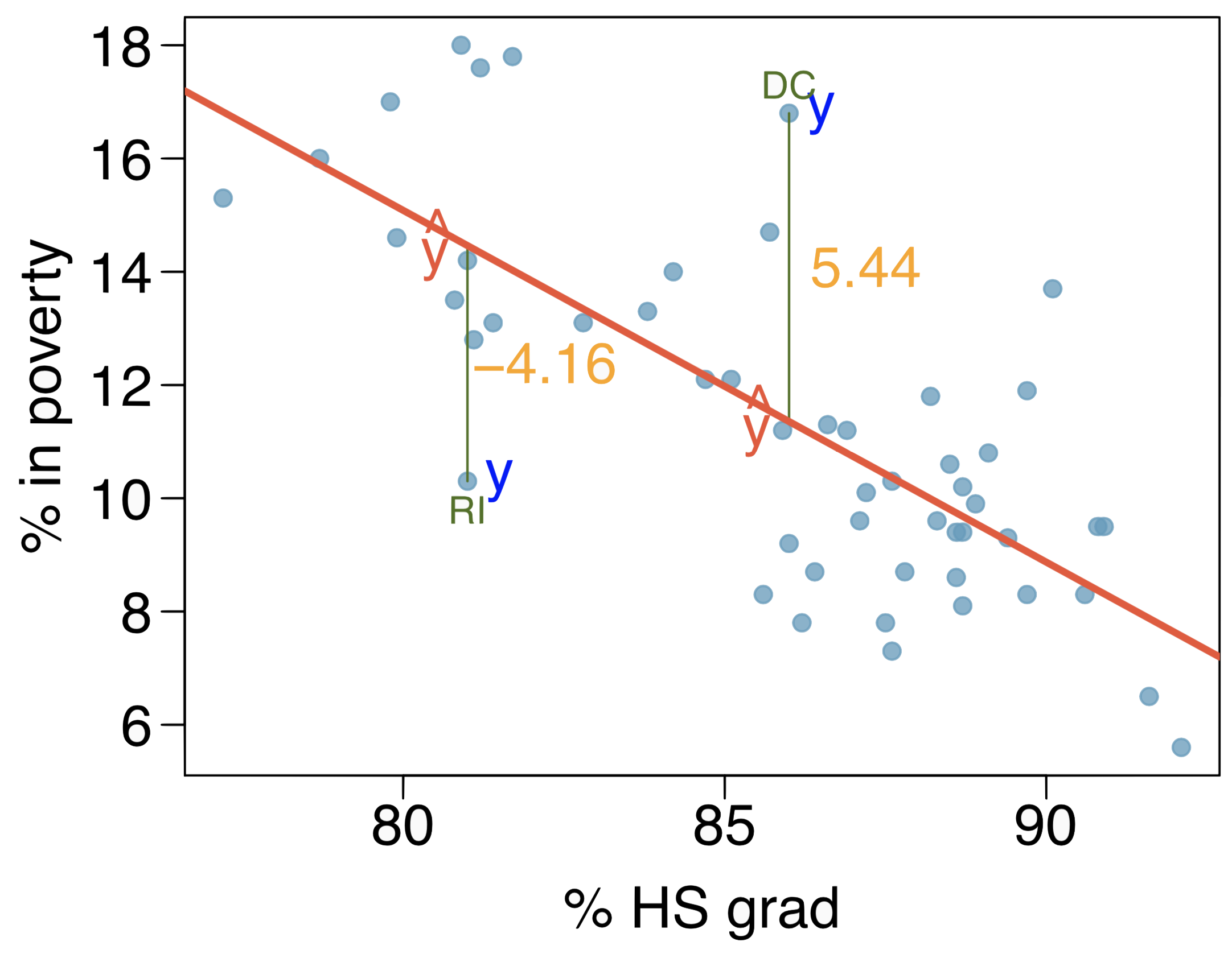
Residuals (cont.)
Residual is the difference between the observed (y_{i}) and predicted ŷ_{i}.

Slide 15
Residuals (cont.)
Residual is the difference between the observed (y_{i}) and predicted ŷ_{i}.
% living in poverty in DC is 5.44% more than predicted.

Slide 16
Residuals (cont.)
Residual is the difference between the observed (y_{i}) and predicted ŷ_{i}.
% living in poverty in DC is 5.44% more than predicted.
% living in poverty in RI is 4.16% less than predicted.

Slide 17
Quantifying the relationship
Correlation describes the strength of the linear association between two variables.

Slide 18
Quantifying the relationship
Correlation describes the strength of the linear association between two variables.
It takes values between -1 (perfect negative) and +1 (perfect positive).

Slide 19
Quantifying the relationship
Correlation describes the strength of the linear association between two variables.
It takes values between -1 (perfect negative) and +1 (perfect positive).
A value of 0 indicates no linear association.

Slide 20
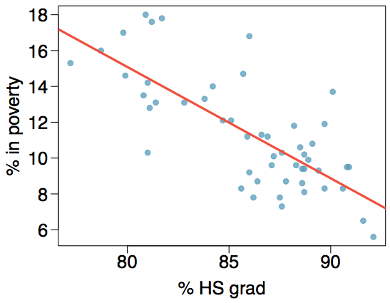
Guessing the correlation
Which of the following is the best guess for the correlation between percent in poverty and percent HS grad?
0.6
-0.75
-0.1
0.02
-1.5

Slide 21
Guessing the correlation
Which of the following is the best guess for the correlation between percent in poverty and percent HS grad?
0.6
-0.75
-0.1
0.02
-1.5

Slide 22
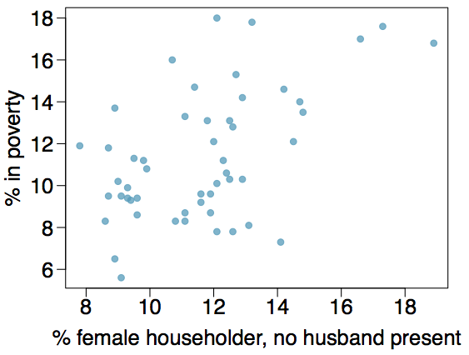
Guessing the correlation
Which of the following is the best guess for the correlation between percent in poverty and percent female householder?
0.1
-0.6
-0.4
0.9
0.5

Slide 23
Guessing the correlation
Which of the following is the best guess for the correlation between percent in poverty and percent female householder?
0.1
-0.6
-0.4
0.9
0.5

Slide 24
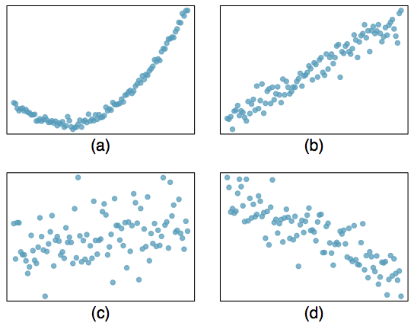
Assessing the correlation
Which of the following is has the strongest correlation, i.e. correlation coefficient closest to +1 or -1?

Slide 25
Assessing the correlation
Which of the following is has the strongest correlation, i.e. correlation coefficient closest to +1 or -1?
(b) → correlation means linear association

Slide 26
Fitting a line by least squares regression

Slide 27
A measure for the best line
We want a line that has small residuals

Slide 28
A measure for the best line
We want a line that has small residuals
Option 1: Minimize the sum of magnitudes (absolute values) of residuals |e₁| + |e₂| + … + |e_{n}|

Slide 29
A measure for the best line
We want a line that has small residuals
Option 1: Minimize the sum of magnitudes (absolute values) of residuals |e₁| + |e₂| + … + |e_{n}|
Option 2: Minimize the sum of squared residuals -- least squares
e₁² + e₂² + … + e_{n}²

Slide 30
A measure for the best line
We want a line that has small residuals
Option 1: Minimize the sum of magnitudes (absolute values) of residuals |e₁| + |e₂| + … + |e_{n}|
Option 2: Minimize the sum of squared residuals -- least squares
e₁² + e₂² + … + e_{n}²
Why least squares?

Slide 31
A measure for the best line
We want a line that has small residuals
Option 1: Minimize the sum of magnitudes (absolute values) of residuals |e₁| + |e₂| + … + |e_{n}|
Option 2: Minimize the sum of squared residuals -- least squares
e₁² + e₂² + … + e_{n}²
Why least squares?
Most commonly used

Slide 32
A measure for the best line
We want a line that has small residuals
Option 1: Minimize the sum of magnitudes (absolute values) of residuals |e₁| + |e₂| + … + |e_{n}|
Option 2: Minimize the sum of squared residuals -- least squares
e₁² + e₂² + … + e_{n}²
Why least squares?
Most commonly used
Easier to compute by hand and using software

Slide 33
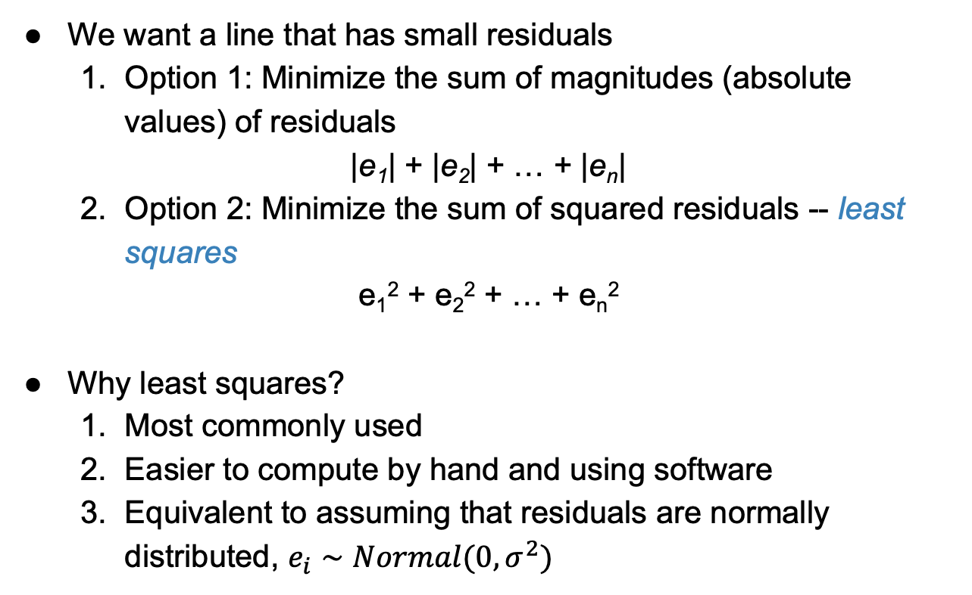
A measure for the best line
We want a line that has small residuals
Option 1: Minimize the sum of magnitudes (absolute values) of residuals |e₁| + |e₂| + … + |e_{n}|
Option 2: Minimize the sum of squared residuals -- least squares
e₁² + e₂² + … + e_{n}²
Why least squares?
Most commonly used
Easier to compute by hand and using software
Equivalent to assuming that residuals are normally distributed, $e_{i}∼Normal(0, σ^{2})$

Slide 34
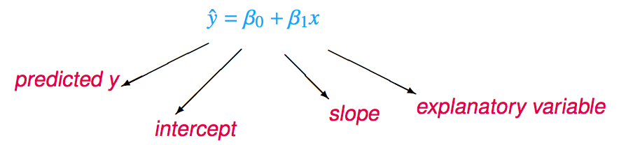
The least squares line
Notation:
Intercept:
Parameter: β₀
Point estimate: b₀
Slope:
Parameter: β₁
Point estimate: b₁

Slide 35
Conditions for the least squares line
Linearity

Slide 36
Conditions for the least squares line
Linearity
Nearly normal residuals

Slide 37
Conditions for the least squares line
Linearity
Nearly normal residuals
Constant variability

Slide 38
Conditions: (1) Linearity
The relationship between the explanatory and the response variable should be linear.

Slide 39
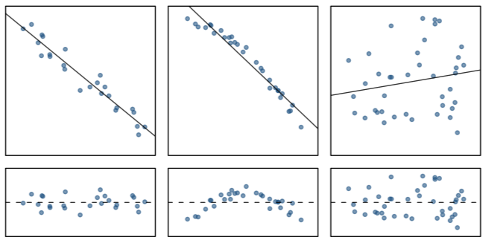
Conditions: (1) Linearity
The relationship between the explanatory and the response variable should be linear.
Check using a scatterplot of the data, or a residuals plot.

Slide 40
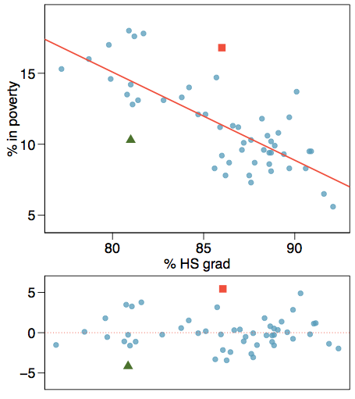
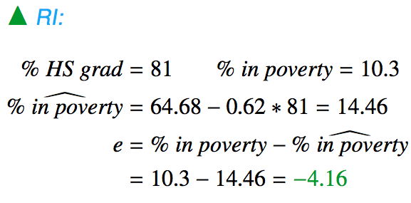
Anatomy of a residuals plot

Slide 41
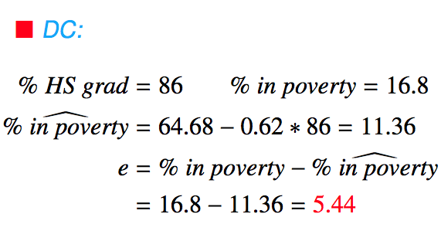
Anatomy of a residuals plot

Slide 42
Conditions: (2) Nearly normal residuals
The residuals should be nearly normal.

Slide 43
Conditions: (2) Nearly normal residuals
The residuals should be nearly normal.
This condition may not be satisfied when there are unusual observations that don't follow the trend of the rest of the data.

Slide 44
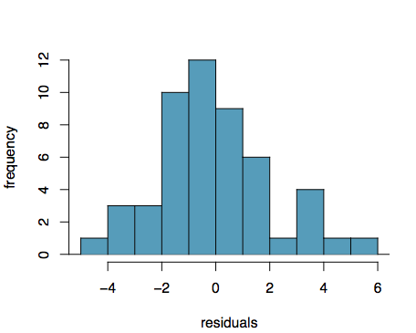
Conditions: (2) Nearly normal residuals
The residuals should be nearly normal.
This condition may not be satisfied when there are unusual observations that don't follow the trend of the rest of the data.
Check using a histogram or normal probability plot of residuals.

Slide 45
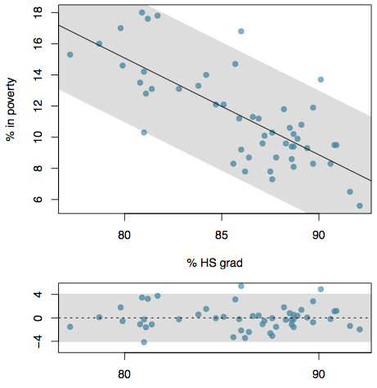
Conditions: (3) Constant variability
The variability of points around the least squares line should be roughly constant.

Slide 46
Conditions: (3) Constant variability
The variability of points around the least squares line should be roughly constant.
This implies that the variability of residuals around the 0 line should be roughly constant as well.

Slide 47
Conditions: (3) Constant variability
The variability of points around the least squares line should be roughly constant.
This implies that the variability of residuals around the 0 line should be roughly constant as well.
Also called homoscedasticity.

Slide 48
Conditions: (3) Constant variability
The variability of points around the least squares line should be roughly constant.
This implies that the variability of residuals around the 0 line should be roughly constant as well.
Also called homoscedasticity.
Check using a histogram or normal probability plot of residuals.

Slide 49
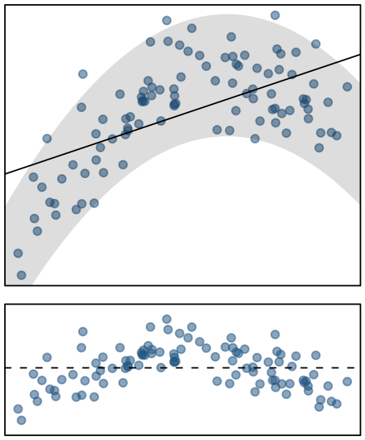
Checking conditions
What condition is this linear model obviously violating?
Constant variability
Linear relationship
Normal residuals
No extreme outliers

Slide 50
Checking conditions
What condition is this linear model obviously violating?
Constant variability
Linear relationship
Normal residuals
No extreme outliers

Slide 51
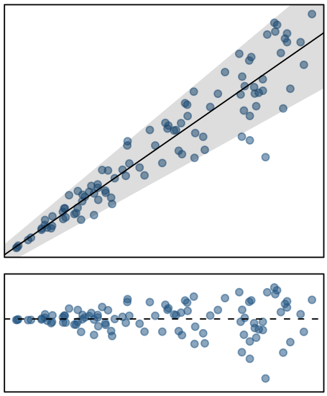
Checking conditions
What condition is this linear model obviously violating?
Constant variability
Linear relationship
Normal residuals
No extreme outliers

Slide 52
Checking conditions
What condition is this linear model obviously violating?
Constant variability
Linear relationship
Normal residuals
No extreme outliers

