Slide 1
BIA

Slide 2
Business Impact Analysis
BIA is the evaluation of an IS impact to business continuity
The analysis ranges from HIGH to LOW
Depending on importance to the business
“BIA allows the ISCP Coordinator / Security to characterize the system components, supported Mission/business processes and services provided and based on that information, characterize the consequences of a disruption” –SP 800-34 R1 NIST
BIA is required
Contingency Planning Requirements
Priorities of IS
BIA is part of SDLC
Occurs in Initiation Phase
Can occur again in Dev/Acquisition phase
Incorporate Steps 1 and 2 from RMF in BIA
Notes:
BIA is the process of evaluating an Information Systems impact if down and effects the businesses continuity plan. We can range the impact from High to Low and will consider the importance of the IS. This Analysis is required to comprehend the priorities of the IS and the contingency Planning Requirements. The SDLC encompasses this analysis during the initiation phase and Development phase.

Slide 3

Three Step BIA
Determine Mission/business Processes and recovery criticality
Outage Impacts
Downtime Tolerance
System processes Identified
Impact of Disruption
Identify Resource Requirements
Evaluate Resources of IS
Facilities
Personnel
Equipment
Software
Notes:
To conduct an analysis we must determine the Mission or business process and recovery criticality on an information system. Each information system in the company will have its own business process / mission We consider the outage impacts, down time, system processes, and impact of disruption. We then will identify the resource requirements For facilities, personnel, equipment, and software for each information system.

Slide 4

Identify Priorities for System Resources
After above steps are completed
Create a hierarchal list of priorities
Create a sequence of recovery activities
Notes:
Once the other three steps are complete we will then identify priorities for the system requirements. Through this we will make a list of those resources to determine their importance.

Slide 5
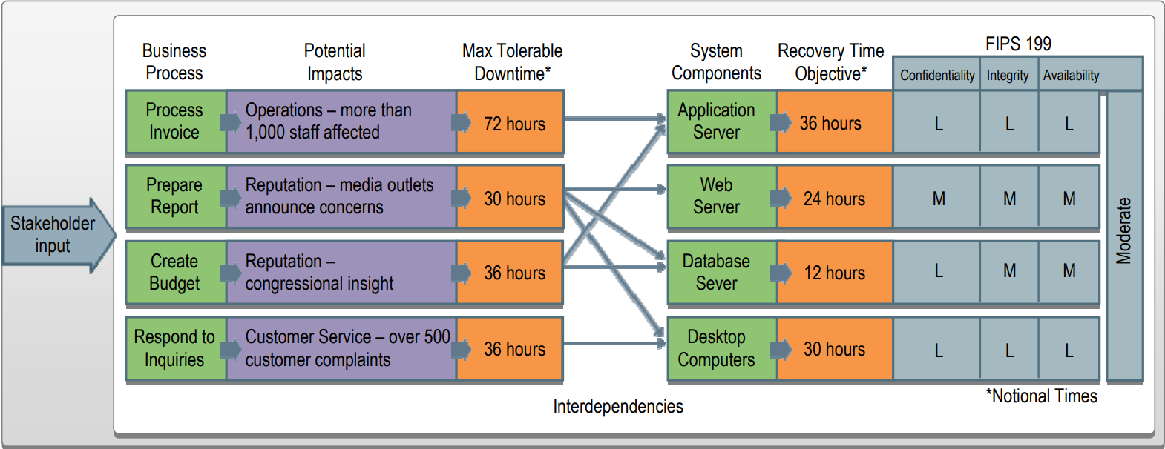
Into Practice
Notes:
Business process is identified INVOICE
This process is required by 1000 staff members in order to ensure business as usual
Tolerable downtime has been indicated as 72 hours MAX
This process relies on the Application server which has a recovery time objective of 36 hours… This could in fact only take a few hours to get back up depending on the error
FIPS 199 lays out the impact depending on the CIA with an overall rate of LOW for the INVOICE Process

Slide 6
Downtime Measurements for Management
Downtime will need to be measured and presented to stake and shareholders
Maximum Tolerable Downtime (MTD)
Total amount of time a product owner is willing to accept that the system is down
Required for correct recovery method identification
Required for in-depth procedures
Recovery Time Objective (RTO)
Maximum amount of time a system resource can remain unavailable before an unacceptable impact occurs on the MTD
Required for selecting technologies best suited for meeting MTD
POAM Required if cannot meet RTO and MTD cannot change
Notes:
Downtime measurements are for managers to understand the importance of an IS
We measure this through the MTD in which is the total amount of time a product owner is willing to accept that a system is down in production
We need this agreement in order to include it in the procedures for recovery. This also allows us to know what is the priority of this system. If it is low we know to go work on the High impact systems
We also use RTO to be aware of how long a system resource can be down before there is an impact to the system. This is like if IIS service went down in which this is a required resource for an application or website to remain operational. If redundant systems are not in play the site or app would be down immediately. If there were redundant systems then how long would it take before there is a performance hit?
We use RTO to also buy tech that can meet the MTD if the IT department and product owner can not come to an agreement with MTD and RTO then a POAM will need to be created to accomplish this

Slide 7

Recovery Point Objective
Point in time, prior to disruption or system outage, to which mission/business process data can be recovered
Amount of data loss a product owner can tolerate during recovery
Not part of MTD
Notes:
RPO is another measurement where we identify the point in time we can revert to in order to avoid the disruption or system outage. This would be the equivalent of a Vmrware snapshot being used to recover a down database or bad patches on a server. This is mainly for the IT departments to be aware of.

Slide 8
Take aways from BIA
RTO must ensure MTD is not exceeded
RTO will be shorter than MTD
Shows Importance of Asset management
Will assist in resource identification
Understanding our Downtime will allow security to assess risk and mitigations
BIA will encompass all factors of the IS
BIA should be conducted on every IS the organization utilizes
Notes:
We cannot have out RTO exceeding our MTD. BIA shows the importance of Asset management in order to identify resources
Knowing our downtime tolerance will allow security to assess risk and mitigations much easier due to knowing the importance levels of those systems
We conduct a BIA on every IS in the organization

Slide 9
ISCP
02

Slide 10
Information System Contingency Plan
ISCP is the policy that will be trigged by the Disaster Recovery Plan
This plan contains recovery times, assessments and recovery procedures for an IS during a disruption or outage
Plan provides key information
roles and responsibilities
Inventory information
Assessment procedures
Detailed recovery procedures
Testing
Notes:
ISCP is a document that will be triggered during an outage. This document contains the procedures, recovery times, and assessments for an IS. This plan also includes key information on Point of Contacts if there ever was an outage

Slide 11
ISCP differs from a Disaster Recovery plan
ISCPs are non site specific
Encompass detailed procedures of the IS to recover
ISCP Process
BIA
Preventive Controls
Contingency Strategy
Testing Training and Exercises (TT&E)
Maintenance
Notes:
ISCP Differs from a DRP in that they are non site specific and includes detailed procedures for recovering that system
The ISCP is broken down into multiple processes which are BIA Preventive controls contingency strategy TT&E and Maintenance

Slide 12
Preventive Controls
Once the BIA is completed some risk / vulnerabilities maybe eliminated or mitigated
NIST SP 800-53 lists out preventive controls depending on system type and configuration
Some common controls:
UPS
Generators
HVAC Units for cooling
Fire Suppression System
Fire and smoke detectors
Water Sensors
Heat resistant and water proof containers
Offsite storage of backup media
Frequent backups (weekly / monthly)
Notes:
When the BIA is being conducted, we might be able to identify ways to mitigate or remove vulnerabilities. Some controls we can use to mitigate vulnerabilities like electrical shorts, Fires, Power Outages and data loss are UPS’s generators fire suppression Offsite backups and heat and water proof containers for the media

Slide 13
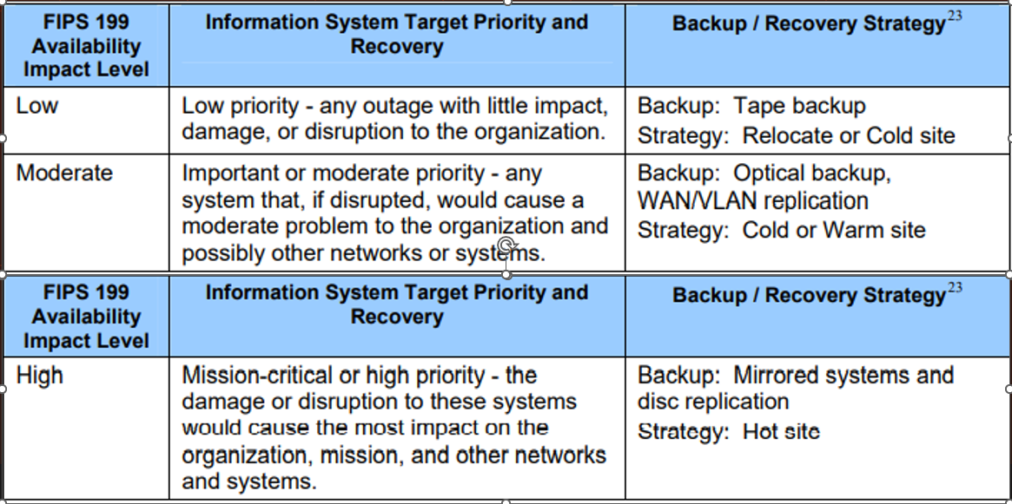
Contingency Strategy
There are multiple forms of Contingency Strategies Organizations can implement
Backup and Recovery
System restorations
Notes:
We can Utilize these strategies for complex recovery operations. Most of the strategies can cost a lot of capital to stand up. Utilizing Tape Backup and pushing the data offsite will provide us with the ability to either relocate or restore a system but this takes time to get the tapes back from the offsite vault. We can also use WAN / VLAN replication which is handled by software to replicate data and backups to another server or site. Then we have out mirror systems to a hot site which contains a full replication of the entire datacenter, including physical equipment and controls, and software.

Slide 14
Physical Backup Solution
Backup systems come in a variety of configurations
Security sometimes maintains these systems or utilizes them for tape backups
Back up system would include
Physical Server (HPE)
2 x 32 Core Intel CPUs
64 GB RAM
24 HDD Front
2 X 4.2 TB NVME For Cache
Fibre Channel card 10GB min LC connections
Notes:
Having a backup system is crucial to any information system. This should be considered when architecting the datacenter. Certain Backups perform better than others and provide different features so choosing the correct one for your needs is crucial. Some physical requirements are listed as:

Slide 15
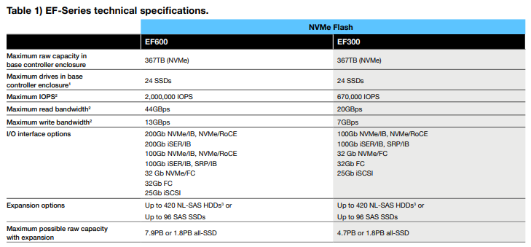
SAN (NETAPP)
Notes:
Here is the SAN portion of the backup solution. This is where we will store the physical data that can be later retrieved for immediate recovery.

Slide 16
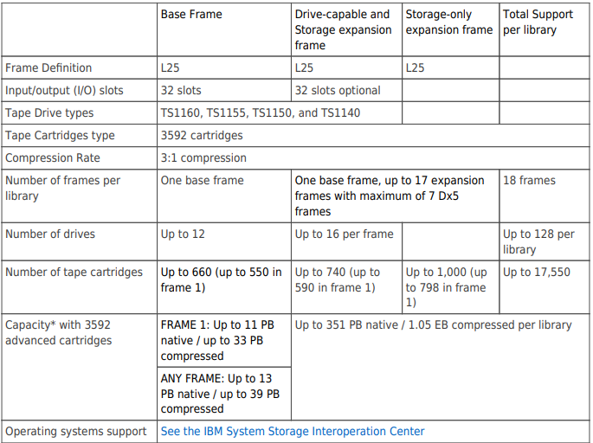
Tape Deck
Notes:
The Tape deck will be configured and installed as a secondary source of data storage. This allows for the tapes to be removed and sent off site to be stored at another facility.

Slide 17
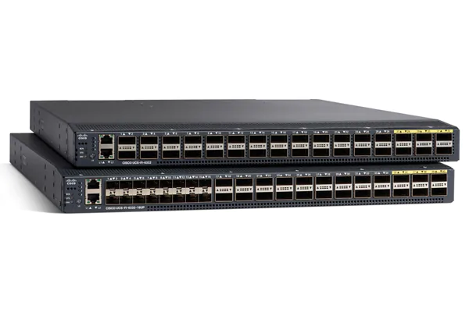
Cisco Fabric Interconnect
24 Ports
Bandwidth 2.56 Tbps
Going to purchase Fibre Channel Modules
Notes:
The Fabric Interconnect switches are what allow for high speed connections between the tape deck, servers, and Sans.

Slide 18
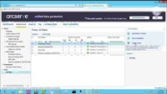
Backup Software
ArcServe
Notes:
A backup software I have used in the past was ArcServe. They seem to be a leading vendor for backups but there are plenty of other software out there.

Slide 19
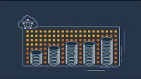
Cloud Backup AWS

Slide 20
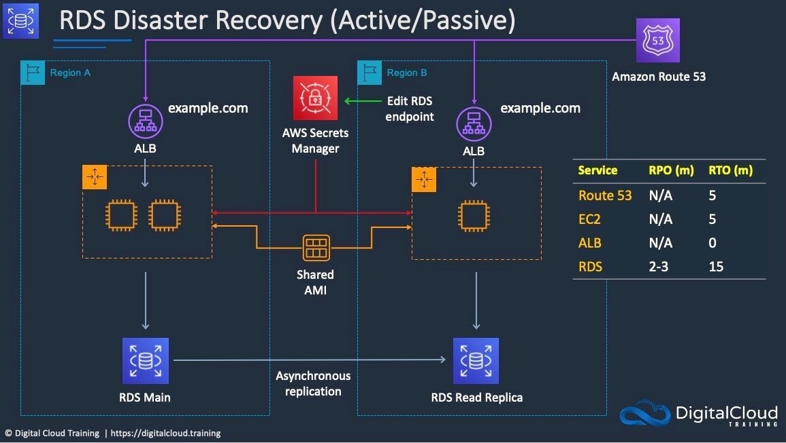
Notes:
This is an AWS cloud Active Passive configuration for application and database recovery

Slide 21
Offsite Storage
Tape media will be stored off premises
We can achieve this through third party services
IRON MOUNTAIN serves as an offsite storage facility
Notes:
For our tape media we will be storing it off site and utilizing the vendor Iron Mountain to pick up store and deliver our tapes.

Slide 22
Alternate Sites
Cold Sites
Facilities that have the capability of housing your datacenter
Warm Sites
Partially equipped for office spaces and some of your system hardware, software, telecoms and power
Hot Sites
Facilities that contain the system requirements and configured with necessary system hardware, supporting infrastructure, and personnel
Mobile Sites
Self-contained transportable shells custom fitted with specific telecoms and systems
Mirrored Sites
Full redundant Facilities with automated real-time information mirroring
Notes:
Diving into more advanced ways to maintain availablilty is by having alternate sites. We have our cold sites, warm sites, hot sites, mobile sites, and mirrored sites. These setups are very expensive and what has driven many companies to cloud or container based architectures. For our Cold sites we have a facility that has the capability of housing our datacenter but does not contain any equipment or configuration. Warm sites have partially equipped office space and some system hardware, software, telecoms, and power available. Hot sites are facilities that contain the system requirements and configuration with necessary system hardware supporting infrastructure and personnel. Mobile Sites are self-contained transportable shells that are custom fitted with specific telecoms and systems. Mirrored sites are fully redundant facilities with automated real-time information mirroring.

Slide 23
Testing, Training, Exercises
Testing
Personnel should be testing the backup solution and recovery procedures on at minimum a quarterly basis
Training
Personnel should be trained on this equipment and procedures to ensure they have information for a recovery
Exercises
Personnel should run through scenarios of failure in order to prove the procedures work
Chaos Monkey
Will bring down a random server to test redundancy
Notes:
Testing Notification procedures system recovery internal external connectivity system performance restoration of norm operations
Training purpose of the plan, cross team coordination and comms Reporting procedures Security requirements Team specific processes Individual responsibilities
Exercises Table top and Functional Exercises discussion based and validation

Slide 24
Maintenance
ISCP must be maintained
Updated with revisions
New Tech
New Policies
New Information
Technology must be updated
Tape Library's Firmware
Cisco Devices Firmware
SAN Firmware
Server Patches and Drivers
Notes:
This document must be constantly updated and tested to maintain viability through out the company. New Tech must be incorporated to stay update to date and never be out of compliance along with its firmware and software updates.

Slide 25


Slide 26
Citations
ABERNATHY, R. O. B. I. N. (2021). Cissp Cert guide. PEARSON IT CERTIFICATION.

