Slide 1
Query Reranking As A Service
University of Texas at Arlington
George Washington University
University of Texas at Arlington
Abolfazl Asudeh
Nan Zhang
Gautam DaS
© 2016 VLDB Endowment 21508097/16/03

Slide 2
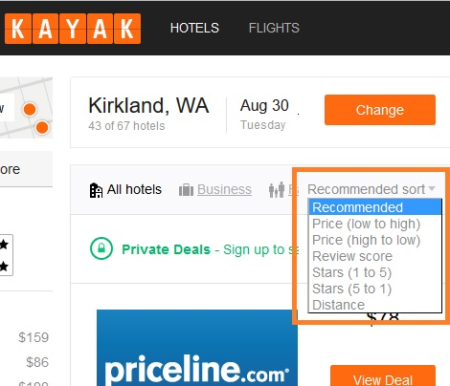
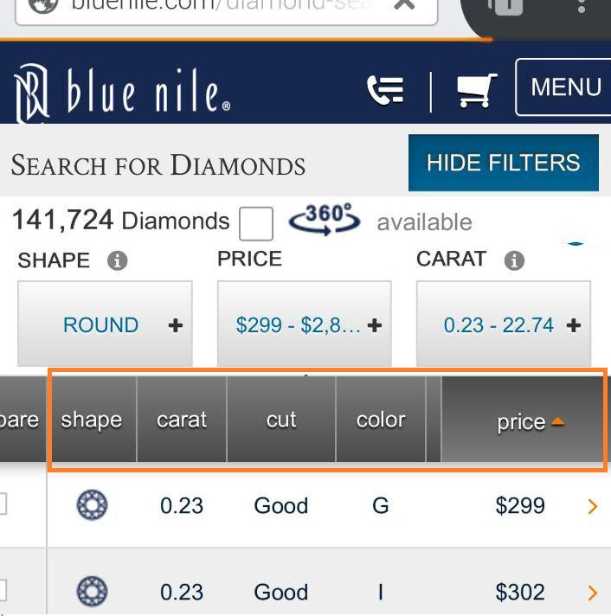

Ranked Retrieval Model

Slide 3
Practical Challenges
How to design a small number of “good” ranking functions when different users often have diverse and sometimes contradicting preferences
e.g., “transit time” in airfare search, “mileage per year” in used car search
Similarly, users with disabilities or special needs often need special ranking functions
Some database owners lack the expertise, resources, or even motivation to properly study the requirements of their users

Slide 4



Motivation
Backend DB
filtering+ ranking
Top-k web Interface
Reranking Service
User

Slide 5
Applications
Meta-Ranking Service
remember user preferences across multiple web databases (e.g., multiple car dealers)
Applications dedicated for users with disabilities, special needs, etc.

Slide 6
Critical Requirements
Accuracy: The output query answer must precisely follow the user-specified ranking function
Versatility: Support a wide variety of user-specific ranking function (so long as it is monotonic). Allow pass-through of selection conditions. No knowledge of system ranking function.
Efficiency: the number of queries issued to the web database must be minimized.
Because almost all such databases enforce certain query-rate limit.
e.g., Google Flights allows only 50 free queries per user per day.

Slide 7
Solution Novelty: Baselines
Crawling the entire database
Problem: efficiency
”Page down” [TZD13a, TZD13b] to retrieve more than k tuples
Problem: no guarantee of accuracy unless retrieving all n tuples

Slide 8

Database Model
Hidden (web) Database
Limited query interface
Ranked Retrieval Model (Top-k)
based on its-own ranking function(s)

Slide 9
Problem Statement
Query Reranking (Get-Next) Problem:
Consider: a hidden web database D with a top-k interface
with an arbitrary, unknown, system ranking function.
Given:
a user query q
a user-specied monotonic ranking function S
the top-h (h ≥ 0 can be greater than, equal to, or smaller than k) tuples satisfying q according to S
Find
the No. (h + 1) tuple for q while minimizing the number of queries issued D.

Slide 10
1D-RERANK

Slide 11
1D Re-Ranking Problem
Given:
An attribute
t_{h}, the h-ranked tuple according to the attribute
Find:
t_{h+1}, the (h+1)-ranked tuple according to the attribute
Why?
1D ➔ MD using TA or Fagin’s algorithm
Rank by “transit time”

Slide 12
1D-BASELINE
q₂
q₁
q₀
NULL
t_{h}
t₁
t_{h+1}
t₀
Problem: the query cost depend on the correlation between the system ranking function and the attribute!
Negative Result: no algorithm can outperform 1D-BASELINE in the worst-case scenario.

Slide 13
1D-BINARY
q₂
q₃
q₁
q₀
NULL
NULL
t_{h}
t₁
t₀
t_{h+1}
query cost:

Slide 14


1D-RERANK
Key Observation: dense regions ➔ repeated incurrence of high query cost for re-ranking
Key Idea: Crawl dense regions to benefit future re-ranking requests (On-The-Fly Indexing)
ask from oracle if region is dense
follow 1D-BINARY
until search region is not dense yet
Oracle

Slide 15
MD-RERANK

Slide 16
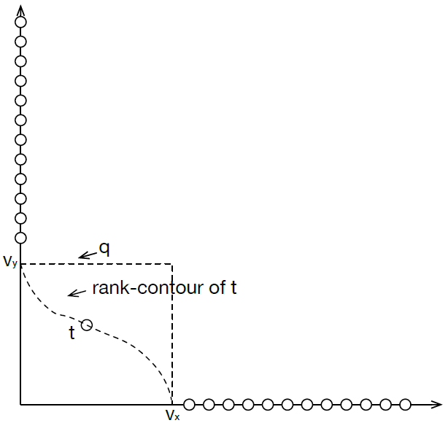
Applying Sorted-List Algorithms (e.g. TA) on 1D-RERANK
The Get-next operation designed by 1D-RERANK can get used to develop a sorted-access top-k algorithm (e.g. TA) on top of it and enable HD Get-next.
It has a major efficiency problem, mainly because of not leveraging the full power provided by client-server databases.

Slide 17
MD-BASELINE
y
apply 1D-RERANK
q0: select * → t₀
q1: where x < t₀[x] and y < l(y) → null
q2: where x ≥ t₀[x] and x < l(x) and y < t₀[y] → t₁
q3: where x ≥ t₀[x] and x < b(x) and y < t₀[y] → null
q4: where x ≥ b(x) and x < I(x) and y < b(y)→ null
q5: where x < t₁[x] and y < t₁[y] → null
l(y)
✓
t₀
t₁
b(y)
x
b(x)
l(x)

Slide 18
MD-BINARY
y
apply 1D-RERANK
l(y)
✓
q0: select * → t₀
q1: where x < t₀[x] and y < l(y) → null
q2: where x ≥ t₀[x] and x < l(x) and y < t₀[y] → t₁
q3: where x ≥ t₀[x] and x < v₀[x] and y < v₀[y] → null
q4: where x ≥ t₀[x] and x < b(x) and y < t₀[y] → null
q5: where x ≥ b(x) and x < I(x) and y < b(y)→ null
q6: where x < t₁[x] and y < t₁[y] → null
t₀
t₁
V₀
b(y)
x
b(x)
l(x)

Slide 19
MD-RERANK
High-level idea: follow MD-BINARY until a remaining search space (1) is covered by a region in the index; or (2) has volume smaller than the threshold.
On-The-Fly Indexing: proactively record as an index densely located tuples once we encounter them, so that we do not need to incur a high query cost every time a query q triggers visits to the same dense region.

Slide 20
Experiments setup
Simulating the Top-k web interface on top of an offline dataset.
US Department of Transportation (DOT): 457,013 tuples and over 28 attributes.
Considered two system ranking functions:
SR1(positively correlated ): 0.3 AIR-TIME + TAXI-IN (SR1) – Default function
SR2 (negatively correlated): -0.1 DISTANCE - DEP-DELAY (SR2)
Default k = 10.
Online Experiments
Blue Nile (BN) diamonds: largest online retailer of diamonds; contained 117,641 tuples (diamonds) over 12 attributes.
Yahoo! Autos (YA): offers a popular search service for used cars; contained 13,169 cars within 30 mile of New York city over 8 attributes.

Slide 21
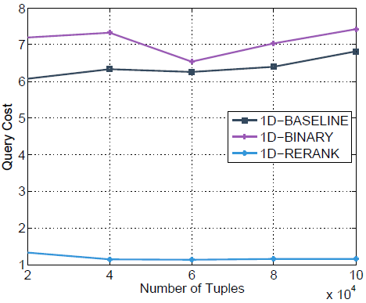
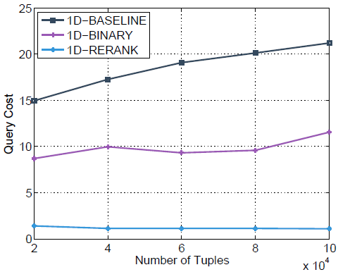
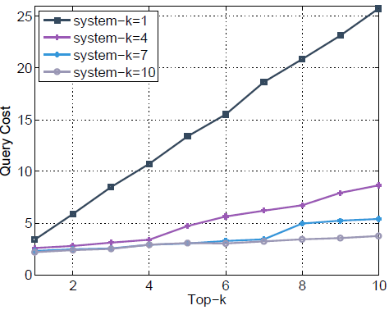
Offline Experiment Results
1D, Impact of n (SR1)
1D, Impact of n (SR2)
1D, Impact of System-k

Slide 22
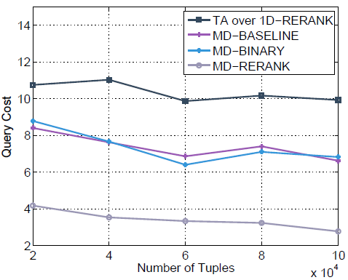
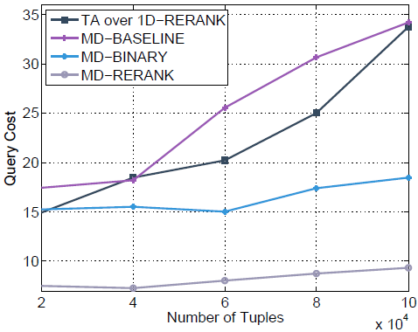
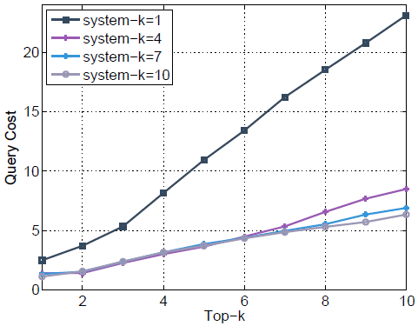
Offline Experiment Results
MD, Impact of n (SR1)
MD, Impact of n (SR2)
MD, Impact of System-k

Slide 23
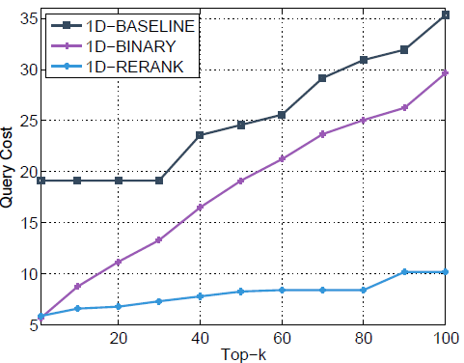
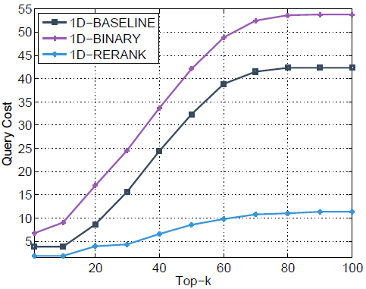
Online Experiment Results
BN, 1D: Top-k query cost
YA, 1D: Top-k query cost

Slide 24
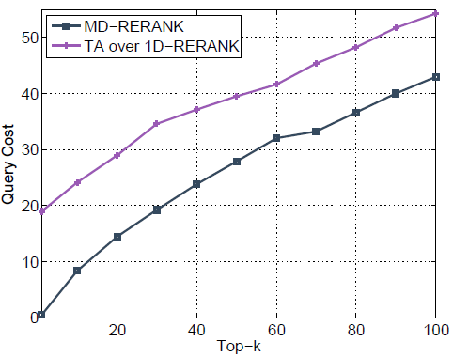
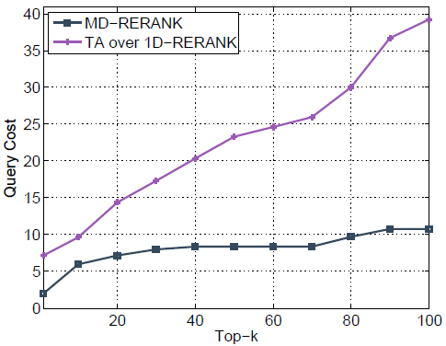
Online Experiment Results
BN, MD: Top-k query cost
YA, MD: Top-k query cost

Slide 25
Thanks!

