Slide 1
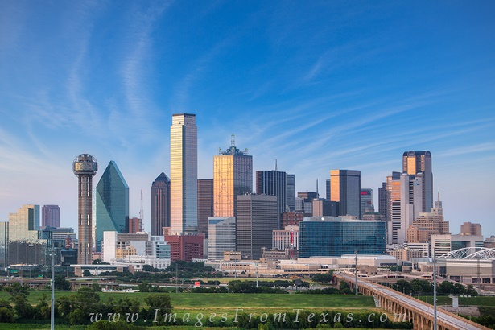



Discovering the Skyline of Web Databases
University of Texas at Arlington
University of Texas at Arlington
George Washington University
University of Texas at Arlington
Abolfazl Asudeh
Saravanan Thirumuruganathan
Nan Zhang
Gautam DaS
© 2016 VLDB Endowment 21508097/16/03

Slide 2


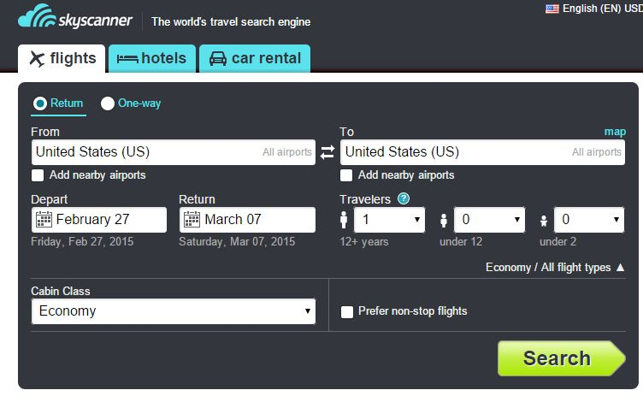
Some Terms
m attributes
Hidden (web) Database
Limited query interface
Limited number of (Top-k) results
t_{i}[A_{j}]
based on its-own ranking function
n tuples
t_{i}
A_{j}

Slide 3


Some Terms
$$a[1.7,0.9,0.5]$$
$$b[1.7,1.1,0.5]$$
Domination
Skyline
$$a≻b$$

Slide 4



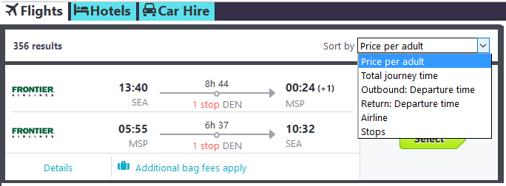

Why this problem?
How to minimize cost per mileage?
What if the user have a different ranking function in mind?
Skyline contains the Top-1 of any monotonic function
any function that does not prefer a dominated tuple over the dominating one
k-sky band contains the Top-k (extension details in paper)
Other applications: Multi-criteria decision making , …

Slide 5
Problem Statement
Wait!
almost all such DBs limit the number of queries per IP
example:
50 free queries per user per day in Google Flight!
Given:
A hidden database D, without knowledge of its ranking function
except being domination-consistent (monotonic)
Find:
all skyline tuples
while minimizing the number of queries issued through the interface

Slide 6

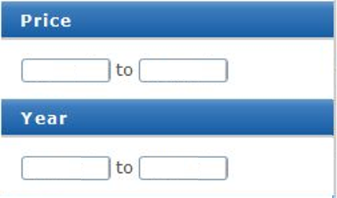
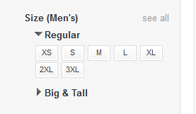
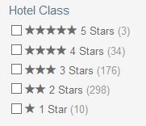
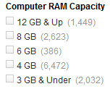
Categories of Search Interfaces
Single-ended range Query predicate (SQ): specify only the upper-bound.
Range Query predicate (RQ): have the freedom to specify lower and upper bounds.
Point Query predicate (PQ): predicated can only be in form of equality.
Mixed Query predicate (MQ): interface contains a mixture of range and point predicates.

Slide 7
SQ Skyline Discovery (SQ-DB-SKY): 2D example
select *
select * where x<t₁[x]
select * where y<t₁[y]
select * where x<t₂[x]
select * where x<t₁[x] and y<t₂[y]
select * where y<t₁[y] and x<t₃[x]
select * where y<t₃[y]
Two queries per skyline tuple → O(S)
S is the skyline size

Slide 8
SQ-DB-SKY: HD example, its problem
select *
q₁:t₃
 | A₁ | A₂ | A₃
t₁ | 5 | 1 | 9
t₂ | 4 | 4 | 8
t₃ | 1 | 3 | 7
t₄ | 3 | 2 | 3
where A₃<7
where A₁<1
where A₂<3
q₃:t₄
q₄:t₄
q₂:null
where A₃<3
and A₁<3
where A₂<2
and A₃<3
and A₁<3
q₁₀:null
q₅:null
and A₂<2
q₆:t₁
q₇:null
q₈:null
and A₁<5
and A₃<9
q₉:null
where A₂<1
q₁₁:null
q₁₂:null
q₁₃:null

Slide 9
SQ-DB-SKY: HD example, its problem
select *
q₁:t₃
It may discover a skyline tuple many times
where A₃<7
where A₁<1
where A₂<3
→ worst-case O(m.S^{m+1})
q₃:t₄
q₄:t₄
q₂:null
where A₃<3
Reason: the intersection between branches is not empty
and A₁<3
and A₃<3
and A₁<3
q₁₀:null
where A₂<2
q₅:null
and A₂<2
q₆:t₁
q₇:null
q₈:null
and A₁<5
and A₃<9
q₉:null
where A₂<1
q₁₁:null
q₁₂:null
q₁₃:null
It cannot get resolved due to the interface limitation
There exists cases in which no algorithm
can do better than O(S^{m})!

Slide 10
RQ Skyline Discovery (RQ-DB-SKY): High-level idea
Here we have the freedom to specify the lower (as well as the upper) bound.
can partition the search space to mutually exclusive sub-spaces
→ discover each tuple at most once!
Example:
q₁: select *
q₂: select * where A₁<t₁[A₁]
q₃: select * where A₁≥t₁[A₁] and A₂<t₁[A₂]
q₃: select * where A₁≥t₁[A₁] and A₂≥t₁[A₂] and A₃<t₁[A₃]
…
Resolution: combine it with SQ-DB-SKY if a query matches one of the previously discovered skylines, switch to partitioning mode
not every returned tuple is skyline!
→ Can be as bad as crawling all the tuple

Slide 11
RQ-DB-SKY: example
select *
×
q₁:t₃
 | A₁ | A₂ | A₃
t₁ | 5 | 1 | 9
t₂ | 4 | 4 | 8
t₃ | 1 | 3 | 7
t₄ | 3 | 2 | 3
where A₃<7 and A₂≥3
where A₂<3
where A₃<7
where A₁<1
q₄:t₄
q₃:t₄
R(q₄): null
q₂:null
and A₁<3
where A₂<2
and A₃<3
q₅:null
q₆:t₁
q₇:null
and A₁<5
and A₃<9
where A₂<1
q₈:null
q₉:null
q₁₀:null

Slide 12
PQ 2D Skyline Discovery (PQ-2D-SKY): example
select * → t₁[5,1]
select * where x=0 → null
select * where x=1 → t₂[1,4]
select * where y=2 → null
select * where y=3 → null
select * where y=0 → t₃[7,0]
Proved to be instance optimal

Slide 13
PQ Skyline Discovery (PQ-DB-SKY): HD
For m>2, the problem changes drastically
unlike in the 2D case, instance optimality becomes provably unachievable!
Even for a greedy solution over all 2D subspaces, PQ-2D-SKY is not directly applicable
→ PQ-2DSUB-SKY
High-level greedy heuristic:
Prune search space based on the first discovered tuple
while search space is not fully explored, Pick the 2D subspace with largest domain sizes and apply PQ-2DSUB-SKY to identify its skylines

Slide 14
MQ Skyline Discovery (MQ-DB-SKY):
The combination of previously discussed algorithms.
High-level idea:
apply the RQ-DB-SKY (or SQ-DB-SKY if one-ended) on range predicates.
Find the dominated-on-range-attributes regions according to the current skylines.
For each point-predicate value that can lead to a new skyline in the dominated regions
check if the query on that value&region contains more than k tuples (while updating the skylines).
If so, crawl the tuples in its 2D subspaces and update the skyline.

Slide 15
Experiments setup
Simulating the hidden DB on top of an offline dataset.
US Department of Transportation (DOT): 457,013 tuples and over 28 attributes.
Online Experiments
Blue Nile (BN) diamonds: largest online retailer of diamonds; contained 209,666 tuples (diamonds) over 6 attributes.
Google Flights (GF): one of the largest flight search services; 4 ordinal attributes.
Yahoo! Autos (YA): offers a popular search service for used cars; contained 125,149 cars within 30 mile of New York city; 3 ordinal attributes.

Slide 16
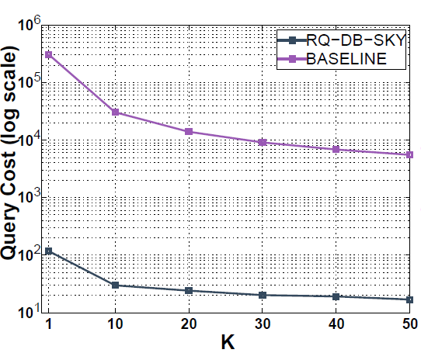
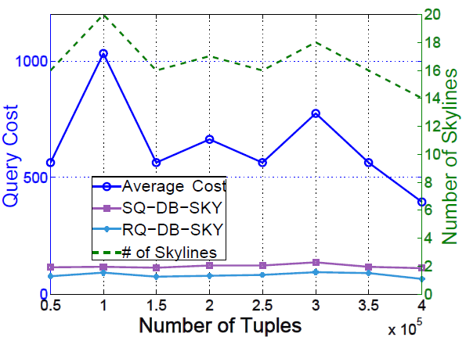
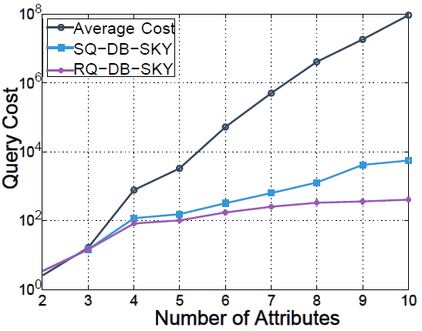
Offline Experiment Results
RQ, Impact of k
RQ, Impact of n
RQ, Impact of m

Slide 17
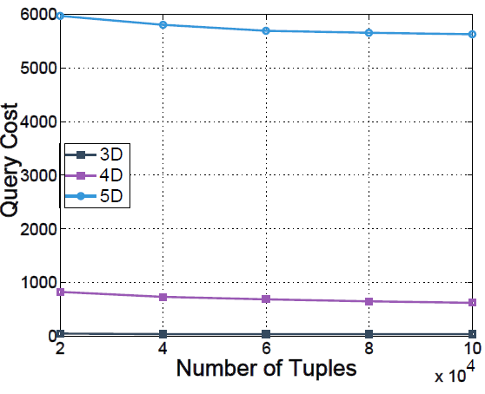
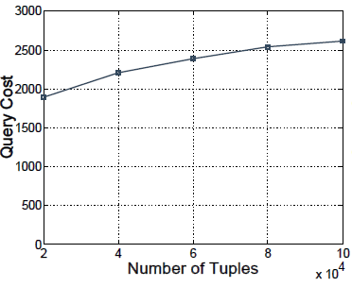
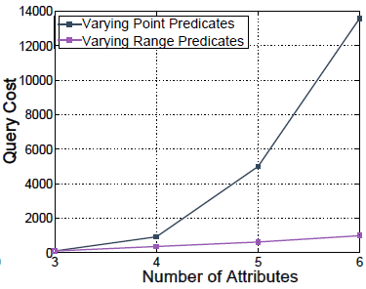
Offline Experiment Results
PQ, Impact of n,m
MQ, Impact of n
MQ, Impact of m

Slide 18
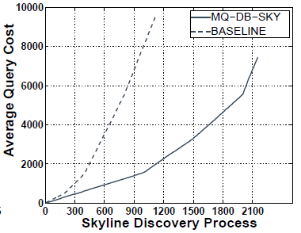
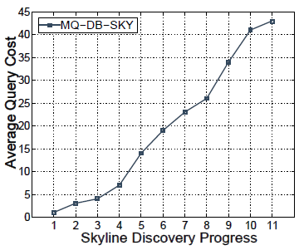
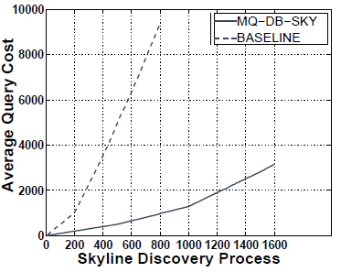
Online Experiment Results
BN, anytime property
GF, anytime property
YA, anytime property

Slide 19
Questions?

