Slide 1


Efficient Computation of Regret-ratio Minimizing Set: A Compact Maxima Representative
University of Texas at Arlington
University of Texas at Arlington
George Washington University
University of Texas at Arlington
Abolfazl Asudeh
Azade Nazi
Nan Zhang
Gautam DaS
SIGMOD’17 © 2017 ACM. ISBN 978-1-4503-4197-4/17/05

Slide 2
Outline
Motivation and Problem statement
2D-RRMS (Two-Dimensional Regret-Ratio Minimizing Set)
HD-RRMS (Higher-Dimensional Regret-Ratio Minimizing Set)
Experiments

Slide 3
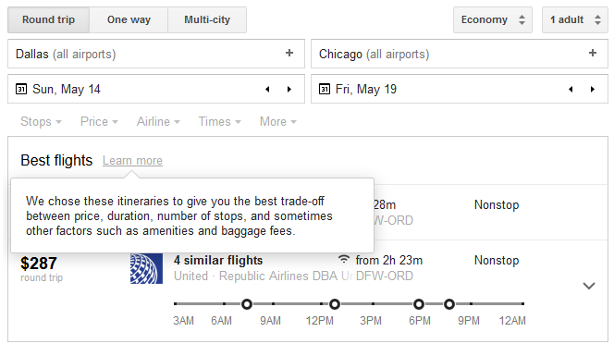

Maxima Queries
… to give the best trade-off b/w
price, duration, number of stops, …
$$f=∑w_{i}A_{i}$$

Slide 4
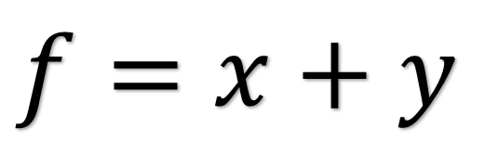
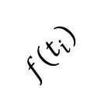

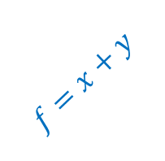
Example
$$t_{i}$$
✓
$$f=x+y$$
$${f(t}_{i})$$
$$f=x+y$$

Slide 5
Example Convex hull (sky convex)
✓
✓
✓

Slide 6
Example
✓
☞
✓
☞
A subset of skyline:
the set of non-dominated points
☞
✓
☞

Slide 7
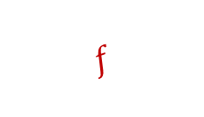
Example Convex hull (sky convex)
✓
$$f$$

Slide 8
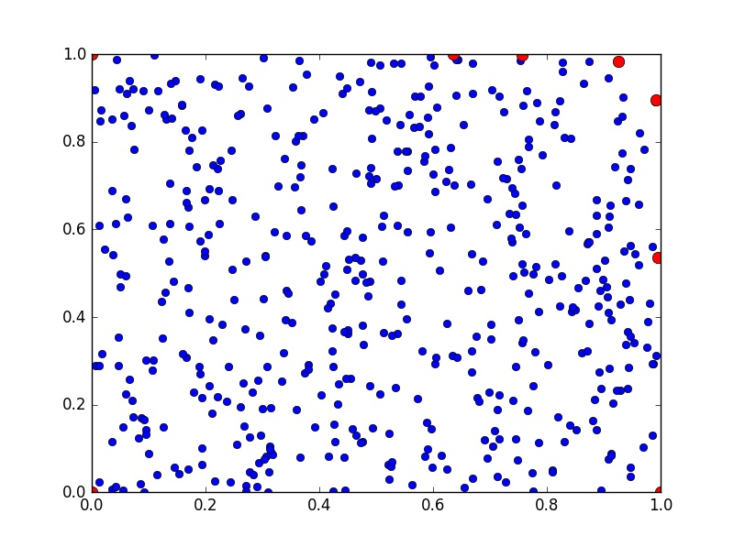
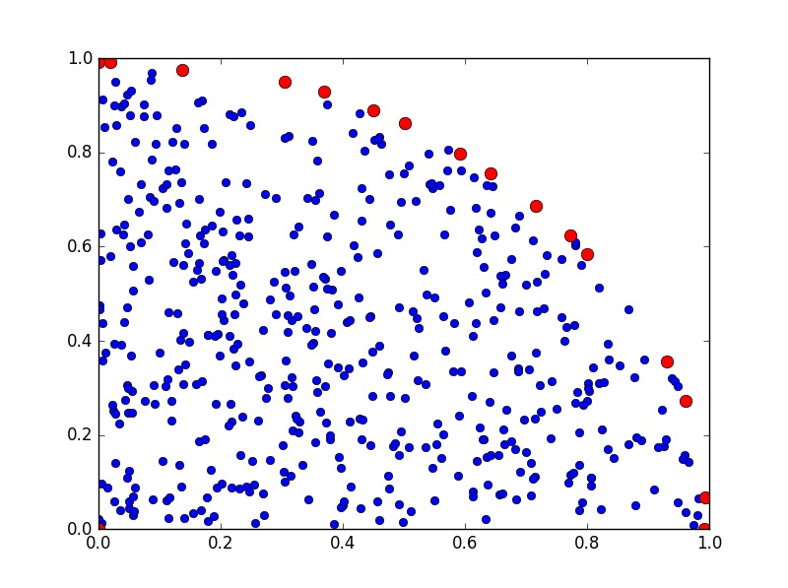
Convex hull size Problem Curvature effect

Slide 9
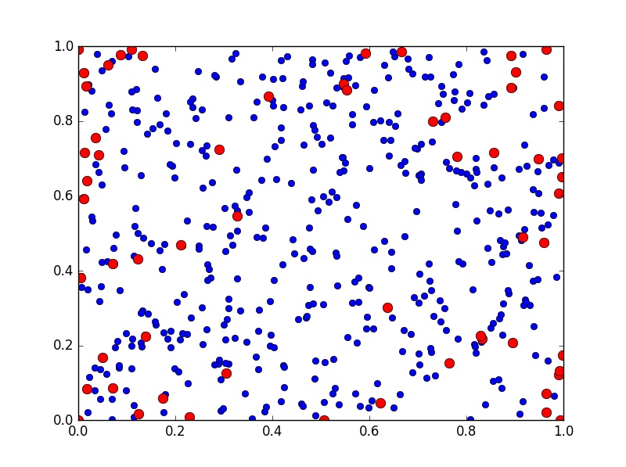
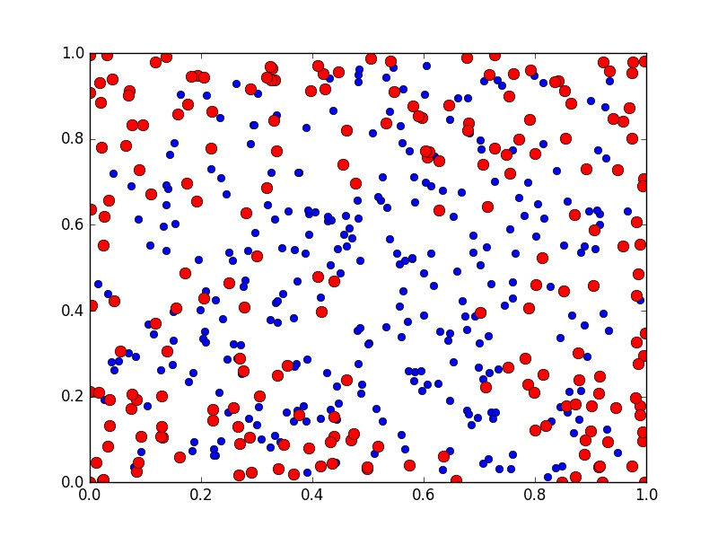
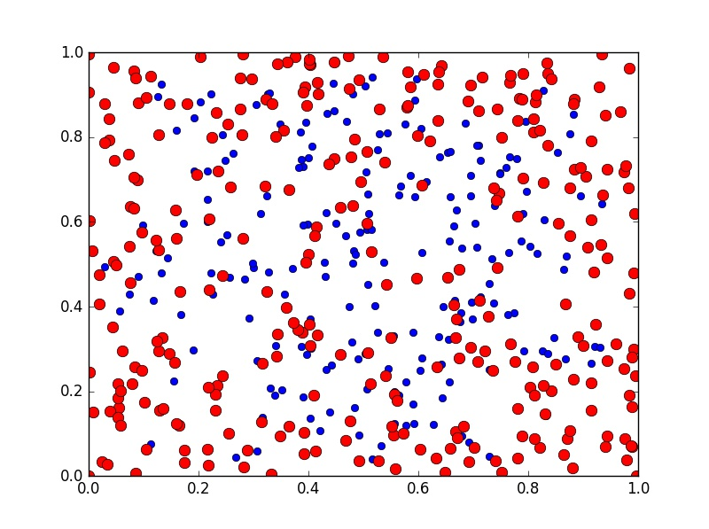
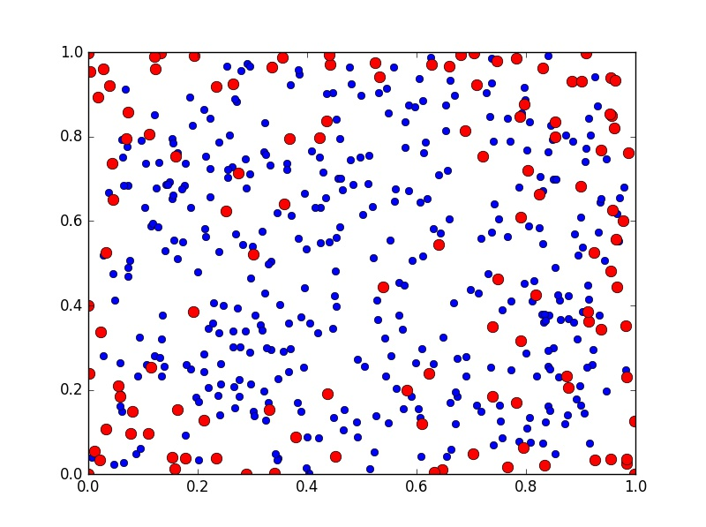
Convex hull size Problem effect of the number of attributes (m)
m=5
m=6
m=2
m=3
m=4

Slide 10
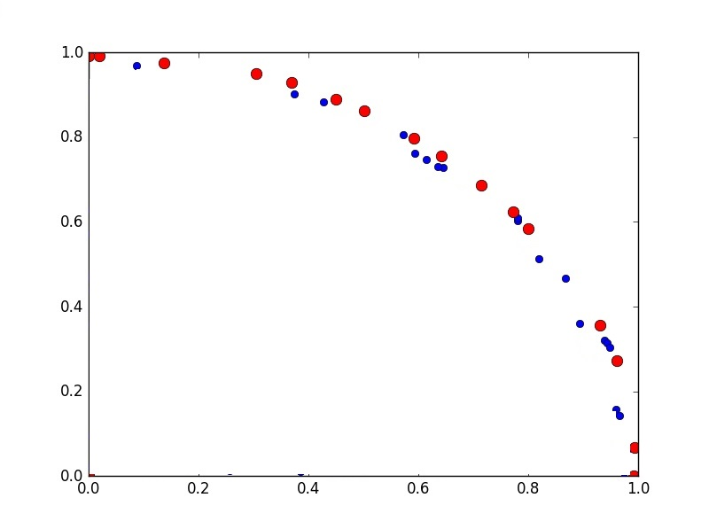



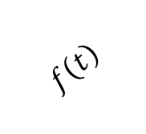
Regret-Ratio Minimizing Set
$$f\left(t\right)−f(t^{′})$$
Problem:
Find a subset of size at most r
that minimizes the maximum
Regret-ratio over all functions
✓
$$\frac{f\left(t\right)−f(t^{′})}{f(t)}$$
✓
$$f\left(t\right)$$
$$f$$

Slide 11
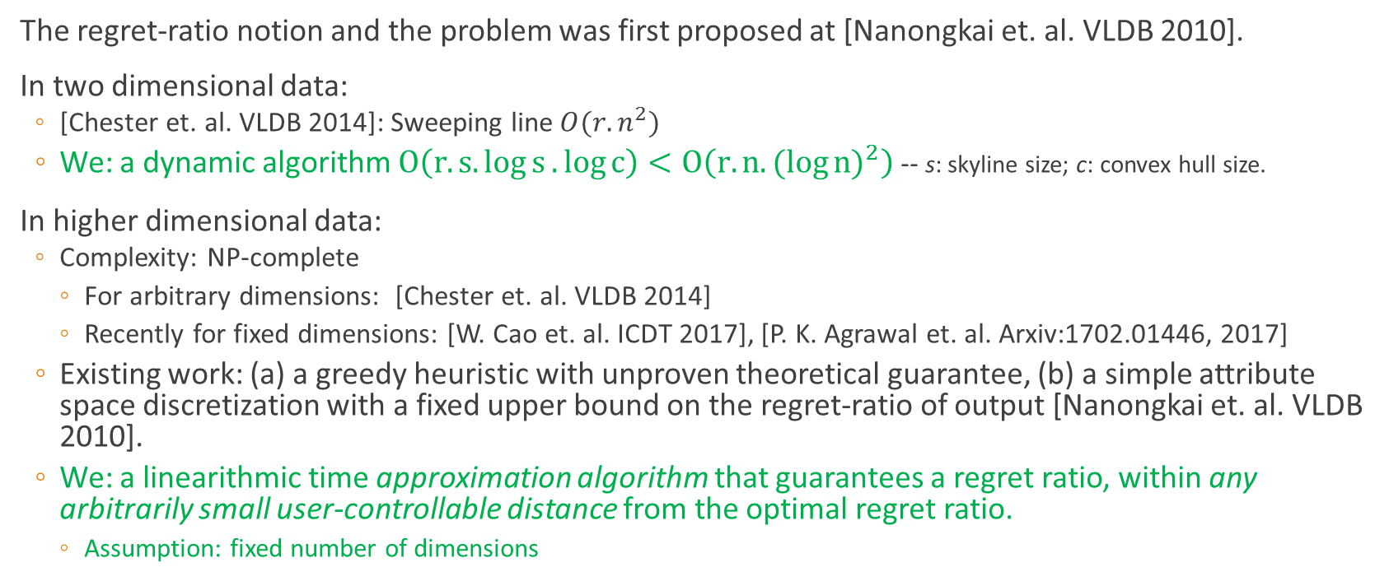
Overview of the literature, Our contributions
The regret-ratio notion and the problem was first proposed at [Nanongkai et. al. VLDB 2010].
In two dimensional data:
[Chester et. al. VLDB 2014]: Sweeping line$O(r.n^{2})$
We: a dynamic algorithm $O\left(r.s.\log{s}.\log{c}\right)<O\left(r.n.{(log{n})}^{2}\right)$ -- s: skyline size; c: convex hull size.
In higher dimensional data:
Complexity: NP-complete
For arbitrary dimensions: [Chester et. al. VLDB 2014]
Recently for fixed dimensions: [W. Cao et. al. ICDT 2017], [P. K. Agrawal et. al. Arxiv:1702.01446, 2017]
Existing work: (a) a greedy heuristic with unproven theoretical guarantee, (b) a simple attribute space discretization with a fixed upper bound on the regret-ratio of output [Nanongkai et. al. VLDB 2010].
We: a linearithmic time approximation algorithm that guarantees a regret ratio, within any arbitrarily small user-controllable distance from the optimal regret ratio.
Assumption: fixed number of dimensions

Slide 12
Outline
Motivation and Problem statement
2D-RRMS (Two-Dimensional Regret-Ratio Minimizing Set)
HD-RRMS (Higher-Dimensional Regret-Ratio Minimizing Set)
Experiments

Slide 13
High-level idea
Order the skyline points from top-left to bottom right, add two dummy points t₀ and t_{s+1}, and construct a complete weighted graph on these points
t₁
✗
t₀
t₂
✗
t₃
Weight of an edge is the Max. regret ratio of removing all the points in its top-right half-space
✗
t₄
✗
t₅
t₆
t₇

Slide 14
High-level idea
t₀
Order the skyline points from top-left to bottom right, add two dummy points t₀ and t_{s+1}, and construct a complete weighted graph on these points
t₁
t₂
t₃
Weight of an edge is the Max. regret ratio of removing all the points in its top-right half-space → use binary search
t₄
t₅
t₆
t₇

Slide 15
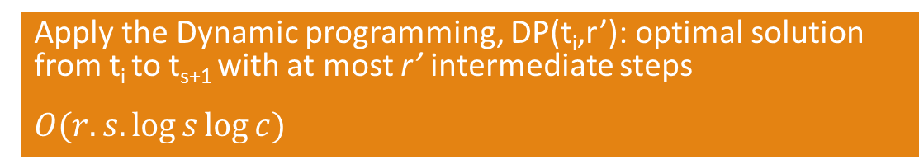
High-level idea
Order the skyline points from top-left to bottom right, add two dummy points t₀ and t_{s+1}, and construct a complete weighted graph on these points
t₁
✗
t₀
t₂
✗
t₃
Weight of an edge is the Max. regret ratio of removing all the points in its top-right half-space → use binary search
✗
t₄
✗
Apply the Dynamic programming, DP(t_{i},r’): optimal solution from t_{i} to t_{s+1} with at most r’ intermediate steps
$O(r.s.\log{s}\log{c})$
t₅
t₆
t₇

Slide 16
Outline
Motivation and Problem statement
2D-RRMS (Two-Dimensional Regret-Ratio Minimizing Set)
HD-RRMS (Higher-Dimensional Regret-Ratio Minimizing Set)
Experiments

Slide 17
Steps
RRMS
Start with a conceptual model
Discuss its problems
DMM
Propose the idea of function space discretization
Transform RRMS to a Min Max problem
MRST
Define the intermediate problem “Min Rows Satisfying a Threshold”
Transform MRST to a fixed-size instance of Set-cover problem

Slide 18

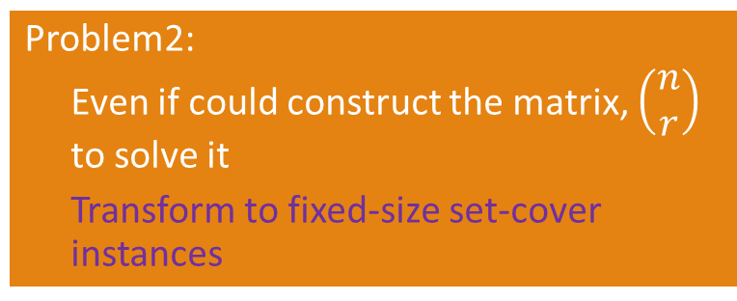
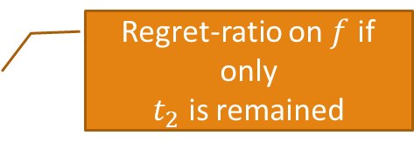


Conceptual Model
F
(all possible functions)
f
$$t_{1}$$
Transform the problem to a min-max problem
Regret-ratio on $f$ if only $t_{2}$ is remained
$$t_{2}$$
Problem1:
F is continuous → infinite number of columns
Matrix Discritization
...
Problem2:
Even if could construct the matrix, $\left(\begin{matrix}n \\ r\end{matrix}\right)$ to solve it
Transform to fixed-size set-cover instances
$$t_{s}$$
Max (
Min
)

Slide 19
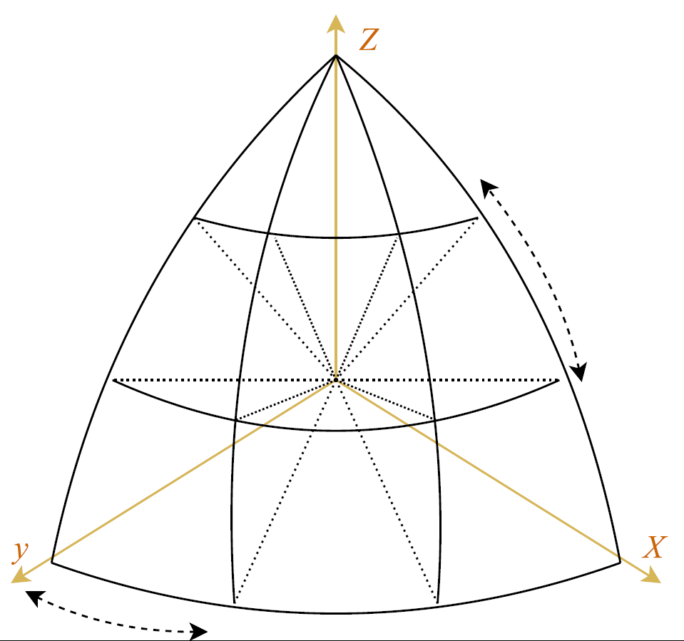
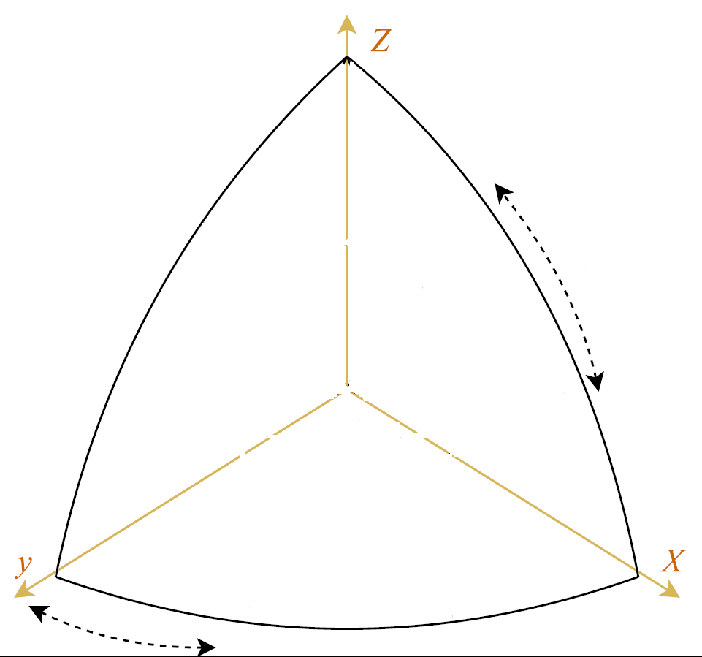
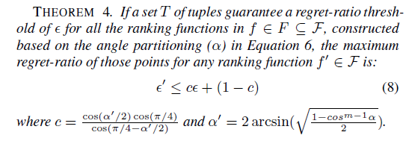
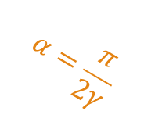


Matrix Discretization
$$θ_{2}$$
f
Arbitrarily small user-controllable distance from the optimal solution
$$α=\frac{π}{2γ}$$
$$θ_{1}$$

Slide 20

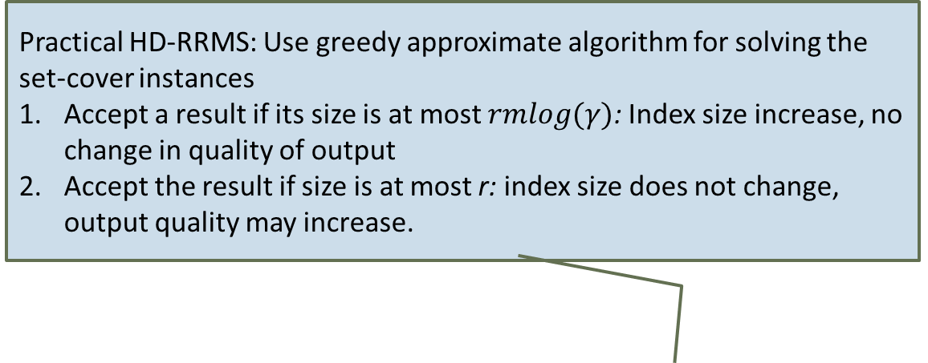

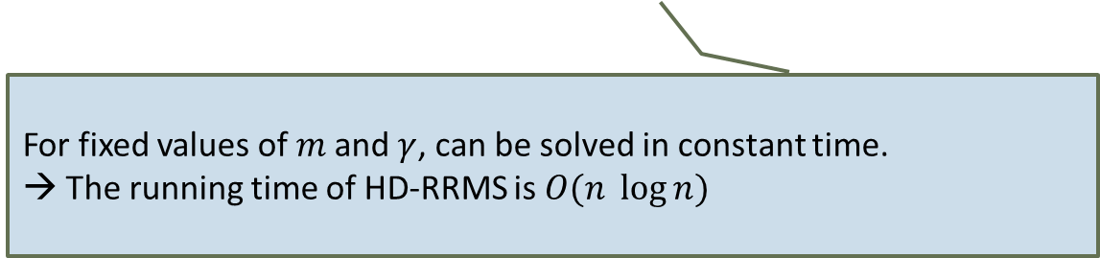


DMM: Discretized Min Max Problem
F (discretized function space)
Practical HD-RRMS: Use greedy approximate algorithm for solving the set-cover instances
Accept a result if its size is at most $rmlog(γ)$: Index size increase, no change in quality of output
Accept the result if size is at most r: index size does not change, output quality may increase.
F
Observation: the optimal regret-ratio is one of the cell values!
F (discretized function space)
(all possible functions)
f
Order the values in M.
Do a binary search over the values and for each value
f
$$t_{1}$$
$$t_{i}$$
$$t_{2}$$
Define an intermediate problem:
Min. rows satisfying the threshold (MRST)
1 if regret-ratio of t for f is at most threshold, 0 otherwise
...
Convert M to a (fixed-size) binary matrix
Convert MRST to a (fixed size) set-cover instance
$$t_{s}$$
For fixed values of $m$and $γ$, can be solved in constant time.
→ The running time of HD-RRMS is $O(n \log{n})$
Max (
Min
)

Slide 21
Outline
Motivation and Problem statement
2D-RRMS (Two-Dimensional Regret-Ratio Minimizing Set)
HD-RRMS (Higher-Dimensional Regret-Ratio Minimizing Set)
Experiments

Slide 22
Setup
Synthetic Data:
Three datasets (correlated, independent, and anti-correlated) 10M tuples over 10 ordinal attributes.
Real-world Datasets
Airline dataset: 5.8M records over two ordinal attributes.
US Department of Transportation (DOT) dataset: 457K records over 7 ordinal attributes.
NBA dataset: 21K tuples over 17 ordinal attributes.

Slide 23
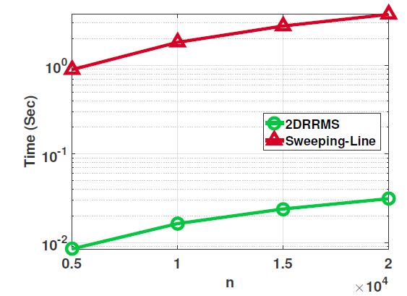
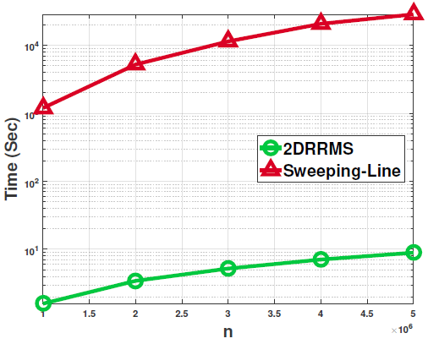
2D-RRMS
NBA dataset
Airline dataset

Slide 24
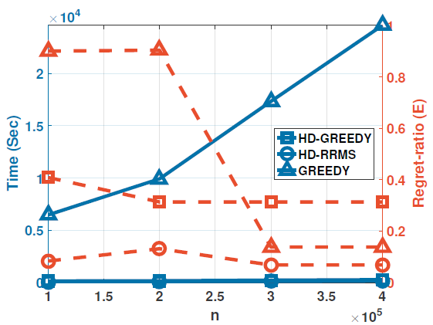
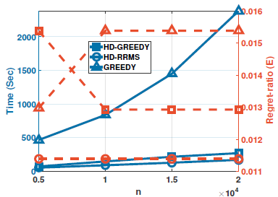
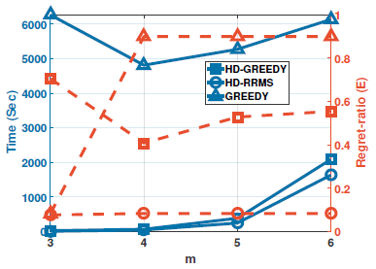
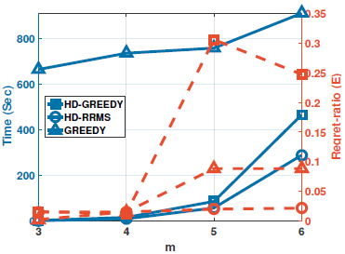
HD-RRMS
DOT dataset
NBA dataset

Slide 25
Thank You!

