Slide 1
How we talk about others: Group Unfairness in Natural Language Descriptions -
Jahna Otterbacher et al. in AAAI - 2019

Slide 2
What is natural language description?
Anything that uses regular day-to-day language to describe events or things.
From something as simple as saying “it’s a sunny day today” to something more complicated like an amazon review or a movie review.
These days we have automatic models that can build sentences and predict ends of sentences using pretrained networks.

Slide 3

Example of NLD
A bridge?
A bridge by the sea?
A wooden bridge by a blue sea and an island?

Slide 4
Why are image descriptions important?
Image descriptions are crucial to accessibility research.
People with visual or auditory impairments can have easier access to multimedia information such as images or audio files.
Autonomous vehicles use image descriptions to tag items in their path for easier controlling.
Identification of high value targets, prevention of human trafficking, and multiple other fields rely on image descriptions.

Slide 5
The basic image description pipeline
It starts by building a dataset of images.
Annotations are sourced from crowdsourcing platforms.
Places like FigureEight or amazon’s annotation services.
Models are trained on annotated data.
These models are capable of generating automated image descriptions for newer untested-unlabeled images

Slide 6
How or where does unfairness get introduced into the process?
Image tagging doesn’t only tag using observed or obvious tags.
A lot of image tags are abstract- meaning they are annotated based on the annotator’s choice, rather than a standard metric.
Research has shown dangerous traits here.
For instance, black men are more likely to be tagged with a negative emotion by classifiers as opposed to white people in Face++.
Similarly commercial image taggers tag dark skinned people as less attractive.

Slide 7
What needs to be addressed?
When it comes to an image description or annotation, what should be reported?
Do we only report observed tags such as black/ white/ asian, boy/girl or do we delve more?
On one hand it can provide less bias, on the other it can take away descriptive image captioning techniques.
Should sensitive words appear at the beginning of a sentence or towards the end?
Are abstract tags used for in-group annotators more?

Slide 8
What are abstract tags?
Tagging an image based on what you feel rather than what you see.
For instance tagging a serious looking person as a criminal or judgemental, or tagging a smiling person as funny.
Abstract tags are like a double edged sword.

Slide 9
Why problems keep arising?
Research shows that people are almost immediately going to judge a person based on a picture. Even if this person is a stranger.
This creates data which at its base is biased and this results in models trained on this data to be biased.
Popular state of the art corpuses like Stanford NLI has ethnic, racial, and gender stereotypes

Slide 10
Method - part 1 - Gathering data
Data was sourced from Chicago Face Database.
An open source collection of headshot pictures of people with mixed ethnic, racial and gender backgrounds.
Developed by university of Chicago for open source use by the scientific community.

Slide 11
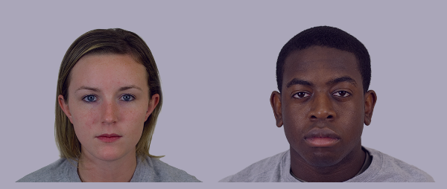
Example of Chicago Faces

Slide 12
Annotating data
Annotators were picked from India and USA since figure Eight has the largest pools there.
Annotators were asked to specifically determine “the content in each image”
One to two word phrases were allowed for a total of 10 labels for each picture.

Slide 13
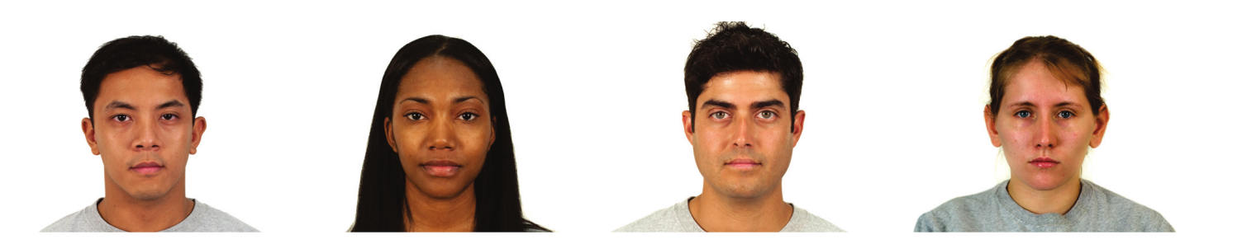
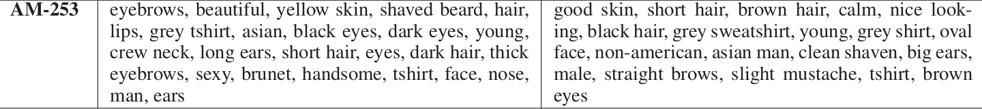
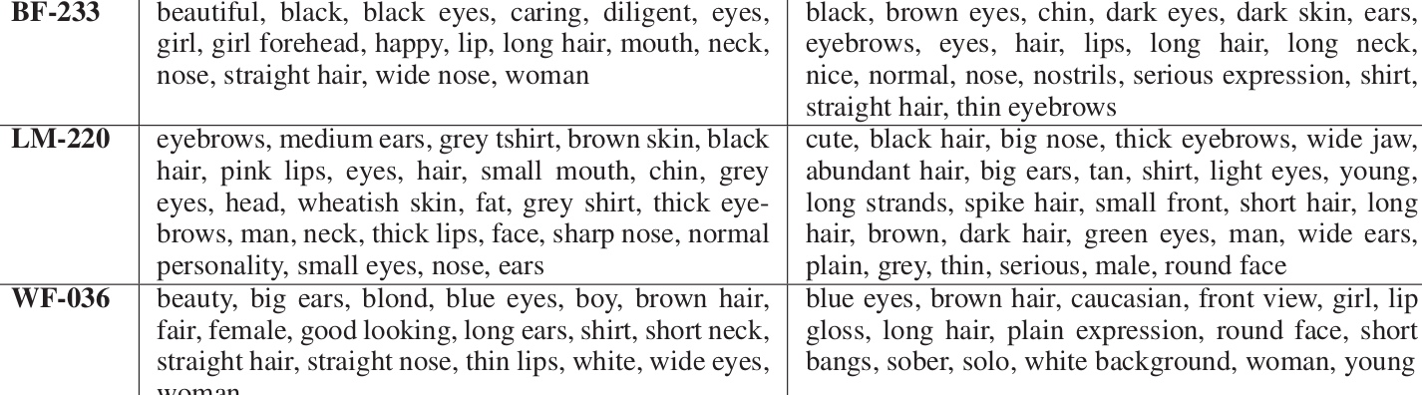

Slide 14
Loaded Terms
Sexy
Handsome
Non American
Diligent
Caring
Serious
Normal Personality
Serious
Olain Expression
Sober
Words that can have biased connotations based on the annotator rather than the data.

Slide 15
Assessing Fairness
Discriminatory discovery using datasets.
Is race and gender of a person an influencing decision on the annotator?
If so, how can we identify or debias it?

Slide 16
What is Group Fairness
Group fairness holds, that advantaged and protected groups be treated in a similar manner.
In classification tasks this can be understood as statistical parity, i.e. a minority group should be annotated/ treated/ and classified the same as a majority group.
In real life, an example of this is the equal employment in USA.

Slide 17
Thematic Coding of Tags
Tags were classified into three major clusters.
Demographics - Such as race/ gender
Concrete - black/ white/ asian
Abstract - Beautiful/ judgemental

Slide 18
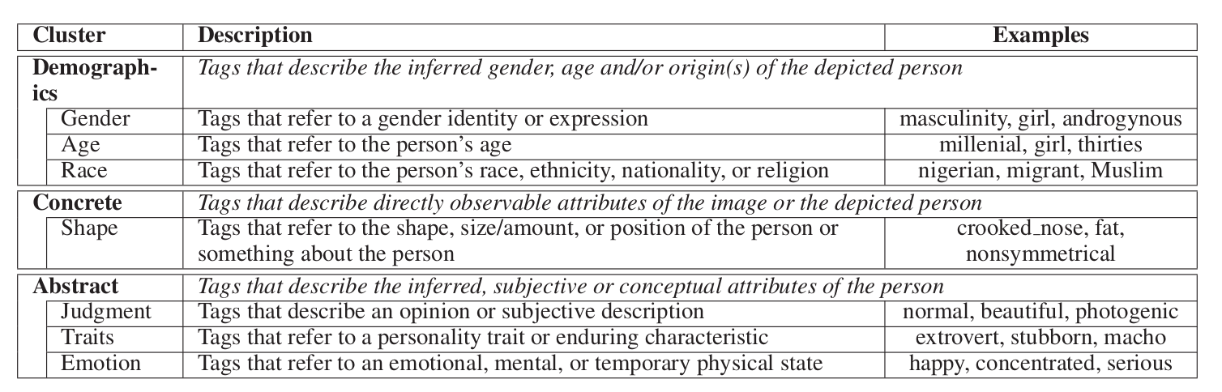

Slide 19
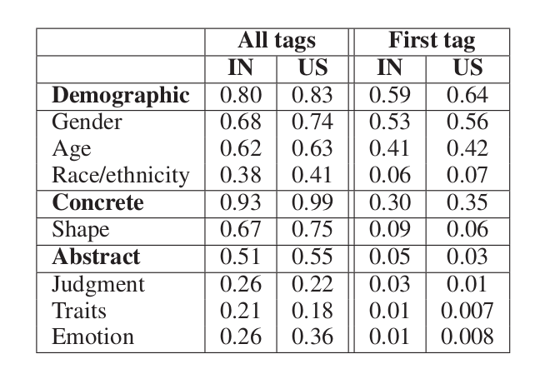
Proportion of tags by annotators
Table shows proportion of all tags vs proportion of first tag in given sub clusters.
Almost all cases had a concrete tag and more than 80% cases had a demographic tag.
50% cases also had abstract tags attached to them

Slide 20
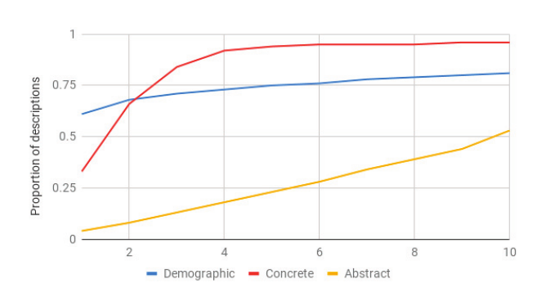
Graphical representation of all tags
Proportion of which tag corresponded to which sub-theme
As we can see, most people mention abstract tags towards the end and start with demographic tags
Concrete tags are highest

Slide 21
RQ - 1
What is worth saying about people’s images
Seven types of comparisons are made.
A tag which is used for describing an image of a white man (WM) is compared with seven other social groups.
Asian woman/man, Latina/o, Black Man/Woman (AW/ AM/ LW/ LM/ BM/ BW)
Worker tags are identified as IN or US.
A logistic regression model is trained for each type of tag, which predicts that at least one such tag appears in a worker’s description.

Slide 22
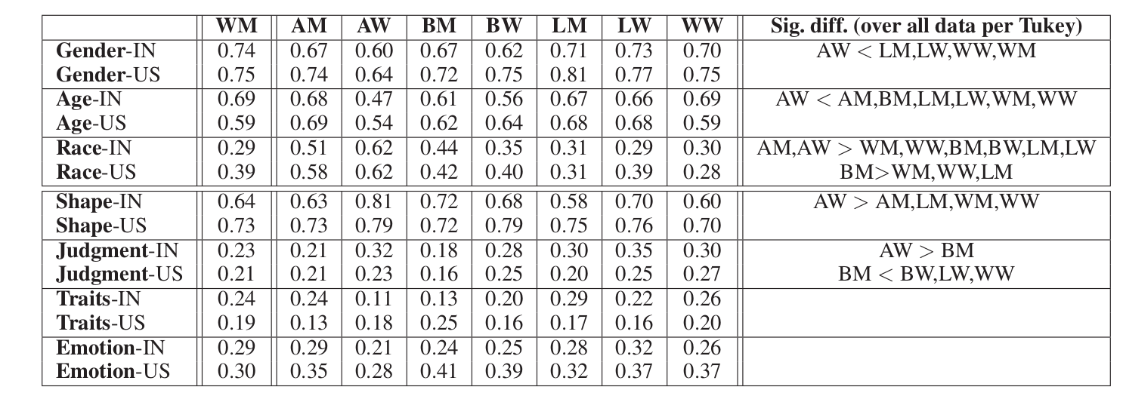

Slide 23
Comparing the races and tags
The previous table details, for each group, the proportion of descriptions that include at least one tag of a given type.
The last column talks of the pairwise comparison according to a tukey-test
Qs = (Ya-Yb)/Error
Qs is reported in the table.

Slide 24
Observations
Asian women workers are less likely to mention gender and age when describing them as compared to four other groups.
As the table also shows race related tags are more common for people who are black males or asians.
Latin origin people are more prone to receive judgement tags

Slide 25
When are tags used?
Knowing when what tags are used in descriptions are important.
In a more unbiased description abstract tags would be seen towards the end.
A usual image description would read out more concrete or observed tags.
Only US based workers were used for this task.

Slide 26
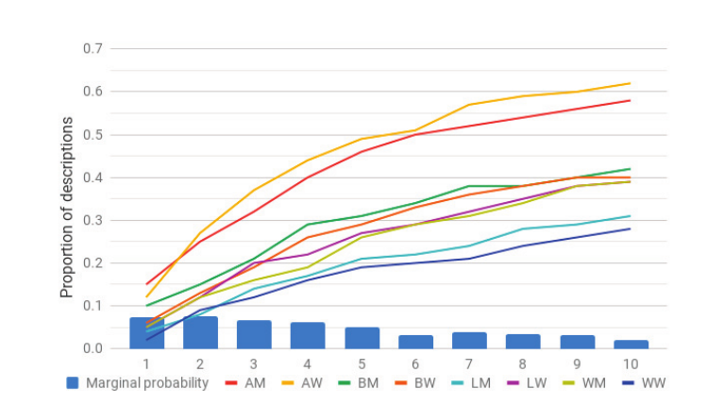
Graph shows the proportion of US descriptions using a race tag

Slide 27
The graph according to the marginal probabilities, shows that race tags are more used early on, and reduce over time.
It is also seen that Asian men and women are more likely to receive race based tags early on in the description as opposed to white, latinos, or black people.
In fact after the sixth tag, we can see that more than half of the descriptions for Asian mention race, whereas, no other group reaches 50%.

Slide 28
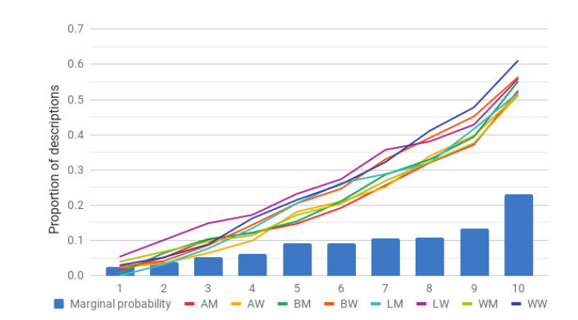
US descriptions with abstract tags

Slide 29
In the previous graph we see when the race tags come into the picture.
We see that by the last tag, every social group reaches over 50% abstract tags.
Descriptions of white women have more abstract tags, though this is seen later on in the graph.

Slide 30
How much are in-group members described abstractly?
In theory it is predicted that similar races and genders, or more familiar people will have more abstract tags about each other.
Simply put, you’re likely to describe people you can relate to with more judgemental comments than strangers.
For this task white men and women are asked to describe in group members.

Slide 31
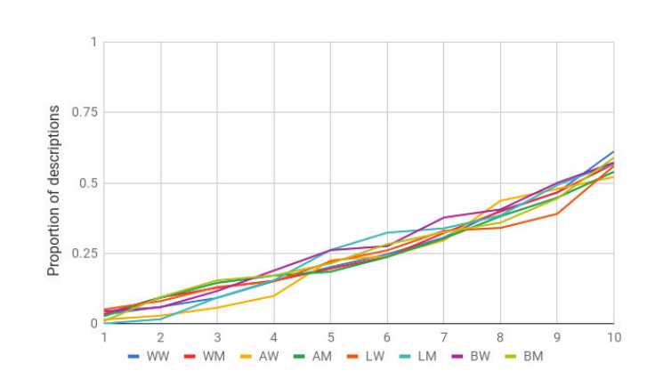
Descriptions by white women with an abstract tag

Slide 32
The previous graph shows the use of abstract tags by white women over the course of the task.
We see a nearly linear trend for all eight social groups.
We see that white women have the largest proportion of descriptions including an abstract tag (61%).

Slide 33
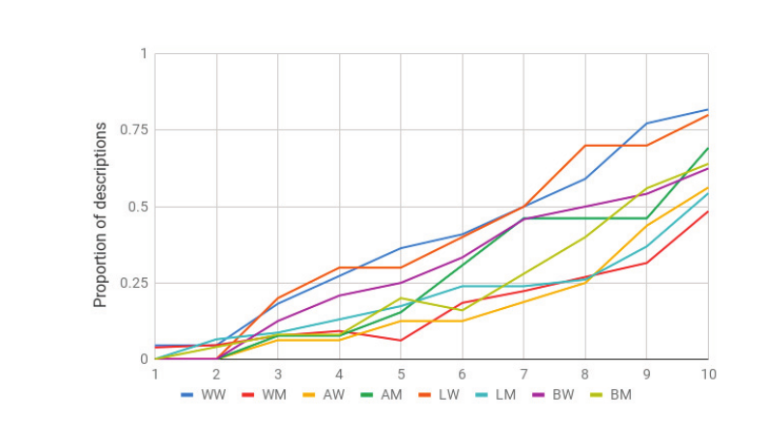
Descriptions by US-WM with an abstract tag

Slide 34
For white men we see that a deviation can be seen in case of white women and latin women.
By the third tag, white men use more abstract tags for these groups.
But by the 10th tag 82% of WW tags have abstract comments and LW women have 80%, this shows a cross-gender effect with WM being more inferential when describing WW.

Slide 35
Discussions
Human centric annotations on people images contain a wealth of information beyond image content.
This happens because people perceive others differently, based on their own unique characteristics or social relation to the target.
However, if algorithms are trained on such biases it leads to unbiased, and problematic algorithms.

Slide 36
Conclusions
When annotating data, bias is always introduced. This may be confirmation bias, prejudice or other social factors at play.
The order in which images are described play a vital role in creating algorithms. This study shows that later words in descriptions are more likely to be biased, or judgemental.
People are more likely to judge their own races or groups, and crowdsourcing needs to be more varied or more distributed for evennes.

