Slide 1
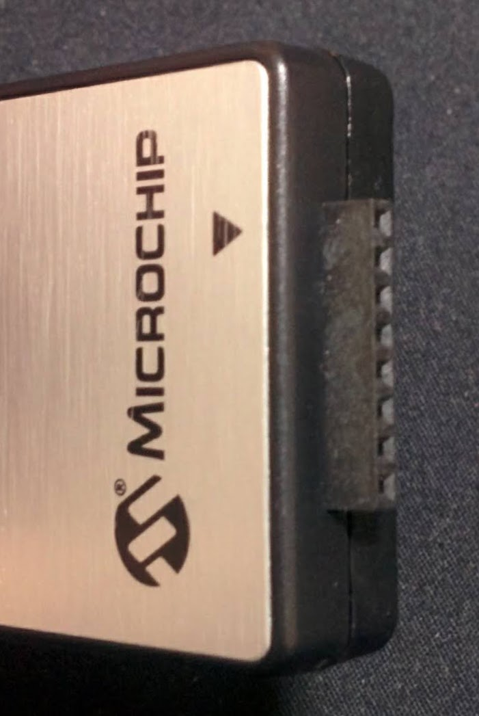
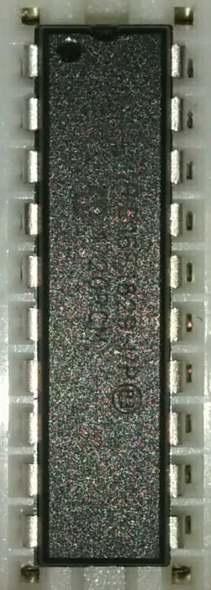
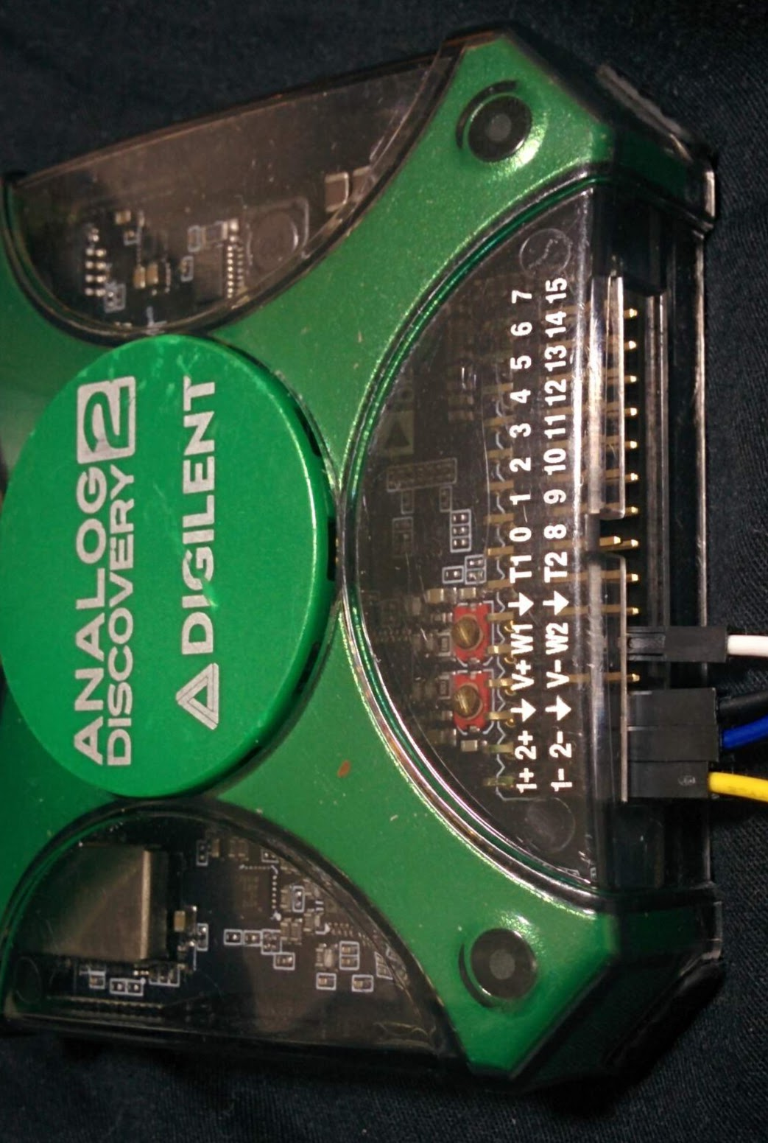
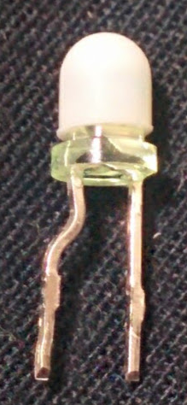
Vdd
RA5
RA4
MCLR
RC5
RC4
RC3
RC6
RC7
RB7
Vss(GND)
ICSPDAT
ICSPCLK
RA2
RC0
RC1
RC2
RB4
RB5
RB6
10k
MCLR
Vdd
GND
ICSPDAT
ICSPCLK
1-
1+
2-
2+
W1
GND
1k

