Slide 1
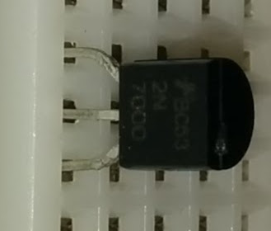
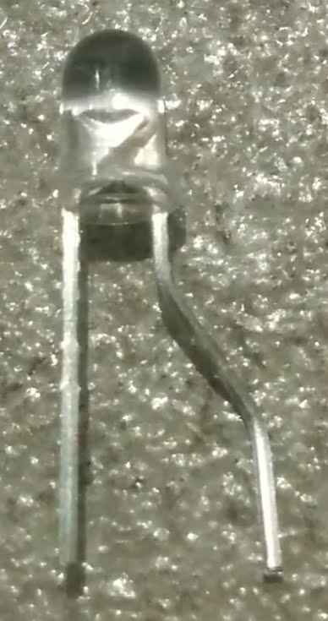
Arduino
Source
Gate
Drain
5V
GPIO
GND
100Ω

Slide 2
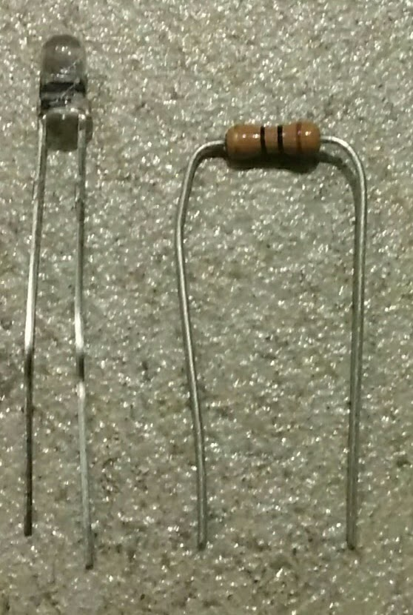
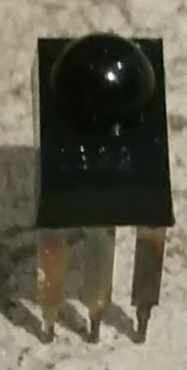
Arduino
Arduino
5V
GPIO
GND
GPIO
GND

