Slide 1
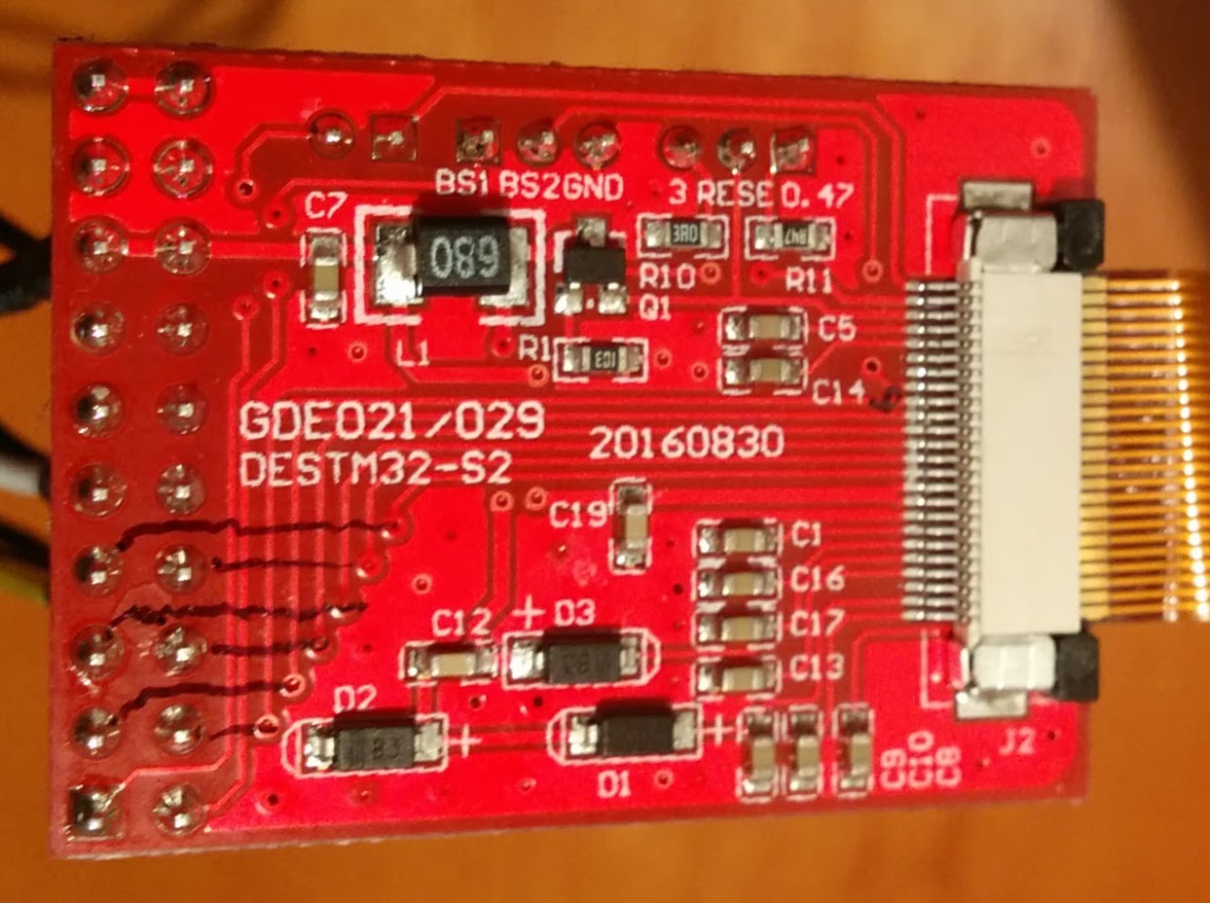
Raspberry Pi
3V3
VDD
GND
GND
MOSI
SCLK
CE0
IO25
IO17
IO24
DIN
CLK
CS
DC
RESET
BUSY

