Slide 1
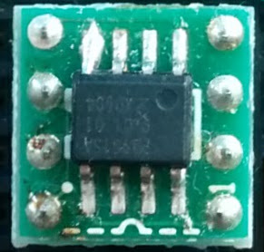
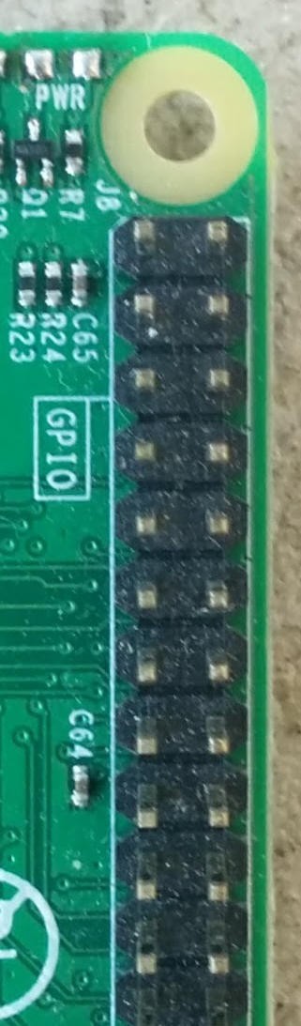
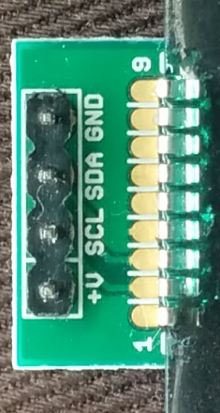
3V3
SDA
SCL
VCC
SCL1
SDA1
SCL1
SDA1
GND
GND

