Slide 1
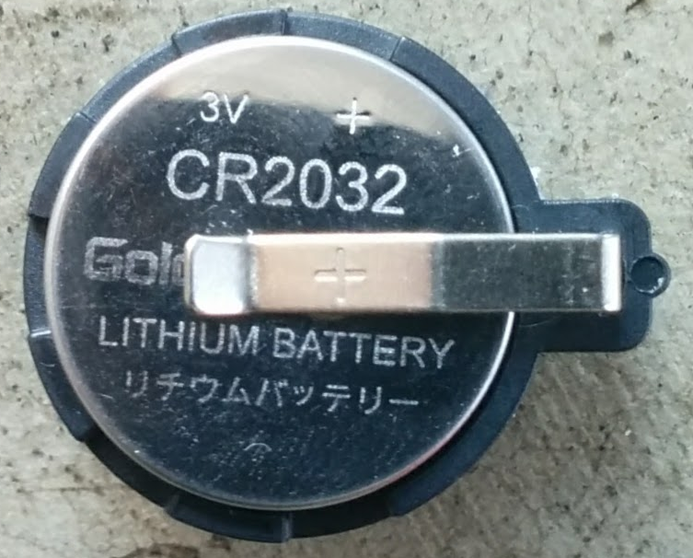
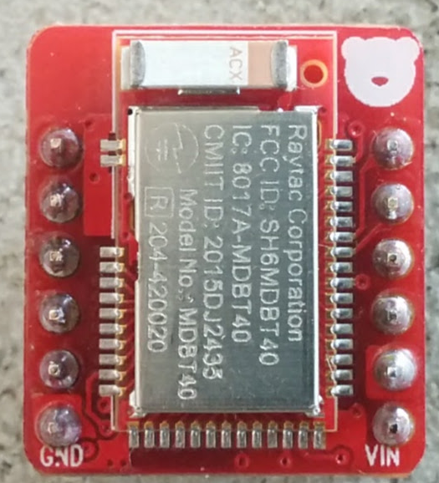
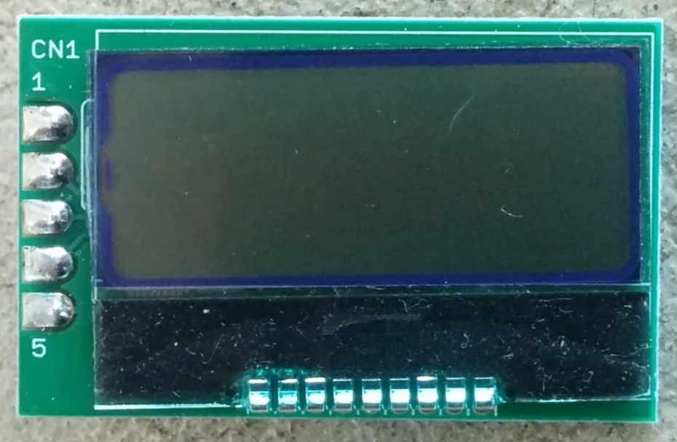
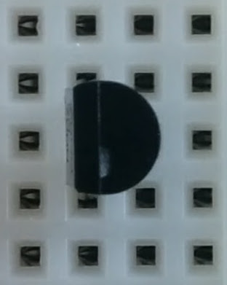
VDD
SDA (D2)
D1
D0
SCL (D3)
GND
GND
3V
VDD
RESET
SCL
SDA
GND
Drain
Gate
Source
1KΩ

