Slide 1
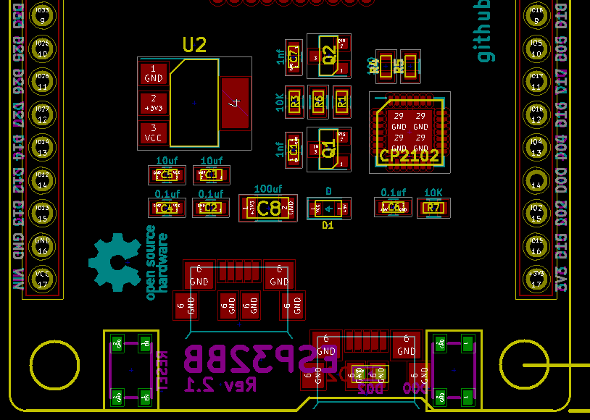
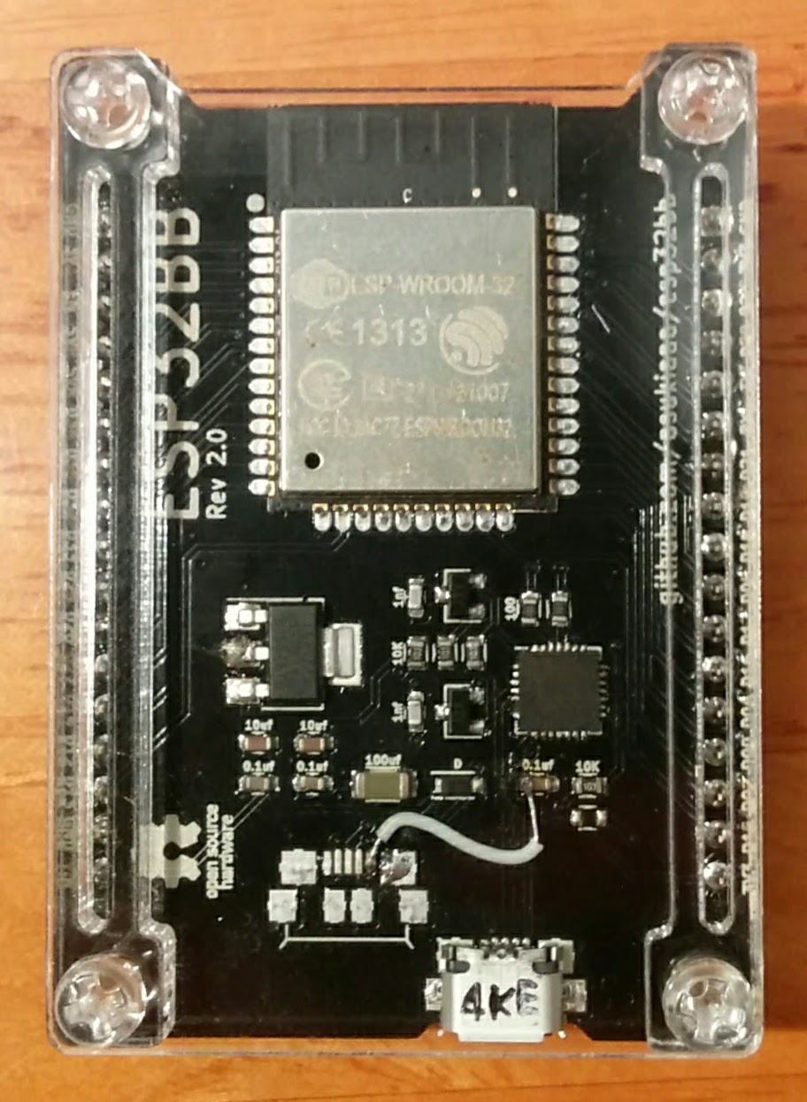
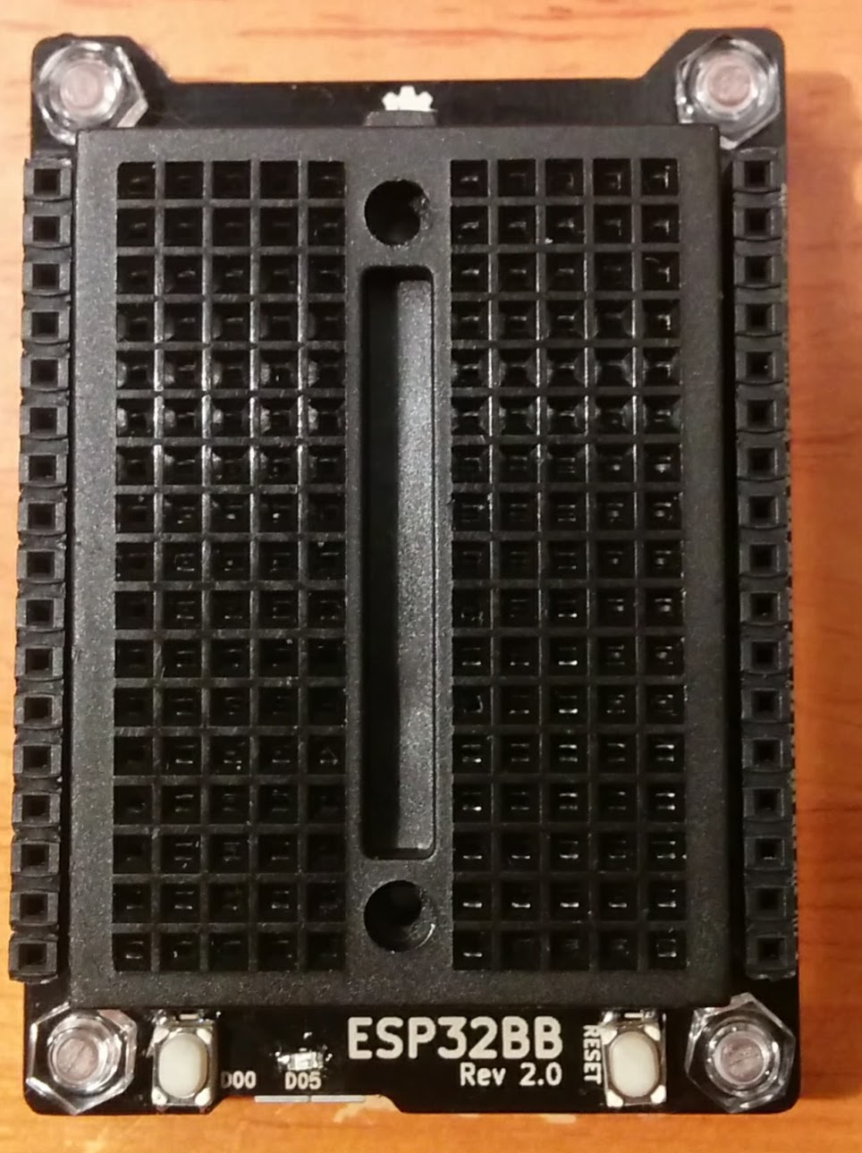
Component labels
Front side
Back side
ESP32 module that has
TELEC mark
Please
ignore
bread
board
1x17
Pin
Socket
(female)
←
Diode
Diode
→

