Slide 1
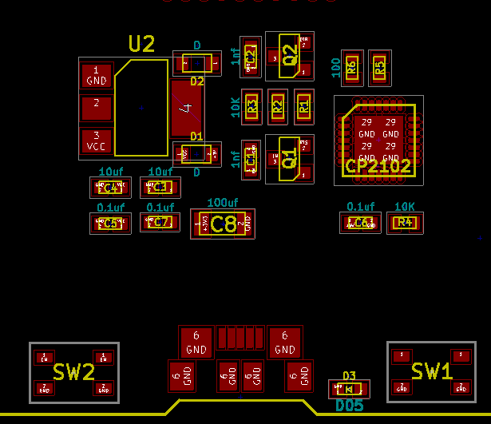
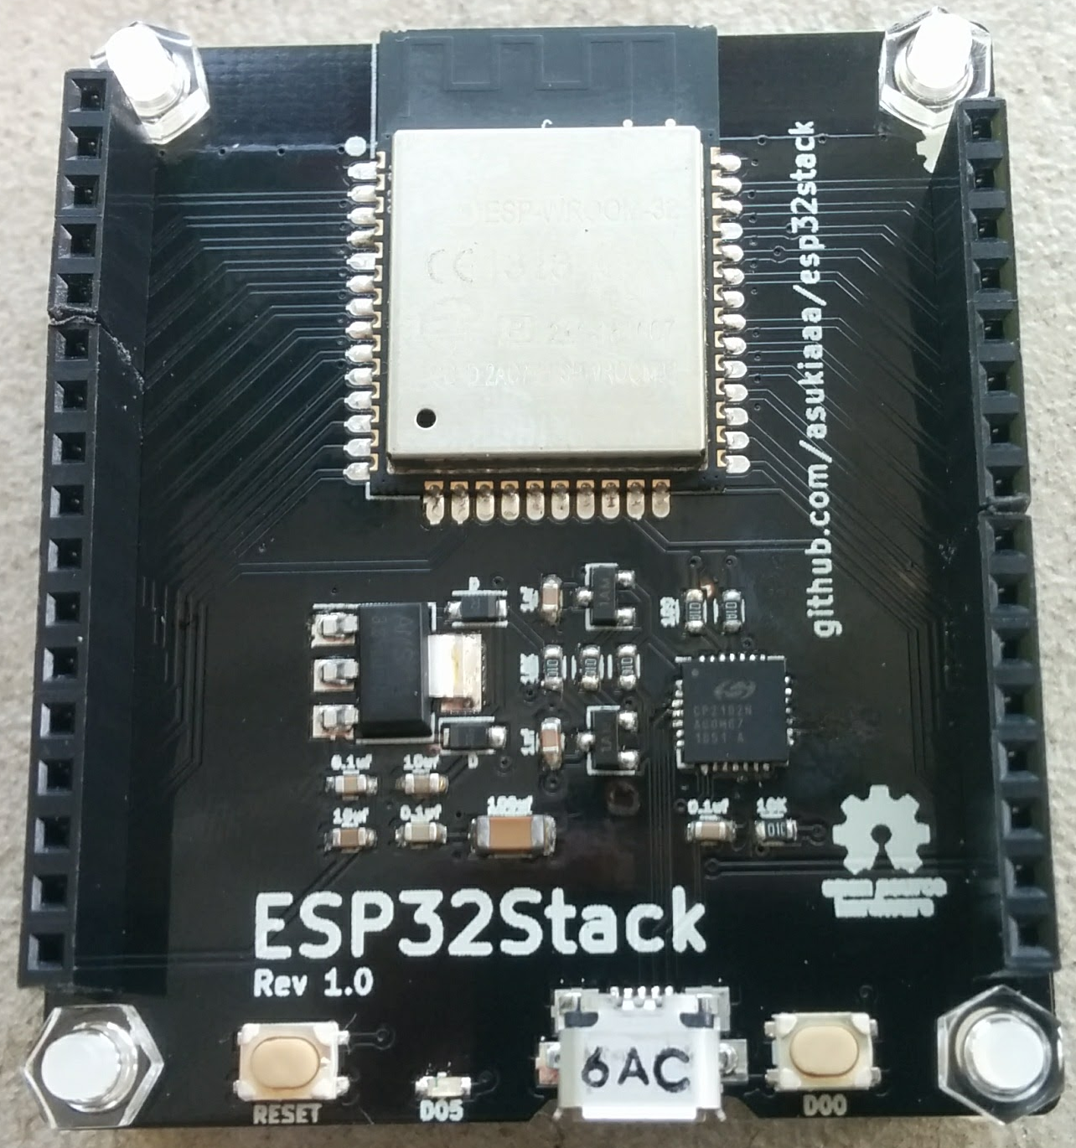
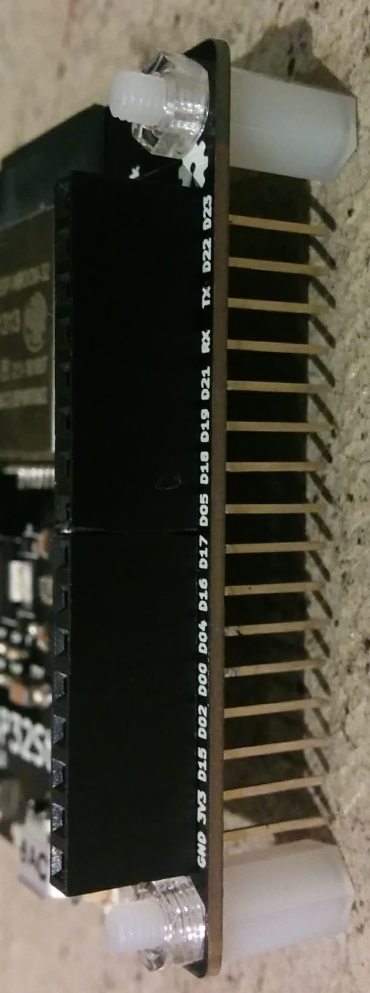
Component labels
Front
Side
ESP32 module that has
TELEC mark
Diode
→
Long leg
pin socket
(female)
←
Diode
Diode
←

