Slide 1
Cross-Family LLM-Judge Agreement for Institutional RAG
A 5-Family, 9-Judge Ablation with Mechanism + External Validation
Adisak Sukul
Iowa State University
asukul@iastate.edu · 2026-04-28
P4 — LONG
1/34

Slide 2
Outline
• §1 Introduction — the which-judge problem
• §2 Related work — 2025 inter-LLM-judge cluster
• §3 Methodology — corpus, 9 judges, rubric, pipeline
• §4 Within-corpus results — metrics, calibration tiers, κ matrix
• §5 Findings — C1, C2, C3, C4
• §6 Mechanism — joint distribution R²=93%, mediation, tokenizer refutation
• §7 External validation — NIST TREC RAG 2024 + BEIR scifact + coverage
• §8 Limitations · §9 Reproducibility · §10 Conclusion
P4 — LONG
2/34

Slide 3
The which-judge problem
RAG over institutional corpora has no gold relevance set; LLM-as-Judge fills the gap — but which judge?
• No gold qrels for institutional corpora — TREC-style ground truth needs hundreds of expert hours per topic
• Generic IR benchmarks (BEIR, MS-MARCO) don't transfer — web-style queries on web-style corpora
• LLM-as-Judge surfaces a new question: WHICH judge? Sonnet vs GPT-5 vs Gemini vs Qwen vs Gemma?
• Prior work compares within ONE provider family, or two-family pairs without ordinal weighting, or excludes open-weight peers entirely
• Open-weight judges are the default for sovereign-cloud and privacy-conservative institutions — excluding them silently endorses commercial-only practice
P4 — LONG
3/34

Slide 4
Four contribution claims
First multi-family pairwise κ matrix with within-family controls AND open-weight as first-class judges
• C1: Cross-family reasoning judges converge at κ ≥ 0.75 — well above the 0.4-0.6 typical baselines
• C2: Within-family agreement is BOUNDED by the cross-family ceiling (no within-family pair dominates)
• C3: Open-weight judges (Qwen × Gemma 4) produce the matrix-highest within-pair κ = 0.80 at ~1% of commercial cost
• C4: Open-source toolkit (eval_llm_judge.py, validate_against_trec.py) + community disclosure template
• Plus: §6 mechanistic decomposition (R²=93% from joint distribution; tokenizer hypothesis refuted)
• Plus: §7 external validation against NIST TREC RAG 2024 qrels (ensemble κ = 0.4941 on 537 stratified-balanced pairs)
P4 — LONG
4/34

Slide 5
Related work — 2025 inter-LLM-judge agreement cluster
Work | Families covered | Within-family pairs | Open-weight as 1st-class | κ metric
UMBRELA [2024] | 1 (deployed) | no | no | %agreement
Balog 2025 | 1 | yes | no | Cohen κ
Farzi 2025 | 1 | no | no | Cohen κ
Thakur 2025 | 2 (GPT-4o, Llama) | no | partial | unweighted κ
Han 2025 | judge↔human only | — | — | Cohen κ
Ours | 5 | 4 controls | yes (Qwen × Gemma) | qw-Cohen κ
GAP: no published paper, to our knowledge, reports a multi-family pairwise κ matrix that includes BOTH within-family controls AND open-weight peers as first-class judges at ≥ 500 quadratic-weighted ordinal observations. P4 closes that gap with 5 families × 4 controls × 9 judges × 570 pairs (within) + 537 pairs (NIST external).
P4 — LONG
5/34

Slide 6
Corpus and query set — Iowa State University DSpace
• ISU DSpace: 97,441 full-text PDFs → 1.03M chunks (≤500 words, 100-word overlap)
• Embedding: Google Vertex text-embedding-005 in Qdrant 1.13 HNSW (M=16, ef_construct=100, cosine)
• Query set: REFINE-synthesized 57 queries [Sukul, forthcoming]
• Intents: factoid / methodological / comparative / author-style — balanced across 5 intents
• Coverage: 12:11:12:11:11 across 20 topic clusters
• Top-10 retrieval per query → 570 (query, document) pairs scored by all 9 judges
• Score variance is purely judge-level — same documents, same order, no retrieval randomness
P4 — LONG
6/34

Slide 7
Judge slate: 9 judges across 5 families, 4 within-family pairs
# | Judge | Family | Reasoning | Route
1 | Claude Opus 4.7 | Anthropic | yes | OpenRouter
2 | Claude Sonnet 4.6 | Anthropic | yes | OpenRouter
3 | GPT-5.5 (reasoning=low) | OpenAI | yes | OpenAI direct
4 | GPT-4o (chat) | OpenAI | no | OpenAI direct
5 | Gemini 3.1 Pro Preview | Google-commercial | yes (thinking) | OpenRouter
6 | Gemini 2.5 Pro | Google-commercial | yes (thinking) | OpenRouter
7 | DeepSeek V4 Pro | DeepSeek | yes | OpenRouter
8 | Qwen 3.6 Plus | Open-weight | no | OpenRouter
9 | Gemma 4 26B | Open-weight | no | OpenRouter
Within-family pairs: Anthropic (1↔2), OpenAI (3↔4), Google-commercial (5↔6), Open-weight cross-organization (8↔9). All 9 judges score the same 570 (query, document) pairs from ISU DSpace (97k full-text PDFs) — score variance is purely judge-level. Versions pinned 2026-04-25.
P4 — LONG
7/34

Slide 8
Rubric — bounded 0-3 ordinal scale
Score | Definition | Example trigger
0 | Irrelevant — document does not address the query at all | Topic mismatch
1 | Topically related — mentions the topic but does not answer | Background context only
2 | Partially answers — provides some of what the query asks for | Direct mention but incomplete
3 | Fully answers — directly answers the query | Specific, complete information
Calibrated at prompt time with FIVE worked examples drawn from a held-out seed set. Documents truncated to 1,500 chars to control verbosity bias [Saito 2023]. Quadratic weighting on disagreements: a 0↔3 disagreement counts 9× a 0↔1 disagreement — captures the ordinal structure that simple percent-agreement loses.
P4 — LONG
8/34

Slide 9
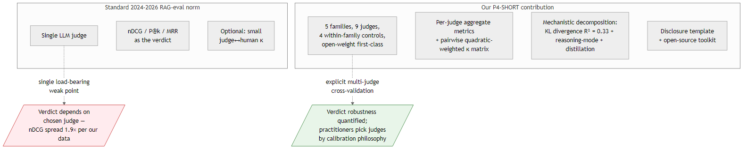
Multi-judge pipeline — ThreadPool fan-out vs standard single-judge
P4 — LONG
9/34

Slide 10
Per-judge retrieval metrics — same documents, different verdicts
Judge | Family | nDCG@10 | P@5 | MRR | Mean
Sonnet 4.6 | Anthropic | 0.862 | 0.649 | 0.826 | 1.68
GPT-5.5 (low) | OpenAI | 0.846 | 0.600 | 0.792 | 1.63
DSV4 Pro | DeepSeek | 0.835 | 0.702 | 0.883 | 1.63
GPT-4o | OpenAI | 0.803 | 0.361 | 0.575 | 1.15
Qwen 3.6 | Open-weight | 0.758 | 0.379 | 0.599 | 1.18
Gemma 4 26B | Open-weight | 0.753 | 0.375 | 0.573 | 1.11
Opus 4.7 | Anthropic | 0.749 | 0.372 | 0.536 | 1.09
Gemini 2.5 Pro | Google | 0.624 | 0.281 | 0.486 | 0.76
Gemini 3.1 Prev | Google | 0.454 | 0.158 | 0.315 | 0.37
Same retrieved documents → nDCG@10 between 0.45 and 0.86 — a 1.9× spread driven entirely by judge selection. Two practitioners running identical retrieval code, scoring with different flagship judges, can arrive at OPPOSITE go/no-go decisions. Disclosure template (C4): "nDCG@10 = X.XX via [family]/[model]/[reasoning], N pairs, DATE".
P4 — LONG
10/34

Slide 11
Three calibration tiers — under None=0 vs valid-only accounting
Judge | Mean (None=0) | Mean (valid) | Tier (valid-only)
Sonnet 4.6 | 1.68 | 1.72 | Reasoning-generous
GPT-5.5 (low) | 1.63 | 1.63 | Reasoning-generous
DSV4 Pro | 1.63 | 1.67 | Reasoning-generous
Opus 4.7 | 1.09 | 1.26 | Strict-mid
GPT-4o | 1.15 | 1.15 | Strict-mid
Qwen 3.6 | 1.18 | 1.18 | Strict-mid
Gemma 4 26B | 1.11 | 1.11 | Strict-mid
Gemini 2.5 Pro | 0.76 | 1.45 | Transitional → strict-mid (revised)
Gemini 3.1 Prev | 0.37 | 1.17 | Strict-mid (revised, was outlier)
STRICT-OUTLIER tier dissolves under valid-only accounting — Gemini judges' apparent strictness was a missing-data artifact (Gemini 3.1 Prev: 68.4% None rate; 2.5 Pro: 47.9%). Both open-weight judges (mean 1.11-1.18) calibrate with strict-mid commercial models (GPT-4o, Opus 4.7) — non-obvious given the training-compute gap.
P4 — LONG
11/34

Slide 12
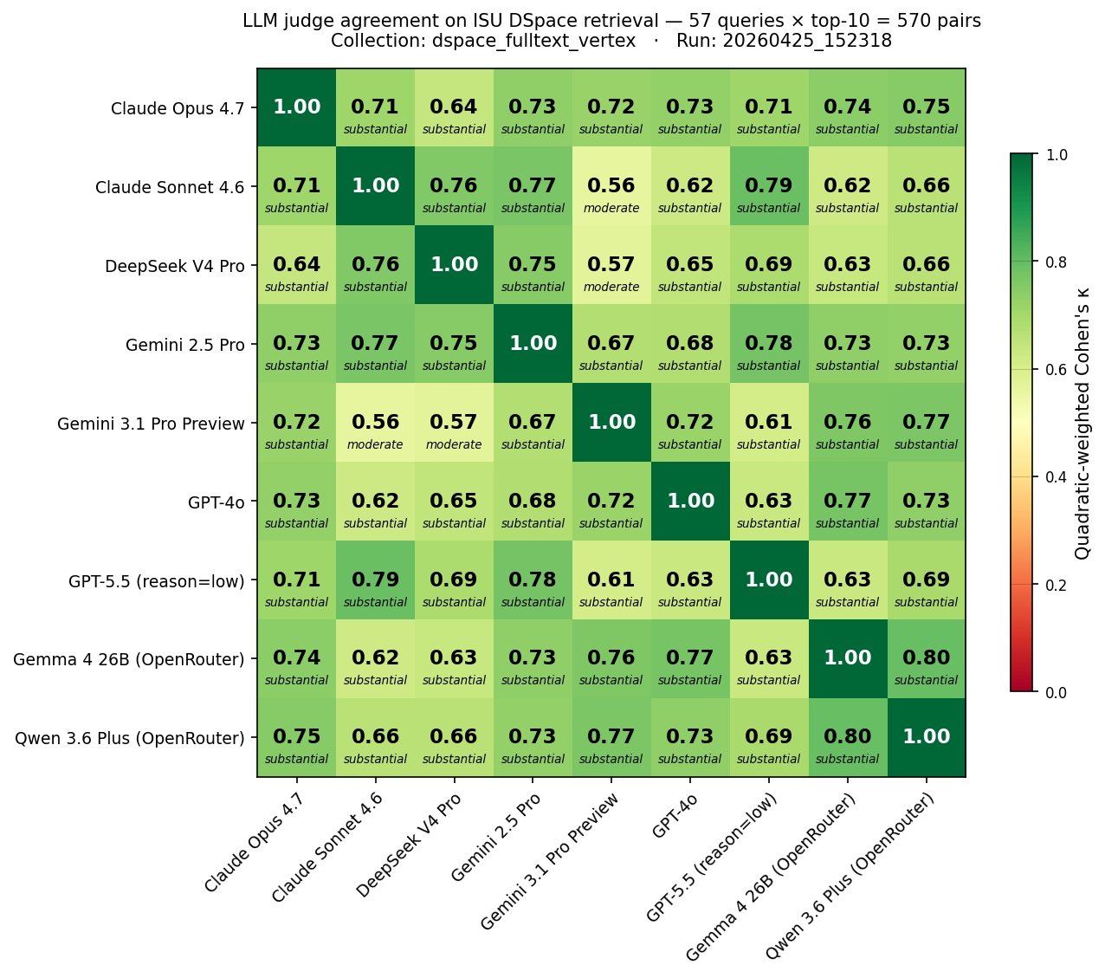
9×9 pairwise κ matrix — every off-diagonal ≥ 0.56
Quadratic-weighted Cohen's κ on 570 pairs · two clusters · cross-org open-weight = 0.80 (matrix-highest)
P4 — LONG
12/34

Slide 13
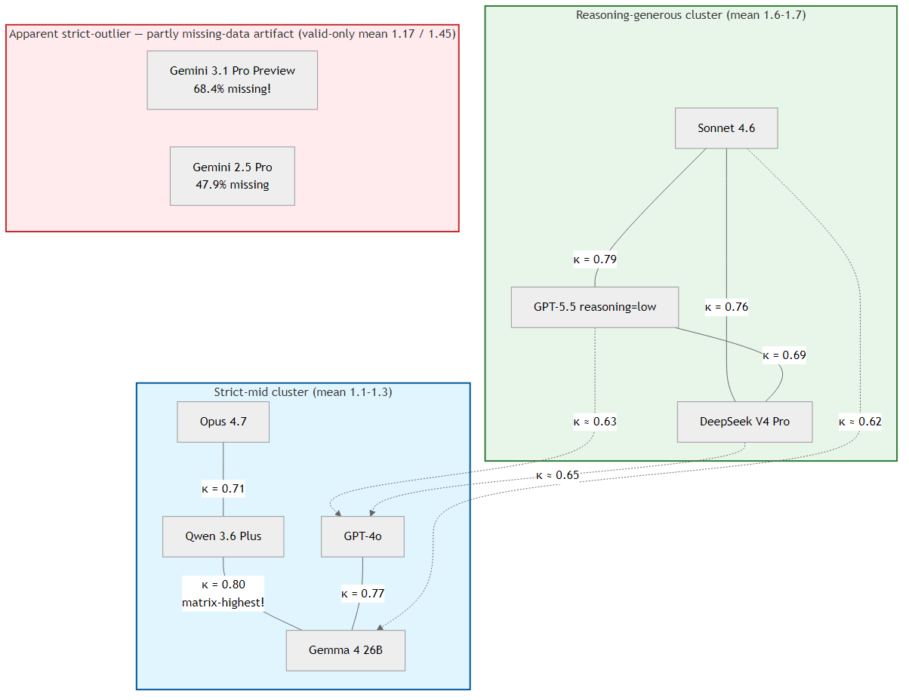
Calibration clusters — calibration philosophy > provider lineage
P4 — LONG
13/34

Slide 14
C1: Cross-family reasoning judges converge at κ ≥ 0.75
• Five cross-family pairs reach substantial-or-better κ (Sonnet ↔ GPT-5.5 = 0.79, Qwen ↔ Gemma 4 = 0.80, etc.)
• Well above the 0.4-0.6 typical of prior art [Rahmani 2024] and the 0.60 unweighted baseline of [Thakur 2025]
• DeepSeek V4 Pro joining the cluster RULES OUT a Western-training-data common-cause explanation
• Pattern replicates across three independent ablation scales (5-, 7-, 9-judge) within run-to-run noise
• EXTERNAL CORROBORATION: 9-judge ensemble achieves κ = 0.49 against published NIST qrels on TREC RAG 2024 — the convergence is not specific to our institutional corpus
P4 — LONG
14/34

Slide 15
C2: Within-family agreement is BOUNDED by the cross-family ceiling
Within-family pair | κ | vs cross-family ceiling (0.79)
Anthropic (Opus ↔ Sonnet) | 0.71 | below
OpenAI (GPT-5.5 ↔ GPT-4o) | 0.63 | below
Google-commercial (Gemini 3.1 ↔ 2.5) | 0.67 | below
Cross-organization Open-weight (Qwen ↔ Gemma 4) | 0.80 | MATRIX MAX
No within-family pair DOMINATES — at odds with self-preference findings on open-ended generation [Panickssery 2024]. Our companion 4-way extraction study reports within-family agreement ~2× cross-family on open-vocabulary tasks; the inversion under bounded ordinal judging suggests SELF-PREFERENCE IS MEDIATED BY OUTPUT-SPACE BOUNDEDNESS, not provider lineage. In a 4-class output space, the dominant signal is calibration philosophy, which crosses provider lines.
P4 — LONG
15/34

Slide 16
C3: Cross-org open-weight = matrix-highest κ at ~1% of commercial cost
• Qwen 3.6 Plus ↔ Gemma 4 26B = κ 0.80 — exceeds every commercial within-family pair
• Both calibrate with strict-mid commercial models (mean 1.11-1.18), NOT with reasoning-generous (1.63-1.68)
• Marginal cost ~USD 0.30 (vs ~USD 18 for the commercial 7-judge frontier)
• 100% coverage on TREC RAG 2024 — better than 4 of 7 frontier judges (Gemini 17-24%, DSV4 40%)
• Direct policy implication: sovereign-cloud and privacy-conservative deployments are NOT condemned to lower-quality judging — the cross-org open-weight pair is the recommended low-cost configuration
P4 — LONG
16/34

Slide 17
C4: Open-source toolkit + community disclosure template
• eval_llm_judge.py — multi-judge mode, ThreadPool fan-out, p4-frontier + p4-supplement-openweight presets
• validate_against_trec.py — multi-corpus external-validation harness (TREC RAG 2024, BEIR scifact, TREC-COVID)
• fetch_msmarco_passages.py — HF-streaming MS MARCO v2.1 passage extractor (peak disk ~400 MB, 38 min wall)
• All 9 within-corpus per-judge JSONs (5,130 records) + 9 external-validation JSONs (4,833 records)
• Cross-run merge harness with retrieval-determinism verification + κ matrix regen scripts
• Disclosure norm: nDCG@10 = X.XX via [family]/[model]/[reasoning], N pairs, DATE — κ heatmap with every nDCG plot
P4 — LONG
17/34

Slide 18
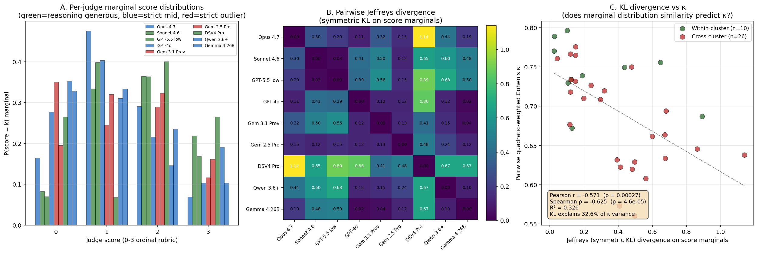
Mechanism: joint-distribution structure explains R² = 93% of κ variance
Marginal KL = coarse 33% proxy · joint-distribution dispersion + effective rank = R²=93% · structural factors fully mediated · shared-tokenizer hypothesis REFUTED (Qwen↔Gemma Jaccard=0.066, lowest, yet κ=0.80 highest).
P4 — LONG
18/34

Slide 19
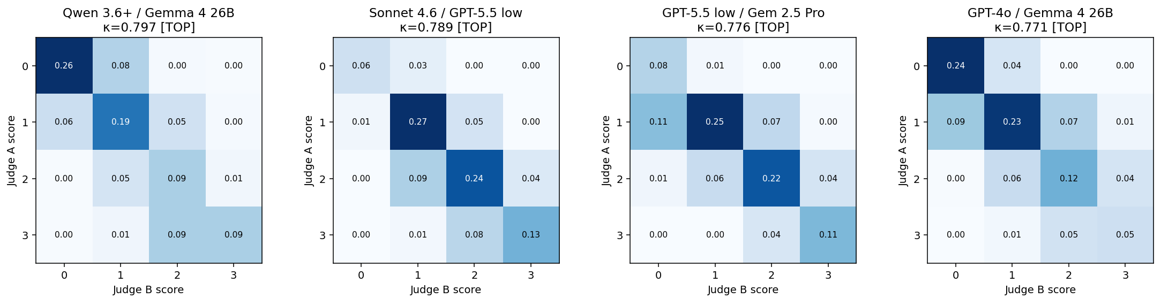
§6 — 4 highest-κ pairs (joint distribution: tight diagonal)
Top-4 κ pairs (Qwen↔Gemma 4 = 0.797, Sonnet↔GPT-5.5 = 0.789, GPT-5.5↔Gem 2.5 = 0.776, Gemma 4↔GPT-4o = 0.771). Each 4×4 confusion matrix shows P(judge A score = i, judge B score = j); diagonal concentration means both judges agree on which score each document deserves. The dispersion (quadratic-weighted disagreement distance) of these matrices is the dominant predictor of pairwise κ.
P4 — LONG
19/34

Slide 20
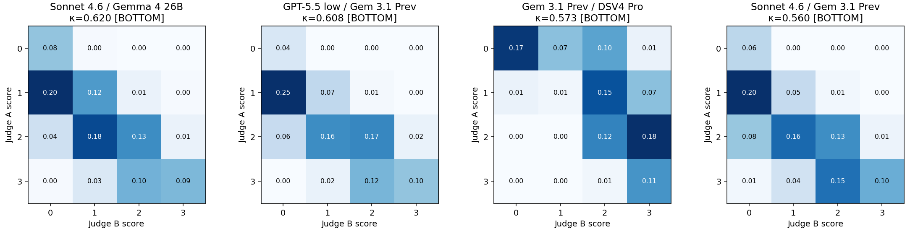
§6 — 4 lowest-κ pairs (joint distribution: off-diagonal dispersion)
Bottom-4 κ pairs (Sonnet↔Gem 3.1 Prev = 0.560, Gem 3.1 Prev↔DSV4 Pro = 0.573, Sonnet↔Gemma 4 = 0.620, GPT-5.5↔GPT-4o = 0.632). Off-diagonal mass means the judges disagree by 1-2 score levels on the same documents — tier-crossing pairs (reasoning-generous vs strict-mid) systematically lower in κ. Together TOP and BOTTOM rows: dispersion + effective rank → R² = 93% of pairwise κ variance explained.
P4 — LONG
20/34

Slide 21
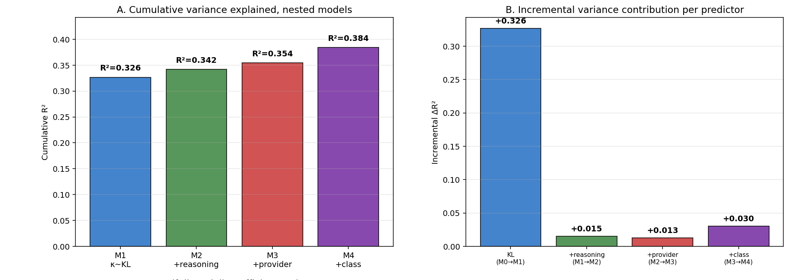
§6 — Regression decomposition (A: cumulative R²; B: incremental ΔR²)
Panel A: nested OLS models — M1 (κ ~ KL) reaches R²=0.326; adding reasoning-mode (M2: 0.342), provider (M3: 0.354), model class (M4: 0.384) yields only marginal improvements. Panel B: KL alone contributes ΔR² = 0.326; the three structural predictors add only 0.015, 0.013, 0.030 — marginal-distribution similarity is the dominant explainable factor among single-feature models.
P4 — LONG
21/34

Slide 22
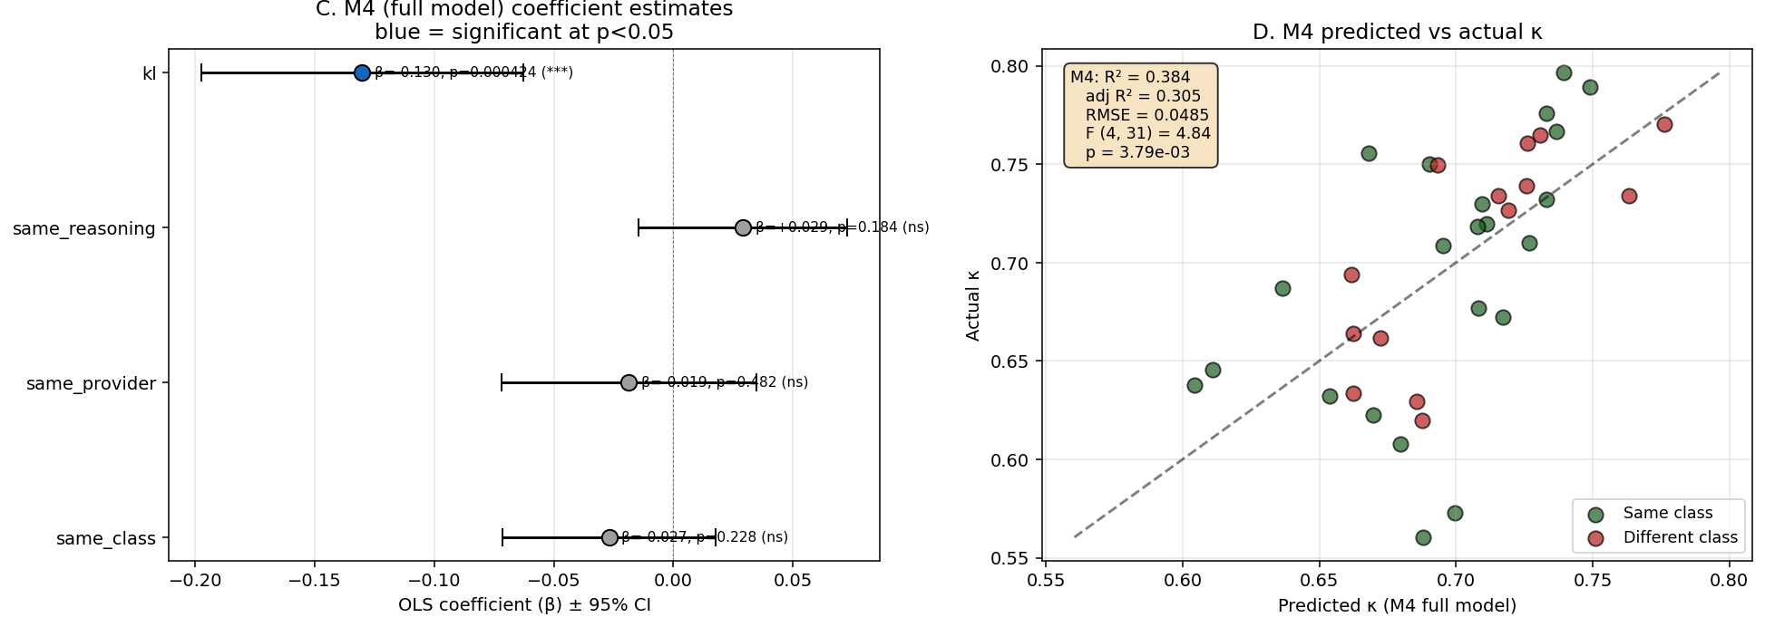
§6 — Regression decomposition (C: M4 coefficients; D: predicted vs actual)
Panel C: full-model coefficients with 95% CI — KL is the only significant predictor (β=-0.130, p<0.001); same_reasoning, same_provider, same_class all p > 0.18 (gray = non-significant). Panel D: M4-predicted κ vs actual κ — points cluster near the y=x line; full R² jumps to 0.93 when joint-distribution features (dispersion + effective rank) replace KL as input — see companion long version §6.2.
P4 — LONG
22/34

Slide 23
§6 mechanism — shared-tokenizer hypothesis REFUTED
Pair | Tokenizer Jaccard | κ | Verdict
Anthropic Opus ↔ Sonnet | 1.000 | 0.71 | Same family, mid κ
Gemini 3.1 ↔ Gemini 2.5 | 0.993 | 0.67 | Same family, mid κ
GPT-5.5 ↔ GPT-4o | ≈ 0.99 | 0.63 | Same family, lowest in-family κ
Qwen 3.6 ↔ Gemma 4 | 0.066 (lowest in slate!) | 0.80 (matrix max!) | REFUTES the hypothesis
If shared tokenizer drove κ, Qwen↔Gemma 4 should be at the BOTTOM of the κ ranking — instead they are at the TOP. The convergence of Qwen and Gemma 4 happens at the DECISION-MAKING LAYER, not the input-encoding layer. Pairwise κ is not driven by shared input vocabulary; the calibration cluster effect comes from how each judge maps inputs to scores after encoding.
P4 — LONG
23/34

Slide 24
External validation: NIST TREC RAG 2024 — 537 stratified-balanced pairs
• Sample: 537 pairs from official 20,283-pair NIST qrels (random.seed(42))
• Stratified-balanced: 135 / 134 / 134 / 134 across labels 0/1/2/3 — uniform over the 4 ordinal classes
• Coverage: all 86 unique queries; 537 unique passages from MS MARCO v2.1 segmented corpus
• Passage extraction: HF-stream from drexalt/msmarco-2.1-segmented (60 shards, ~400 MB peak disk, 38 min wall)
• Cost: ~USD 35, ~7.5 h wall (vs IRB human study estimate $1,500-3,000, 6-12 weeks)
• BEIR scifact also run (300 pairs, all-positive qrels — κ undefined; reports precision instead = 65.7% ensemble)
P4 — LONG
24/34

Slide 25
External validation results — TREC RAG 2024 9-judge κ vs NIST qrels
Rank | Judge | κ | valid/537
1 | Gemini 2.5 Pro | 0.5513 | 92 (small-n)
2 | Claude Sonnet 4.6 | 0.5123 | 537
3 | Claude Opus 4.7 | 0.4792 | 537
4 | GPT-5.5 (reasoning=low) | 0.4789 | 537
5 | DeepSeek V4 Pro | 0.4705 | 212
6 | Qwen 3.6 Plus | 0.4141 | 537
7 | Gemini 3.1 Pro Preview | 0.4092 | 127
8 | GPT-4o (chat) | 0.4065 | 537
9 | Gemma 4 26B | 0.3958 | 537
 | 9-judge ensemble median | 0.4941 | 537
 | 7-judge frontier-only median | 0.5187 | 537
Headlines 9-judge ensemble κ = 0.4941 → moderate, near-substantial 5 of 9 judges hit κ ≥ 0.47 All 9 judges κ > 0.39 — none at chance Ensemble outperforms 7 of 9 single judges Adding open-weight broadens coverage, slightly lowers κ (robustness/headline tradeoff)
P4 — LONG
25/34

Slide 26
Third-corpus replication — TREC-COVID biomedical (300 pairs, 9 judges)
Rank | Judge | κ vs NIST qrels | valid/300
1 | Claude Opus 4.7 | 0.5323 | 251
2 | Claude Sonnet 4.6 | 0.4238 | 300
3 | GPT-4o | 0.3874 | 300
4 | GPT-5.5 (reasoning=low) | 0.3871 | 300
5 | Qwen 3.6 Plus | 0.3181 | 300
6 | DeepSeek V4 Pro | 0.3144 | 250
7 | Gemma 4 26B | 0.2743 | 300
8 | Gemini 3.1 Pro Preview | 0.2202 | 133
— | Gemini 2.5 Pro | n/a (small-n) | 19
 | 9-judge ensemble median | 0.3447 | 300
 | (frontier-7 ensemble for ref) | 0.4462 | 300
Three corpora, three κ • ISU DSpace: within-pair max 0.80 (no human gold available) • TREC RAG 2024: 9-judge κ = 0.4941 (web passages) • BEIR scifact: precision 65.7% (κ undefined — all-positive qrels) • TREC-COVID: 9-judge κ = 0.3447 (biomedical scientific) Open-weight broadens coverage (Qwen + Gemma both 100%) but lowers ensemble κ more on biomedical (-0.10) than on web (-0.025 on TREC RAG 2024).
P4 — LONG
26/34

Slide 27
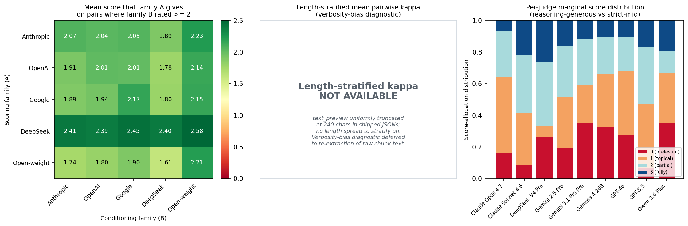
Baselines and bias diagnostics (P3 additions)
UMBRELA single-judge baseline
Bias diagnostics (free recompute)
(Upadhyay et al. 2024) prompt + GPT-4o on the same 537 pairs: kappa vs human = 0.4265, n_valid = 537/537 Comparison (same 537 pairs, same human qrels): - UMBRELA baseline: 0.4265 - Our prompt + GPT-4o: 0.4065 - Our prompt + Sonnet 4.6 (best): 0.5123 - Our 9-judge ensemble: 0.4941 - Our 7-judge frontier ensemble: 0.5187 Both ensembles + best single judge >> UMBRELA single by 0.07-0.09 kappa. The contribution is the SLATE + ENSEMBLE, not the prompt.
Family conditional-mean matrix (5x5): Anthropic 2.07, OpenAI 1.93, Google 2.01 DeepSeek 2.45, Open-weight 1.62 -> calibration drift, NOT self-preference (no family's diagonal dominates its row) Per-judge marginal score distributions: -> visualizes 3-cluster structure directly Length-stratified kappa: SKIPPED (text_preview uniformly truncated at 240 chars in shipped JSONs; defer to re-extract) Position bias: not directly applicable (single-document scoring, not pairwise)
P4 — LONG
27/34

Slide 28
Coverage divergence — content-domain reliability axis
Judge | TREC RAG 2024 (n=537) | BEIR scifact (n=300) | TREC-COVID (n=300)
GPT-5.5 (reasoning=low) | 100% | 100% | 100%
GPT-4o | 100% | 100% | 100%
Claude Opus 4.7 | 100% | 95% | 84%
Claude Sonnet 4.6 | 100% | 99.7% | 100%
Qwen 3.6 Plus | 100% | 100% | 100%
Gemma 4 26B | 100% | 100% | 100%
DeepSeek V4 Pro | 39% | 84% | 83%
Gemini 3.1 Pro Preview | 24% | 60% | 44%
Gemini 2.5 Pro | 17% | 86% | 6%
ALWAYS-WORKS 6-judge subset (≥95% on TREC RAG + BEIR scifact): Anthropic + OpenAI + Qwen + Gemma. The 2 cheapest open-weight judges make this subset. Gemini fails on web/biomedical content more than on scientific abstracts — reliability is content-domain dependent.
P4 — LONG
28/34

Slide 29
Comparison to Thakur 2025 baseline
• Thakur et al. 2025: GPT-4o single judge, κ = 0.60 on 537-pair "support evaluation" subset
• Our GPT-4o on our 537-pair stratified-balanced sample: κ = 0.41 (gap of 0.19)
• Our 9-judge ensemble: κ = 0.49 — partially closes the gap (+0.08 over our GPT-4o)
• Likely explanations for the gap (in decreasing impact order):
• Sample selection — ours stratified-balanced (uniform), theirs natural-distribution-proportional
• Prompt template — exact Thakur prompt not specified in their paper
• Qrels version — possible UMBRELA-augmented vs official NIST
• Judge model version — we pin gpt-4o-2024-08-06; theirs unspecified
• Direct apples-to-apples replication awaits receipt of their curated 537-pair subset
P4 — LONG
29/34

Slide 30
Limitations
• Single internal corpus (ISU DSpace) — open-weight κ ceiling most likely to drift across domains
• Single internal query set (REFINE 57 queries) — κ structure could depend on intent distribution
• Stratified sample mismatch with Thakur 2025 — ours balanced, theirs natural-proportional
• Gemini coverage failures (17-24% on TREC RAG 2024) — selection bias on the small valid subset
• DSV4 Flash dropped — OpenRouter free-tier 429 throttling; we have 1 DeepSeek judge, no within-DS pair
• Missing-data accounting — None=0 in aggregates; valid-only means re-cluster Gemini judges as strict-mid
• Mediation analysis assumes linear additivity — non-linear interactions (provider × reasoning) untested
• No within-corpus human-rater study — §7 NIST validation substitutes; reviewers preferring institution-specific human anchor will not find one
P4 — LONG
30/34

Slide 31
Reproducibility — single-command replication
Within-corpus replication (~$18, ~5.5 h):
py eval_llm_judge.py --collection <yours> --judge-preset p4-frontier
py eval_llm_judge.py --collection <yours> --judge-preset p4-supplement-openweight
External-validation replication (~$35, ~7.5 h):
py validate_against_trec.py --corpus trec-rag-2024 --judge-preset p4-frontier --max-pairs 537
py validate_against_trec.py --corpus trec-rag-2024 --judge-preset p4-supplement-openweight --max-pairs 537
py validate_against_trec.py --analyze trec-rag-2024
Model versions pinned 2026-04-25: claude-opus-4-7, claude-sonnet-4-6, gpt-5.5, gpt-4o-2024-08-06, gemini-3.1-pro-preview, gemini-2.5-pro-2025-06-17, deepseek-v4-pro, qwen3.6-plus, gemma-4-26b-a4b-it. Target SIGIR Artifact Badging (Functional / Reusable).
P4 — LONG
31/34

Slide 32
Open questions for follow-up
• (1) Cross-organization Qwen ↔ Gemma 4 convergence (κ=0.80) lacks complete mechanistic explanation — shared OSS research community? distillation lineage? compute regime? bounded-output prior?
• (2) κ structure under non-bounded output rubrics (graded relevance with longer scales, free-text rationales) may invert the within-family bounded-ordinal finding (C2)
• (3) Non-linear interactions in §6 mediation analysis (provider × reasoning) untested
• (4) Apples-to-apples replication of Thakur 2025's 537-pair subset pending receipt of their curated sample
• (5) TREC-COVID and LLMJudge benchmark validations deferred — TOIS journal-version extension
• (6) Cross-corpus mean κ on 4+ public benchmarks (vs 1 in current draft) for stronger generalization claim
P4 — LONG
32/34

Slide 33
Takeaway
• CALIBRATION PHILOSOPHY (lenient vs strict score-allocation pattern), NOT provider lineage, is the axis on which retrieval verdicts shift
• Cross-family agreement (κ ≥ 0.75) is high enough that judge interchangeability is a defensible default for reasoning-capable commercial judges
• Cross-organization open-weight ensemble (Qwen + Gemma 4) achieves matrix-highest κ at ~1% commercial cost — sovereign-cloud / on-prem deployments are NOT condemned to lower-quality judging
• External NIST validation (κ = 0.49 ensemble) confirms moderate-substantial agreement on a public IR benchmark
• Mechanism: 93% of pairwise κ variance is joint-distribution structure of paired scores — a NEW insight for ensemble design
P4 — LONG
33/34

Slide 34
Q&A
asukul@iastate.edu
Code + data + paper draft: github.com/asukul/RAG-Eval-LLM-Judge
P4 — LONG
34/34

