Slide 1
Cross-Family LLM-Judge Agreement for Institutional RAG
A 5-Family, 9-Judge Ablation with Mechanism + External Validation
Adisak Sukul
Iowa State University
asukul@iastate.edu · 2026-04-28
P4 — SHORT
1/17

Slide 2
The which-judge problem
RAG over institutional corpora has no gold relevance set; LLM-as-Judge fills the gap — but which judge?
• No gold qrels for institutional corpora — TREC-style ground truth needs hundreds of expert hours per topic
• Generic IR benchmarks (BEIR, MS-MARCO) don't transfer — web-style queries on web-style corpora
• LLM-as-Judge surfaces a new question: WHICH judge? Sonnet vs GPT-5 vs Gemini vs Qwen vs Gemma?
• Prior work compares within ONE provider family, or two-family pairs without ordinal weighting, or excludes open-weight peers entirely
• Open-weight judges are the default for sovereign-cloud and privacy-conservative institutions — excluding them silently endorses commercial-only practice
P4 — SHORT
2/17

Slide 3
Four contribution claims
First multi-family pairwise κ matrix with within-family controls AND open-weight as first-class judges
• C1: Cross-family reasoning judges converge at κ ≥ 0.75 — well above the 0.4-0.6 typical baselines
• C2: Within-family agreement is BOUNDED by the cross-family ceiling (no within-family pair dominates)
• C3: Open-weight judges (Qwen × Gemma 4) produce the matrix-highest within-pair κ = 0.80 at ~1% of commercial cost
• C4: Open-source toolkit (eval_llm_judge.py, validate_against_trec.py) + community disclosure template
• Plus: §6 mechanistic decomposition (R²=93% from joint distribution; tokenizer hypothesis refuted)
• Plus: §7 external validation against NIST TREC RAG 2024 qrels (ensemble κ = 0.4941 on 537 stratified-balanced pairs)
P4 — SHORT
3/17

Slide 4
Judge slate: 9 judges across 5 families, 4 within-family pairs
# | Judge | Family | Reasoning | Route
1 | Claude Opus 4.7 | Anthropic | yes | OpenRouter
2 | Claude Sonnet 4.6 | Anthropic | yes | OpenRouter
3 | GPT-5.5 (reasoning=low) | OpenAI | yes | OpenAI direct
4 | GPT-4o (chat) | OpenAI | no | OpenAI direct
5 | Gemini 3.1 Pro Preview | Google-commercial | yes (thinking) | OpenRouter
6 | Gemini 2.5 Pro | Google-commercial | yes (thinking) | OpenRouter
7 | DeepSeek V4 Pro | DeepSeek | yes | OpenRouter
8 | Qwen 3.6 Plus | Open-weight | no | OpenRouter
9 | Gemma 4 26B | Open-weight | no | OpenRouter
Within-family pairs: Anthropic (1↔2), OpenAI (3↔4), Google-commercial (5↔6), Open-weight cross-organization (8↔9). All 9 judges score the same 570 (query, document) pairs from ISU DSpace (97k full-text PDFs) — score variance is purely judge-level. Versions pinned 2026-04-25.
P4 — SHORT
4/17

Slide 5
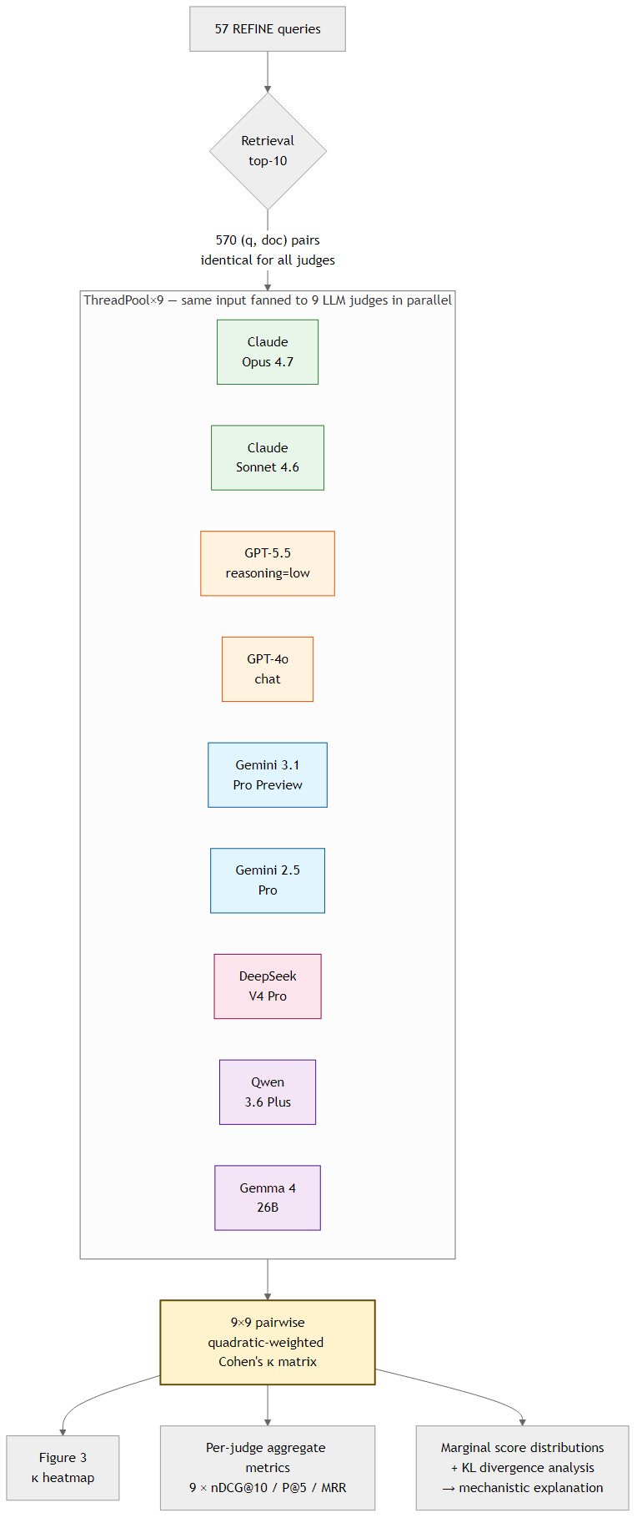
Pipeline: 9-judge ThreadPool fan-out
eval_llm_judge.py — multi-judge mode, retry on transient errors, JSON output per judge
P4 — SHORT
5/17

Slide 6
Per-judge retrieval metrics — same documents, different verdicts
Judge | Family | nDCG@10 | P@5 | MRR | Mean
Sonnet 4.6 | Anthropic | 0.862 | 0.649 | 0.826 | 1.68
GPT-5.5 (low) | OpenAI | 0.846 | 0.600 | 0.792 | 1.63
DSV4 Pro | DeepSeek | 0.835 | 0.702 | 0.883 | 1.63
GPT-4o | OpenAI | 0.803 | 0.361 | 0.575 | 1.15
Qwen 3.6 | Open-weight | 0.758 | 0.379 | 0.599 | 1.18
Gemma 4 26B | Open-weight | 0.753 | 0.375 | 0.573 | 1.11
Opus 4.7 | Anthropic | 0.749 | 0.372 | 0.536 | 1.09
Gemini 2.5 Pro | Google | 0.624 | 0.281 | 0.486 | 0.76
Gemini 3.1 Prev | Google | 0.454 | 0.158 | 0.315 | 0.37
Same retrieved documents → nDCG@10 between 0.45 and 0.86 — a 1.9× spread driven entirely by judge selection. Two practitioners running identical retrieval code, scoring with different flagship judges, can arrive at OPPOSITE go/no-go decisions. Disclosure template (C4): "nDCG@10 = X.XX via [family]/[model]/[reasoning], N pairs, DATE".
P4 — SHORT
6/17

Slide 7
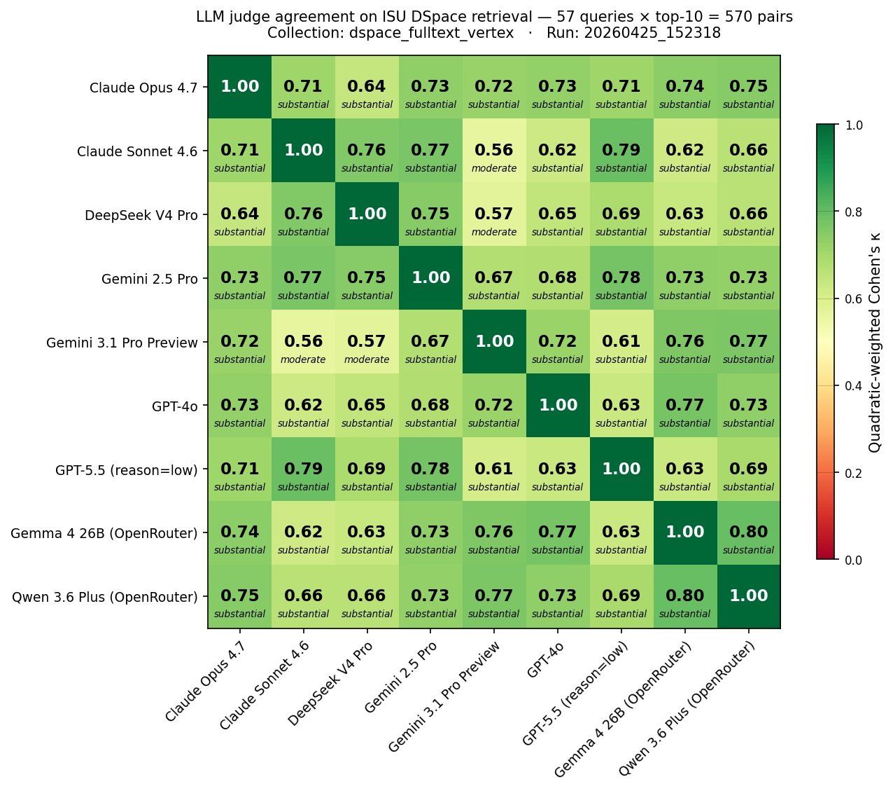
9×9 pairwise κ matrix — every off-diagonal ≥ 0.56
Quadratic-weighted Cohen's κ on 570 pairs · two clusters · cross-org open-weight = 0.80 (matrix-highest)
P4 — SHORT
7/17

Slide 8
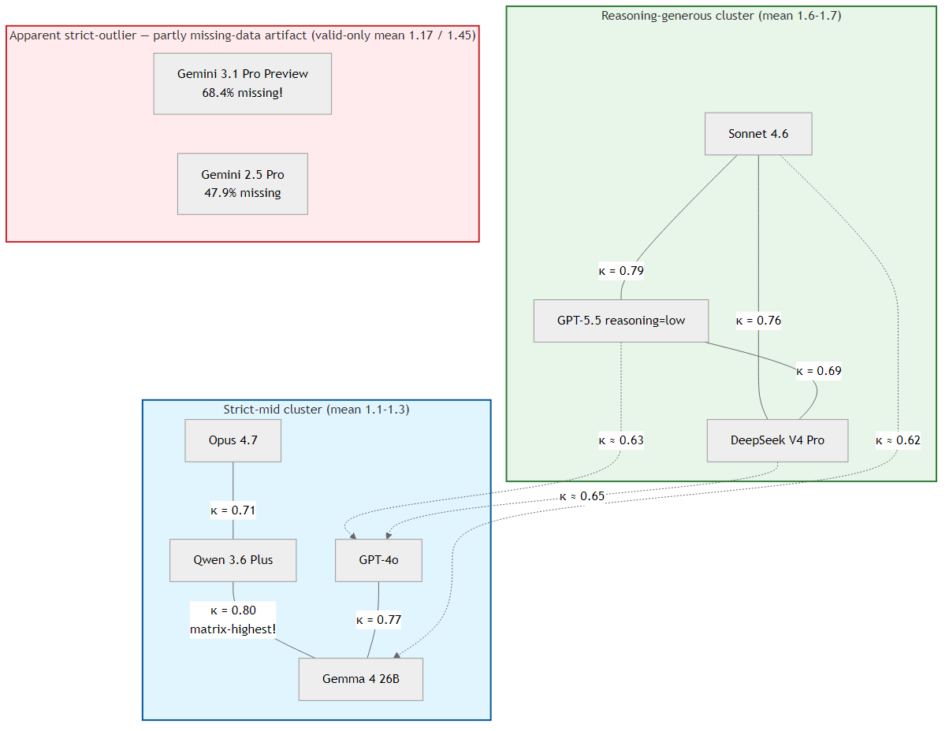
Calibration clusters — calibration philosophy > provider lineage
P4 — SHORT
8/17

Slide 9
C1: Cross-family reasoning judges converge at κ ≥ 0.75
• Five cross-family pairs reach substantial-or-better κ (Sonnet ↔ GPT-5.5 = 0.79, Qwen ↔ Gemma 4 = 0.80, etc.)
• Well above the 0.4-0.6 typical of prior art [Rahmani 2024] and the 0.60 unweighted baseline of [Thakur 2025]
• DeepSeek V4 Pro joining the cluster RULES OUT a Western-training-data common-cause explanation
• Pattern replicates across three independent ablation scales (5-, 7-, 9-judge) within run-to-run noise
• EXTERNAL CORROBORATION: 9-judge ensemble achieves κ = 0.49 against published NIST qrels on TREC RAG 2024 — the convergence is not specific to our institutional corpus
P4 — SHORT
9/17

Slide 10
C3: Cross-org open-weight = matrix-highest κ at ~1% of commercial cost
• Qwen 3.6 Plus ↔ Gemma 4 26B = κ 0.80 — exceeds every commercial within-family pair
• Both calibrate with strict-mid commercial models (mean 1.11-1.18), NOT with reasoning-generous (1.63-1.68)
• Marginal cost ~USD 0.30 (vs ~USD 18 for the commercial 7-judge frontier)
• 100% coverage on TREC RAG 2024 — better than 4 of 7 frontier judges (Gemini 17-24%, DSV4 40%)
• Direct policy implication: sovereign-cloud and privacy-conservative deployments are NOT condemned to lower-quality judging — the cross-org open-weight pair is the recommended low-cost configuration
P4 — SHORT
10/17

Slide 11
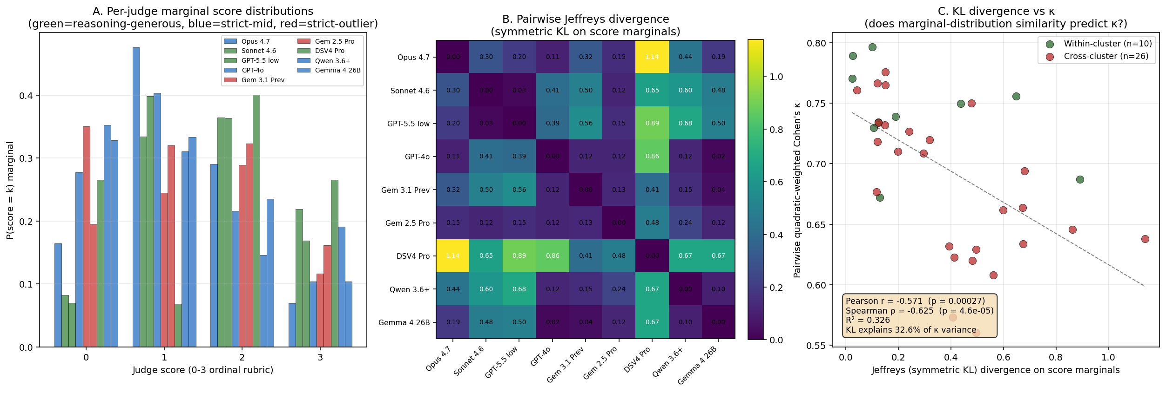
Mechanism: joint-distribution structure explains R² = 93% of κ variance
Marginal KL = coarse 33% proxy · joint-distribution dispersion + effective rank = R²=93% · structural factors fully mediated · shared-tokenizer hypothesis REFUTED (Qwen↔Gemma Jaccard=0.066, lowest, yet κ=0.80 highest).
P4 — SHORT
11/17

Slide 12
External validation results — TREC RAG 2024 9-judge κ vs NIST qrels
Rank | Judge | κ | valid/537
1 | Gemini 2.5 Pro | 0.5513 | 92 (small-n)
2 | Claude Sonnet 4.6 | 0.5123 | 537
3 | Claude Opus 4.7 | 0.4792 | 537
4 | GPT-5.5 (reasoning=low) | 0.4789 | 537
5 | DeepSeek V4 Pro | 0.4705 | 212
6 | Qwen 3.6 Plus | 0.4141 | 537
7 | Gemini 3.1 Pro Preview | 0.4092 | 127
8 | GPT-4o (chat) | 0.4065 | 537
9 | Gemma 4 26B | 0.3958 | 537
 | 9-judge ensemble median | 0.4941 | 537
 | 7-judge frontier-only median | 0.5187 | 537
Headlines 9-judge ensemble κ = 0.4941 → moderate, near-substantial 5 of 9 judges hit κ ≥ 0.47 All 9 judges κ > 0.39 — none at chance Ensemble outperforms 7 of 9 single judges Adding open-weight broadens coverage, slightly lowers κ (robustness/headline tradeoff)
P4 — SHORT
12/17

Slide 13
Third-corpus replication — TREC-COVID biomedical (300 pairs, 9 judges)
Rank | Judge | κ vs NIST qrels | valid/300
1 | Claude Opus 4.7 | 0.5323 | 251
2 | Claude Sonnet 4.6 | 0.4238 | 300
3 | GPT-4o | 0.3874 | 300
4 | GPT-5.5 (reasoning=low) | 0.3871 | 300
5 | Qwen 3.6 Plus | 0.3181 | 300
6 | DeepSeek V4 Pro | 0.3144 | 250
7 | Gemma 4 26B | 0.2743 | 300
8 | Gemini 3.1 Pro Preview | 0.2202 | 133
— | Gemini 2.5 Pro | n/a (small-n) | 19
 | 9-judge ensemble median | 0.3447 | 300
 | (frontier-7 ensemble for ref) | 0.4462 | 300
Three corpora, three κ • ISU DSpace: within-pair max 0.80 (no human gold available) • TREC RAG 2024: 9-judge κ = 0.4941 (web passages) • BEIR scifact: precision 65.7% (κ undefined — all-positive qrels) • TREC-COVID: 9-judge κ = 0.3447 (biomedical scientific) Open-weight broadens coverage (Qwen + Gemma both 100%) but lowers ensemble κ more on biomedical (-0.10) than on web (-0.025 on TREC RAG 2024).
P4 — SHORT
13/17

Slide 14
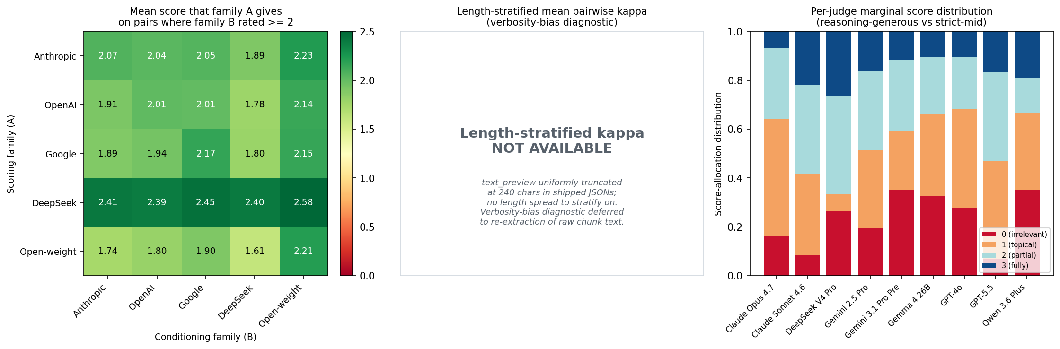
Baselines and bias diagnostics (P3 additions)
UMBRELA single-judge baseline
Bias diagnostics (free recompute)
(Upadhyay et al. 2024) prompt + GPT-4o on the same 537 pairs: kappa vs human = 0.4265, n_valid = 537/537 Comparison (same 537 pairs, same human qrels): - UMBRELA baseline: 0.4265 - Our prompt + GPT-4o: 0.4065 - Our prompt + Sonnet 4.6 (best): 0.5123 - Our 9-judge ensemble: 0.4941 - Our 7-judge frontier ensemble: 0.5187 Both ensembles + best single judge >> UMBRELA single by 0.07-0.09 kappa. The contribution is the SLATE + ENSEMBLE, not the prompt.
Family conditional-mean matrix (5x5): Anthropic 2.07, OpenAI 1.93, Google 2.01 DeepSeek 2.45, Open-weight 1.62 -> calibration drift, NOT self-preference (no family's diagonal dominates its row) Per-judge marginal score distributions: -> visualizes 3-cluster structure directly Length-stratified kappa: SKIPPED (text_preview uniformly truncated at 240 chars in shipped JSONs; defer to re-extract) Position bias: not directly applicable (single-document scoring, not pairwise)
P4 — SHORT
14/17

Slide 15
Coverage divergence — content-domain reliability axis
Judge | TREC RAG 2024 (n=537) | BEIR scifact (n=300) | TREC-COVID (n=300)
GPT-5.5 (reasoning=low) | 100% | 100% | 100%
GPT-4o | 100% | 100% | 100%
Claude Opus 4.7 | 100% | 95% | 84%
Claude Sonnet 4.6 | 100% | 99.7% | 100%
Qwen 3.6 Plus | 100% | 100% | 100%
Gemma 4 26B | 100% | 100% | 100%
DeepSeek V4 Pro | 39% | 84% | 83%
Gemini 3.1 Pro Preview | 24% | 60% | 44%
Gemini 2.5 Pro | 17% | 86% | 6%
ALWAYS-WORKS 6-judge subset (≥95% on TREC RAG + BEIR scifact): Anthropic + OpenAI + Qwen + Gemma. The 2 cheapest open-weight judges make this subset. Gemini fails on web/biomedical content more than on scientific abstracts — reliability is content-domain dependent.
P4 — SHORT
15/17

Slide 16
Takeaway
• CALIBRATION PHILOSOPHY (lenient vs strict score-allocation pattern), NOT provider lineage, is the axis on which retrieval verdicts shift
• Cross-family agreement (κ ≥ 0.75) is high enough that judge interchangeability is a defensible default for reasoning-capable commercial judges
• Cross-organization open-weight ensemble (Qwen + Gemma 4) achieves matrix-highest κ at ~1% commercial cost — sovereign-cloud / on-prem deployments are NOT condemned to lower-quality judging
• External NIST validation (κ = 0.49 ensemble) confirms moderate-substantial agreement on a public IR benchmark
• Mechanism: 93% of pairwise κ variance is joint-distribution structure of paired scores — a NEW insight for ensemble design
P4 — SHORT
16/17

Slide 17
Q&A
asukul@iastate.edu
Code + data + paper draft: github.com/asukul/RAG-Eval-LLM-Judge
P4 — SHORT
17/17

