Slide 1
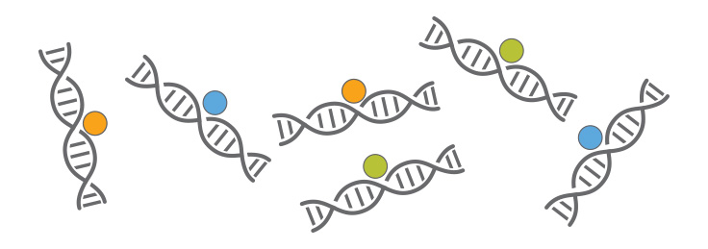
ChIP-seq introduction
Huitian Diao (Yolanda)
References:
ENCODE ChIP-seq pipeline: https://www.encodeproject.org/pipelines/ENCPL138KID/
Intro to ChIP-seq: https://github.com/hbctraining/Intro-to-ChIPseq

Slide 2

Using sticky notes for feedback
“I’ve got a good handle on things…”
“I think I understand but I’m still working through things…”
“I’m not understanding and I’m a little lost right now...”

Slide 3
Get course material
Github
Applied-Bioinformatics
Github
HW
git pull
git push
copy
My local:
Applied-Bioinformatics
My local:
My_name_HW
If you want to use packages you installed in “chip” environment, do:
source activate chip

Slide 4
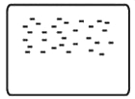
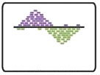

ChIP-seq analysis steps
0
1
2
√
0.0 | Acquire raw reads | fastq-dump
0.1 | Fastq quality control | fastqc
0.2 | Trimming | TrimGlore
Raw sequenced reads
√
Raw reads
√
Alignment
√
1.0 | Alignment | Bowtie2
1.1 | Convert, sort, filter | Samtools
1.2 | Filter blacklisted regions | bedtools
Aligned file
√
Aligned to
Genome
Peak Calling
2.0 | Peak calling | MACS2
2.1 | ChIP quality control | ChIPQC
2.2 | Peak visualization | UCSC genome browser
2.3 | Peak annotation | ChIP-seeker
Peak list
Identified Peak
Bardet, Anaïs F., et al. Nature protocols 7.1 (2012): 45.

Slide 5
Trimming & filtering tips
Filtering type | Step | Necessity
Quality trimming | Before alignment | Sometimes, if increase mapping quality
Adapter trimming | Before alignment | Sometimes, if increase mapping quality
PCR duplicate filter | After alignment | Always
ChIP blacklisted region filter | After alignment | Always (for ChIP samples)
chrY, chrM, etc | After alignment | Based on need

Slide 6
Practice 4.5 Filter blacklisted region & customized filtering
Tips:
Bedtools
samtools
awk
Always: Google
Questions:
1. Download: bam file: SRR3001750_srt_dupr.chr2.chr11.bam blacklisted region bed file: mm10.blacklist.bed
2. Filter blacklisted regions from the bam file, name output SRR3001750_srt_dupr.chr2.chr11_flb.bam
3. Filter out chr11 reads from SRR3001750_srt_dupr.chr2.chr11_flb.bam, name SRR3001750_srt_dupr.chr2.chr11_flb_flt.bam

Slide 7
ChIP-seq analysis steps
0
1
2
√
0.0 | Acquire raw reads | fastq-dump
0.1 | Fastq quality control | fastqc
0.2 | Trimming | TrimGlore
Raw sequenced reads
√
Raw reads
√
Alignment
√
1.0 | Alignment | Bowtie2
1.1 | Convert, sort, filter | Samtools
1.2 | Filter blacklisted regions | bedtools
Aligned file
√
Aligned to
Genome
√
Peak Calling
2.0 | Peak calling | MACS2
2.1 | ChIP quality control | ChIPQC
2.2 | Peak visualization | UCSC genome browser
2.3 | Peak annotation | ChIP-seeker
Peak list
Identified Peak
Bardet, Anaïs F., et al. Nature protocols 7.1 (2012): 45.

Slide 8
MACS2 peak calling
Positive and negative strand reads around
DNA binding protein
MACS2 scan for
bimodal enrichment pattern
Typical v.s.
Low-complexity ChIP-seq peaks
Notes:
Transcription factor chip: narrow peak
Histone modification: bigger peak

Slide 9
Practice 4.6 MACS2 peak calling
Tips:
MACS2 documentation
awk
grep
wc
sort
Always: Google
Questions:
1. Use MACS2 with appropriate setting to call peaks for the file SRR3001750_srt_dupr.chr2.chr11.bam (downloaded from last exercise)
2. Examine the out put and find out:
In broadPeaks file, how many peaks were identified in chr2? How many peaks were identified in chr11?
How many peaks in broadPeaks were identified with –log10pvalue > 2?
Find the coordinates of peak with highest signal from treat_pileup.bdg file

Slide 10
Visualization of ChIP-seq data
IGV
UCSC Genome browser (Guidelines)
(Convert bedgraph to bw)
Hosting your data: https://de.cyverse.org/de/
Create public links
Add link to UCSC custom tracks (select correct genome and assembly)
View your track
Save session
Save screenshots as pdf (or other formats)

Slide 11
Practice 4.7 Data visualization with UCSC genome browser
Tips:
Always: Google
Questions:
Sign up for Cyvrse and UCSC genomebrowser
Convert the treat_pileup.bdg file into bw format. Calculate the size of both files
Upload the bw file and visualize in UCSC genome browser
For the peak with highest signal you found in practice 4.6, take a genome browser screen shot with ~10,000bp in the window. What are the annotated features around the peak?

