Slide 1

SDLC
Software Development Life Cycle

Slide 2

SDLC Course Overview
Chapter 1.
SDLC
Chapter 2.
Waterfall Model
Chapter 3.
Iterative Model
Chapter 4.
Spiral Model
Chapter 5.
Agile Model

Slide 3
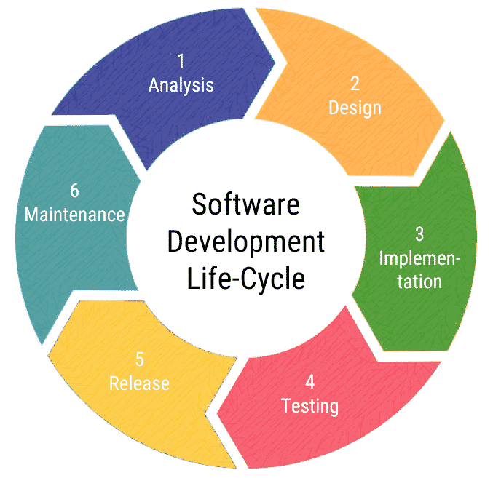
SDLC
SDLC is a process followed for a software project, within a software organization. It consists of a detailed plan describing how to develop, maintain, replace and alter or enhance specific software. The life cycle defines a methodology for improving the quality of software and the overall development process.

Slide 4
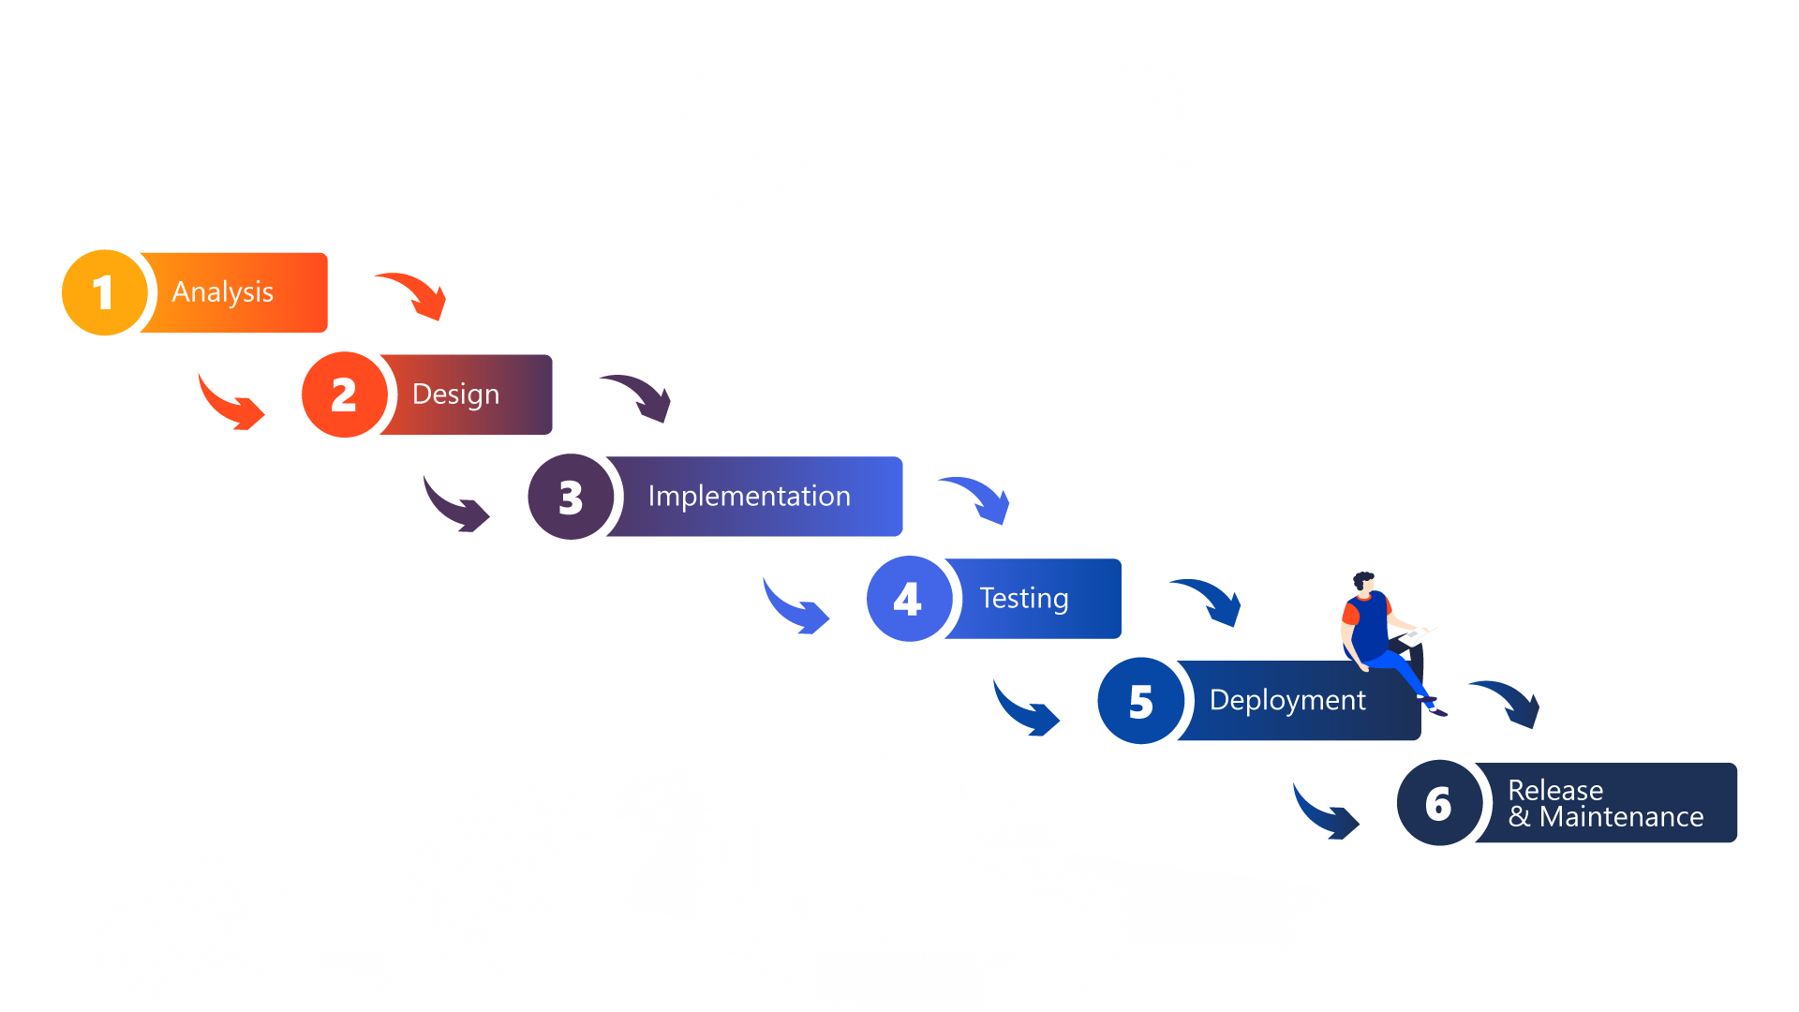
Waterfall Model
The Waterfall Model was the first Process Model to be introduced. It is also referred to as a linear-sequential life cycle model. It is very simple to understand and use. In a waterfall model, each phase must be completed before the next phase can begin and there is no overlapping in the phases.
The Waterfall model is the earliest SDLC approach that was used for software development.

Slide 5
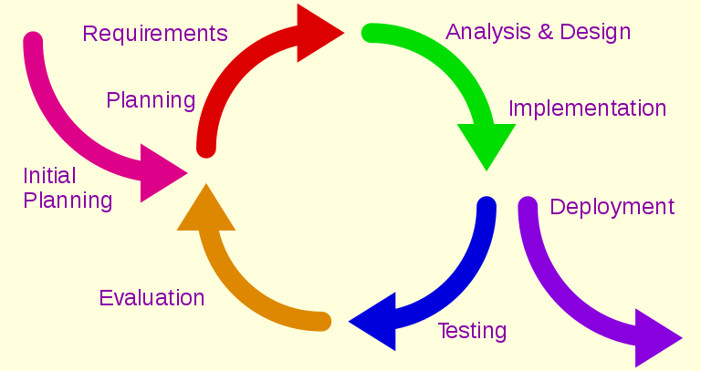
Iterative Model
Iterative process starts with a simple implementation of a small set of the software requirements and iteratively enhances the evolving versions until the complete system is implemented and ready to be deployed.
An iterative life cycle model does not attempt to start with a full specification of requirements. Instead, development begins by specifying and implementing just part of the software, which is then reviewed to identify further requirements.

Slide 6
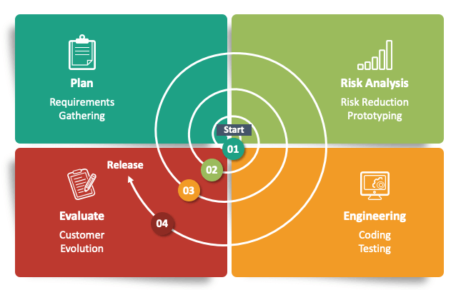
Spiral Model
The spiral model combines the idea of iterative development with the systematic, controlled aspects of the waterfall model. This Spiral model is a combination of iterative development process model and sequential linear development model i.e. the waterfall model with a very high emphasis on risk analysis. It allows incremental releases of the product or incremental refinement through each iteration around the spiral.

Slide 7
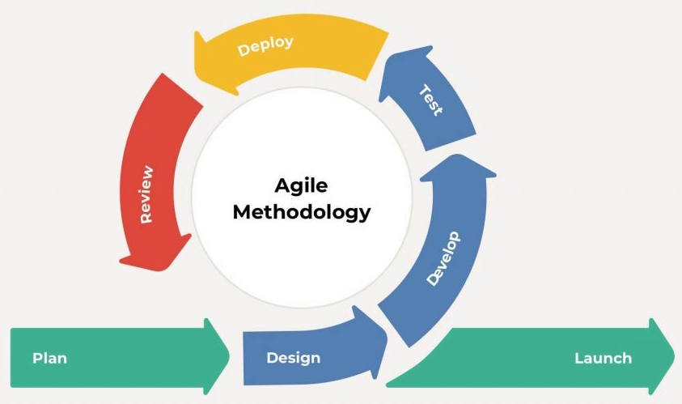
Agile Model
Agile SDLC model is a combination of iterative and incremental process models with focus on process adaptability and customer satisfaction by rapid delivery of working software product. Agile Methods break the product into small incremental builds. These builds are provided in iterations. Each iteration typically lasts from about one to three weeks. Every iteration involves cross functional teams working simultaneously.

Slide 8
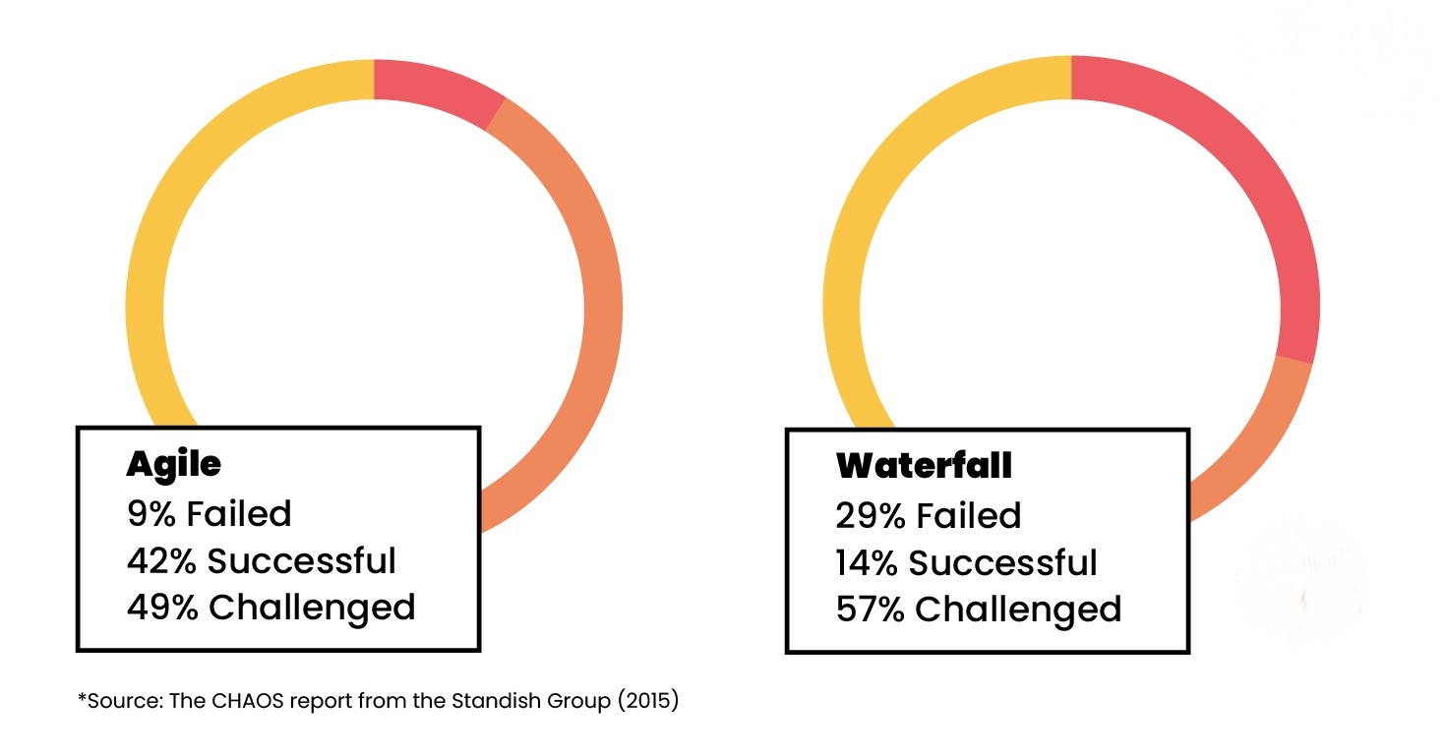
Agile Vs Traditional
The table on this page compares software projects from 2011–2015, segmented by the agile process and waterfall method.
The total number of software projects is more than 10,000.
The results show that agile projects have tree times the success rate as waterfall projects, and waterfall projects have three times the failure rate as agile projects.
The overall results clearly show that waterfall projects do not scale well, while agile projects scale much better.
However, note that the smaller the project, the smaller the difference is between the agile and the waterfall process.

Slide 9
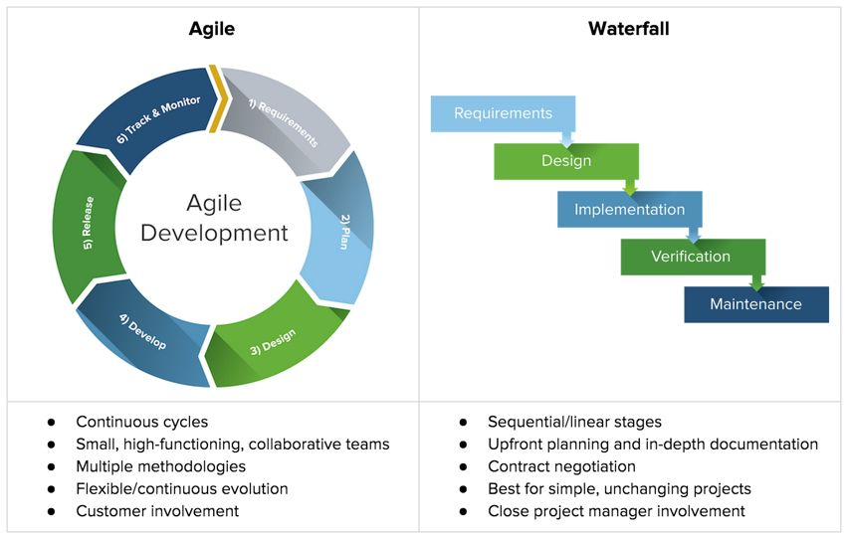
Agile Vs Traditional
Agile is based on the adaptive software development methods, whereas the traditional SDLC models like the waterfall model is based on a predictive approach. Predictive teams in the traditional SDLC models usually work with detailed planning and have a complete forecast of the exact tasks and features to be delivered in the next few months or during the product life cycle.

Slide 10

Thank You!
Have a nice day

