Slide 1
3rd Semester Project
How to predict future sales by analyzing a big data set with the help of machine learning algorithms?
Mohammad Mosiur Rahman
Hunor Vadasz-Perhat
Mohammad Azizul Huq

Slide 2
Overview of presentation
Introduction
Problem Statement
Project Exploration
Our Project Plan
Data Visualization and data selection
Simple Linear regression and Multiple Linear Regression
Overview of ARIMA model
Conclusion

Slide 3

Introduction

Slide 4

Problem Statement
How to predict future sales by analyzing a big data set with the help of machine learning algorithms?

Slide 5
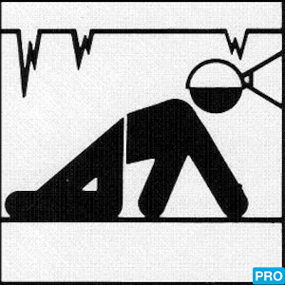
Project Exploration
Goals of project:
To get an overview of the particular steps in a data science project
To answer the problem statement
To be able to critically reflect on the process

Slide 6
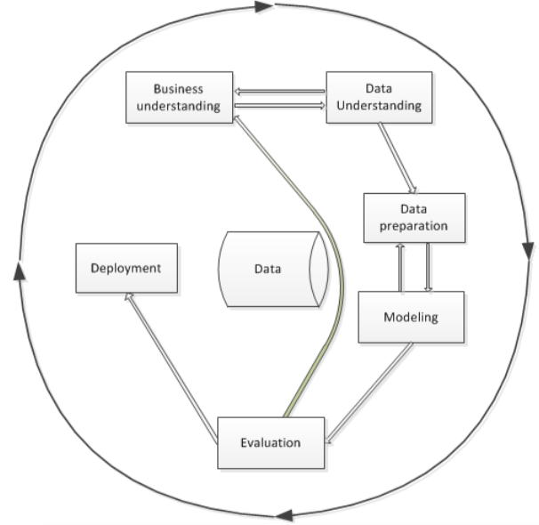
Our Project Plan
Our project plan is based upon the CRISP-DM model
The model consists of 6 phases
Each phase includes several tasks
Outer circle symbolizes the cyclic nature of the process

Slide 7
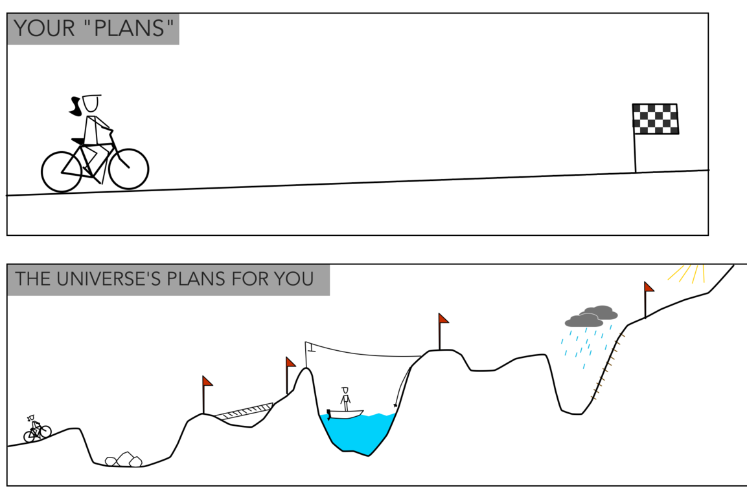
Our Project Plan

Slide 8

Data Understanding
In order to understand our data better we evaluated whether our data is …
Structured or unstructured
Qualitative or quantitative
Nominal or ordinal or interval or ratio

Slide 9
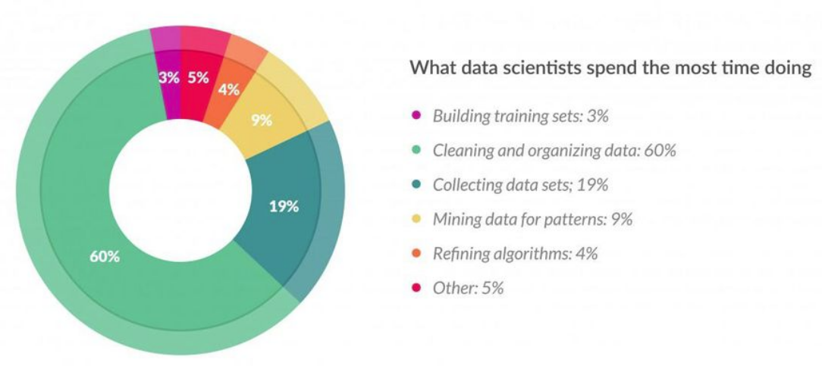
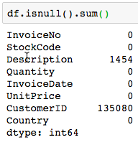
Data Cleaning
The reality is that data scientist spend a lot of time with cleaning and preparing data because of…
Missing data
Irrelevant data
Inconsistent data
Erroneous data

Slide 10
Data Visualization
The process of taking raw data,transforming it into graphs,charts and images that explain the numbers and allow us to gain insights from it.
Identify areas that need attention and improvement
Predict sales volumes
Clarify which factors influence customers behaviour

Slide 11
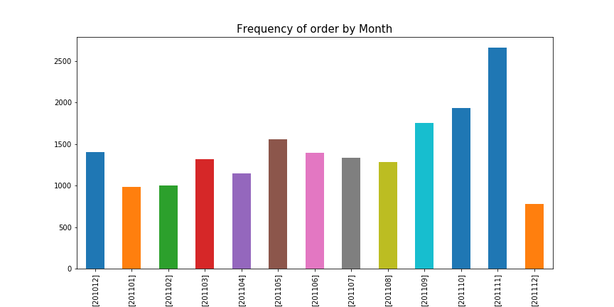
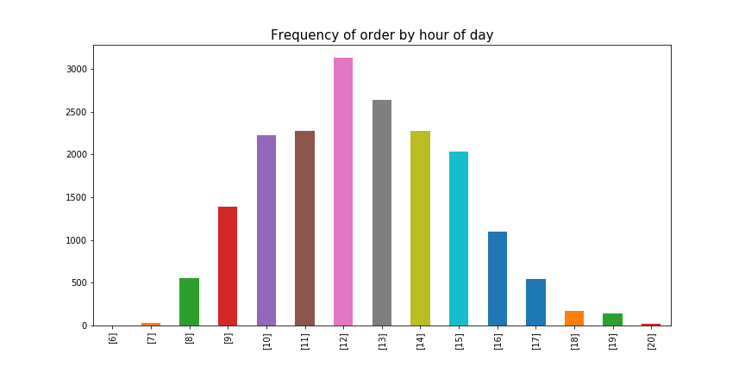
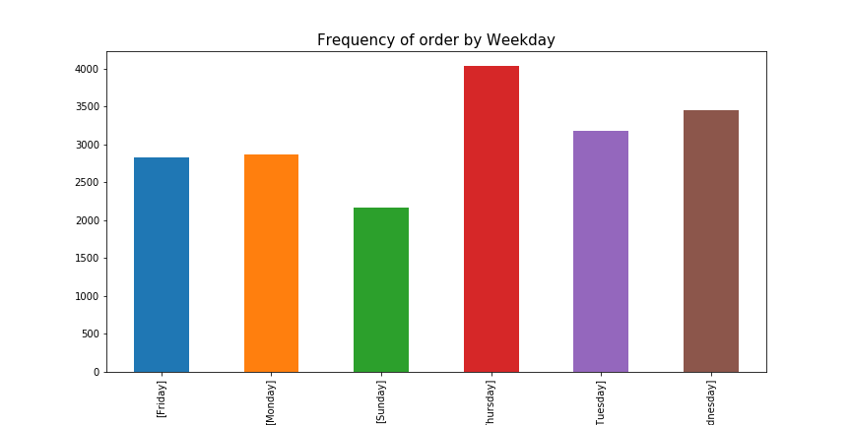
Data Visualization

Slide 12
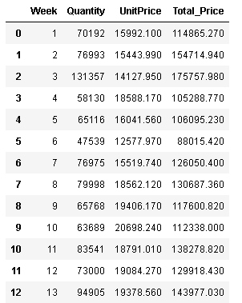
Data Selection
Cleaned and selected the data that would be used for the Multiple Linear regression model in the implementation phase of our project.

Slide 13
Modeling
The machine learning field,the terms hypothesis and model are often used interchangeably. Hypothesis could be the “educated guess” and the model would be the action of this guess to test this hypothesis.
We Have selected three Machine Learning models
Linear regression Model
Multiple Regression Model
ARIMA Model

Slide 14
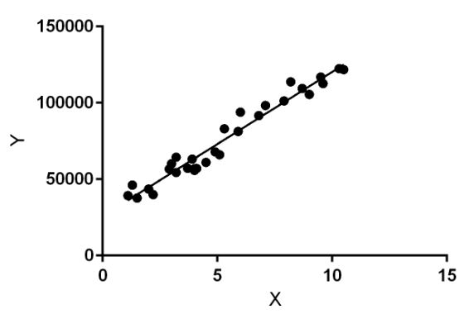

Linear Regression
Linear regression uses one or more independent variable(X) to explain or predict the outcome of dependent variable(Y).
In this figure X(input) is the work experience And Y(output) is the salary of person.The Regression line is the best fit line for this model.
Linear regression model-

Slide 15

Multiple Linear Regression
It is a statistical technique that uses several independent variable to predict the outcome of response variable.
A multiple linear regression model with k predictor variables x1, x2, ..., xk and a response y, can be written as:
Example-
In our model ,Total_Sales can depend on the quantity and Uniteprice.

Slide 16
Implementation & Result
In this section, we have implemented our multiple Regression model which can predict the Total sales of any week of the year.
Each row represents the specific Week, the total
Quantity of products,total Unit Price
and the Total_Price which is denoted as Total_sale.

Slide 17
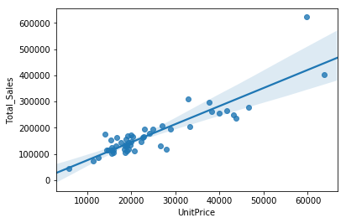
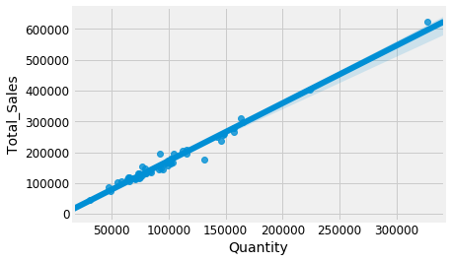
Implementation & Result
We check that linear relationship exists in our data set between-
The Total_Price(dependent variable) and the Quantity(independent variable)
The Total_Price(dependent variable) and the UnitPrice(independent variable)

Slide 18
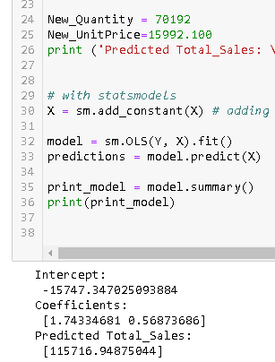
Implementation & Result
We calculate intercept and coefficients and used this information to build Multiple Linear Regression. Here we got our Predicted Total_Sales.

Slide 19
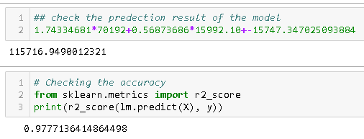
Implementation & Result
Check the prediction result of the model-

Slide 20
Overview of ARIMA model
Arima : In order to extract meaningful statistics and other characteristics we used time series data which have only two variables Time and Sales. We wanted to predict the future sales in accordance with time. So we chosen the ARIMA time series model to predict the future values based on the previous observed values.
ARIMA model is classified as an ARIMA (p, d, q)
p= p is the order of Autoregressive(AR) term.
d= d is the number of differencing required to make the time series stationary.
q= q is the order of Moving average(MA) term, it refers to the lag of error component.

Slide 21
Overview of ARIMA model
Basic Steps :
The data must be stationary before it is fed into an ARIMA model.
The residuals must be stationary after they calculated from the ARIMA model.
If the data is not stationary then the difference it until it becomes stationary.
Find which model coefficients provide the best fit for the data, lower (AIC) is usually the best model.
Validate the model
Build the model to predict the future sales data.

Slide 22
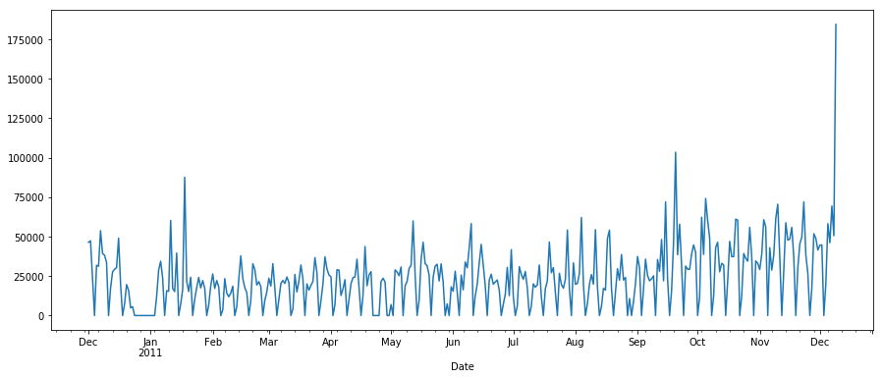
Overview of ARIMA model
Our Time Series Data :

Slide 23
Overview of ARIMA model
AR(p) : Autoregression a model that uses the dependent relationship between an observation and some number of lagged observations.
I(d) : Differencing of raw observations in order to make the time series stationary.
Ydt=Yt−Yt−1
MA(q) : Moving average a model that uses the dependency between an observation and a residual error from a moving average model applied to lagged observations.
ARIMA (p,d,q): AutoRegressive Integrated Moving Average

Slide 24
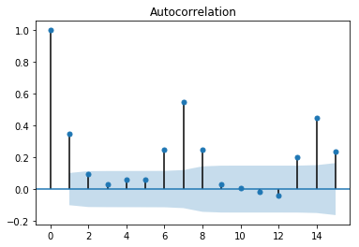
Overview of ARIMA model
Auto-Correlation-Function (ACF) :
The correlation between the observation at the
current time spot and the observations at
previous time spots.
St = Avg Sales this day.
St-1=Avg Sales last day
St-2 = Avg Sales of previous last day.

Slide 25
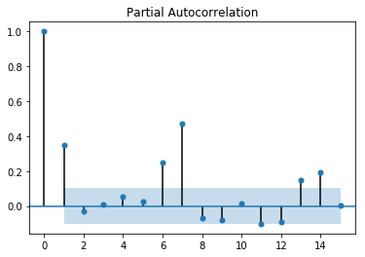
Overview of ARIMA model
Partial Auto-Correlation Function (PACF) :
The correlation between observations at two time
Spots given that we consider both observations
Are correlated to observations at other spots.

Slide 26
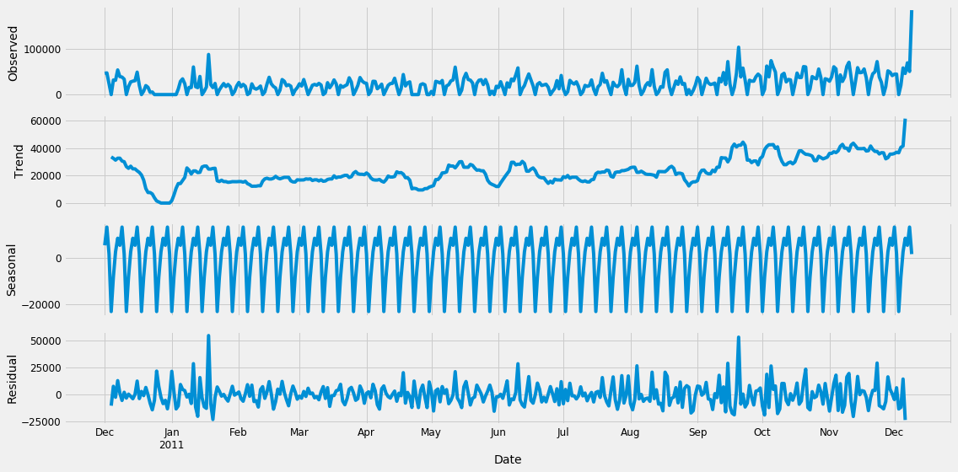
Overview of ARIMA model
Observed : Our Actual Data
Trend : Some kind of trend
Seasonal : Regularly occurring pattern
Residual : Residual Values.

Slide 27
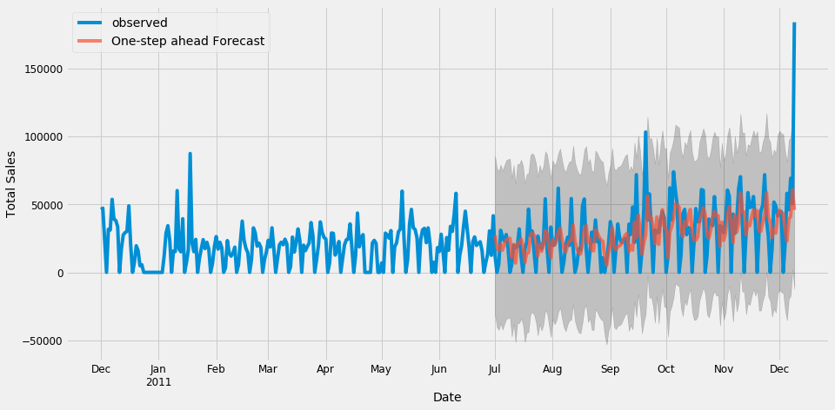
Overview of ARIMA model
Validate the model :
The output with forecasted values
of total sales in red from jul to dec.

Slide 28
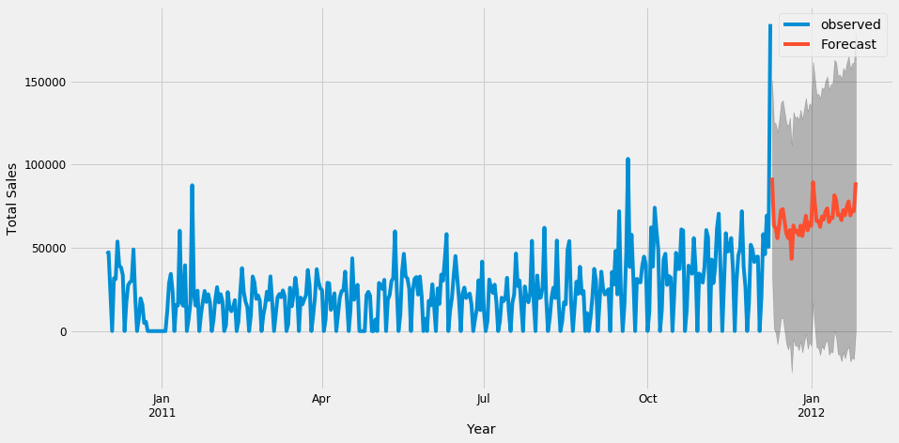
Overview of ARIMA model
Future Sales Prediction :
The ARIMA forecasting equation for a
Stationary time series can be represented as a
A linear equation in which the predictors
Consist of lags of the dependent variable
and/or lags of the error term.

Slide 29
Conclusion
The group managed to answer the problem statement
The group managed to create its own plan and fulfill it
The group got an overview of the process of a data science project
The group got a deeper understanding about the various topics regarding data science
BUT
Data science is interdisciplinary field and investigating these disciplines is vital in order to get better at the craft

