Slide 1



Slide 2











Notes:
Please take a moment and thank our Principal, Platinum and Gold Sponsors.

Slide 3
Minimalist’s Guide to Building Hybrid Mobile Apps

Slide 4
Alper Sunar
@asunar
github.com/asunar
Paylocity

Slide 5

We’re hiring !
100% remote (or Arlington Heights, IL)
SaaS company (.NET, Mobile)
Smart, open-minded co-workers
Generous training allowance
Talk to me if interested

Slide 6









Building an SPA? Pick a framework

Slide 7
Stay close to the grain. Build with HTML, CSS and JavaScript – Addy Osmani https://the-pastry-box-project.net/addy-osmani/2014-March-26

Slide 8
Let’s do it!

Slide 9
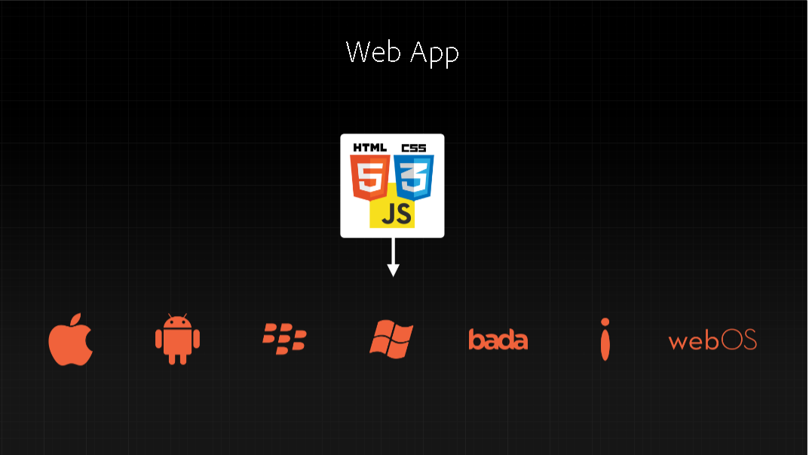

Slide 10
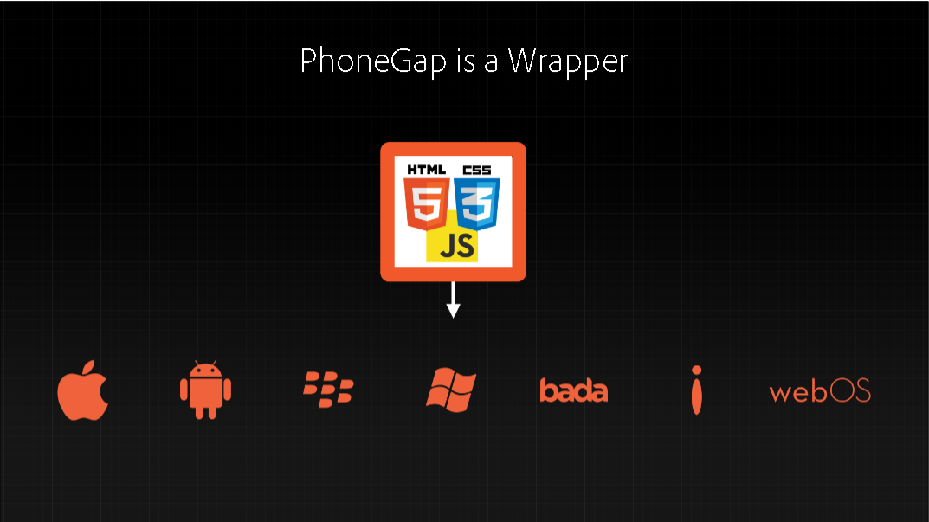

Slide 11
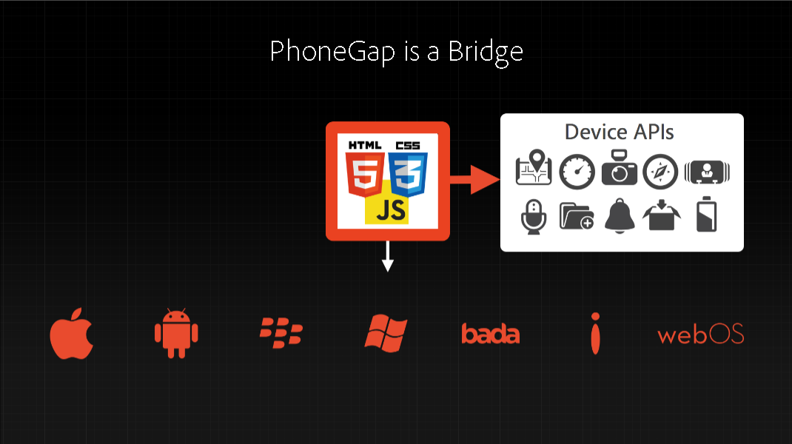

Slide 12
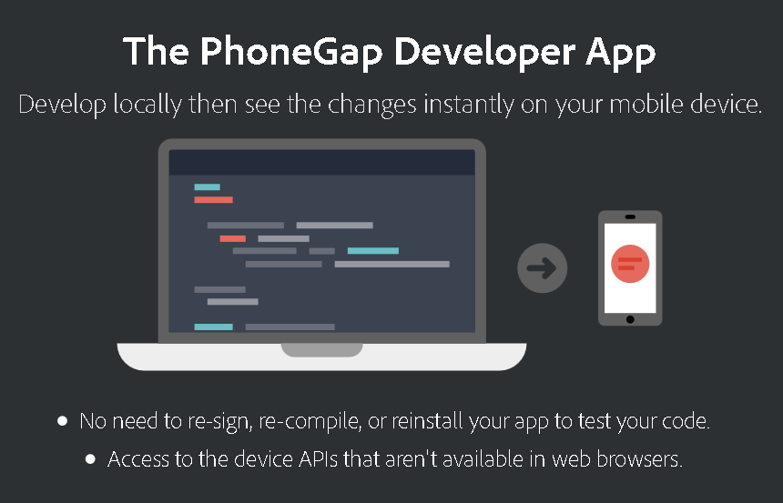
Testing on the device

Slide 13
300ms delay => FastClick

Slide 14
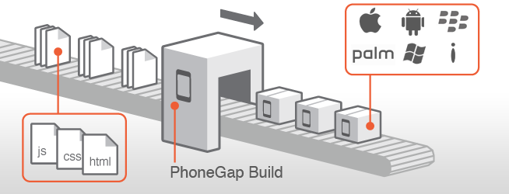
PhoneGap Build
www folder => DONE!
Configap for configuration
Rejoice

Slide 15
Next Steps
Contact server to get update session/speaker info
Send notifications when sessions in your schedule are updated
Send notification when sessions in your schedule are about to begin
…

Slide 16
Questions?

Slide 17
Thank you!
Alper Sunar
@asunar
github.com/asunar
Paylocity

Slide 18

Notes:
Next year’s date.

