Slide 1

Examples
BWP 1
BWP 2
#
of
PRBs
BWP 1
CBW
BWP
BWP 2
BWP 2
BWP 3
BWP 3

Slide 2
Time
Slot (0.5 ms)
Symbol
1 | 2 | 3 | 4 | 5 | 6 | 7 | 8 | 9 | 10 | 11 | 12 | 13 | 14
2
3
4
5
6
7
8
9
10
11
12
Subcarrier
(15 kHz)
PRB
(180 kHz)
Frequency
Subframe (1 ms)

Slide 3
IMSI
International Mobile Subscriber Identity
Identifies the SIM or USIM
MSIN
Mobile Subscriber Identification Number
PLMN
Public Land Mobile Network
MNC
Mobile
Network Code
MCC
Mobile Country Code
HLR/HSS
Identity
Subscriber Identity
3 digits
2 to 3 digits
BWP 2
BWP 1
BWP 3
BWP 1
BWP 2
BWP 3

Slide 4
IMSI
International Mobile Subscriber Identity
Identifies the SIM or USIM
MSIN
Mobile Subscriber Identification Number
PLMN
Public Land Mobile Network
MNC
Mobile
Network Code
MCC
Mobile Country Code
HLR/HSS
Identity
Subscriber Identity
3 digits
2 to 3 digits

Slide 5
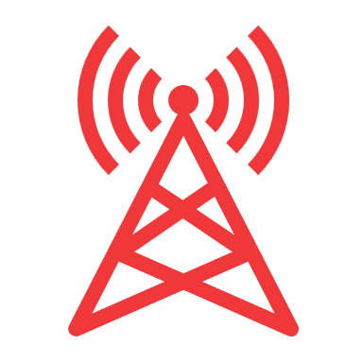

PDN-GW
SGi
Internet
S5
CP
UP
HSS
S6
MME
S11
Serving-GW

