Slide 1

Employee Data Analysis using Excel
STUDENT NAME: S BHAVANI
REGISTER NO: 312217711
NAAN MUDHALVAN ID: asunm1011010unm1011010312217711
DEPARTMENT: COMMERCE
COLLEGE: GOVERNMENT ARTS AND SCIENCE COLLEGE, TIRUVOTTIYUR

Slide 2

PROJECT TITLE
Employee Performance Analysis using Excel

Slide 3


AGENDA
Problem Statement
Project Overview
End Users
Our Solution and Proposition
Dataset Description
Modelling Approach
Results and Discussion
Conclusion
3/21/2024 Annual Review

Slide 4

PROBLEM STATEMENT
To analyze employee data to uncover insights into performance, compensation fairness, and retention rates. The goal is to identify trends and issues that impact employee effectiveness and satisfaction, enabling data-driven improvements in HR practices and organizational strategies.

Slide 5

PROJECT OVERVIEW
This project involves analyzing employee data to enhance organizational effectiveness. The analysis will focus on evaluating employee performance, assessing compensation fairness, and understanding turnover rates. By integrating data from performance reviews, payroll records, and demographic information, the project aims to identify key trends and issues. The outcome will include actionable insights and recommendations to improve HR practices, optimize compensation structures, and develop strategies to boost employee retention and satisfaction.
.

Slide 6
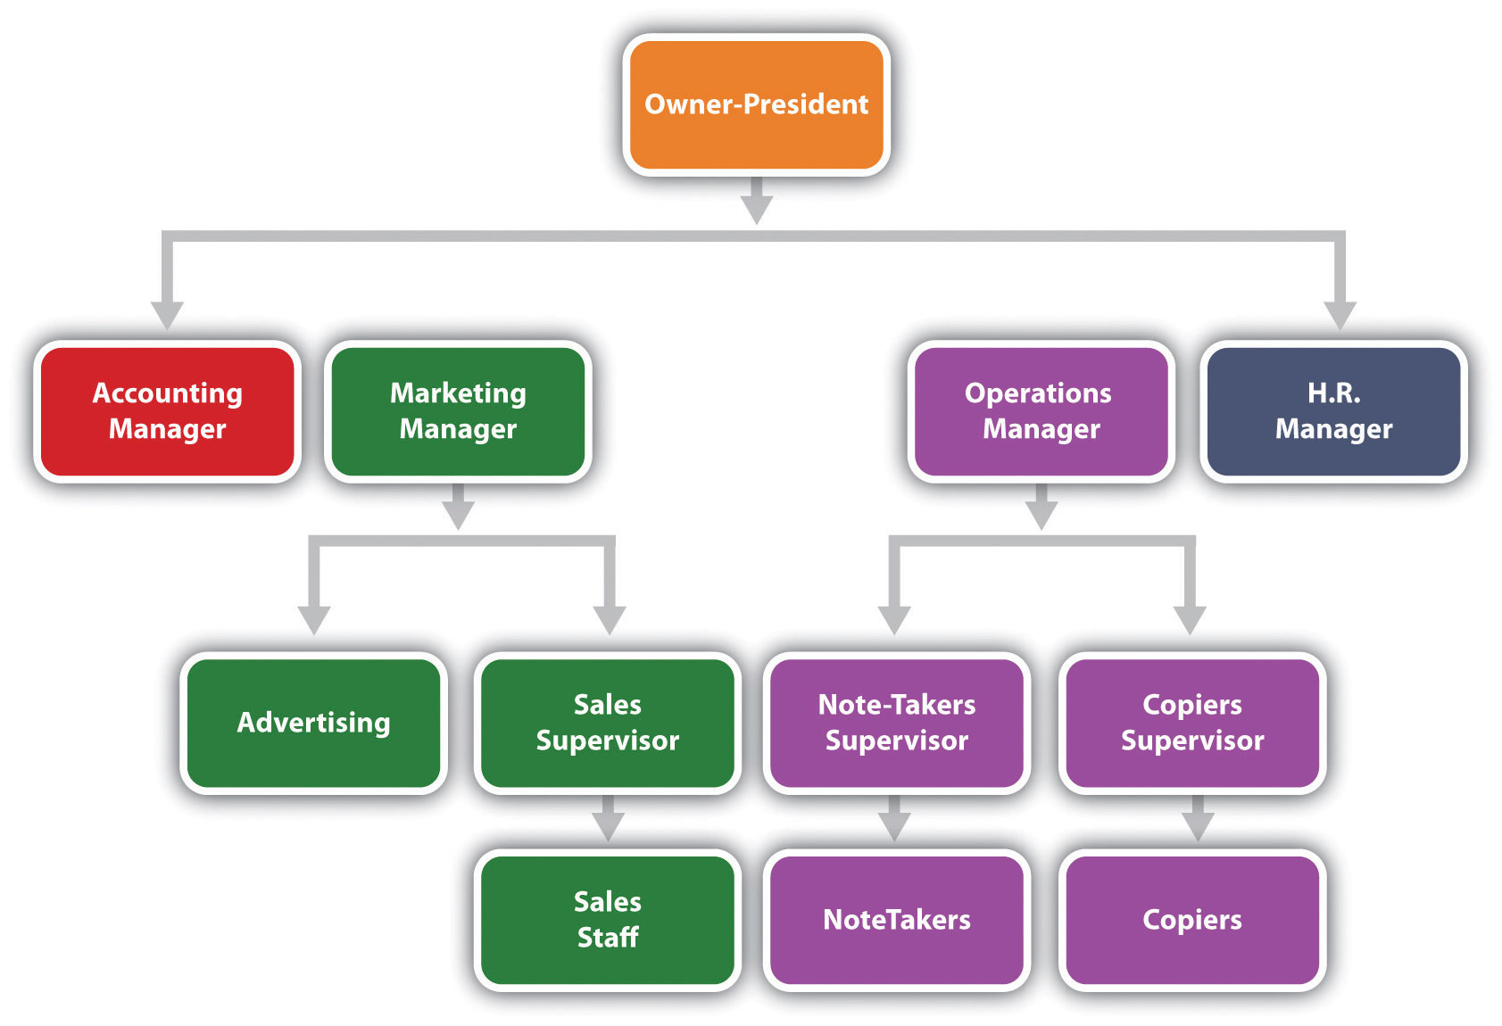

WHO ARE THE END USERS?

Slide 7

OUR SOLUTION AND ITS VALUE PROPOSITION
CONDITIONAL FORMATING - MISSING
FILTER - REMOVE
FORMULA – PERFORMANCE
PIVOT – SUMMARY
GRAPH – DATA VISUALISATION

Slide 8
Dataset Description
Downloaded the employee dataset from kaggle. They have totally 26 features in it.
I get only 9 specified features
Employee ID: Unique identifier for each employee in the organization.
First Name: The first name of the employee.
Last Name: The last name of the employee.
Business Unit: The specific business unit or department to which the employee belongs.
Employee Status: The current employment status of the employee (e.g., Active, On Leave, Terminated).
Employee Type: The type of employment the employee has (e.g., Full-time, Part-time, Contract).

Slide 9
Dataset Description
Employee Classification Type: The classification type of the employee (e.g., Exempt, Non-exempt).
Gender: A code representing the gender of the employee (e.g., M for Male, F for Female, N for Non-binary).
Performance Score: A score indicating the employee's performance level (e.g., Excellent, Satisfactory, Needs Improvement).
Current Employee Rating: The current rating or evaluation of the employee's overall performance.

Slide 10

THE "WOW" IN OUR SOLUTION
PERFOEMANCE LEVEL =IFS(Z8>=5,”VER HIGH”,Z8>=4,”HIGH”,Z8>=3,”MED”,TRUE,”LOW”)
3/21/2024 Annual Review
10

Slide 11
MODELLING
DATA COLLECTION:
OPEN THE PAGE OF KAGGLE WEB
SEARCH “EMPLOYEE PERFORMANCE DATASET”
DOWNLOAD “EMPLOYEE DATA SET (ALL IN ONE)”.
FEATURE COLLECTION:
EMPLOYEE ID, FIRST NAME, LAST NAME, BUSINESS UNIT, EMPLOYEE STATUS, EMPLOYEE TYPE, EMPLOYEE CLASSIFICATION TYPE, GENDER, PERFORMANCE SCORE, CURRENT EMPLOYEE RATING.
DATA CLEANING:
CONTITIONAL FORMATTING
FILTER
11

Slide 12
MODELING
PERFORMANCE LEVEL:
1) GRADING THE EMPLOYEE RATING USING EXCEL FORMULA
SUMMARY:
1) CREATING A PIVOT TABLE
2) FILTER THE DATA
3) USING THE SLICER
4) INSERT RECOMMENDED CHART
12

Slide 13
RESULTs
13

Slide 14

conclusion
The employee data analysis reveals critical insights into performance trends, compensation fairness, and retention patterns. By evaluating performance metrics, salary distributions, and turnover rates, the analysis highlights areas for improvement in HR practices and compensation strategies. Key findings include disparities in compensation that need addressing, performance gaps that could benefit from targeted development programs, and turnover trends that suggest strategies for enhancing employee retention. Implementing these insights can lead to more informed decision-making, improved employee satisfaction, and a more effective organizational strategy.

