Slide 1
Employee Data Analysis using Excel
STUDENT NAME: SHARMA G
REGISTER NO:122200102
DEPARTMENT:BCOM (CS)
COLLEGE PACAIYAPPAS COLLEGE FOR WOMEN KANCHIPURAM

Slide 2
PROJECT TITLE
Salary and compensation analysis through Excel Data modeling
Salary and compensation analysis through Excel data modeling

Slide 3


AGENDA
Problem Statement
Project Overview
End Users
Our Solution and Proposition
Dataset Description
Modelling Approach
Results and Discussion
Conclusion
3/21/2024 Annual Review

Slide 4

PROBLEM STATEMENT
problem statement is a document that outlines a specific problem in an organization. For instance, problem statements often refer to inefficiencies in a given workplace process that hinder progress in a project or task.

Slide 5

PROJECT OVERVIEW
If you're a project manager or are responsible for leading a team through a project, it may be helpful to create a project overview. A project overview outlines the important details of your project, such as its goals and potential risks. Knowing more about project

Slide 6

WHO ARE THE END USERS?
An end user is the person a product development team has in mind when they design a product. They differ from customers because they can’t resell the product or service they purchase. If you

Slide 7

OUR SOLUTION AND ITS VALUE PROPOSITION
A value proposition is a short statement that communicates why buyers should choose your products or services. It's more than just a product or service description — it's the specific solution that yo

Slide 8
Dataset Description
A data set (or dataset) is a collection of data. In the case of tabular data, a data set corresponds to one or more database tables, where every column of a table

Slide 9

THE "WOW" IN OUR SOLUTION
From a WOW! project perspective, the key is to find big cost savings opportunities. Percentages do not necessarily need to be large, but the dollars must be substantial. That is, a 20% reduction that saves $100,000 USD is not as interesting as a 2% reduction that saves $2 million USD. Note that hard dollar
3/21/2024 Annual Review
9

Slide 10
MODELLING
Modeling involves making a representation of something. Creating a tiny, functioning volcano is an example of modeling. Teachers use modeling when they have a class election that represents a
10

Slide 11
MODELLING
Modeling involves making a representation of something. Creating a tiny, functioning volcano is an example of modeling. Teachers use modeling when they have a class election that represents a larger one, like a presidential election. Modeling is anything that represents something else, usually on a smaller scale.
11

Slide 12
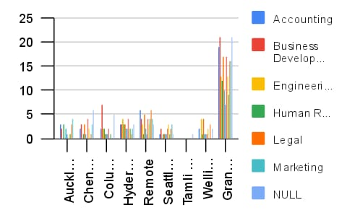
RESULTS
12

Slide 13
conclusion
SALARY IS NOT SOMETHING WE SHOULD IGNORE, even though many of us might not want to spend too much time dwelling on money matters or worrying that we don’t make enough.

