Slide 1
Employee Data Analysis using Excel
STUDENT NAME: Alis Esthar Rani Y
REGISTER NO:122200072
DEPARTMENT:B.COM cs
COLLEGE: PACHAIYAPPA's COLLGE FOR WOMEN KANCHIPURAM.

Slide 2
PROJECT TITLE
Employee Performance Analysis using Excel

Slide 3


AGENDA
Problem Statement
Project Overview
End Users
Our Solution and Proposition
Dataset Description
Modelling Approach
Results and Discussion
Conclusion
3/21/2024 Annual Review

Slide 4

PROBLEM STATEMENT
The problem statement should address not only what the problem is, but why it's a problem and why it's important to solve it. This will wrap the other 'W' questions in organically, in most cases. For example: Why should we fix this problem?

Slide 5

PROJECT OVERVIEW
.
A project overview is a detailed description of a project's goals and objectives, the steps to achieve these goals, and the expected outcomes. In addition, a project overview enables you to outline the project schedule, budget, necessary resources, and status.
.

Slide 6

WHO ARE THE END USERS?
Successful technology solutions prioritize user experience design around user-centricity. Designers must consider factors such as readability, simplicity, and efficiency to enhance the overall usability of the product for end users.

Slide 7

OUR SOLUTION AND ITS VALUE PROPOSITION
A value proposition is a short statement that explains the benefits of a product or service and why a customer should choose it over competitors. It should be specific, clear, and written in the language of the customer. Here are some tips for writing a value proposition

Slide 8
Dataset Description
The organized collections of data is known as dataset. They are mostly used in fields like machine learning, business, and government to gain insights, make informed decisions, or train algorithms

Slide 9

THE "WOW" IN OUR SOLUTION
Every time I travel to Boston, I stay in the same hotel. It's not fancy and the location isn't great, but they know how to wow a customer. The way that I’m treated when I go there has always left an impression on me.
3/21/2024 Annual Review
9

Slide 10
MODELLING
Modeling is an extremely useful teaching tool that should be used as often as possible. Modeling is a teaching strategy where a teacher explicitly shows the students how to complete an activity or assignment before the students begin. Modeling is also an excellent class management technique.12 Aug 2020
10

Slide 11
MODELLING
Modeling is an extremely useful teaching tool that should be used as often as possible. Modeling is a teaching strategy where a teacher explicitly shows the students how to complete an activity or assignment before the students begin. Modeling is also an excellent class management technique.12 Aug 2020
11

Slide 12
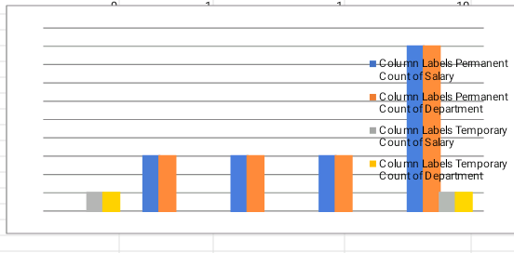
RESULTS
12

Slide 13
conclusion
When you come to a conclusion, you decide that something is true after you have thought about it carefully and have considered all the relevant facts.

