Slide 1


Employee Data Analysis using Excel
STUDENT NAME: Sunil Kumar M
REGISTER NO: 312200961(asunm10942519)
DEPARTMENT: B.com General
COLLEGE : DRBCCC Hindu College

Slide 2

Project Title!
Employee attendance analysis

Slide 3

AGENDA
1 | Problem Statement
2 | Project Overview
3 | End Users
4 | Our Solution and Proposition
5 | Dataset Description
6 | Modelling Approach
7 | Results and Discussion
8 | Conclusion

Slide 4

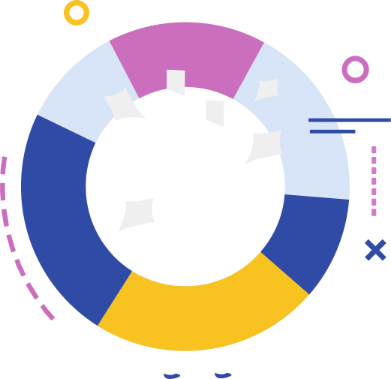

Problem Statement
Organizations often face challenges in effectively managing and analyzing employee attendance data. Inconsistent attendance tracking, lack of insights into absenteeism trends, and the impact of attendance on productivity can lead to operational inefficiencies, increased costs, and lower employee morale.
This presentation aims to explore how comprehensive employee attendance analysis can identify patterns, improve attendance management, and support strategic decision-making to enhance overall organizational performance.

Slide 5

Project Overview
The "Employee Attendance Analysis" project focuses on evaluating and improving the management of employee attendance within an organization. Attendance is a critical aspect that directly influences productivity, operational efficiency, and employee morale. This project aims to collect, process, and analyze attendance data to identify patterns of absenteeism, tardiness, and other related trends.
The ultimate goal of the project is to enhance the organization’s attendance management system, ensuring that it not only tracks attendance accurately but also provides actionable insights to optimize workforce management. This will contribute to higher productivity, improved employee satisfaction, and reduced operational costs.

Slide 6

WHO ARE THE END USERS?
Human Resource Department
Management and Executives
Team Leaders and Supervisors
Payroll Department
Employees

Slide 7

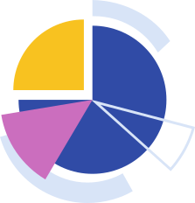
Our Solution And Its Value Proposition
Our solution is an advanced Employee Attendance Analysis system designed to collect, process, and analyze attendance data with precision and efficiency. By integrating data from various sources, including time-tracking software, biometric systems, and manual logs, our solution provides a comprehensive overview of employee attendance patterns.
Improve Workforce Management: By identifying attendance trends, managers can make informed decisions regarding staffing, scheduling, and resource allocation, ultimately enhancing productivity.
Reduce Operational Costs: By minimizing unplanned absenteeism and optimizing workforce utilization, the organization can significantly reduce costs associated with overtime, temporary staffing, and lost productivity.
Enhance Employee Engagement: By addressing attendance issues promptly and fairly, the organization can foster a more positive work environment, leading to higher employee satisfaction and retention.

Slide 8
Dataset Description
Department: The department or team the employee belongs to.
Role/Position: The employee’s job title or role within the organization.
Employee ID: A unique identifier for each employee.
Date: The specific date for each attendance record.
Check-In Time: The time when the employee clocks in for the day.
Check-Out Time: The time when the employee clocks out for the day.

Slide 9
THE "WOW" IN OUR SOLUTION
AI-Powered Predictive Analytics: Predicts future attendance issues, allowing proactive management and tailored interventions.
Real-Time Dashboards: Provides instant, customizable insights into attendance data for quick decision-making.
Seamless Integration: Integrates with existing systems, ensuring consistent data flow and reducing errors.
Employee Self-Service: Empowers employees with access to their attendance records and gamified features to boost engagement.
Advanced Compliance Monitoring: Real-time alerts for policy deviations and regulatory adherence, minimizing legal risks.

Slide 10


MODELLING
Data Preprocessing: Clean data, handle missing values, and create features for trends.
Predictive Modeling: Apply algorithms (decision trees, random forests) to predict absenteeism.
Evaluation Metrics: Use accuracy, precision, and cross-validation to ensure reliability.
Deployment: Integrate into HR systems and monitor performance for adjustments.

Slide 11

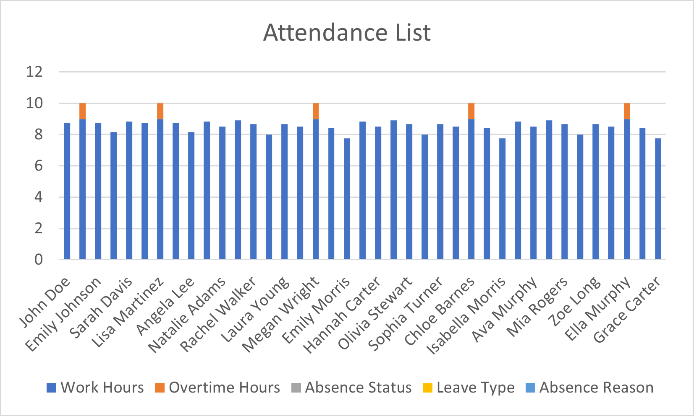
Results

Slide 12
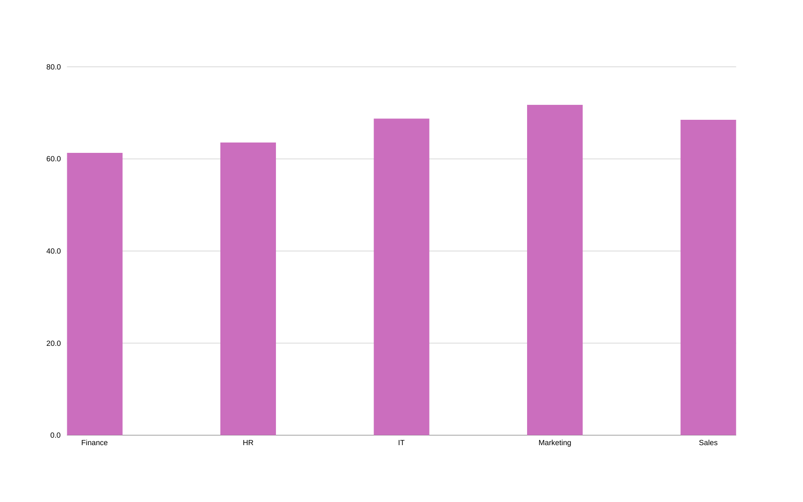
Results

Slide 13
Conclusion
Our Employee Attendance Analysis project has provided valuable insights into attendance patterns, enabling the organization to enhance its workforce management. Key takeaways include:
Enhanced Understanding: The analysis reveals critical trends and patterns in employee attendance, helping identify areas for improvement.
Predictive Power: Predictive modeling has equipped us with tools to anticipate absenteeism and tardiness, allowing for proactive management and better resource planning.
Improved Efficiency: Real-time data and automated reporting streamline attendance tracking, reducing administrative burden and operational costs.
Increased Engagement: Transparent and fair attendance policies foster a positive work environment, contributing to higher employee satisfaction and retention.

