Slide 1
Employee Data Analysis using Excel
STUDENT NAME: N.Deepa
REGISTER NO:22CA07(asunm136322ca07)
DEPARTMENT:B.com(commerce computer applications)
COLLEGE:valliammal college for women

Slide 2
PROJECT TITLE
Employee Performance Analysis using Excel

Slide 3


AGENDA
Problem Statement
Project Overview
End Users
Our Solution and Proposition
Dataset Description
Modelling Approach
Results and Discussion
Conclusion
3/21/2024 Annual Review

Slide 4

PROBLEM STATEMENT
salary analysis of employee data can help
businesses in a number of ways
it helps identify pay disparities to achieve
fairness internally and in comparison to the
industry

Slide 5

PROJECT OVERVIEW
.
this dataset contains information about the salaries of
employees at a company.each row represents a different
employee,and the columns include information such as
name,hra ,da,gross salary,pf and net salary

Slide 6
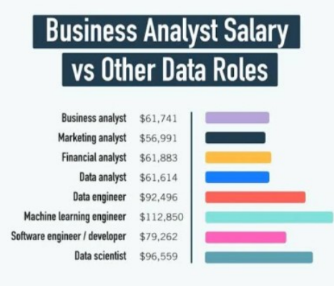

WHO ARE THE END USERS?
1.employee
2.employer
3.worker
all the sectors can
be users

Slide 7

OUR SOLUTION AND ITS VALUE PROPOSITION
1.filter-remove
2.formula-hra,da,pf,gross
salary,net salary
3.pirot-summary
4.graph-data visulalisation

Slide 8
Dataset Description
1.employee-edunet
2.ememployee id
3.name-type
4.salary
5.hra,da,pf,gr gross salary,net
salary

Slide 9

THE "WOW" IN OUR SOLUTION
1.hra=salary*%
2.da=salary*%
3.pf=salary*12%
4.i am prepare garph and Excel by
using only an mobile
3/21/2024 Annual Review
9
a salary benchmark helps you
organize and summarize your
data so you can review situation
that need to be employee

Slide 10
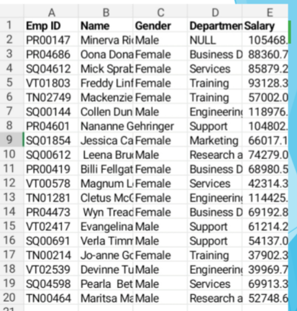
MODELLING
10

Slide 11
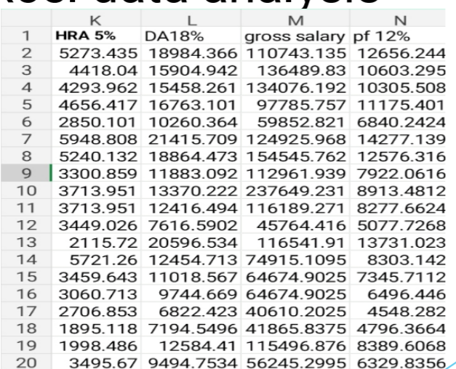
salary and compensation analysis through excel data analysis

Slide 12
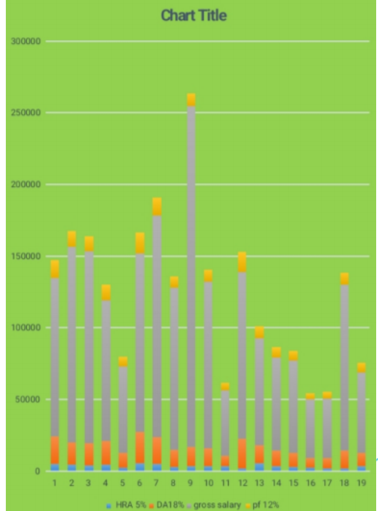
RESULTS
12

Slide 13
conclusion
a salary benchmark helps you
organize and summarize your
data so you can review situation
that need to be employee

