Slide 1
Digital Portfolio
STUDENT NAME: Sandhiya J
REGISTER no & NMID: 8BBDEE82A355D249D0D4EAB0E8B9744E
DEPARTMENT: Department of BCA
COLLEGE: COLLEGE/ UNIVERSITY: Mahalashmi Womens college of Arts and Science / Madras university

Slide 2
Project Title
Student Portfolio Website
A personal portfolio website built with HTML, CSS, and JavaScript.

Slide 3

Agenda
- Project statement
- Project Overview
- End Users
- Tools & technologies
- Features & functionality
- Results
- Conclusion
- Github link

Slide 4
Project Statement
A problem statement for a presentation on “digital portfolio” typically outlines the challenge or gap that digital portfolios aim to address. Here is a clear and concise problem statement example for a digital portfolio topic: ​
“Traditional methods of showcasing skills, achievements, and work samples often lack accessibility, interactivity, and real-time updates, making it difficult for individuals to effectively present their capabilities to potential employers or clients. There is a need for a dynamic, easily accessible platform—such as a digital portfolio—that enables comprehensive, organized, and visually appealing presentation of personal or professional work.”​

Slide 5

Project Overview
The project is a responsive portfolio website built with HTML, CSS, and JavaScript. It includes sections like About, Skills, Projects, and Contact, with an engaging theme and interactive design

Slide 6

Who are the End Users
Students showcasing their work
Recruiters seeking talented individuals
Teachers/mentors evaluating projects
Friends and peers exploring creativity

Slide 7
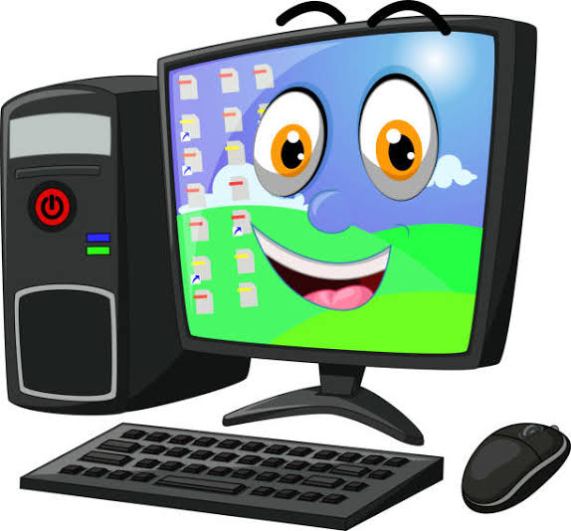
Tools and Techniquies
HTML5
CSS3 (Flexbox, Grid, Animations)
JavaScript (Interactive features)
Responsive Web Design principles

Slide 8

Portfolio Design and Layout🎨
Bold header with gradient background
Hero section with introduction & image
About, Skills, Projects, and Contact sections
Footer with unique personal tagline

Slide 9
Features and Functionality
Responsive layout for all devices
Interactive buttons (Hello Alert)
Hover effects for skills & projects
Attractive theme with gradients and highlights

Slide 10

Result
Successfully created a stylish and functional personal portfolio website that reflects Sandhiya’s bold, bright, and creative personality.

Slide 11
Conclusion
A digital portfolio is an essential tool that effectively showcases skills, projects, and
achievements in a clear and engaging way. It enhances professional visibility,
opens up career opportunities, and
allows easy sharing and updating of work. A well-designed, user-friendly portfolio creates a strong personal brand
and helps make a memorable impression on potential employers or clients.

