Slide 1
Employee Data Analysis using Excel
STUDENT NAME: S.ANITHA
REGISTER NO:asunm1485422200785
DEPARTMENT: B.com ( ISM )
COLLEGE : SOKA IKEDA COLLEGE OF ARTS AND SCIENCE FOR WOMEN

Slide 2
PROJECT TITLE
Employee Performance Analysis using Excel

Slide 3


AGENDA
Problem Statement
Project Overview
End Users
Our Solution and Proposition
Dataset Description
Modelling Approach
Results and Discussion
Conclusion
3/21/2024 Annual Review

Slide 4

PROBLEM STATEMENT
Lack of study in this area Studies were carried out elsewhere but not done locally Studies were carried out using a particular type of sample but mine will use a different type of sample Studies have found some factors but I want to find more factors

Slide 5

PROJECT OVERVIEW
A project overview is a detailed description of a project's goals and objectives, the steps to achieve these goals, and the expected outcomes

Slide 6

WHO ARE THE END USERS?
End users are consumers. They do not produce, sell, support, or maintain the product. These people often do not have the same technical understanding as the product's designers and developers. It's critical for a business to consider the end-user experience while developing products and services.

Slide 7

OUR SOLUTION AND ITS VALUE PROPOSITION
A value proposition is a statement that explains the benefits of a product or service, how it solves a customer's problem, and why customers should buy it. It's a customer-focused statement that's usually a sentence or phrase that can be used as a slogan or headline.

Slide 8
Dataset Description
A dataset, or data set, is a structured collection of data that is organized and stored together for a specific purpose and is related to the same subject.

Slide 9

THE "WOW" IN OUR SOLUTION
When someone makes us feel appreciated, respected and heard, we are impressed. 'Wow' is down to how you make your customers feel. That is what they'll remember.
3/21/2024 Annual Review

Slide 10
MODELLING
I have been scouring the Internet looking for a suitable dataset to model employee performance. I have been asking friends and scouring websites from Google to Kaggle, but I could not find anything. Luckily, I stumbled upon a GitHub article, written by Akshay Dusad, where the author uses an example dataset to model employee performance analysis.

Slide 11
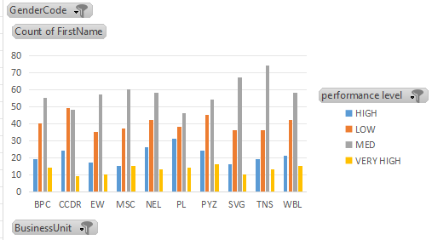
RESULTS
So, it can be concluded that, from the simple regression test results, the discipline variable on employee performance only contributes to an increase of 0,270 units.

Slide 12
conclusion
Employee performance metrics are key to tracking how well employees are carrying out their job. HR must have methods to measure the productivity and efficiency of employees. Tracking employee performance metrics benefits both the organization and the employee. We’ve listed 21 key performance indicators for employees that you should track, with examples.

