Slide 1
Employee Data Analysis using Excel
STUDENT NAME:V PRIYADHARSHINI
REGISTER NO:312216187
DEPARTMENT:B.COM Bank management
COLLEGE:SHRI SHANKARALA SUNDARBAI JAIN COLLEGE

Slide 2
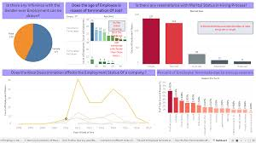
PROJECT TITLE
Employee Performance Analysis using Excel

Slide 3


AGENDA
Problem Statement
Project Overview
End Users
Our Solution and Proposition
Dataset Description
Modelling Approach
Results and Discussion
Conclusion
3/21/2024 Annual Review

Slide 4

PROBLEM STATEMENT
It is based on your literature review and informs your study design in a manner that facilitates the creation of a proposed solution through the data analysis.

Slide 5

PROJECT OVERVIEW
.
Employee Details dataset contains information such as employee ID, name, position, salary, and attendance. This information can be used to gain insights into the company's workforce, their performance, and overall productivity. Objectives : 1 To Analyze employee attendance patterns.

Slide 6
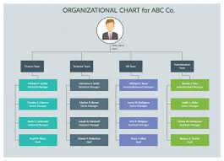

WHO ARE THE END USERS?

Slide 7

OUR SOLUTION AND ITS VALUE PROPOSITION
Conditional formatting-missing
Filter-remove
Formula-Performance
Pivot-summary
Graph-data visualiztion

Slide 8
Dataset Description
Employee=kaggle
26-features
9-features
Emp id-num
Name-text
Emp type
Performance level
Gender-male female
Employee rating-num

Slide 9

THE "WOW" IN OUR SOLUTION
Performance level =IFS (Z8>=5,”VERY
HIGH” ,Z8>,”Z8>=3”MED” ,TRUE,”LOW)
3/21/2024 Annual Review
9

Slide 10
MODELLING
Data Collection
Feature Collection
Data cleaning
Performance level
Summary
Visulazation
10

Slide 11
RESULTS
11

Slide 12
conclusion

