Slide 1
Employee Data Analysis using Excel
STUDENT NAME: yogadharshini.m
REGISTER NO:312217091(asunm1659312217091)
DEPARTMENT:B.com general
COLLEGE Shri krishnaswamy college for women

Slide 2
PROJECT TITLE. Visualizing Employee attendance Trends with excel charts

Slide 3


AGENDA
Problem Statement
Project Overview
End Users
Our Solution and Proposition
Dataset Description
Modelling Approach
Results and Discussion
Conclusion
3/21/2024 Annual Review

Slide 4
PROJECT STATEMENT
Project title:Visualizing Employee Attendance:Visualizing employee attendance can be done effectively using several methods. Here are some common approaches:1. Heat Maps: These show attendance trends over time, highlighting periods of high and low attendance with varying colors. They can help identify patterns or issues with attendance.2. *Bar Charts*: These can display attendance data for different time periods (daily, weekly, monthly) or across different departments or teams.

Slide 5

PROJECT OVERVIEW
.
Project Objective: To create a visual tool that effectively tracks and displays employee attendance, allowing HR and management to monitor patterns, identify issues, and make informed decisions. Scope: - *Data Collection:* - Gather data on employee attendance, including clock-in/out times, absences, and late arrivals.

Slide 6

WHO ARE THE END USERS?
Who are the end users:The end users for the "Visualizing Employee Attendance" project typically include:1. *HR Managers and Staff:* - *Primary Users* who will utilize the tool to monitor attendance, manage employee records, and identify trends related to absenteeism and punctuality. - They may also use the visualizations for performance reviews and compliance reporting.2. *Department Managers and Team Leaders:* - They use the tool to track their team's attendance, identify any patterns or issues, and manage team productivity. - The data can help in scheduling, managing workloads, and addressing attendance-related concerns with employees.

Slide 7

OUR SOLUTION AND ITS VALUE PROPOSITION
Our solution and it's value proposition:Our solution is a comprehensive, data-driven Key Features:- *Real-time Data Integration:* Automatically syncs with HR systems to ensure up-to-date attendance records.- *Interactive Dashboards:* User-friendly interfaces that display attendance metrics, trends, and patterns across various departments and timeframes.- *Customizable Views:Allows users to filter data by department, role, date range, and other relevant criteria.

Slide 8
Dataset Description
Dataset description :Here's a description of the dataset required for the "Visualizing Employee Attendance" project:Dataset Description for Visualizing Employee Attendance1. Employee Information: Employee ID: Unique identifier for each employee. - *Name:* Full name of the employee. - Department:The deparDataset description : Here’s a description of the dataset required for the “Visualizing Employee Attendance” project: Dataset Description for Visualizing Employee Attendance 1. Employee Information: Employee ID: Unique identifier for each employee. - *Name:* Full name of the employee. - Department:The department or team the employee belongs to. - Job Title:The rolttendance Records

Slide 9

THE "WOW" IN OUR SOLUTION
The "wow" in our solution :The "wow" factor in our solution for Visualizing Employee Attendance lies in its ability to go beyond standard attendance tracking, offering features that significantly enhance user experience, decision-making, and operational efficiency. Here are the key aspects that deliver the "wow" factor:1. Predictive Analytics and AI Integration: Future Attendance Forecasting:* Using machine learning algorithms, the tool predicts future attendance trends based on historical data, helping managers anticipate and address potential absenteeism before it becomes an issue. 2. Real-Time Collaboration and Communication: Live Dashboards: Managers and HR staff can access real-time attendance data, enabling them to respond instantly to issues as they arise. 3. Employee Self-Service Portal: Personalized Attendance Insights: Employees have access to a dashboard that shows their own attendance trends, comparison to team averages, and potential impacts on their performance evaluations. 4. Customization and Flexibility:
3/21/2024 Annual Review
9

Slide 10
MODELLING
Modelling:Modeling for Visualizing Employee Attendance involves designing a structured framework that represents the data, processes, and relationships necessary to generate meaningful visual insights. 1. Data Modeling: Entity-Relationship Diagram (ERD): Entities: Employee: Attributes include Employee ID, Name, Department, Job Title, Date of Hire, Employment Type. Attendance Record: Attributes include Attendance ID, Date, Clock-In Time, Clock-Out Time, Work Hours, Attendance Status, Employee ID (foreign key). Leave Record: Attributes include Leave ID, Employee ID (foreign key), Leave Type, Leave Start Date, Leave End Date, Approval Status. Shift: Attributes include Shift ID, Shift Start Time, Shift End Time, Break Duration, Employee ID (foreign key). 2. Data Processing Model: ETL (Extract, Transform, Load) Process: Extract: Pull raw attendance and employee data from HR systems, time-tracking software, and other relevant databases. Transform:
10

Slide 11
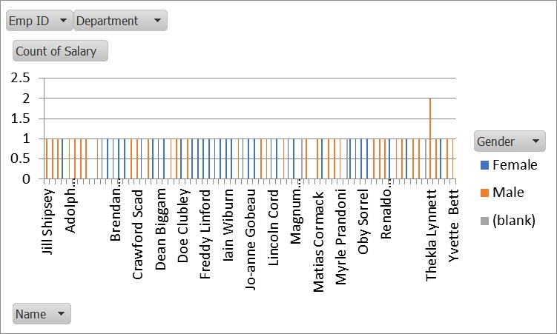
RESULTS
11

Slide 12
conclusion
Conclusion:In conclusion, visualizing employee attendance provides valuable insights into patterns, trends, and potential issues related to workforce management. Effective visualization helps in making informed decisions and promoting a culture of accountability and transparency within the workplace.

