Slide 1
Employee Data Analysis using Excel
STUDENT NAME:E. DURGA DEVI
REGISTER NO : 312219012
DEPARTMENT : 3rd YEAR B.COM[GENERAL]
COLLEGE : APOLLO ARTS AND SCIENCE COLLEGE, CHENNAI

Slide 2
PROJECT TITLE
Employee working Performance Analysis using Excel

Slide 3


AGENDA
Problem Statement
Project Overview
End Users
Our Solution and Proposition
Dataset Description
Modelling Approach
Results and Discussion
Conclusion
3/21/2024 Annual Review

Slide 4

PROBLEM STATEMENT
Employee performance is a critical factor inuuencing organizational success, requiring effective assessment and management strategies. Addressing performance issues promptly can enhance productivity and employee satisfaction.
An employee dataset overview provides essential insights into workforce demographics, performance metrics, and engagement levels, crucial for optimizing human resource strategies. Proper analysis can reveal trends and gaps, aiding in targeted improvements

Slide 5

PROJECT OVERVIEW
.
Employee performance is a critical factor inuuencing organizational success, requiring effective assessment and management strategies. Addressing performance issues promptly can enhance productivity and employee satisfaction.
An employee dataset overview provides essential insights into workforce demographics, performance metrics, and engagement levels, crucial for optimizing human resource strategies. Proper analysis can reveal trends and gaps, aiding in targeted improvements

Slide 6

WHO ARE THE END USERS?
**Human Resources (HR) Managers:** They use the insights to make informed decisions about promotions, training, and development.
**Team Leaders and Supervisors:** They apply performance data to provide feedback, set goals, and manage team performance.
**Employees:** They benefit from feedback and performance evaluations that help them improve and advance in their careers.
The end users in employee performance analysis typically include:

Slide 7

OUR SOLUTION AND ITS VALUE PROPOSITION
*Conditional formating- blank values.
*Using- Pivot table & Chart.

Slide 8
Dataset Description
Employee data set- Kaggle
There are 26 features
The important ten features are,
Employment ID
*First name *Last name
*Gender
*Employee status
*Employee type
*Employee classification
*Performance score
*Current employee ratings
Business units

Slide 9

THE "WOW" IN OUR SOLUTION
Performance Level– There are categories into Levels such as very high,high,med,low,etc...
Using Pivot table and charts is to analyse the employees performance.
3/21/2024 Annual Review
9

Slide 10
MODELLING
*Data Preparation: Clean and organize data, ensuring accuracy and consistency.
*Trend Analysis: Apply charts and graphs (e.g., line charts, bar graphs) to visualize trends over time, such as employee performance or turnover rates.
*Pivot Tables: Create pivot tables to aggregate and analyze data across different dimensions, such as department, tenure, or job role.
*Regression Analysis: Utilize regression functions to identify relationships between variables, such as the impact of training on performance.
10

Slide 11
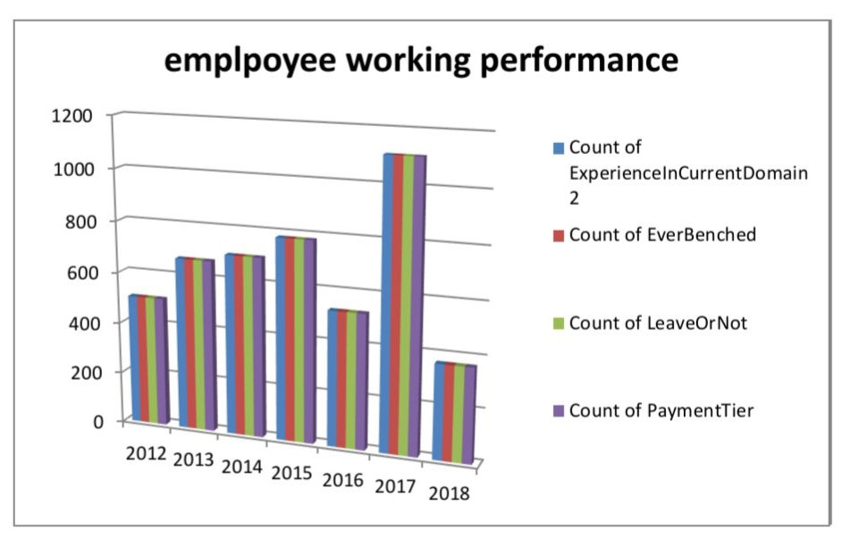
RESULTS
11

Slide 12
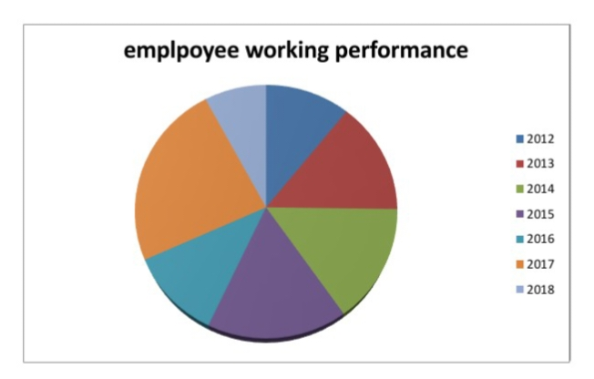

Slide 13
conclusion
The conclusion of employee data analysis reveals key insights into workforce trends, performance, and areas for improvement. By analyzing metrics such as productivity, turnover rates, and engagement levels, organizations can identify strengths and weaknesses in their HR strategies. This analysis supports data-driven decision-making, enabling targeted interventions to enhance employee performance, optimize recruitment processes, and improve overall organizational effectiveness. In essence, effective data analysis provides a foundation for strategic planning and

