Slide 1
Employee Data Analysis using Excel
STUDENT NAME: M.VIGNESHWARAN
REGISTER NO: 312220233
DEPARTMENT: 3rd B.COM (GENERAL)
COLLEGE: JEPPIAAR COLLEGE OF ARTS AND SCIENCE

Slide 2
PROJECT TITLE
Employee Performance Analysis using Excel

Slide 3


AGENDA
Problem Statement
Project Overview
End Users
Our Solution and Proposition
Dataset Description
Modelling Approach
Results and Discussion
Conclusion
3/21/2024 Annual Review

Slide 4

PROBLEM STATEMENT
I want to develop an Excel-based tool to analyse and evaluate employeeperformance metrics, including:-
Job Knowledge and Skills- Quality of Work- Communication and Teamwork- Adaptability and Problem-Solving- Overall Performance Rating

Slide 5

PROJECT OVERVIEW
.
Objective:Create an Excel-based dashboard to analyze and evaluate employeeperformance, providing insights for data-driven decisions on development,growth, and resource allocation.
Scope:1. Design a user-friendly Excel template for data input and analysis2. Develop formulas and calculations for performance scoring andweighting3. Create visualizations (charts, graphs, tables) to display performancetrends and insights

Slide 6

WHO ARE THE END USERS?
Human Resource Manager
Supervisors
Employees
Analysts
Executive leadership

Slide 7

OUR SOLUTION AND ITS VALUE PROPOSITION
Conditonal Formatting - To Highlight the Blanks cells and change the font colour of the cell .
Sort & Filter - Remove the BlankValues.
Pivot Table - Performance Analysis from the Company through Current Employee Rating.
Formulas - IFS (To get the Feedback of Rating )
Graphs- (Area Chart ) - FINAL REPORT on Employee Performance

Slide 8
Dataset Description
Employee Performance Dataset - IBM Edunet Portal.
Features - 29
Employee status - Text values
Employee type - Text values
Location code - Numerical values
Job function description - Text values
Gender code - Text values
Performance score - Text values
Current employee rating - Numerical values
Feedback - Text values

Slide 9

THE "WOW" IN OUR SOLUTION
New Formula Used : IFS
To Find out the Feedback for Performance of Employees by Analysing the Current Employee Rating
3/21/2024 Annual Review
9

Slide 10
MODELLING
Dataset Collection - Employee Performance Dataset
Dataset Preparation - Deleting Blanks, Filtering and Removing Blank data in the Dataset.
Using IFS formula to attain the Feedback for Job Performace through Current Employee Rating (1,2,3,4,5) (Good & Bad)
Insert Pivot Table to Summarize the Dataset on Employee Performance based on Gender Code , Current Employee Rating , and Feedback of Performance .
Data Visualization using Area Chart to represent the Performnce of the Employee.
Result and Discussion
Final Report
10

Slide 11
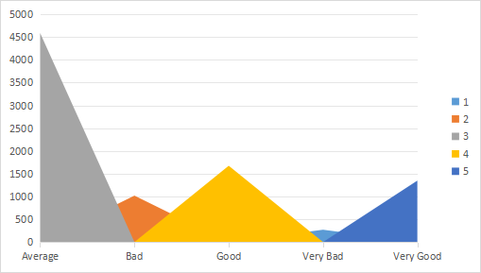
RESULTS
11

Slide 12
Conclusion
The Employee Performance Analysis using Excel has provided acomprehensive and data-driven approach to evaluating employeeperformance. By leveraging Excel's powerful tools and techniques.

