Slide 1
Employee Data Analysis using Excel
STUDENT NAME: E. Arun
REGISTER NO: 312204662/ CA8E3BE9BFE4E0A82CC42D5BCF7FB97B
DEPARTMENT: B. com (General) 3rd year
COLLEGE: New price Shri bhavani arts and science college

Slide 2
PROJECT TITLE
Employee Performance Analysis using Excel

Slide 3


AGENDA
Problem Statement
Project Overview
End Users
Our Solution and Proposition
Dataset Description
Modelling Approach
Results and Discussion
Conclusion
3/21/2024 Annual Review

Slide 4

PROBLEM STATEMENT
To write a problem statement on employee performance, you need to identify the specific area of performance that is problematic, such as low productivity, high absenteeism, or poor quality of work.
Step 1: Establish Performance Goals. ...
Step 2: Create a Performance Tracking Spreadsheet. ...
Step 3: Track Performance. ...
Step 4: Analyze Performance Data. ...
Step 5: Provide Feedback. ...
Step 6: Monitor Progress.

Slide 5

PROJECT OVERVIEW
At the top of the Excel spreadsheet, you need cells for an employee's name, job role and date of review. And below that sits the evaluation section. The evaluation section will be specific to your business and possibly also the role, so you'll need to decide what metrics are important.
.
Step 1: Establish Performance Goals. ...
Step 2: Create a Performance Tracking Spreadsheet. ...
Step 3: Track Performance. ...
Step 4: Analyze Performance Data. ...
Step 5: Provide Feedback. ...
Step 6: Monitor Progress

Slide 6

WHO ARE THE END USERS?
A supervisor typically looks at an employee's skills and accomplishments during a specific time period and tracks whether the employee has lived up to …
Use a calculated field in a pivot table to determine the average “Engagement Score” per year. Bring the Engagement Score Column from the Engagement table into the Employee Table using the Vlookup function and then select the Employee table to insert a pivot table.
Often, performance reviews include the manager's evaluation of the employee's overall performance and a self-evaluation conducted by the employee about their

Slide 7

OUR SOLUTION AND ITS VALUE PROPOSITION
Use a calculated field in a pivot table to determine the average “Engagement Score” per year. Bring the Engagement Score Column from the Engagement table into the Employee Table using the Vlookup function and then select the Employee table to insert a pivot table
Step 1: Establish Performance Goals. ...
Step 2: Create a Performance Tracking Spreadsheet. ...
Step 3: Track Performance. ...
Step 4: Analyze Performance Data. ...
Step 5: Provide Feedback. ...
Step 6: Monitor Progress.

Slide 8
Dataset Description
Use a calculated field in a pivot table to determine the average “Engagement Score” per year. Bring the Engagement Score Column from the Engagement table into the Employee Table using the Vlookup function and then select the Employee table to insert a pivot table
Graphic rating scales. A typical graphic scale uses sequential numbers, such as 1 to 5, or 1 to 10, to rate an employee's relative performance in specific areas. ...
360-degree feedback. ...
Self-Evaluation. ...
Management by Objectives (MBO). ...
Checklists.

Slide 9

THE "WOW" IN OUR SOLUTION
Step 1: Role-relevant goal setting to gauge employee performance. Goals are vital to performance because good goals help engage employees in their work. ...
Step 2: Set benchmarks. ...
Step 3: Give employees a guide on how to improve and monitor their progress.
Step 1: Establish Performance Goals. ...
Step 2: Create a Performance Tracking Spreadsheet. ...
Step 3: Track Performance. ...
Step 4: Analyze Performance Data. ...
Step 5: Provide Feedback. ...
Step 6: Monitor Progress
3/21/2024 Annual Review
9

Slide 10
MODELLING
A performance evaluation model is crucial for a company as it measures individual and collective employee. This helps identify strengths and areas for improvement and contributes to professional development, goal alignment, and continuous improvement
Use a calculated field in a pivot table to determine the average “Engagement Score” per year. Bring the Engagement Score Column from the Engagement table into the Employee Table using the Vlookup function and then select the Employee table to insert a pivot table
10

Slide 11
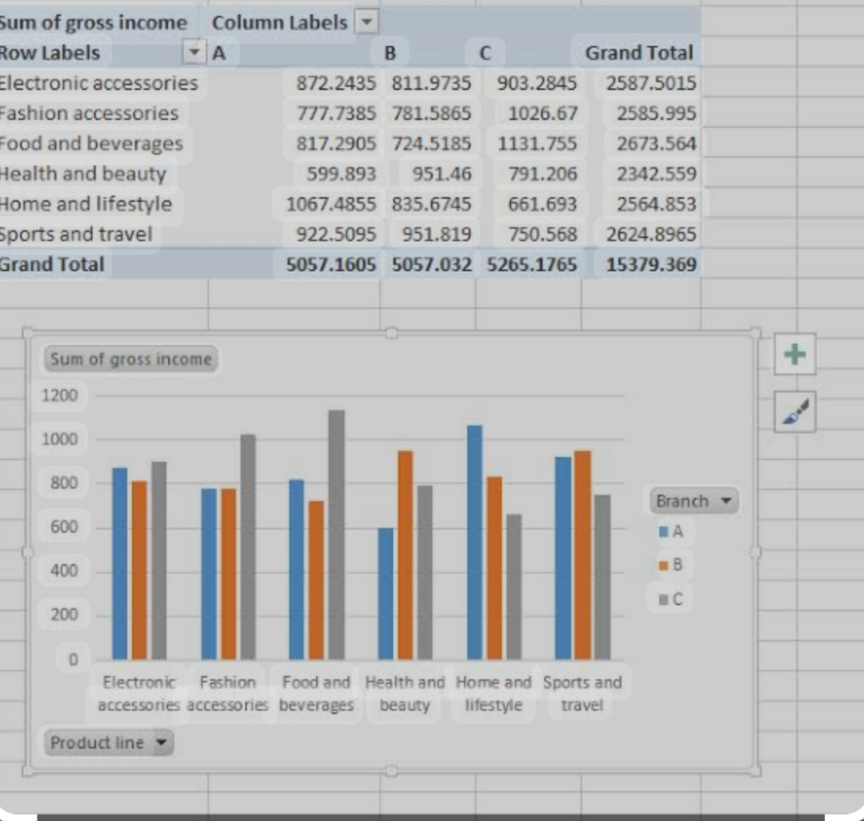
RESULTS
11

Slide 12
conclusion
In conclusion, performance appraisal is an important process that provides numerous benefits to both employees and organizations. It helps employees identify areas for improvement, set goals, receive feedback, and receive recognition for their achievements.
Use a calculated field in a pivot table to determine the average “Engagement Score” per year. Bring the Engagement Score Column from the Engagement table into the Employee Table using the Vlookup function and then select the Employee table to insert a pivot table

