Slide 1

German Traffic Sign Recognition: A CNN Approach
Developed a deep convolutional neural network (CNN) for German Traffic Sign Recognition (GTSRB dataset) using Keras and TensorFlow. This model recognizes 43 traffic sign classes from over 50,000 labeled images, focusing on reliable image classification for autonomous vehicles.

Slide 2


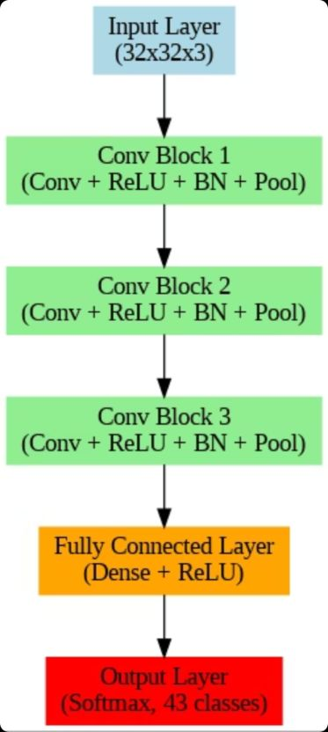



Model Architecture & Training
Architecture
Five convolutional blocks with batch normalization, max pooling, and dropout for regularization.
Model Size
3.85 million parameters, approximately 14.7 MB storage.
Accuracy
Training: 98.6%; Validation: 96.2% over 25 epochs.
Data Preprocessing
Normalization and augmentation (rotation, zoom, shift, shear) for improved generalization.

Slide 3
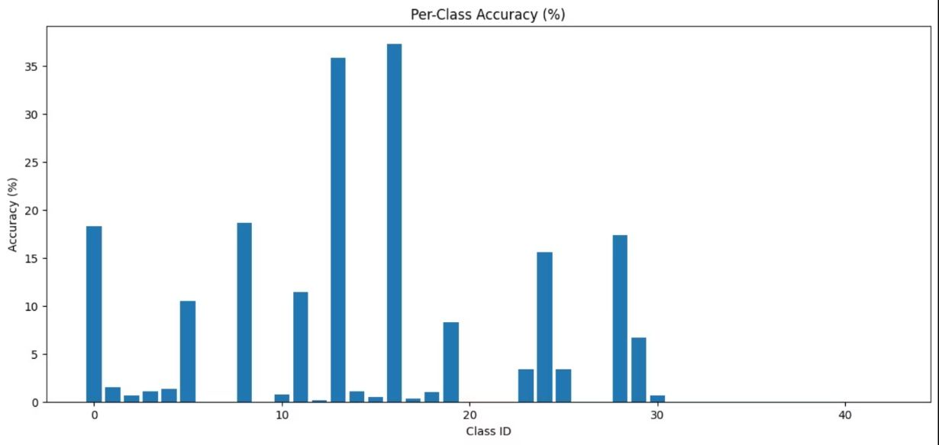
Key Results & Evaluation
Per-class accuracy varied, with some classes (e.g., speed limits) performing excellently, while others were challenging due to visual similarity or class imbalance.
Confusion matrix showed strong diagonal dominance, but noticeable confusion within visually similar traffic sign groups.
Test set accuracy was significantly lower than validation (5.08% vs. 96.17%), indicating a potential issue requiring urgent investigation.
Macro-averaged precision/recall/F1 of ~0.90 indicates generally robust performance, except for outlier classes.

Slide 4

Technical Implementations
Development Environment
Model Persistence
Developed in Python 3.11, utilizing NumPy, Pandas, Matplotlib, and Google Colab (GPU) for workflow and acceleration.
Model saved in .h5 format, enabling direct inference for deployment.

Slide 5


Robustness & Optimization
Data Augmentation
Improved robustness from 80% to 96% accuracy, better handling real-world variations.
Batch Normalization & Dropout
Significantly reduced overfitting and improved convergence speed.

Slide 6


Limitations & Challenges
1
2
Class Imbalance
Real-World Conditions
Certain signs were underrepresented in the dataset.
Model not tested in extreme conditions (e.g., heavy weather, occlusion).
3
Inference Latency
~50ms per image on CPU; GPU needed for real-time deployment.

Slide 7

Recommendations for Enhancement
Advanced Architectures
Explore Residual Networks, MobileNet, EfficientNet, Vision Transformers.
Expanded Data Augmentation
Simulate weather, occlusion, and synthetic image generation.
Efficiency & Accuracy
Implement ensemble methods, knowledge distillation, quantization, and model pruning.
Continuous Learning
Plan for robust monitoring in deployed systems.

Slide 8

Conclusion & Next Steps
The developed CNN achieved strong results on the GTSRB dataset, laying a foundation for future traffic sign recognition research and real-world applications.
Address Discrepancy
Real-Time Optimization
Advanced Designs
Investigate test/validation accuracy discrepancy.
Focus on real-time performance and robustness.
Explore new neural network designs for performance gains.

