Slide 1
FACE RECOGNITION USING REALTIME DATABASE
Submitted in the partial fulfillment for the award of the degree of
BACHELOR OF ENGINEERING
IN
COMPUTER SCIENCE ENGINEERING
Submitted by: 21BCS6274 T KARTHIKEYA 21BCS6116 HARI LUNAVATH 21BCS6323 VIGNAN KUMAR 21BCS6003 SHIVA REDDY
Under the Supervision of:
PRIYANKA KAUSHIK
Department of AIT-CSE
DISCOVER . LEARN . EMPOWER

Slide 2
Outline
Introduction to Project
Problem Formulation
Objectives of the work
Methodology used
Results and Outputs
Conclusion
Future Scope
References

Slide 3
Introduction to Project
The current system for keeping attendance is manual. Both professors and students lose a lot of time because of it. If attendance is taken manually, the students must wait longer. While attendance is recorded manually, there are still opportunities for proxies to attend the class. Human error is a constant expense of manual attendance. Any human may be recognized by their face alone. Hence, automating the attendance procedure will boost class productivity.

Slide 4
Problem Formulation
1. Problem Statement: The problem is to develop a face recognition system that integrates real-time database functionality to enable efficient and dynamic face recognition with the ability to track attendance in real-time.
2. Face Recognition: The primary task is to accurately recognize and match faces in real-time video frames captured from a camera or video stream. The system should be able to detect and identify individuals based on their facial features, even in the presence of variations in lighting conditions, poses, and facial expressions.
3. Real-time Database Integration: The system should integrate a real-time database, such as Firebase Realtime Database, to store and retrieve face recognition data. This includes storing known face encodings, associated student IDs or labels, attendance records, and other relevant information.
4. Attendance Tracking: The system should track attendance by recording the time and date when a recognized face is detected. It should update the attendance records in the real-time database in real-time, maintaining accurate attendance counts for each individual.
5. User Interface: The system should provide a user-friendly interface to display the real-time video stream, recognized faces, and relevant information from the real-time database. It should allow administrators to manage database entries, update attendance records, and perform administrative tasks easily.

Slide 5
Problem Formulation
6. Security and Authentication: The system should incorporate appropriate security measures to ensure secure access to the system and protect 9 sensitive data. This may include user authentication mechanisms, encryption of data, and access control to prevent unauthorized access.
7. Scalability and Performance: The system should be designed to handle a large number of faces and provide efficient and accurate face recognition in real-time. It should be scalable to accommodate a growing number of individuals and perform face recognition tasks with minimal latency.
8. Reliability and Robustness: The system should be reliable and robust, capable of handling various scenarios and environmental conditions. It should be able to handle variations in lighting, pose, facial expressions, and occlusions while maintaining accurate and consistent face recognition results.
9. Integration with Existing Systems: If applicable, the system should be designed to integrate with other existing systems or databases used for student information management, such as student enrollment records or academic databases.
10.Performance Evaluation: The proposed system should be evaluated and benchmarked using appropriate performance metrics, such as recognition accuracy, processing speed, and database query response time, to ensure its effectiveness and efficiency in real-world scenarios. By addressing these problem aspects, the proposed system aims to provide a robust and efficient face recognition solution with real-time database integration for applications such as attendance tracking, access control, and identity verification.

Slide 6
Objectives of the Work
Accurate Face Recognition: Develop a system for real-time face recognition that can accurately identify and match faces, accounting for variations in lighting, poses, expressions, and occlusions.
Real-time Database Integration: Integrate a real-time database to store and retrieve face recognition data, including face encodings, student IDs, attendance records, and other relevant information.
Real-time Attendance Tracking: Implement a feature to track attendance in real-time, updating the attendance records instantly upon face detection.
Efficient Database Management: Develop efficient mechanisms to handle a large number of face recognition entries and attendance records, ensuring fast and reliable database queries, updates, and retrieval.
User-friendly Interface, Security, and Scalability: Create a user-friendly interface, implement security measures to protect data and user privacy, and design the system to be scalable and performant.

Slide 7
Methodology used
Real-time Face Recognition Process:
Face Detection: Identify faces in the video stream using deep learning-based face detectors or techniques like Haar Cascade.
Face Alignment: Align the detected faces to a standard pose for effective recognition by adjusting their positioning, sizing, and orientation.
Feature Extraction: Extract unique facial features from the aligned faces using deep learning-based techniques like face embedding, which encodes features into compact vector representations.
Face Recognition: Compare the extracted features with a database of known faces to identify individuals using methods like nearest neighbor search or clustering.
Database Update: Prompt users to add new faces to the database if encountered in the video stream for future recognition.
Real-time Feedback: Display the results of the face recognition system in real time, such as overlaying names or information on the video stream.

Slide 8
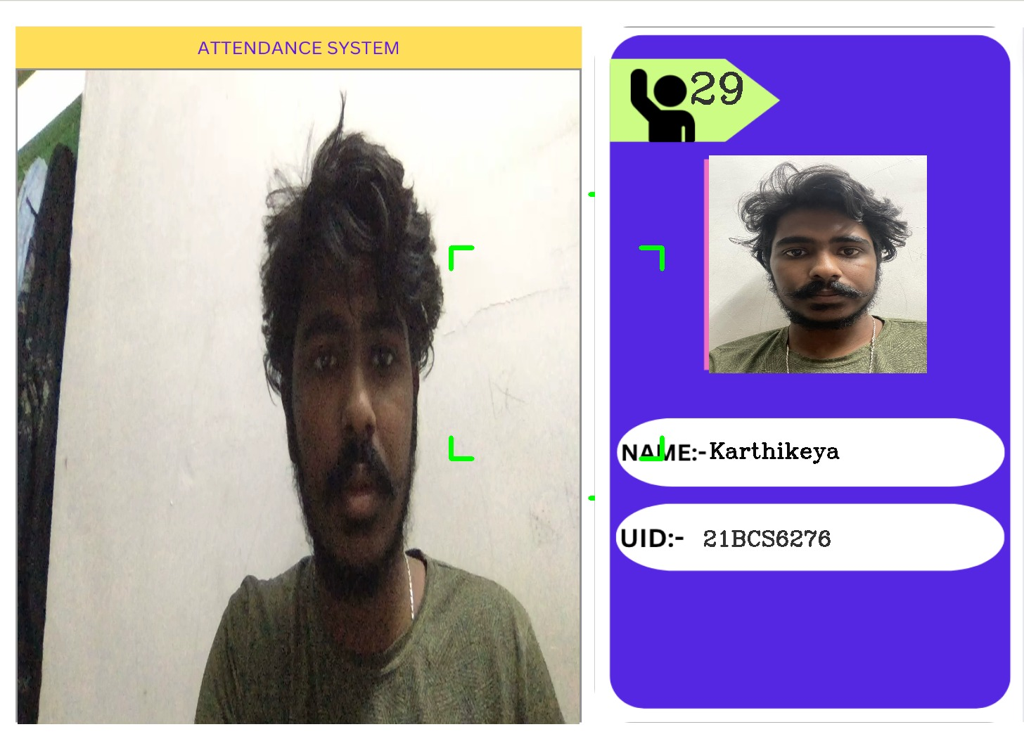
Results and Output
extracting information

Slide 9
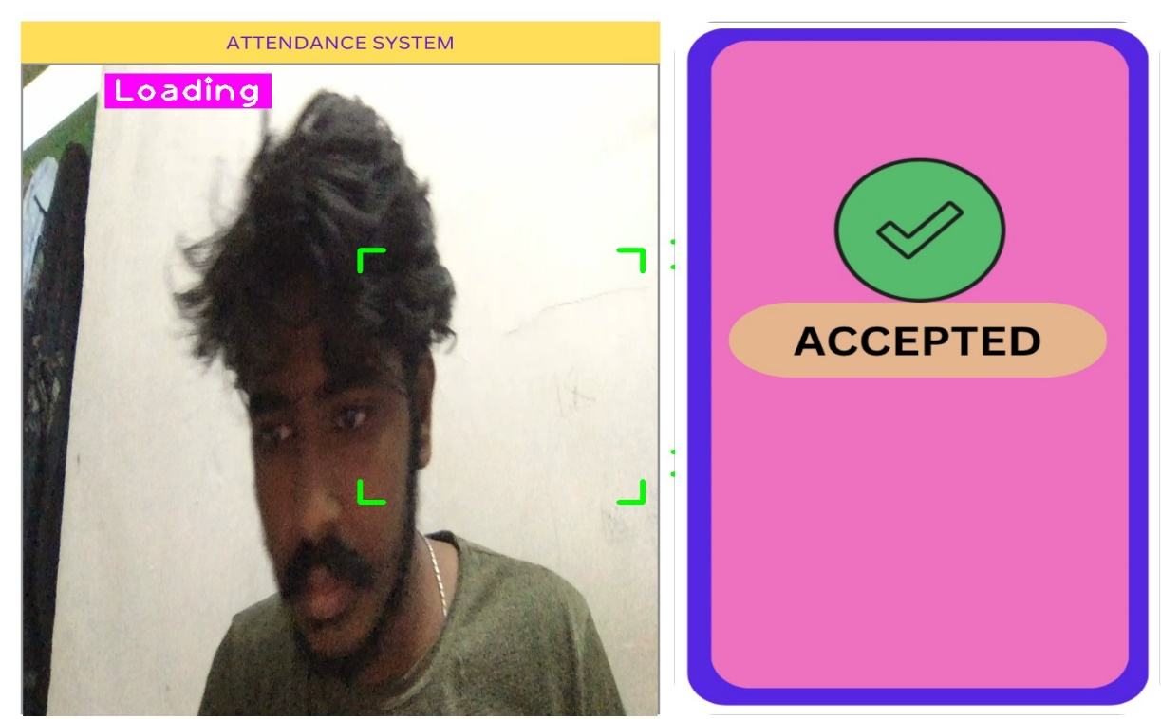
Results and Output
marking attendance in real time

Slide 10
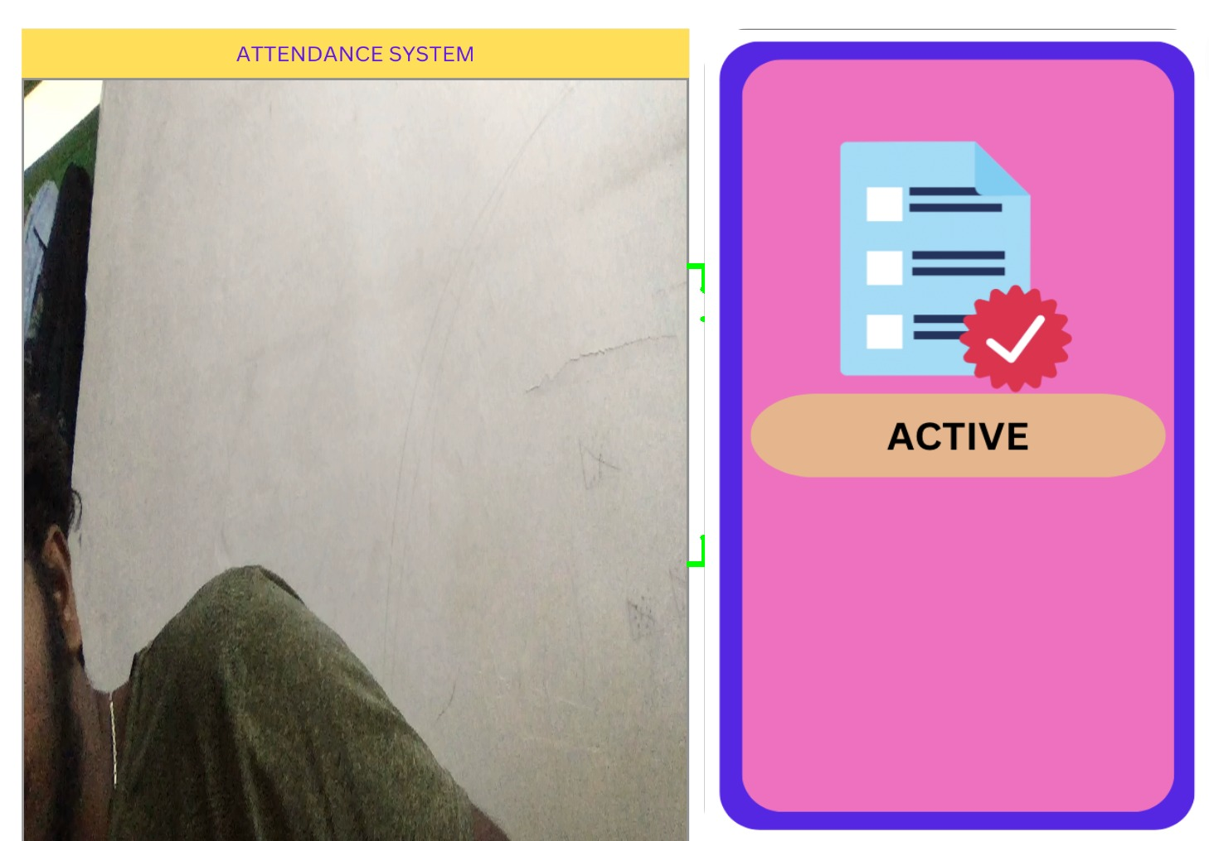
Results and Output
state of student

Slide 11
Conclusion
The project's purpose is to create and use of a face recognition system for keeping track of students' attendance at a school have proven to be a significant development. An automated system that makes use of facial recognition technology has successfully replaced the labor-intensive, error-prone, and time-consuming manual attendance tracking approach. During the pilot test, the system proved its capability to efficiently and reliably track student attendance, removing the chance of proxy attendance and enhancing the procedure in general.
The use of the facial recognition system has helped the educational facility in several ways. As a result, administrative tasks have become easier to manage, instructional time has been preserved, and attendance records' correctness and dependability have improved. The system has considerably increased the efficiency and efficacy of the attendance tracking process by utilizing the power of biometric technology, allowing instructors and staff to devote more time and resources to the system's main educational activities.

Slide 12
Future Scope
Integration with Student Information Systems: Seamlessly integrate the face recognition system with existing student information systems for comprehensive data transfer and improved student records management.
Ongoing System Optimization: Continuously optimize the face recognition system to enhance precision and effectiveness. Strengthen algorithms, upgrade hardware components, and leverage machine learning approaches for better adaptation to changing environmental conditions and student appearances.
Scalability and Wider Implementation: Evaluate and consider expanding the use of the face recognition system to other educational settings, such as classrooms and institutions. Conduct trials and assessments in diverse environments to gather valuable insights for system adaptation and improvement.
Ethics and Legal Considerations: Maintain ongoing discussions regarding the ethical and legal implications of using biometric technologies in educational settings. Ensure compliance with data protection laws, uphold privacy rights, and regularly assess rules and procedures to ensure ethical usage and safeguard privacy.
Reliable and Widely Used Solution: By pursuing these future work areas, the face recognition system can continue to evolve into a reliable and widely adopted solution for attendance tracking in educational institutions. Its development will enhance effectiveness, precision, and overall student engagement, supporting the institution's commitment to excellence and advancing educational procedures

Slide 13
References
[1]. Georgiades, A.S., Blumer, P.N. and Kriegman, D.J., 2001. From few to many: Illumination cone models for face recognition under variable lighting and pose. IEEE Transactions on Pattern Analysis and Machine Intelligence, 23(6), pp.643-660.
[2]. Viola, P. and Jones, M., 2001. Rapid object detection using a boosted cascade of simple features. In Proceedings of the IEEE conference on computer vision and pattern recognition (CVPR) (Vol. 1, pp. I-511). IEEE
[3]. Yang, M., Kriegman, D. and Ahuja, N., 2002. Detecting faces in images: A survey. IEEE Transactions on Pattern Analysis and Machine Intelligence, 24(1), pp.34-58.
[4]. Turag, P., Chellappan, R., Subrahmanyan, V.S. and Udrea, O., 2008. Machine recognition of human faces. Springer Science & Business Media.
[5]. Phillips, P.J., Moon, H., Rizvi, S.A., Reuss, P.J. and Tyson, J.G., 2000. The FERET evaluation methodology for face recognition algorithms. IEEE Transact

