Slide 1
Edge Detection – Canny Algorithm

Slide 2




What is an Edge?
Discontinuity in intensity
Significant change of intensity in an image
Original Image
Edge Image
Original Image
Edge Image

Slide 3
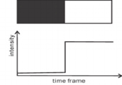
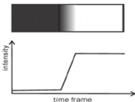
Types of Edges
Step Edge Intensity abruptly changes
Ramp Edge Intensity change is not instantaneous, occurs over a finite distance

Slide 4
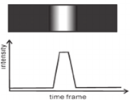

Types of Edges – Contd.
Ridge Edge Intensity abruptly changes, but returns back to original value
Roof Edge Intensity change is not instantaneous, occurs over a finite distance

Slide 5


Edge Detection
Edge detection is an image processing technique for finding the boundaries of objects within images
Original Image
Edge Image

Slide 6
Use of Edge Detection
Extract important features
Divide image into areas corresponding to different objects
Extracted features used by higher level computer vision algorithms

Slide 7
Goal of Edge Detection
Low error rate
Accurately detect as many edge as possible
Probability of detecting real edge points should me maximized
Well localization of detected edge points
Operator should accurately localize on the center of the edge
Single edge point response
One real edge should not result in more than one detected edge
Image noise should not create false edges

Slide 8
Edge Detectors
Robert’s Cross Operator
Sobel Operator
Prewitt Operator
Canny Edge Operator

Slide 9
Overview – Canny Edge Detector
Developed by John F. Canny in 1986
Less Sensitive to noise
Offers good localization of edges
Utilizes gradient of the edge to generate thin, one-pixel wide edges
Also know as optimal detector

Slide 10
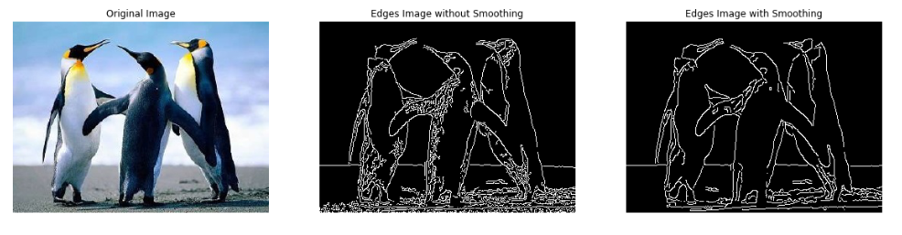
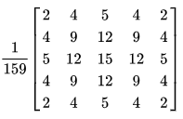
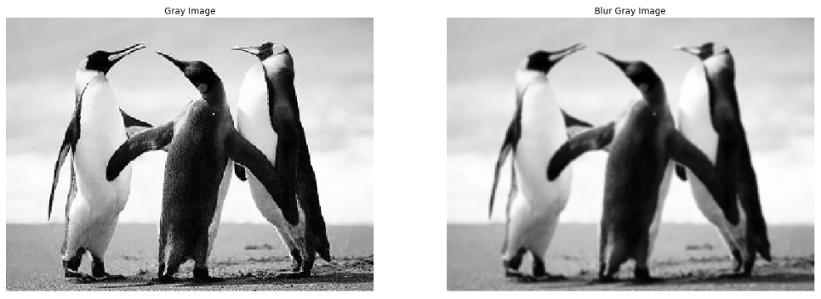
Steps - Canny Edge Detector
Smoothing
Process of removing noise
To prevent false edge detection necessary to filter not noise
Gaussian filter applied to convolve with the image

Slide 11


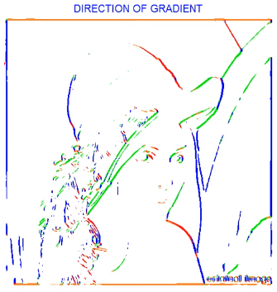
Steps - Canny Edge Detector
Find intensity gradients
Process of finding intensity gradient of the image
Edge detector operator is used which returns a value for the first derivative in the horizontal direction (Gx) and the vertical direction (Gy)

Slide 12

What Next?

Slide 13

Steps - Canny Edge Detector
Non Maxima Suppression
Process of edge thinning

Slide 14
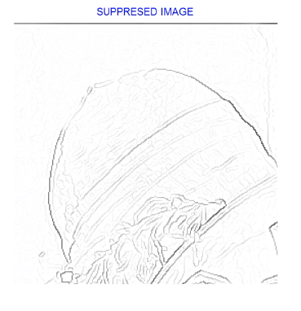
What Next?

Slide 15
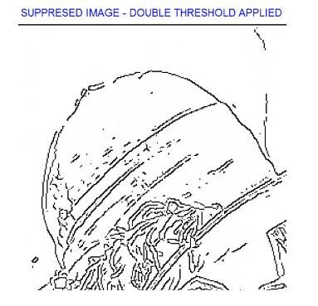
Steps - Canny Edge Detector
Hysteresis Thresholding
Process of determining potential edges
Set low and high threshold values

Slide 16
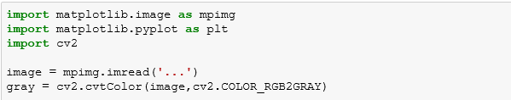
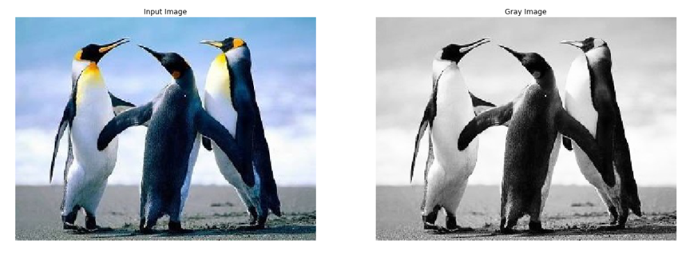
Implementation

Slide 17

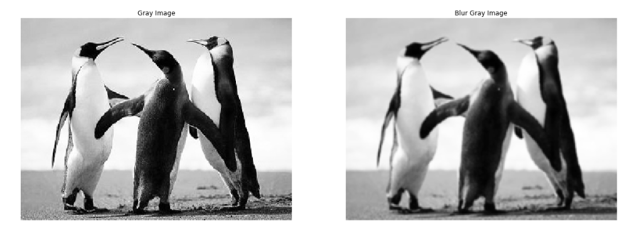
Implementation

Slide 18
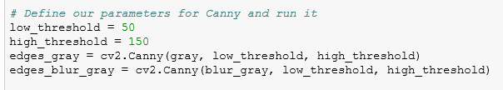
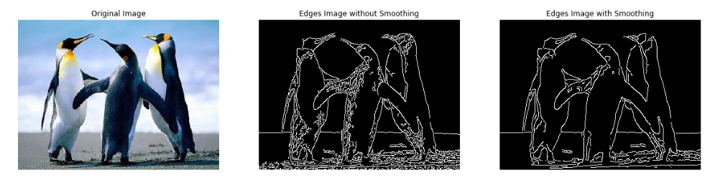
Implementation

Slide 19
Thank You

