Slide 1
Task Scheduler - Introduction
Background:
AVA (Advanced Virtual Assistant – AI Bot) keeps track the latest status of phone claims that have been filed online with Asurion. AVA send SMS notifications to customers with the latest status e.g. “Shipping Status”, “Hold Resolution Status”…
Why/Use Case – keep customer happy…
We need to “Schedule Tasks" in order to keep track & check claim status at different time & frequencies, so we can ‘Proactively’ send notifications to customers.

Slide 2
Task Scheduler – Why we build our own
AWS Services vs. Ava Task Scheduler
 | Solution | Metadata | Minimum Delay | Maximum Delay | Cancel Task | Repeat Task | Dispatching Channel | Deployment/Running Environment
SQS | Delay Queue | Yes | 0 delay - dispatch Immediately | 15 minutes | Yes | No | SQS | AWS
Cloud Watch Cron-Like Scheduling | Time based; cron expression to specify when a task should be triggered | No task metadata | 1 minute | No Maximum | Yes | Yes | SQS | AWS
Ava Task Scheduler | Delay Queue | Yes | 0 delay - dispatch Immediately | No Maximum | Yes | Yes | SQS, Kafka, any other message queue | AWS or standalone

Slide 3
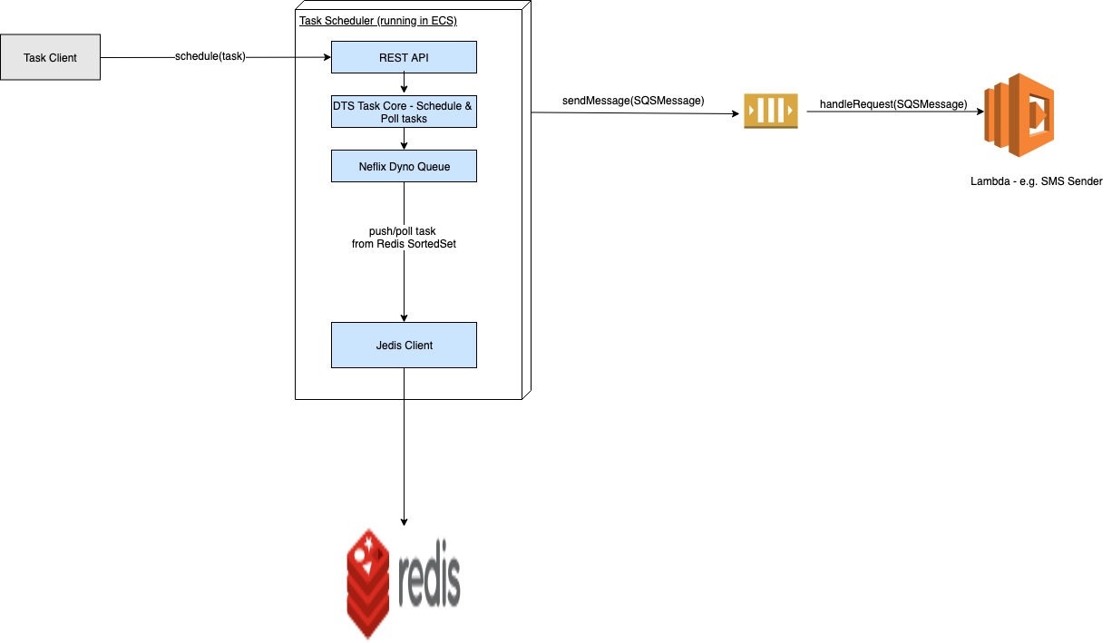
Task Scheduler – Architecture
Manipulate time based queues in Redis
Each task has a timestamp associated and is only polled out after that time
Netflix Dyno-Queue: Provides simple ‘push’ and ‘poll’ API to add task & poll out the task from Redis.
Redis: Sorted set is used to maintain the scheduled tasks. When a task is expired, the task is removed from the queue. Redis ensures there’s only 1 thread/request can delete the task. There’s no extra locking needed while polling and dispatching tasks
Poller Thread to Poll and Dispatch task
Maintains a consistent connection to Redis and continually checks expired tasks and dispatch them immediately

Slide 4
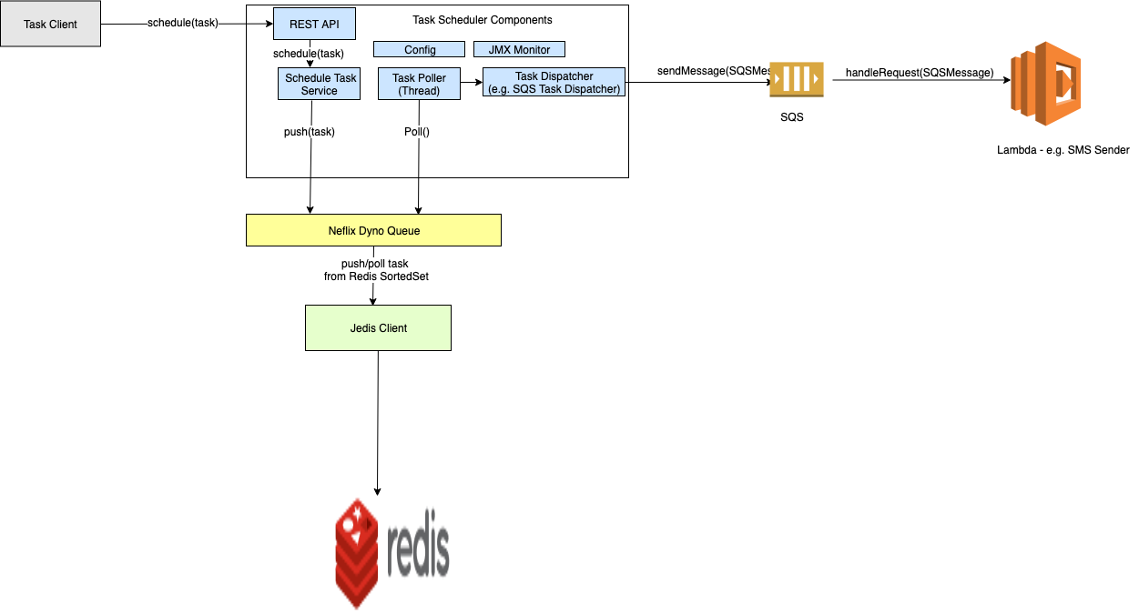
Task Scheduler –Components
Schedule Task Service
Provides REST API to schedule task
Calls Dyno Queue ‘push()’ method add task to Radis
Task Poller
Poller thread calls Dynamo Queue ‘Poll()’ method with current
timestamp to retrieve tasks with timestamp smaller than current time.
The retrieved tasks are given to Task Dispatcher
Task Dispatcher
Dispatch tasks to message queue e.g. SQS, Kinesis, Apache Kafka
Config
Provides and Manages Task configuration in JSON
JMX Monitor
Provides scheduling metrics & system metrics

Slide 5
Task Scheduler – Value Added/Features
Multiple Task Types “Multi-Tenant”:
Support Multiple Task Types
Each Type of Task own its Polling thread & Redis Task Queue; Each type of task is isolated and invisible to other
JSON to configure different task type(s)
Flexible Scheduling:
Task could be scheduled in second, minute, hour, or day
Able to dispatch tasks immediately (nearly real-time)
Flexible Dispatching: Task could be dispatched to different channel e.g. SQS, Kinesis, or over HTTP such as WebSocket to push tasks
JMX Management: provides JMX MBeans collecting scheduling metrics

Slide 6
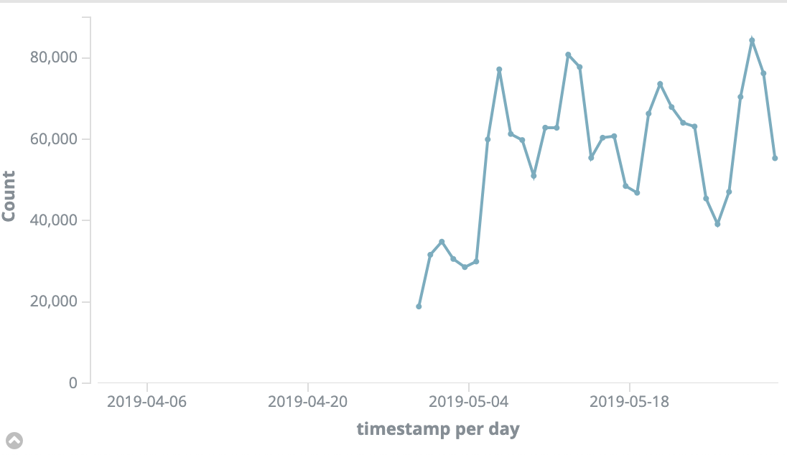
Task Scheduler – Success & Opensource
Had been released & running in PROD longer than 6+ months
Over 1.7+ million of tasks had been Scheduled and Dispatched in
5/2019 (average 0.5 TPS, max 1 TPS).
Opensource Task Scheduler:
Download from https://github.com/asurionlabs/open-task-scheduler

