Slide 1



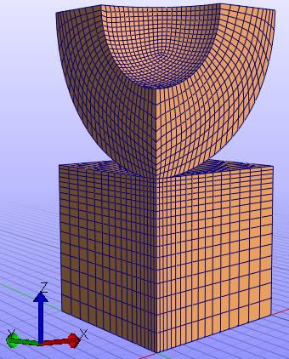
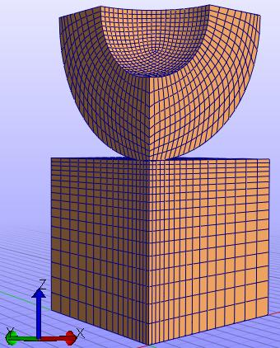
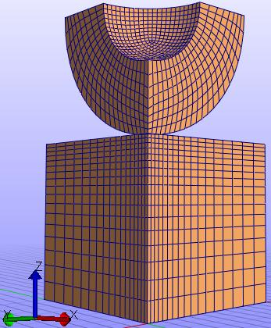
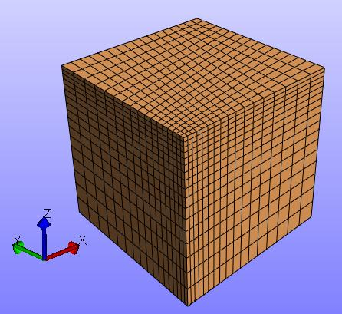
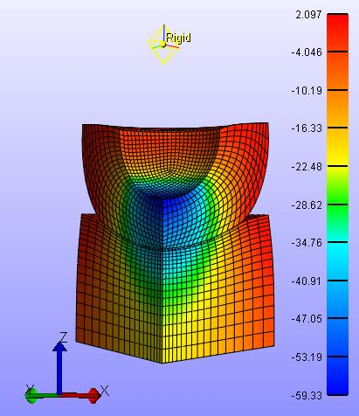
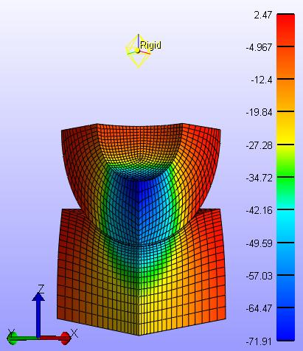
Modeling of Contact in Biphasic Soft Material
Agnila Ghosh Surovi*, Shank S. Kulkarni**, Timothy Truster**
*University of Tennessee Knoxville, Department of Mechanical, Aerospace and Biomedical Engineering, ** University of Tennessee Knoxville, Department of Civil and Environmental Engineering
IMECE Track 16-1
NSF Research Poster Competition
IMECE 2023-120143
PROJECT OBJECTIVES AND GOALS
DATA AND RESULTS
CONCLUSION
Goal:
Develop a contact model capable of measuring the characteristics of biphasic material in contact that will contribute to the advancement of medical and bioengineering fields
Objectives:
The biphasic-biphasic and biphasic-elastic contact modeling using finite element software FEBio.
The mesh convergency study for contact modeling.
The investigation of the change in mechanical response due to the variation of material properties and size of the indenter.
The rate-dependent change in mechanical response of biphasic material.
Mesh Convergence Study
Table-6: Tabular Representation of Mesh Convergence Study
The Z stress, Z displacement, contact pressure in BS-BI increases with decreasing indenter radius as the contact area contracts. Though the peak fluid pressure for BS-BI with 0.8 mm radius is maximum, the fluid pressure with this radius decreases to minimum at the end of 5 seconds. One potential cause is that larger internal stress can induce faster fluid flow toward regions with lower stress.
The Z stress and contact pressure is larger in case of BS-EI. In this case, the peak fluid pressure is greater in case of BS-EI. However, fluid pressure for BS-BI becomes higher at the end of 5 seconds due to the diffusion between the substrate and the indenter.
With respect to the load rate, the NS-NI exhibits no change in Z stress at the end under different loading rate. In contrast, BS-BI shows changes in stress with changing loading rate. BS-BI exhibits stiffer stress curve with faster loading rate.
Modeling Geometry
Meshing
Number of Elements | Z stress (MPa) | Z displacement (mm)
1232 | 39.7291 | 0.257102
2152 | 40.8909 | 0.259558
2681 | 41.191 | 0.26039
5648 | 41.6854 | 0.261517
9983 | 41.8345 | 0.261941
17568 | 41.9875 | 0.262399
24062 | 42.2981 | 0.262825
Assigning Material Properties
Applying Boundary Conditions
(a)
(b)
Table-7: Selected Mesh for Each Model with Different Radius
Figure-4: Graphical Representation of Mesh Convergence Study using the data from (a) Z stress and (b) Z displacement
Submitting Job
Indenter Radius (mm) | Number of Elements | Approximate Element Size(mm)
1 | 9983 | 0.06
0.9 | 8801
0.8 | 7641
Visualizing Result
Does Result Converge?
BACKGROUND
Yes
Biphasic materials, such as hydrogel, can mimic the mechanical properties of soft hydrated tissues, such as, articular cartilage, ligaments, cornea, intervertebral disk and knee meniscus.
Fluid
Carrying out Analysis
No
FUTURE STUDIES
In case of artificial transplantation of hard tissue or soft tissue, it is significant to investigate -
  the contact characteristics within the interface of hard tissue implant and surrounding soft tissue or
  the interfacial properties in the contact of soft tissue implant and surrounding soft tissue.
Soft swollen tissues exhibit rate-dependent mechanical response that the analysis of the contact behavior under different loading rate is also an important phenomenon.
(a)
(b)
(c)
To include multiphasic frictionless contact formulation as well as multiphasic contact formulation with friction
To add contact formulation for adhesion and suction for multiphasic material
Solid
Figure-3: Flowchart for Mesh Sensitivity Analysis
Figure-5: Visual Representation of Selected Mesh Indenter (a) Radius 1 mm, (b) Radius 0.9 mm and (c) Radius 0.8 mm
Figure-1: Biphasic Material
Effect of Radius Variation (BS-BI)
Figure-6: The Reference Point for Analysis
PUBLICATIONS
Currently working to publish journal articles on contact formulation of poroviscoelastic soft material
Zoom in
ACKNOWLEDGEMENTS
Figure-7: Z Stress Variation with Z displacement
Figure-8: Contact Pressure Variation with Time
Figure-9: Fluid Pressure Variation with Time
The authors would like to thank the National Science Foundation for supporting this research (Award No.: 2224371, CMMI-Div Of Civil, Mechanical, & Manufact Inn, Program Director: Lucy T. Zhang)
Effect of Indenter Material Variation
NUMERICAL SETUP
REFERENCES
Table-1: Material Properties (Biphasic)
Modeling Steps
Masud, A., Truster, T. J., & Bergman, L. A. (2012). A unified formulation for interface coupling and frictional contact modeling with embedded error estimation. International journal for numerical methods in engineering, 92(2), 141-177.
Han, G., Eriten, M., & Henak, C. R. (2020). Rate-dependent adhesion of cartilage and its relation to relaxation mechanisms. Journal of the mechanical behavior of biomedical materials, 102, 103493.
Kalyanam, S., Toohey, K. S., & Insana, M. F. (2021). Modeling biphasic hydrogels under spherical indentation: Application to soft tissues. Mechanics of Materials, 161, 103987.
Lai, Y., He, D., & Hu, Y. (2019). Indentation adhesion of hydrogels over a wide range of length and time scales. Extreme Mechanics Letters, 31, 100540.
Solid Volume Fraction, phi0 | Fluid Density (tonne/mm³) | Permeability (mm⁴/N.s) | Young’s Modulus of solid (MPa) | Poisson’s Ratio
0.2 | 1 | 0.001 | 100 | 0.3
Modeling Geometry
Material Properties
Boundary Conditions
Job Submission and Result Visualization
Mesh
Table-2: Material Properties (Elastic)
10 N
Indenter
(a)
(b)
(a)
(b)
Young’s Modulus (MPa) | Poisson’s Ratio
70000 | 0.3
Figure-10: (a) Contact Pressure and (b) Fluid Pressure Variation with Time for BS-BI and BS-EI
Figure-11: Z Stress Contours of Analysis with (a) BS-BI and (b) BS-EI
Table-3: Material Properties (Neo Hookean)
1 mm
Substrate
Rate Dependent Response (NS-NI and BS-BI):
Young’s Modulus (MPa) | Poisson’s Ratio
1000 | 0.3
Zoom in
Zoom in
Table-4: Study Cases
Figure-2: Modeling Geometry and Applied Boundary Conditions
Case 1 | Biphasic Indenter
Case 2 | Elastic Indenter
Case 3 | Indenter Radius 1 mm
Case 4 | Indenter Radius 0.9 mm
Case 5 | Indenter Radius 0.8 mm
Case 6 | Loading Rate 10 N / 0.25 sec
Case 7 | Loading Rate 10 N / 1 sec
Case 8 | Loading Rate 10 N / 4 sec
Table-5: Abbreviation for Used Terms
Frequently Used Terms | Symbol
Biphasic Substrate - Biphasic Indenter | BS-BI
Biphasic Substrate - Elastic Indenter | BS-EI
Neo-Hookean Substrate – Neo-Hookean Indenter | NS-NI
Figure-12: Rate-dependent Response in NS-NI
Figure-13: Rate-dependent Response in BS-BI

Slide 2
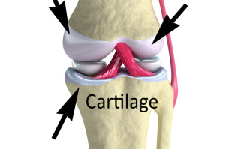
Modeling of Contact in Biphasic Soft Material
Agnila Ghosh Surovi*, Shank S. Kulkarni**, Timothy Truster**
*University of Tennessee Knoxville, Department of Mechanical, Aerospace and Biomedical Engineering, ** University of Tennessee Knoxville, Department of Civil and Environmental Engineering
IMECE Track 16-1
NSF Research Poster Competition
IMECE 2023-120143
PROJECT OBJECTIVES AND GOALS
NUMERICAL SETUP
Goal:
Develop a contact model capable of measuring the characteristics of biphasic material in contact that will contribute to the advancement of medical and bioengineering fields
Objectives:
The biphasic-biphasic and biphasic-elastic contact modeling using finite element software FEBio.
The mesh convergency study for contact modeling.
The investigation of the change in mechanical response due to the variation of material properties and size of the indenter.
The rate-dependent change in mechanical response of biphasic material.
Indenter Size
10 N
Indenter
Parameters
Material of Indenter
Substrate
Loading Rate
1 mm
Motivation
Figure-2: Modeling Geometry and Applied Boundary Conditions
Fluid
Table-1: Study Cases
In case of artificial transplantation of hard tissue or soft tissue, it is significant to investigate -
  the contact characteristics within the interface of hard tissue implant and surrounding soft tissue or
  the interfacial properties in the contact of soft tissue implant and surrounding soft tissue.
Soft swollen tissues exhibit rate-dependent mechanical response that the analysis of the contact behavior under different loading rate is also an important phenomenon.
Case 1 | Biphasic Indenter
Case 2 | Elastic Indenter
Case 3 | Indenter Radius 1 mm
Case 4 | Indenter Radius 0.9 mm
Case 5 | Indenter Radius 0.8 mm
Case 6 | Loading Rate 10 N / 0.25 sec
Case 7 | Loading Rate 10 N / 1 sec
Case 8 | Loading Rate 10 N / 4 sec
Solid
Figure-1: Biphasic Material
[Ref: [Bones and Muscle Tissue Flashcards Flashcards by ProProfs (2011) www.proprofsflashcards.com]
FUTURE STUDIES
To include multiphasic frictionless contact formulation as well as multiphasic contact formulation with friction
To add contact formulation for adhesion and suction for multiphasic material

