Slide 1
Statistical Analysis Tutorial2 ISB - CBA
Suryanarayana, Data Scientist, Flex
Email: Suryanarayana_Ambatipudi_2014@cba.isb.edu
Code: https://github.com/asuryam/ISB-Tutorials/tree/SA1-Tutorial2

Slide 2
PLAN
Solve Practice Problems in the following areas
Hypothesis testing – Single Population, Paired Observations, Comparison of Two Population
Analysis of Variance – Comparison of n Populations n > 2
Chi-Square Testing – Non parametric Test on count/enumerative data
Will cover the session using R or Excel or both

Slide 3
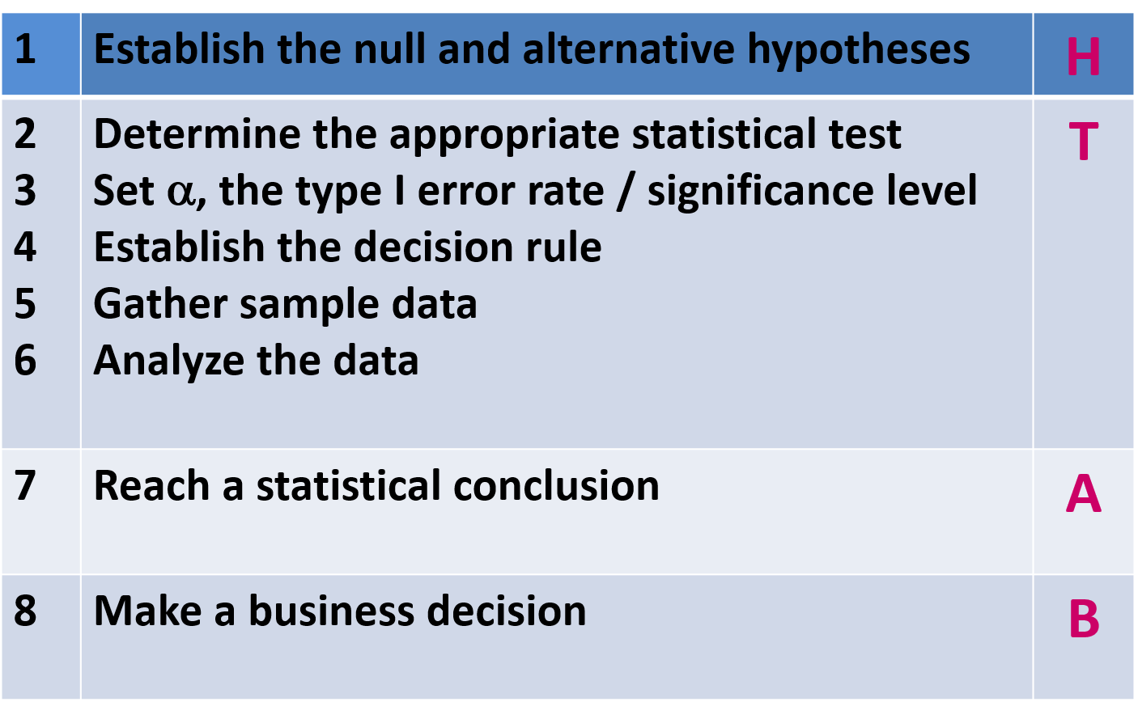
HYPOTHESIS TESTING

Slide 4
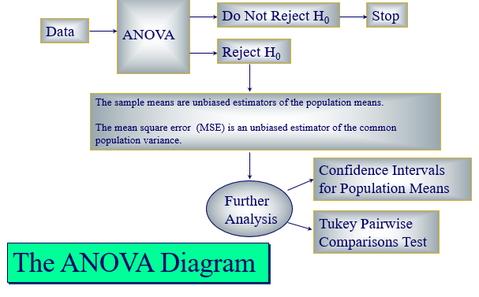
ANOVA
SST = SSTR (r-1)+ SSE (n-r)
Calculate F Statistic – Follows F-Distribution

Slide 5
Chi-SQUARE TEST
Non parametric Testing
Enumerative Data
Does not involve any population parameter like mean or standard deviation
Does not assume any specific population distribution
Calculate the chi-square statistic
Chi-Square Distribution

