Slide 1
Forecasting TutorialS-iI ISB - CBA
Suryanarayana, Data Scientist, Flex
Email: Suryanarayana_Ambatipudi_2014@cba.isb.edu
Code:

Slide 2
PLAN
Neural Networks
Exponential Smoothing
Tutorial will be covered in R
Time Series Plot
Data Partitioning
Predictive Performance comparison

Slide 3
FORECASTING PROCESS – HIGH LEVEL
Business Understanding - Goals, Objective
Data Extraction
Data Exploration
Data Partition – Train and Validate
Apply Several Forecasting Methods
Evaluate and Compare Performance
Deploy and Productionize

Slide 4
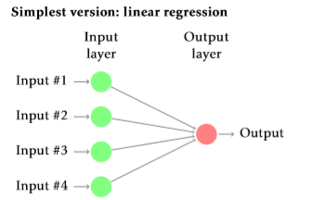
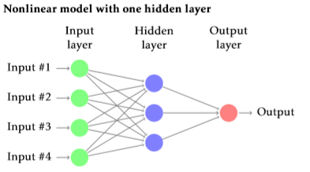
NEURAL NETWORKS InTRO

Slide 5
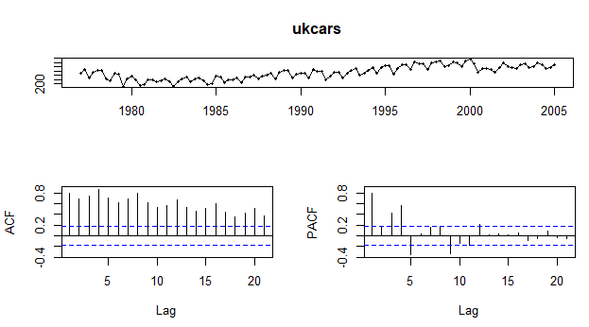
NEURALNETWORK Based Forecasting
Data set – UK Cars
Quarterly Production data from 1977 to 2005
Forecast for next two years- 8 Quarters
NNAR – Neural Network Auto Regressive
p, P , k Variables
p - Autoregressive
P – Autoregressive seasonal
k – Number of neurons in hidden layer
Neural Network– trend + seasonality

Slide 6
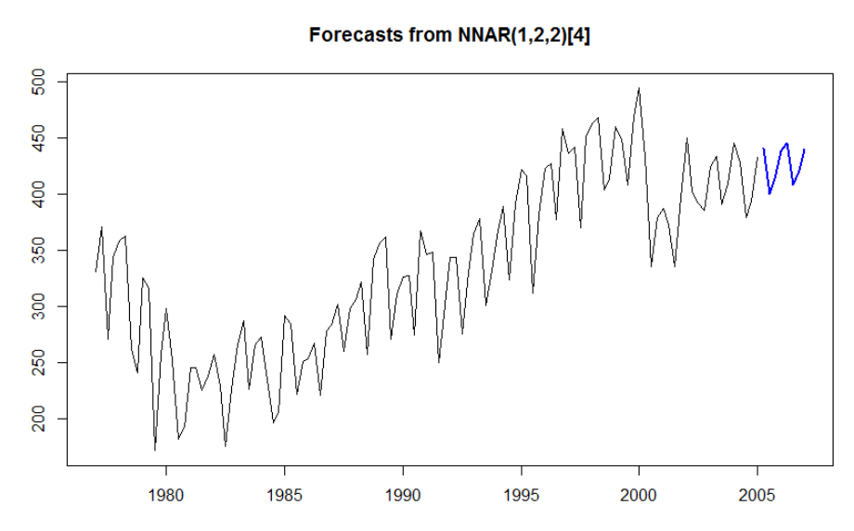
NEURALNETWORK Based Forecasting
Forecast Method | RMSE | MAE | MAPE | Remarks
Mean Method | 89.65515 | 86.76207 | 20.71%
Seasonal Naïve Method | 19.06336 | 16.37712 | 3.89%
Neural Network (Trend + Seasonality ) | 17.07987 | 14.83086 | 3.54%
NNAR(1,0,2) model1 | 42.27158 | 35.05909 | 8.25% | NNAR(p,P,k)
NNAR(2,0,2) model2 | 42.61478 | 35.11326 | 8.26%
NNAR(1,1,2) model3 | 17.0448 | 14.60976 | 3.60%
NNAR(2,1,3) model5 | 18.86028 | 15.33325 | 3.78%
NNAR(1,2,2) model6 | 17.2107 | 12.7121 | 3.15% | Best Model
NNAR Auto (8,1,4) | 29.51282 | 24.14799 | 6.03% | Auto with no parameters specified

Slide 7
EXPONENTIAL SMOOTHING – HIGH LEVEL
Simple Exponential Smoothing – No trend and seasonal pattern
Set Alpha Value (Level)
Alpha (close to zero) – more weight is given to observations from distant past
Alpha(close to 1 ) – more weight is given to recent observations
Naïve forecasts are nothing but alpha = 1
Holts Linear Method (Trend)
Set Alpha (Level)
Set Beta (Smoothing parameter for Trend)
Holts Winter Seasonal Method
Set Alpha (Level)
Set Beta (Trend)
Set Gamma (Smoothing parameter for Seasonality)

Slide 8
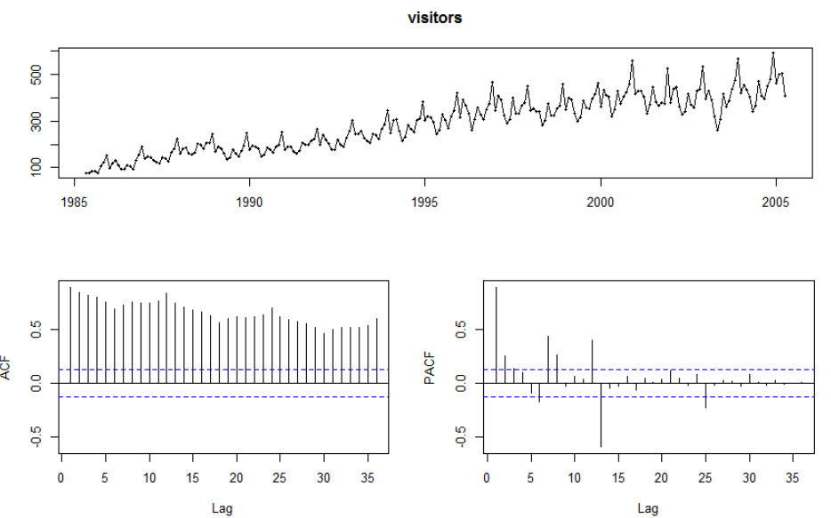
EXPONENTIAL SMOOTHING
Data set – Visitors
Short term Australian overseas Visitors
20 years Monthly data (1985-2004)
Forecast for next 3 years
Simple Exponential Smoothing
Holts Linear Method
Holts Winters seasonal method

Slide 9
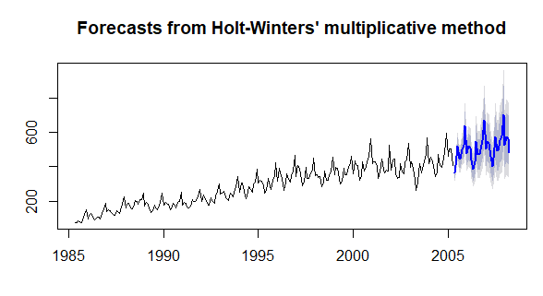
EXPONENTIAL SMOOTHING
Forecast Method | RMSE | MAE | MAPE | Remarks
Mean Method | 168.2513 | 153.2542 | 34.83%
Seasonal Naïve Method | 47.67197 | 39.65833 | 9.48%
Simple Exponential Smoothing | 70.982 | 54.20423 | 13.15% | alpha value
Holts Linear Method | 68.40995 | 52.60911 | 13.76% | alpha and beta
Holts Linear Method Exponential | 70.69107 | 54.87487 | 14.54%
Holts Winter Method | 29.49961 | 22.16192 | 6.01% | alpha, beta & gamma
Holts Winter Method Multiplicative | 27.6149 | 19.7203 | 5.38% | Best model
Holts Winter Method Multiplicative with Damping | 40.12412 | 33.01059 | 7.77% | alpha, beta, gamma & Phi

