Slide 1
Statistical Analysis Tutorials ISB - CBA
Suryanarayana, Data Scientist, Flex
Email: Suryanarayana_Ambatipudi_2014@cba.isb.edu
Code: https://github.com/asuryam/ISB-Tutorials/tree/SA1

Slide 2
PLAN
Solve Practice Problems in the following areas
Normal Distribution and its Properties
Sampling and Sampling Distributions - Central Limit Theorem
Confidence Intervals
Sample Size Determination
Will cover the session using R or Excel or both

Slide 3
NORMAL DISTRIBUTION
Normal Distribution
Mean (µ)
Standard Deviation ( σ )
Properties of Normal Distribution
Several Independent Random Variables are Normally Distributed
Sum of them will also be Normally Distributed
X1,X2…Xn are independent normally distributed random variables
E(X) = E(X1) +E(X2)+….+E(Xn)
V(X) = V(X1)+V(X2)+….+V(Xn)
If X is normally distributed the aX+b will have
Mean = a*E(X) + b
Variance = a²*V(X)
Problems in Normal Distribution

Slide 4
SAMPLING
The sample mean, x-bar , is the most common estimator of the population mean, μ.
The sample variance, s², is the most common estimator of the population variance, σ².
The sample standard deviation, s, is the most common estimator of the population standard deviation, σ.
The sample proportion,p, is the most common estimator of the population proportion,π

Slide 5
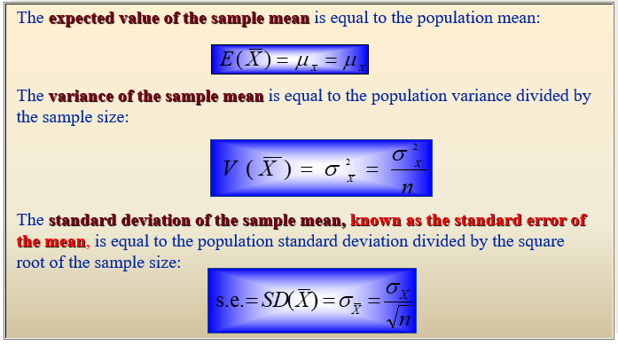
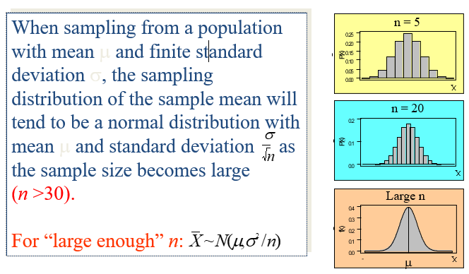
Central Limit Theorem
The sampling distribution of X is the probability distribution of all possible values the random variable may assume when a sample of size n is taken from a specified population

Slide 6
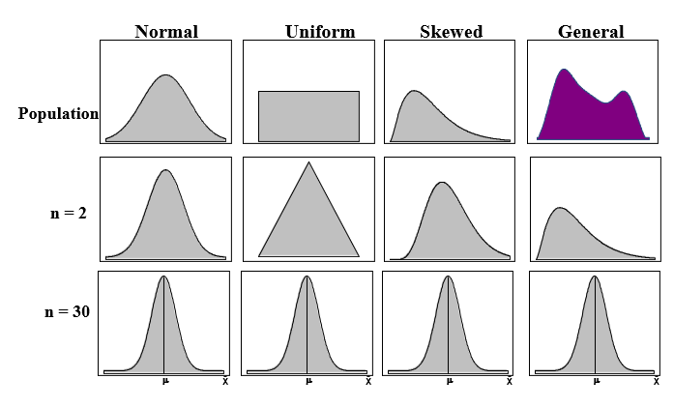
Sampling Distributions from Any Population

Slide 7
Confidence INTERVALS
A Confidence Interval is a range of numbers believed to include the unknown population parameters
Confidence Interval for the population mean when the population standard deviation is known
x-bar +/- 1.96 * σ/sqrt(n) (95% confidence interval)
Sampling Error or Margin of Error 1.96*σ/sqrt(n)
Confidence Interval of population mean when population standard deviation is unknown (T-distribution). Degree of freedom (n-1)
Confidence Intervals for the Population proportions for large samples Z-distribution

