Slide 1
Forecasting Tutorials ISB - CBA
Suryanarayana, Data Scientist, Flex
Email: Suryanarayana_Ambatipudi_2014@cba.isb.edu
Code: https://github.com/asuryam/ISB-Tutorials/tree/Forecasting

Slide 2
PLAN
Regression Based Forecasting
Auto Regressive Integrated Moving Average Models (ARIMA)
Tutorial will be covered in R
Time Series Plot
Data Partitioning
Predictive Performance comparison

Slide 3
FORECASTING PROCESS – HIGH LEVEL
Business Understanding - Goals, Objective
Data Extraction
Data Exploration
Data Partition – Train and Validate
Apply Several Forecasting Methods
Evaluate and Compare Performance
Deploy and Productionize

Slide 4
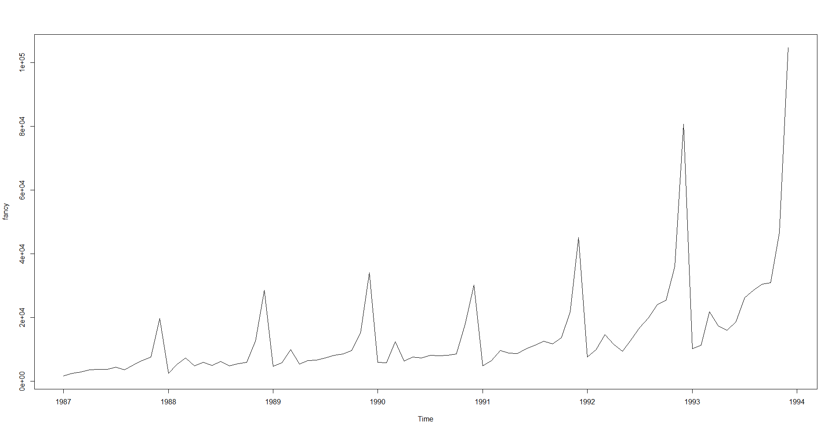
Regression Based Forecasting
Data set – Fancy
Monthly Sales data from 1987 to 1993 of a shop
Shop is located at a Beach Resort
Large influx of visitors during Christmas
Surfing Festival in March since 1988
forecast for next one year

Slide 5
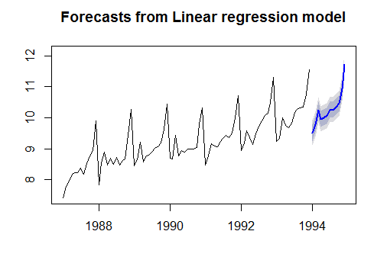
Regression Based Forecasting
Forecast Method | RMSE | MAE | MAPE | Remarks
Mean Method | 30678.69 | 18859.99 | 46.96% | mean of observations of last one year
Seasonal Naïve Method | 9542.346 | 7828.278 | 27.28% | last year's month actual is the forecast
Additive Model | 17451.55 | 10055.28 | 26.67% | y(t) = Level + Trend + Seasonality + noise
Multiplicative Model * | 7101.444 | 5191.669 | 15.52% | y(t) = Level * trend * seasonality * noise
Multiplicative Model with festival dummy variable | 7772.932 | 5546.069 | 16.19% | created new dummy variable to indicate surfing festival every March
*The residuals have some amount of auto correlation – The best model would be Holt-Winter multiplicative model. The forecast plot is in the log scale .

Slide 6



ARIMA
Auto Regressive (AR) Integrated(I) Moving Average(MA)
Differencing (d) – Stationary series
AR (p)
MA (q)

Slide 7
ARIMA PROCESS
Setting (d,p,q)
(d) Order of Differencing to get the series to stationarity. This is fixed.
(p) Partial Correlation plot – identify the lags that are exceeding the thresholds (may be more than one)
(q) Auto Correlation plot – identify the lags that are exceeding the thresholds ( may be more than one)
Run the model with different [p,d,q]’s from the above step
Compare the AICs (Akaike Information Criterion) of several models
Evaluate the other metrics – RMSE, MAPE & MAE on validation set
Choose the best ARIMA model

Slide 8
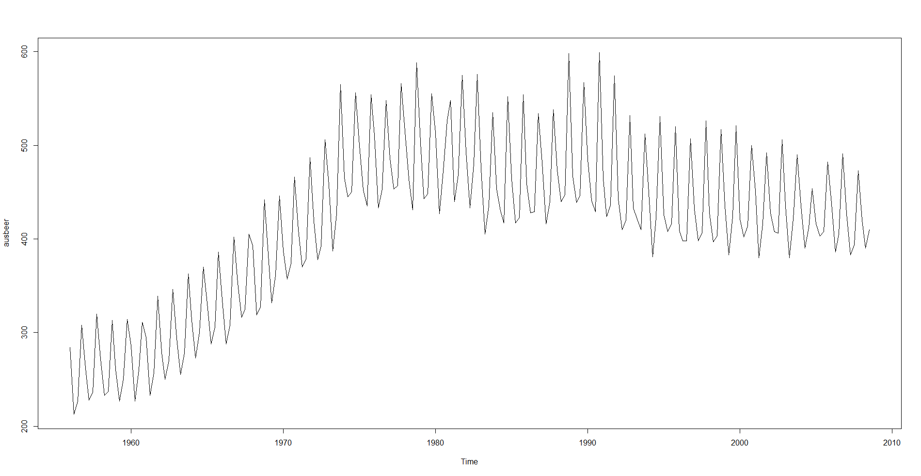
ARIMA
Australian Beer Quarterly Production in Mega Litres
From 1956-Q3 to 2008-Q3
Total observations : 211
Forecast for next 10 years – 40 Quarters

Slide 9
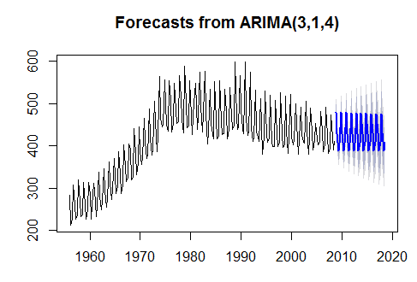
ARIMA
Forecast Method | RMSE | MAE | MAPE | Remarks
Mean Method | 44.88517 | 31.98553 | 6.95% | mean of observations of last one year
Seasonal Naïve Method | 21.50407 | 15.575 | 3.50% | last year's month actual is the forecast now
ARIMA model(3,1,2) train | 15.85488 | 12.83921 | 3.03%
Train
ARIMA Model (p,d,q) | AIC
1,1,1 | 1837.66
1,1,2 | 1835.97
1,1,3 | 1756.42
1,1,4 | 1709.69
2,1,3 | 1585.84
2,1,2 | 1634.75
3,1,2 | 1476.7
Full Model
ARIMA Model (p,d,q) | AIC
3,1,2 | 1476.7
3,1,3 | 1810.68
3,1,4 | 1795.2

