Slide 1
LED strip controller
Mentor: Journey Hancock
Mentee: Millie Kim

Slide 2
What inspired me and how it is used
I was interested in learning how an LED strip controller (e.g. wled) works, and curious if I could build something similar to that.
It can be controlled by a button on the website. The website allows you to control the LEDs in colors by clicking on the buttons. Since I already know web development, I wanted to see what can be integrated with a website.

Slide 3
Languages and libraries
ESP32 wroom microcontroller and ws2812b led strip.
  Esp32 can connect to wifi and ws2812b is the most basic yet powerful led strip with three R,G,B colors. I picked a 60leds/m and non-water proof one as the gap between leds are fair enough.
esp-idf, which is a framework in C language.
  Initially going to use bare-metal C, but realized that it would take more time to understand everything, so I chose a framework that is in C so that I can further work in C without the framework.
A led_strip.h folder downloaded separately to connect with the LED strip.
  The recent esp-idf didn’t come with the package, so I downloaded a folder, also created a led.h folder to #include.

Slide 4
How my mentor helped me
My mentor provided initial ideas for an embedded project. He suggested an LED controller, thermometer, and network project, which helped me understand realistic options as a beginner for my first project.
Helped me define the scope of the project: creating a toggle button system. It was valuable because it was difficult to know how much I could do within the timeframe, as I didn’t have prior experience with an embedded project.
Helped me get the hardware, which was helpful because there are variety of microcontrollers and LED strips out there, which is overwhelming.
Helped me find why my computer didn’t recognize the microcontroller, assisting with the development whenever I have questions.
Got advice that helped me when I was struggling to figure out what I could do better.

Slide 5
How the program benefited me
Learned how to connect everything: website – wifi – esp32 – led strip
Learned the process of using esp-idf: build -> flash -> monitor
Gained basic knowledge about a microcontroller, an electric circuit, and wifi settings along the way.
Learned how to use the library packages required to set up the connection

Slide 6
Future plans
Learn how to code it in C without using the library.
Include more diverse features, like having inputs to select the number of LEDs in a chosen color.
Use the entire LEDs, since I’m only using 1/3 of them currently.
Make the web interface prettier.

Slide 7
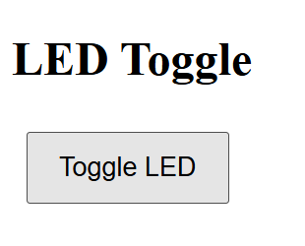
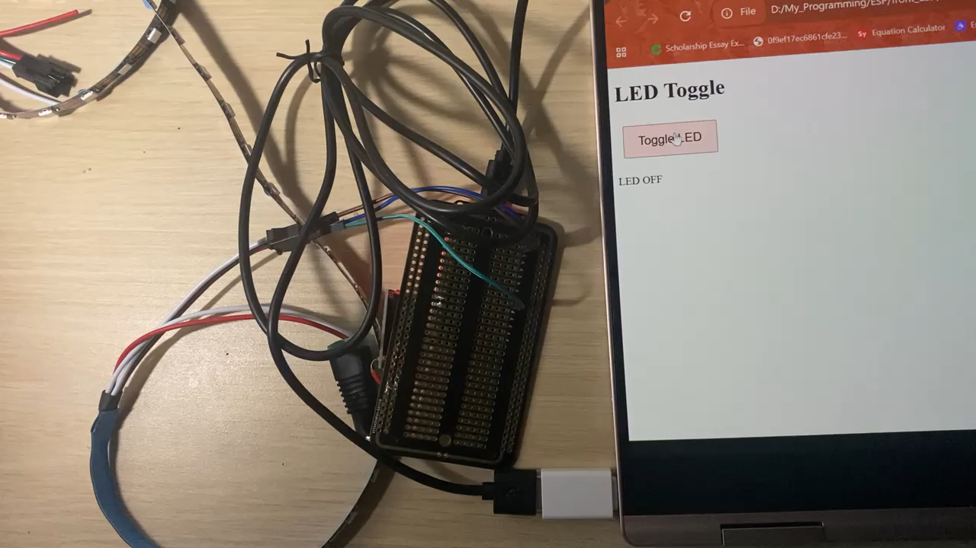
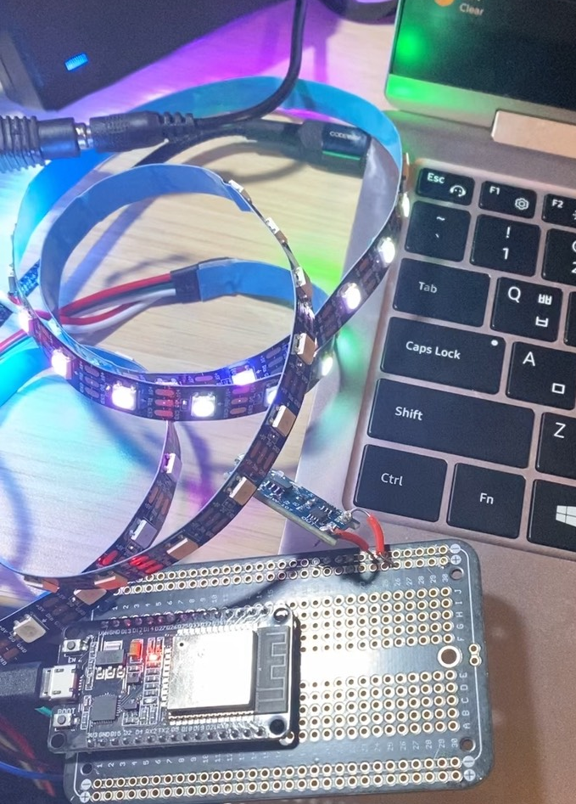
Working example
https://github.com/mk8506/SoDa_LEDcontroller.git

