Slide 1
CU
CHANDIGARH
UNIVERSITY
Student Workspace
Offline-first academic workspace with embedded SQLite, task prioritization, SGPA forecasting, and Pomodoro study tools
Project Team & Evaluation Details:
Abhishek Kumar & Ankit Raj
Department of Computer Science & Engineering • Object Oriented Programming
Chandigarh University
Live App: https://asususerabhishek-alt.github.io/studentworkspace/

Slide 2
CU
CHANDIGARH
UNIVERSITY
Student Workspace is designed as an offline-first academic management suite with clean, distraction-free UI for university students, transforming chaotic deadlines, grade predictions, and study intervals into actionable, focused productivity for academic excellence.
Powered by an embedded local SQLite engine (WebAssembly sql.js) with zero external server dependencies, providing assignment tracking, SGPA forecasting, Pomodoro focus blocks, and active recall flashcards.

Slide 3
CU
CHANDIGARH
UNIVERSITY
Where can this improve student productivity?
Disorganized task overload
Scattered assignment deadlines, lab submissions, and term papers across disparate portals cause missed deadlines, poor prioritization, and last-minute panic.
Manual GPA calculation
Calculating weighted SGPA and forecasting required grades across 10-point scales is tedious, causing students to lose visibility into honors eligibility.
Study burnout & fragmentation
Unstructured study sessions lead to procrastination, while revision notes remain fragmented instead of leveraging scientifically proven active recall flashcards.

Slide 4
Core Capabilities of Student Workspace
Assignments & Deadlines Tracker
Priority queues (High/Medium/Low), dynamic subject search filter, due date countdowns, urgency badges, and quick completion toggles.
Interactive SGPA & CGPA Engine
Automated 10-point university grading scale, weighted credit points, dynamic honors classification (Distinction), and target grade simulator.
Pomodoro Focus Study Timer
25-minute deep focus sprints, 5m/15m breaks, live animated circular SVG progress clock, audio completion cues, and session streak tracking.
Active Recall Revision Flashcards
3D flip-card revision mechanism, mastery categorization, subject filtering, and instant keyboard shortcuts for pre-exam retention.

Slide 5
How Student Workspace Solves Core Academic Friction
Zero Database Overhead
Unified Academic Workspace
Actionable Grade Forecasting
Runs locally via embedded WebAssembly SQLite (sql.js). No external database accounts, credentials, or remote servers required.
Eliminates tool switching by merging assignment tracking, grade simulation, focus timer, and revision into one unified workspace.
Instantly forecasts required grades across semester modules, giving students clear clarity on where to invest study hours.

Slide 6
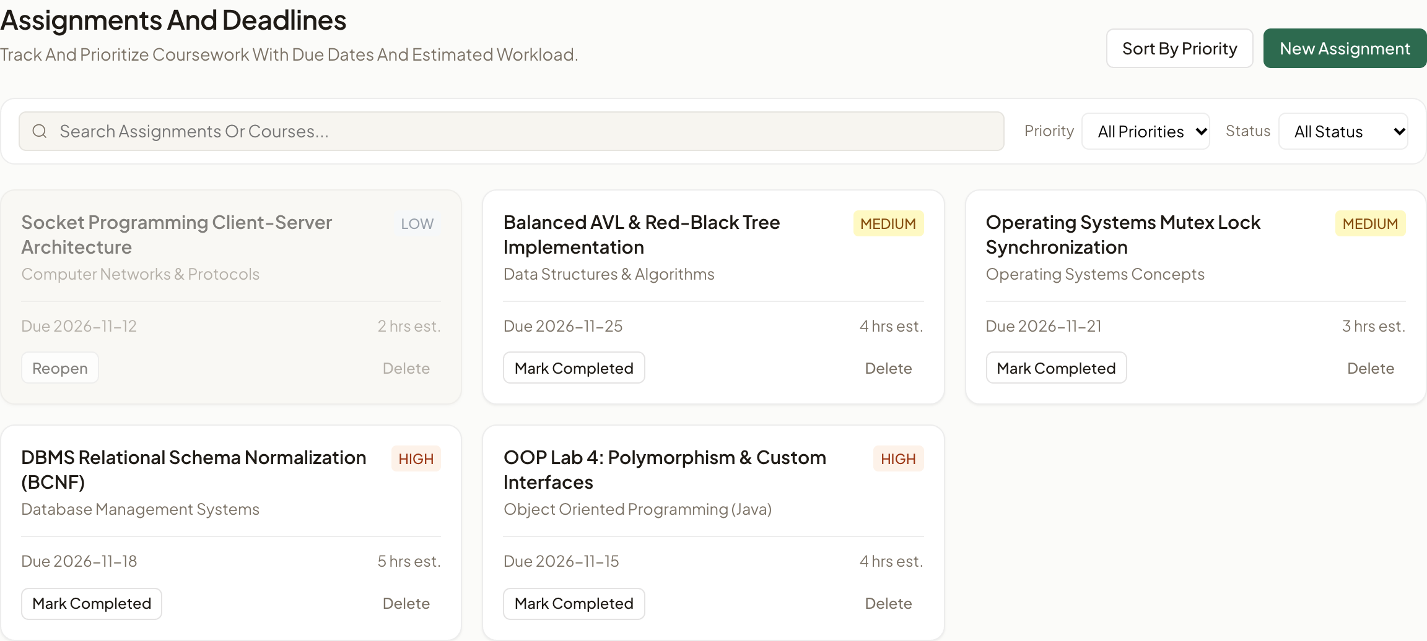
● ● ● https://student-workspace.local/workspace
Student Workspace
Designed for Focus
& Clarity
Academic Workspace • Offline-First Architecture
• Embedded WebAssembly SQLite (sql.js) for true local relational persistence.
• Dual deployment support: 100% static on GitHub Pages and serverless on Vercel.
• Unseeded initial state ensuring complete user control and zero data bloat.
Supported Deployments:
GitHub Pages & Vercel

Slide 7
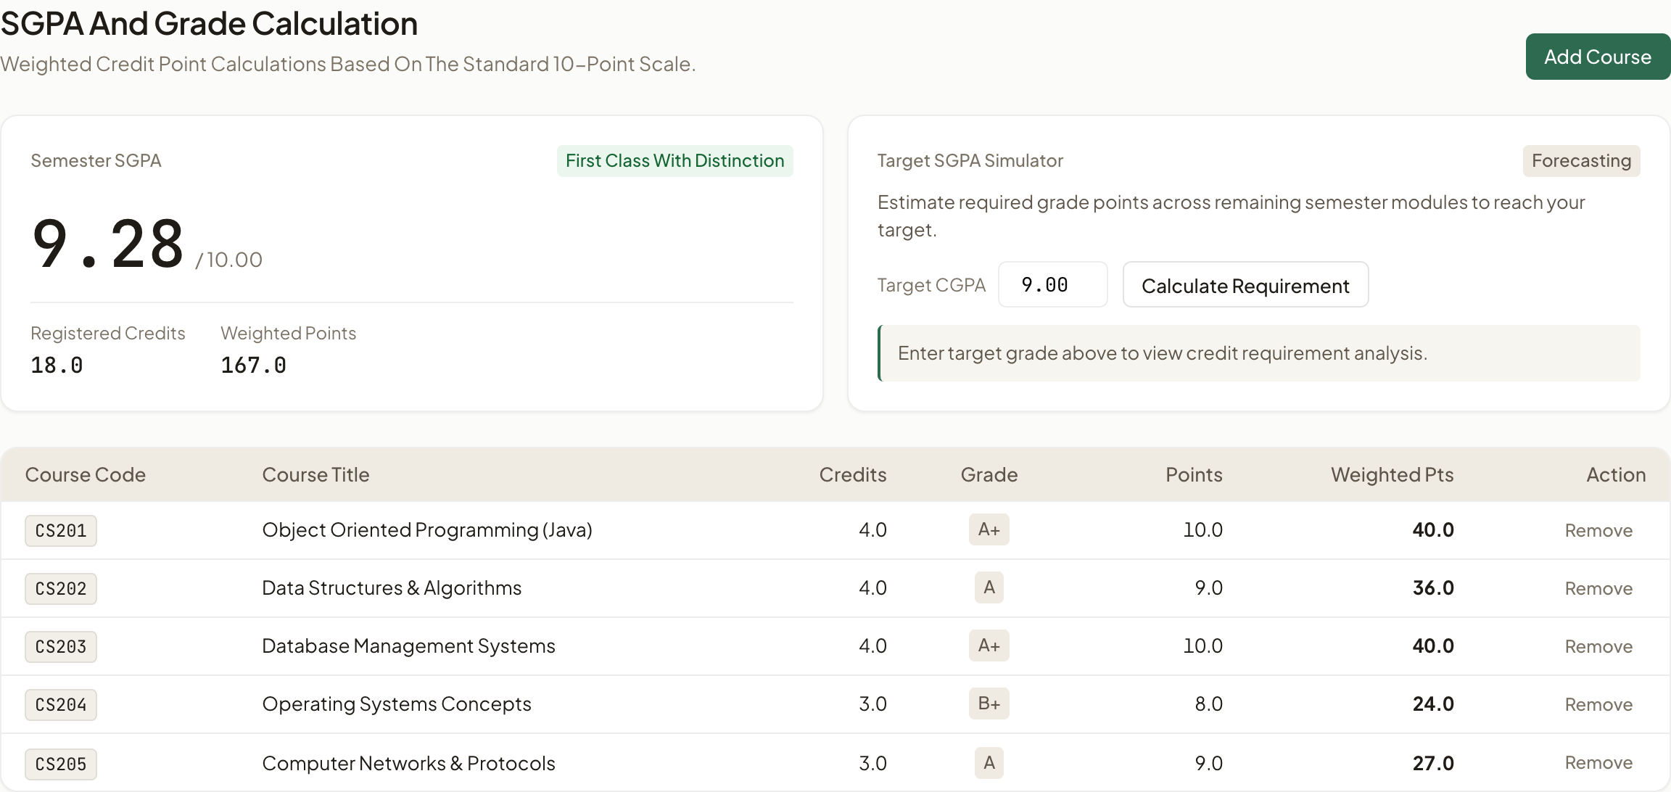
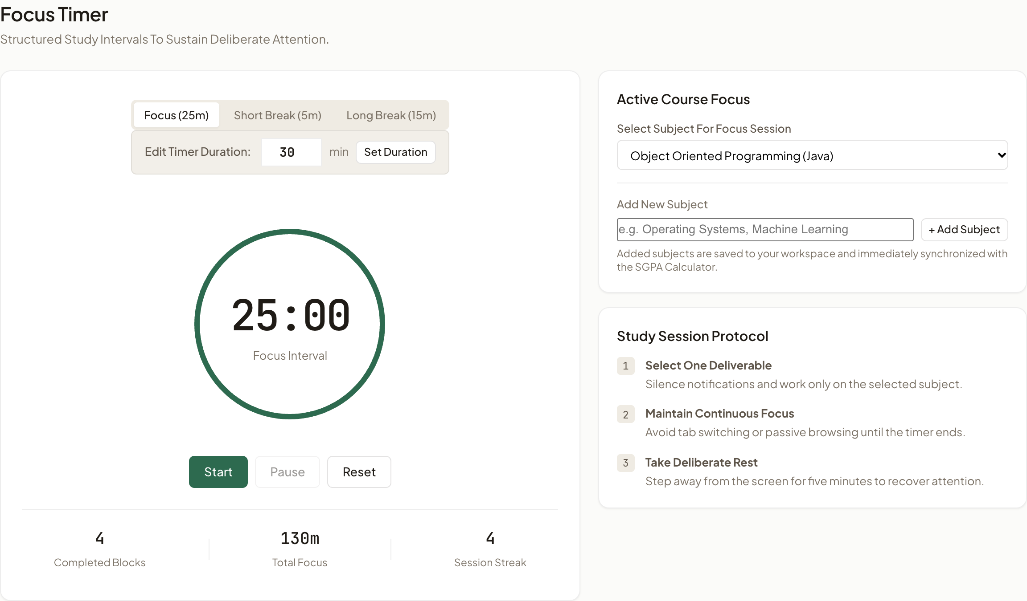
Project Use Cases & Practical Student Workflows
1. Grade Forecasting & Target Analysis
Students model semester grade points and compute the required GPA needed across remaining modules to achieve Honors status.
2. Deep Focus Intervals & Active Recall
25-minute Pomodoro sprints combined with digital 3D flip-cards prevent study fatigue and boost pre-exam concept retention.

Slide 8
Conclusion, Future Scope & Bibliography
Project Summary & Future Scope
✓ Embedded SQLite Architecture: Proves that lightweight in-browser SQLite delivers true database reliability without cloud dependency.
✓ Immediate Practical Value: Solves the core challenges of student life: deadline tracking, grade forecasting, and focused study sprints.
✓ Cloud Sync & Mobile App: Future iterations will introduce optional end-to-end encrypted multi-device synchronization.
✓ Timetable & Calendar Sync: Support for importing .ics university timetable feeds directly into the task scheduler.
Academic Research & Bibliography
[1] Francesco Cirillo: The Pomodoro Technique: The Acclaimed Time-Management System That Has Transformed How We Work, Currency Books.
[2] Karpicke & Blunt: Retrieval Practice Produces More Learning than Elaborative Studying with Concept Mapping, Science 331(6018).
[3] Richard Hipp: SQLite Architecture and Embedded Database Engines, SQLite Development Team.
[4] Mozilla Developer Network: WebAssembly & Client-Side Storage: High-performance in-browser database execution, MDN.

