Slide 1
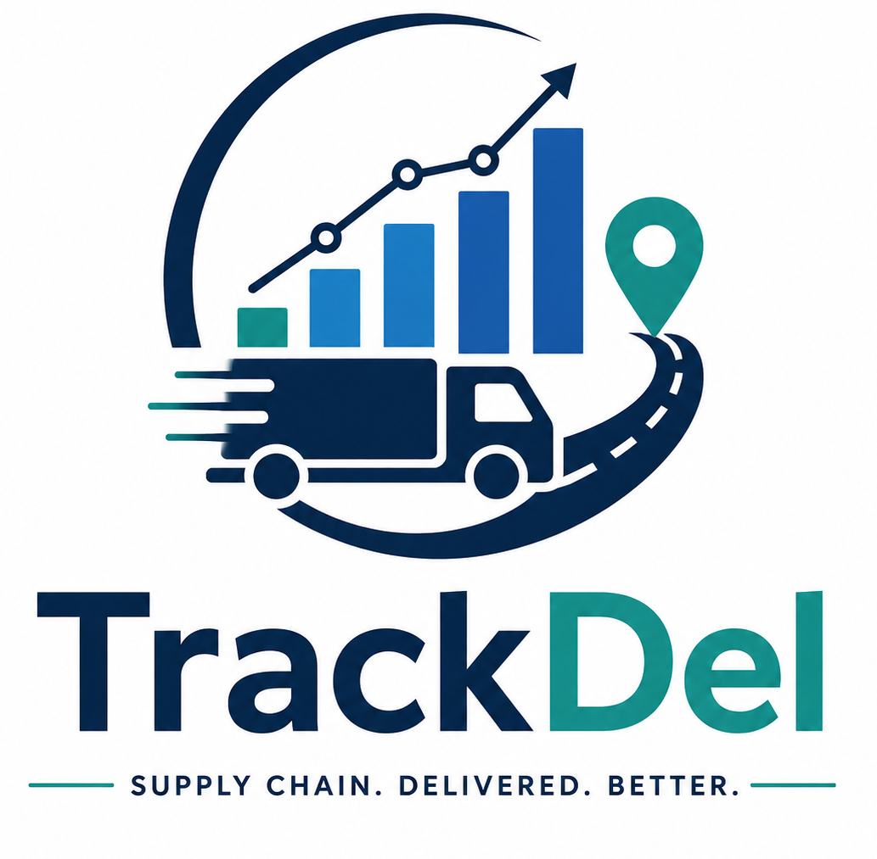
TrackDel
Supply Chain Delivery Performance Dashboard
PREPARED BY
TECHNOLOGY
Tanishq
Python (Pandas)
MySQL
Power BI

Slide 2
Introduction
Supply chain management plays an important role in ensuring timely product delivery and efficient logistics operations. Organizations generate large volumes of operational data that can be analyzed to improve delivery performance and business decision-making.
Built With
Python (Pandas)
Data cleaning & preparation
MySQL
TrackDel is a Supply Chain Delivery Performance Dashboard developed using Python, MySQL, and Power BI. The project transforms raw supply chain data into interactive dashboards that help monitor delivery performance, supplier performance, order status, and logistics efficiency.
Structured data storage
Power BI
Interactive dashboards

Slide 3
Project Objectives
The main objectives of the project are:
Analyze delivery performance across different regions.
Identify delayed and on-time deliveries.
1
2
Evaluate shipping mode performance.
Analyze supplier and product category performance.
3
4
Monitor order status distribution.
Measure logistics efficiency using KPIs.
5
6
Develop interactive Power BI dashboards.
Generate business insights for decision-making.
7
8

Slide 4
Dataset & Data Preparation
Dataset Information
Data Preparation
1
Duplicate Record Verification
Dataset
DataCo Supply Chain Dataset
Missing Value Analysis
2
180,519
53
3
Removed unnecessary columns
Total Records
Total Columns
4
Created Delay_Days feature
5
Data Cleaning using Python (Pandas)
6
Imported cleaned dataset into MySQL

Slide 5
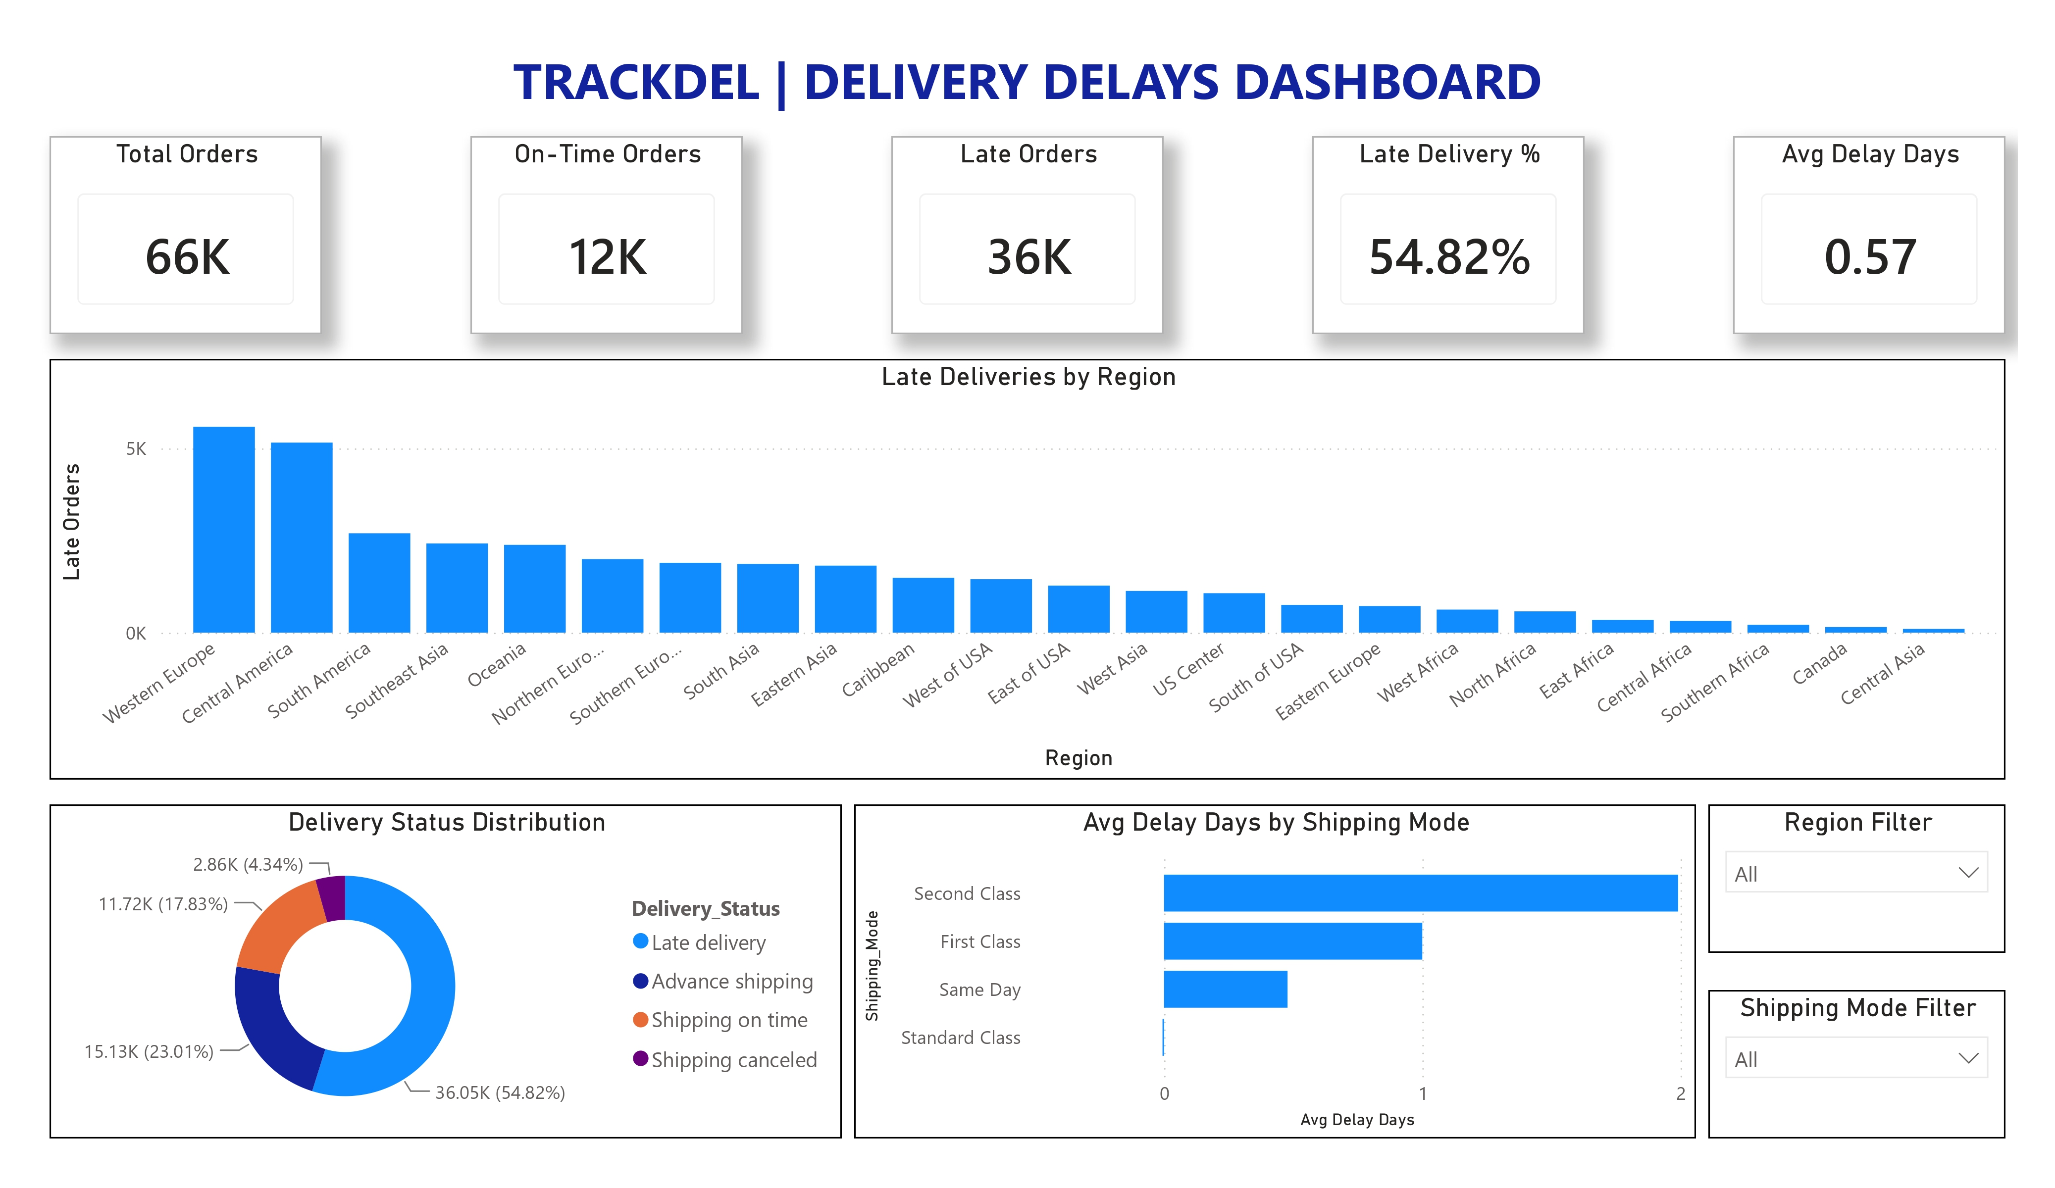
Delivery Delays Dashboard
Key KPIs
Total Orders
On-Time Orders
Late Orders
Late Delivery %
Average Delay Days
Key Insights
More than half of the deliveries were delayed.
Delivery performance varied across different regions.
Average delay differed between shipping modes.
The dashboard helps identify high-risk delivery areas.

Slide 6
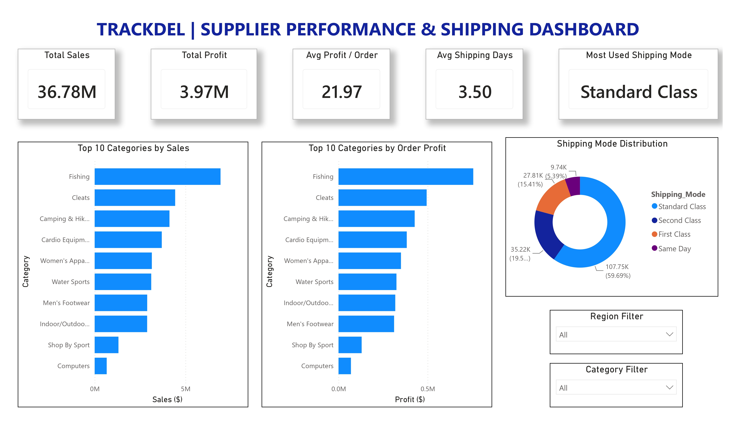
Supplier Performance & Shipping Dashboard
Key KPIs
Total Sales
Total Profit
Average Profit per Order
Average Shipping Days
Most Used Shipping Mode
Key Insights
Standard Class was the most frequently used shipping mode.
Fishing category generated the highest sales.
Sales and profit trends were similar across categories.
Shipping distribution was dominated by Standard Class.

Slide 7
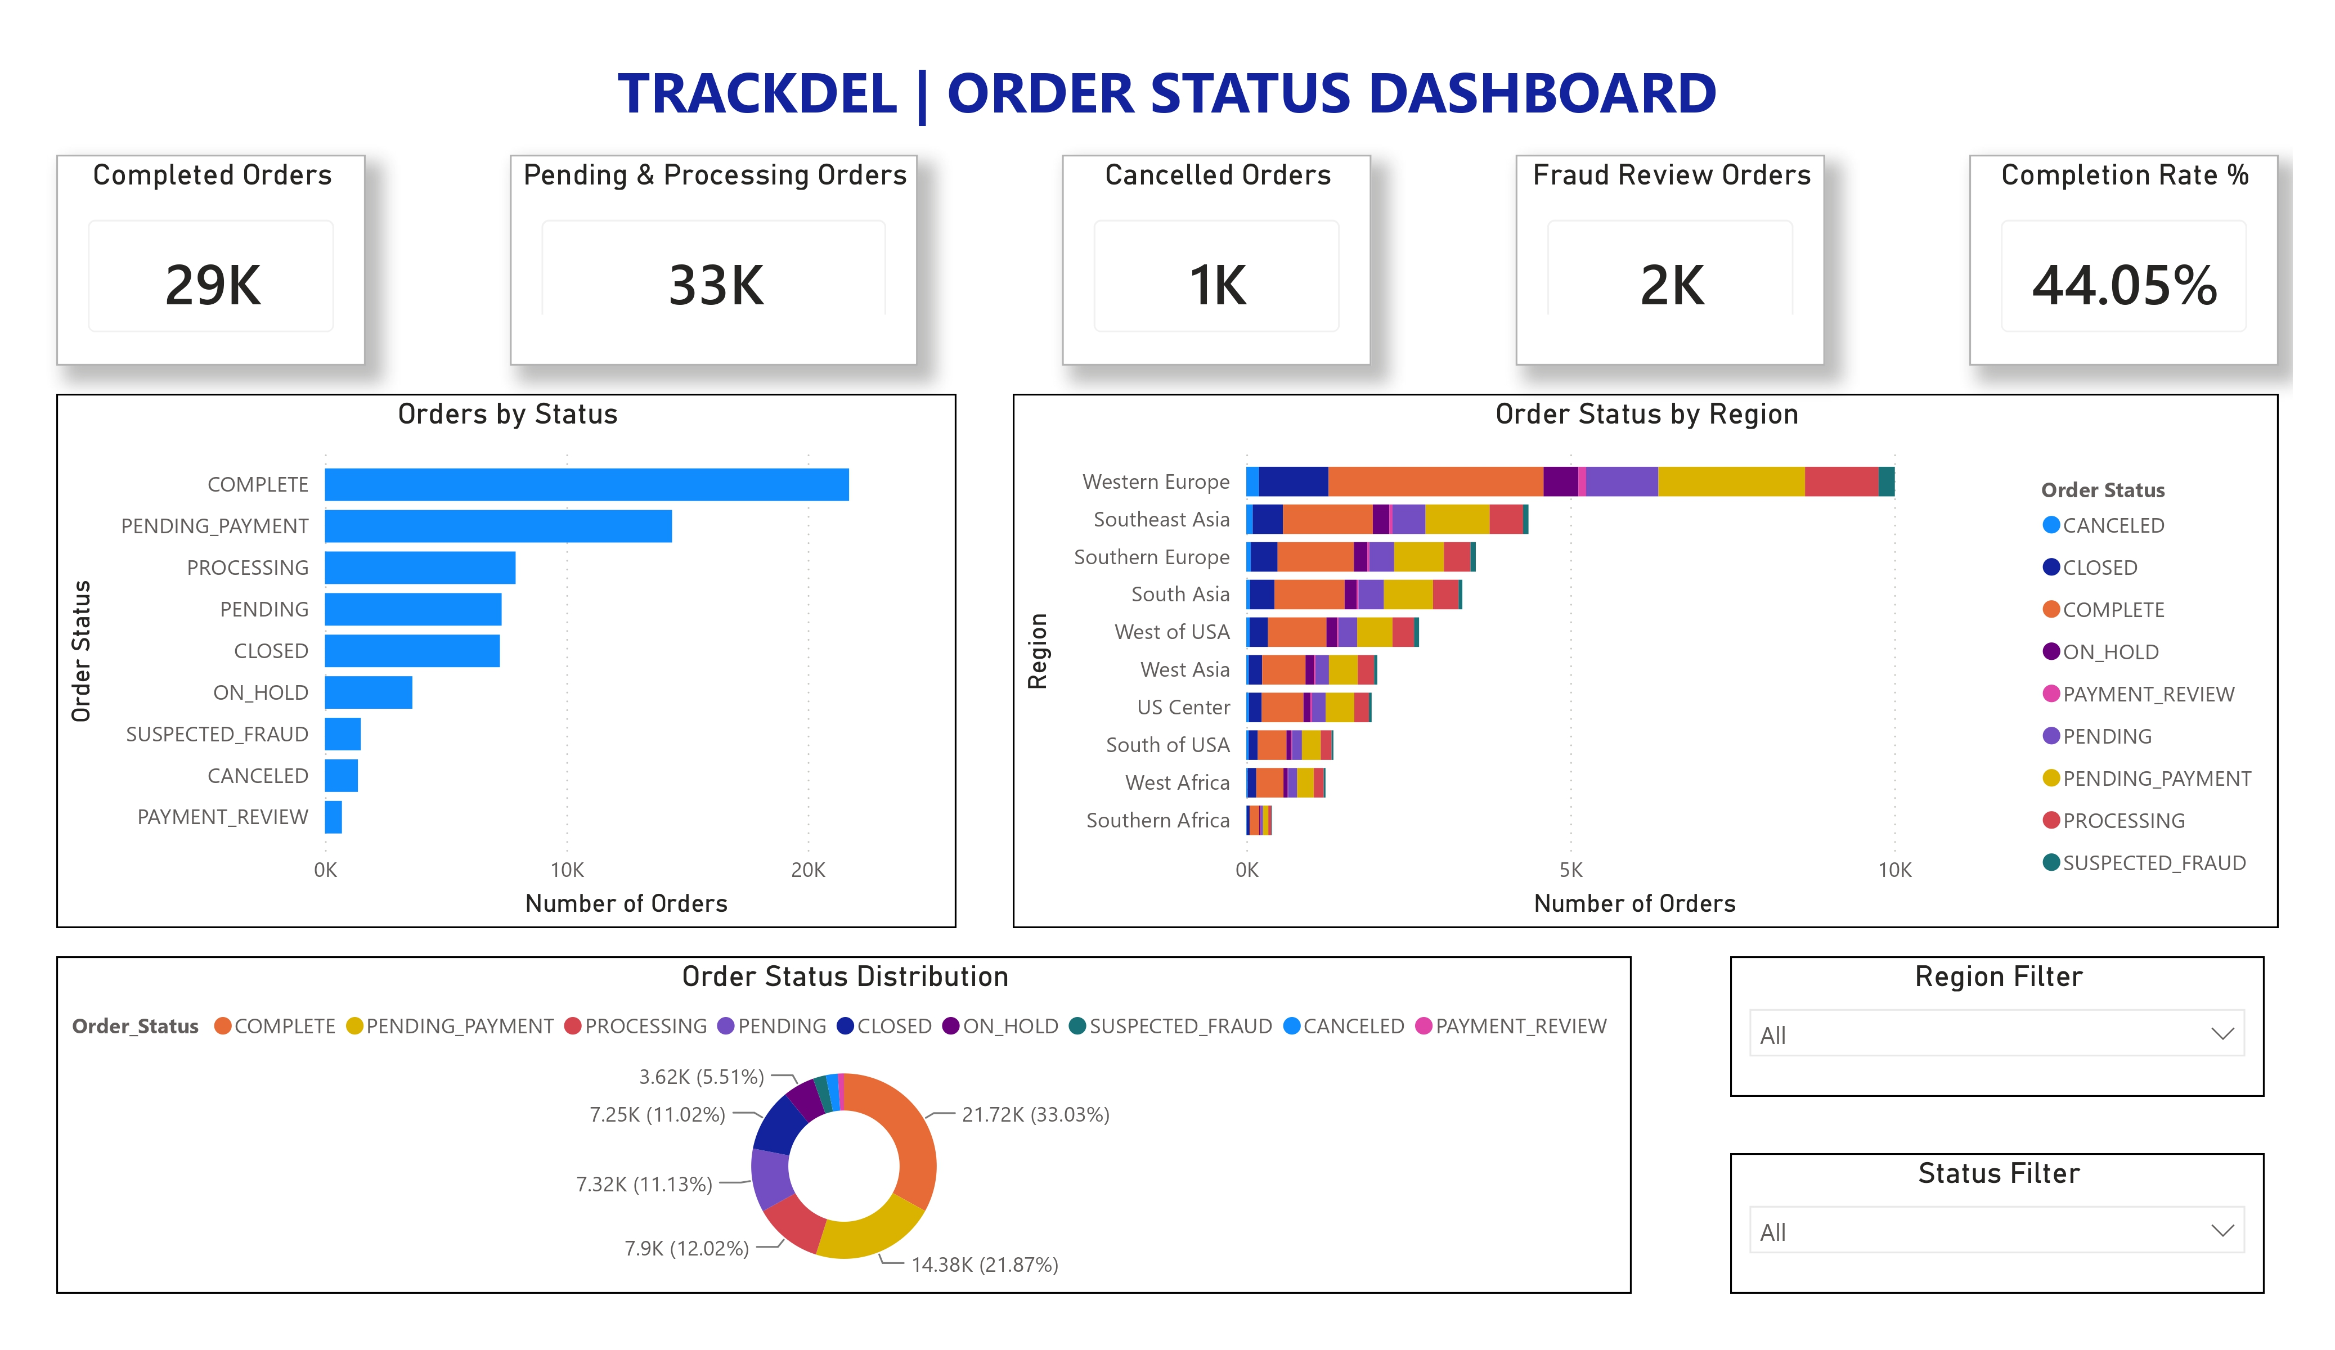
Order Status Dashboard
Key KPIs
Completed Orders
Pending & Processing Orders
Cancelled Orders
Fraud Review Orders
Completion Rate %
Key Insights
Completed orders formed the largest order group.
Pending and Processing orders require continuous monitoring.
Cancelled orders remained comparatively low.
Fraud review orders represented only a small portion of total orders.

Slide 8
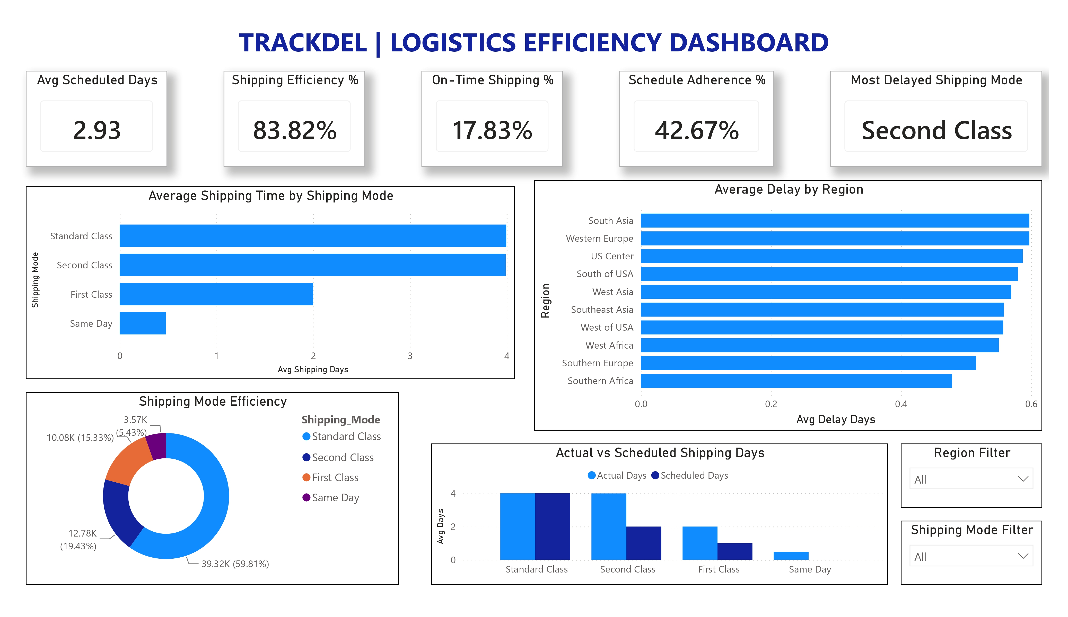
Logistics Efficiency Dashboard
Key KPIs
Average Scheduled Days
Shipping Efficiency %
On-Time Shipping %
Schedule Adherence %
Most Delayed Shipping Mode
Key Insights
Actual shipping time was higher than scheduled shipping time.
Second Class showed the highest delivery delays.
Logistics efficiency differed across shipping modes.
Regional analysis highlighted opportunities for operational improvement.

Slide 9
Key Insights
Late deliveries accounted for over half of the total deliveries.
Standard Class was the most frequently used shipping mode.
1
2
Fishing category achieved the highest sales and profit.
Order completion rate was approximately 44%.
3
4
Second Class experienced the highest average delivery delay.
Logistics performance varied across different regions.
5
6

Slide 10
Conclusion
TrackDel successfully transformed raw supply chain data into interactive dashboards using Python, MySQL, and Power BI.
The project enables users to analyze delivery delays, supplier performance, shipping operations, order status, and logistics efficiency through meaningful visualizations and KPIs.
The dashboards support data-driven decision-making and provide valuable insights for improving overall supply chain performance.
The project demonstrates how Business Intelligence tools can support effective supply chain monitoring and decision-making.

Slide 11
Thank You
Questions & Discussion

