Slide 1


5th INTERNATIONAL CONFERENCE OF EMERGING TECHNOLOGIES (5th INCET 2024) Hosted By : Jain College of Engineering , Belagavi , Karnataka , India
Title: Integrating Western and Indian Music for Genre Recognition: A Deep Learning Approach
Paper ID: 812
PRESENTER NAME-:Jayapriya A N
Affiliation -: School of Electronics and Communication Engineering, KLE Technological University, Hubli, India

Slide 2
Contents
Abstract
Introduction
Literature Review
Methodology
Introduction to spectrogram
Results
Conclusion
Future Directions
References

Slide 3
Abstract
Music genre recognition (MGR) is crucial for user preference and exploration and is often prioritized over other recommendation systems.
While existing music genre classification systems often specialize in Western or Indian music, our work breaks new ground. We present a unique methodology that merges datasets from both Western and Indian musical traditions, offering a more comprehensive approach to genre classification.
Our methodology, employs Convolutional Neural Network (CNN) and Mel-Spectrogram, achieves notable training accuracy, and showcases promising results in automated music genre classification.

Slide 4
Introduction
Genres are labels created by humans to differentiate between different styles of music.
The development of the internet has revolutionized the world by giving access to multimedia content like music.
Numerous music streaming platforms have millions of songs, making managing and accessing vast amount of data a significant challenge.
Music genres play a crucial role in creating solutions for organizing music collections and representing intercultural connections.
This study aims to contribute by studying different genres with a focus on Indian genres like Sufi, Classical, Folk, and Indian Bollywood Pop.

Slide 5
Literature Review
Datasets
Feature Extraction
Classifiers
Results Evaluation
Hybrid Models
Time Domain
Statistical Descriptors, zero-crossing rate,
root mean square energy
Traditional Machine Learning
K Nearest Algorithm, Random forest,
Logistic Regression,
SVM, XGBoost
GTZAN, LMD
MTG-Jamedo,
YouTube-8M, MuMu Dataset
Recognition rate
Precision, F1-score
Recall, ROC AUC, Confusion matrices
Pre-trained Models
MobileNet, VGG-16,
Resnet34, Resnet50,AlexNet
Frequency Domain
DFT, FFT, STFT,
Mel-Frequency Cepstral Coefficients(MFCCs)
Neural Networks
CNN, RNN-LSTM, parallel RNN-CNN

Slide 6
Methodology
Data Sets:
The datasets used are labeled music datasets taken from GTZAN and Kaggle. There are 13 different music classes containing 100 samples for every class. These classes include Semi Classical, Hip-hop, Ghazal, Disco, Country, Carnatic, Blues, Sufi, Rock, Reggae, Pop, Metal, and Jazz all of which have a duration of 30 seconds and a frequency of 44100 Hz.

Slide 7
Methodology
Mel-Spectrograms
Labelled Music Dataset
CNN Architecture
Pre-processing
Training
Data
Input file generation
NumPy Array
Testing
Data
Blues
Trained Model
Output
Carnatic
Country
Reggae
Disco
Pop
Ghazal
Metal
Jazz
Semi-classical
Sufi
Rock
Hip-hop

Slide 8
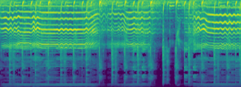

Introduction To Spectrograms
A spectrogram is a visual representation of the spectrum of frequencies of a signal as it varies with time.
Spectrograms are particularly useful for analyzing signals that vary over time, providing insight into how different frequencies contribute to the overall signal at different moments.
It's commonly used in fields such as audio signal processing, speech analysis, and music analysis
Fig – Spectrogram for Hio-hop
genre
Fig – Spectrogram for Classical genre

Slide 9
Results
Our methodology employs a ten-layer CNN architecture for classification, incorporating Dense and dropout layers to address overfitting.
Performance evaluation is based on recognition rate, precision, F1-score, recall, support, and confusion matrix.
Training Accuracy is as follows:
10 epochs for 2 genres: 95%
10 epochs for 13 genres: 80%
20 epochs for 13 genres: 85.3%
50 epochs for 13 genres: 88.46%
Comparative analysis with traditional methods shows the superiority of the CNN approach in handling diverse datasets.
Notes:
Initially, we started training with 10 epochs for two genres and achieved an accuracy of 95%. We increased our genre to 13, trained the model for 10 epochs, and achieved an accuracy of 80%. As this was not sufficient, we increased the number of epochs to 20 and achieved an accuracy of 85.3%, and with the number of epochs increased to 50, we were able to achieve an accuracy of 88.46%.

Slide 10
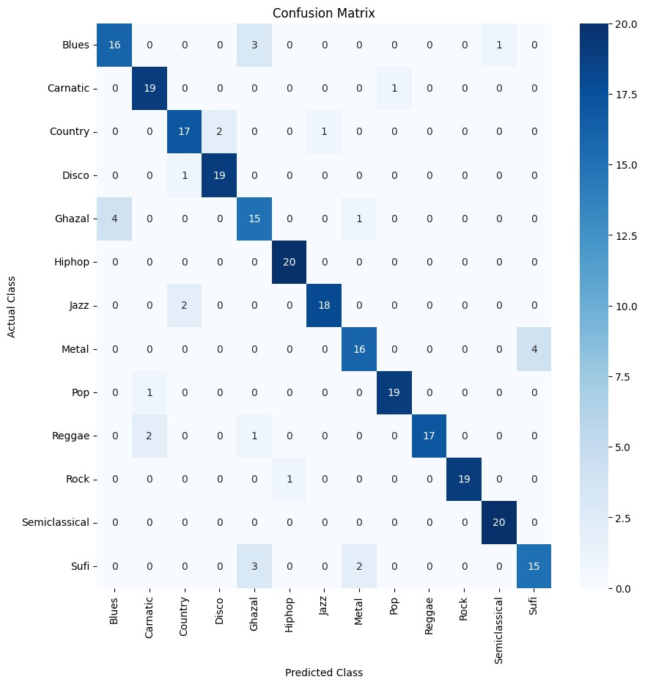
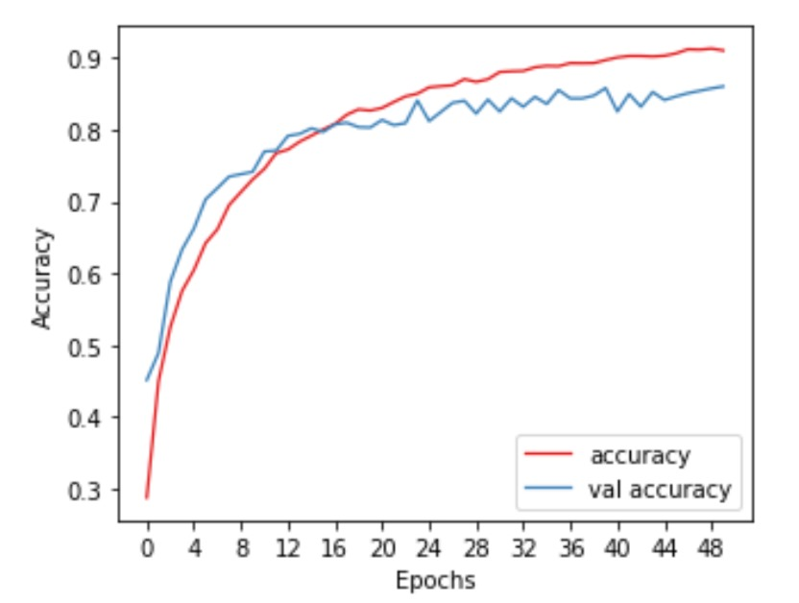
Results
Fig 6. Accuracy vs epoch graphs
Fig 5. Confusion matrix for predicted vs. actual class
Notes:
Initially, we started training with 10 epochs for two genres and achieved an accuracy of 95%. We increased our genre to 13, trained the model for 10 epochs, and achieved an accuracy of 80%. As this was not sufficient, we increased the number of epochs to 20 and achieved an accuracy of 85.3%, and with the number of epochs increased to 50, we were able to achieve an accuracy of 88.46%.

Slide 11
Conclusion
The developed MGR framework consisting Mel-Spectrogram + CNN demonstrates promising results in music genre recognition.
Further by increasing epochs, adding convolution layer for improved accuracy
By integrating both Western and Indian music datasets, our methodology provides a comprehensive perspective on music genre classification, extending beyond the limitations of previous studies confined to specific cultural or regional contexts.

Slide 12
Future Directions
Further refinement and exploration, including experiments with different model architectures and expanding the dataset, could enhance the model’s performance for a broader range of music genres.
The application of this framework extends to music recognition systems, content categorization, and other areas where accurate genre identification is essential.

Slide 13
References
[1] N. M R and S. Mohan B S,”Music Genre Classification using Spectrograms,” 2020 International Conference on Power, Instrumentation, Control and Computing (PICC), Thrissur, India, 2020, pp. 1-5, doi: 10.1109/PICC51425.2020.9362364.
[2] S. Deepak and B. G. Prasad,”Music Classification based on Genre using LSTM,” 2020 Second International Conference on Inventive Research in Computing Applications (ICIRCA), Coimbatore, India, 2020, pp. 985-991, doi: 10.1109/ICIRCA48905.2020.9182850.
[3] V. Shah, A. Tandle, N. Sharma and V. Sheth,”Genre Based Music Classification using Machine Learning and Convolutional Neural Networks,” 2021 12th International Conference on Computing Communication and Networking Technologies (ICCCNT), Kharagpur, India, 2021, pp. 1-8, doi: 10.1109/ICCCNT51525.2021.9579597.
[4] S. Pasrija, S. Sahu and S. Meena,”Audio Based Music Genre Classification using Convolutional Neural Networks Sequential Model,” 2023 IEEE 8th International Conference for Convergence in Technology (I2CT), Lonavala, India, 2023, pp. 1-5, doi: 10.1109/I2CT57861.2023.10126446.
[5] J. Martins de Sousa, E. Torres Pereira and L. Ribeiro Veloso, ”A robust music genre classification approach for global and regional music datasets evaluation,” 2016 IEEE International Conference on Digital Signal Processing (DSP), Beijing, China, 2016, pp. 109-113, doi: 10.1109/ICDSP.2016.7868526.
[6]S. Allamy and A. L. Koerich, ”1D CNN Architectures for Music Genre Classification,” 2021 IEEE Symposium Series on Computational Intelligence (SSCI), Orlando, FL, USA, 2021, pp. 01-07, doi: 10.1109/SSCI50451.2021.9659979.
[7] Y. Yuniar, D. P. Alamsyah and A. Herliana,”Classification of Indonesian Music Genres Using the Support Vector Machine Method,” 2022 4th International Conference on Cybernetics and Intelligent System (ICORIS), Prapat, Indonesia, 2022, pp. 1-6, doi: 10.1109/ICORIS56080.2022.10031473.
[8]R. Sharma and Nisha,”Classification of Music Genres using Neural Network,” 2022 11th International Conference on System Modeling Advancement in Research Trends (SMART), Moradabad, India, 2022,
pp. 142-147, doi: 10.1109/SMART55829.2022.10046811.

Slide 14
References
[9] T. Ozseven and B. E. ¨ Ozseven, ”A Content Analysis of the Research Ap- ¨ proaches in Music Genre Recognition,” 2022 International Congress on Human-Computer Interaction, Optimization and Robotic Applications (HORA), Ankara, Turkey, 2022, pp. 1-13, doi: 10.1109/HORA55278.2022.9799935.
[10] M. S. Ahmed, M. Z. Mahmud and S. Akhter,” Musical Genre Classification on the Marsyas Audio Data Using Convolution NN,” 2020 23rd International Conference on Computer and Information Technology (ICCIT), DHAKA, Bangladesh, 2020, pp. 1-6, doi: 10.1109/ICCIT51783.2020.9392737.
[11] W. Suo,”Efficient Music Genre Classification with Deep Convolutional Neural Networks,” 2022 5th International Conference on Data Science and Information Technology (DSIT), Shanghai, China, 2022, pp. 01-05, doi: 10.1109/DSIT55514.2022.9943952.
[12] M. P. V. N. Sai and S. Kalaiarasi,”Implementation of Music genre classification using Support Vector Clustering algorithm and KNN Classifier for improving accuracy,” 2023 Eighth International Conference on Science Technology Engineering and Mathematics (ICONSTEM), Chennai, India, 2023, pp. 1-6, doi: 10.1109/ICONSTEM56934.2023.10142741.
[13] J. L. Concei¸c˜ao, R. de Freitas, B. Gadelha, J. G. Kienen, S. Anders and B. Cavalcante, ”Applying supervised learning techniques to Brazilian music genre classification,” 2020 XLVI Latin American Computing Conference (CLEI), Loja, Ecuador, 2020, pp. 102-107, doi: 10.1109/CLEI52000.2020.00019.
[14] Chikkamath, Satish, and S. R. Nirmala. "Melody generation using LSTM and BI-LSTM Network." In 2021 International Conference on Computational Intelligence and Computing Applications (ICCICA), pp. 1-6. IEEE, 2021.
[15] Khudavand, Atiq Ahmed, Satish Chikkamath, S. R. Nirmala, and Nalini Iyer. "Music/Non-music Discrimination Using Convolutional Neural Networks." In Soft Computing and Signal Processing: Proceedings of 3rd ICSCSP 2020, Volume 1, pp. 17-28. Springer Singapore, 2021.
[16] Chikkamath, Satish, and S. R. Nirmala. "Music Detection Using Deep Learning with Tensorflow." In ICDSMLA 2020: Proceedings of the 2nd International Conference on Data Science, Machine Learning and Applications,
pp. 283-291. Springer Singapore, 2022.

Slide 15
Thank you

